Slide 1

Survey of Israel
Technologies Division
Project: Curves Handling
02.02.2022

Slide 2
Table of Contents
1) Introduction
2) Curves – Introduction
3) Process - General
4) Process – Model
5) Old BANKAL dataset
6) New Bankal
7) Tool preprocessing
Finding either line segment is a curve
Finding the order of curves relative to parcels
Fix parcel vertices that doesn't keep continuing form
Check the accuracy needed to match between the two layer
8) Fix Curves
9) Challenges Completed
10) Challenges
11) Tool interface
12) Results – converted curves to solve

Slide 3
Introduction
Mapi (Survey of Israel) is currently in the process to replace the data base of the Israeli BANKAL (kadaster dataset), which runs on the old engine (ArcStorm) with the newer more advanced program “ArcPro”. This will enable Mapi to update her data structure, use advanced tools and gains ESRI support.
“Curve handling” project will try to change BANKAL data structure by replacing the “exploded vertices” with geometrical curve. The main objective for this transformation is to reduce the need of multi-vertices polygon objects to an three vertices curve object.

Slide 4
Curves - Introduction
Today, curves represented as collection of points in proximity to each other (Fig. A). The objective is to convert the curves to three points geometry (Fig. B).
A - polygon
B - polygon
[[x1,y1],[x2,y2],[x3,y3],[x4,y4]…]
[[x1,y1],{‘c’:[x,y],[x,y]}]
Finish
Middle

Slide 5
Process - General
The tool is construct from two parts:
Fixing the curves
Fixing the precision after phase 1
Around 20% of the curves fixing will produce a hole or an over lap with sizes from 0.001 to 0.3 centimeters. To overcome this problem, another tool will close the holes and delete the overlap based on the source layer (parcel before fixing).

Slide 6
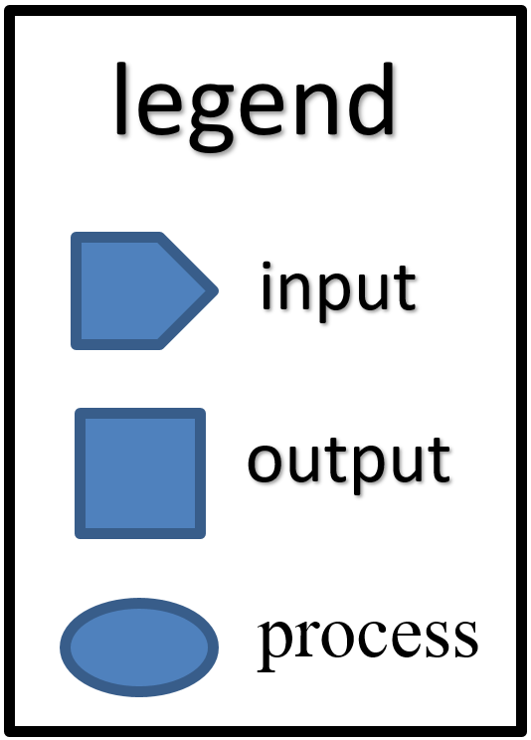
Process - Model
1 - Fix Curves process
Polygons
1. Find curves
2. Fix lines order
3. Fix close vertices
4. Fix GeomKeys
Polygons
Polygons
1. Rebuild polygons
2. Checking
Polylines
Polylines
Polylines
With curves
Reports
2 - Fix precision process
Polygon
source
Polygon
Polygons
Polygon
Curve fixed
* Check Holes, overlap
* Extract curves
* Check Holes, overlap
* Extract curves
Gaps
Polylines
Polylines

Slide 7
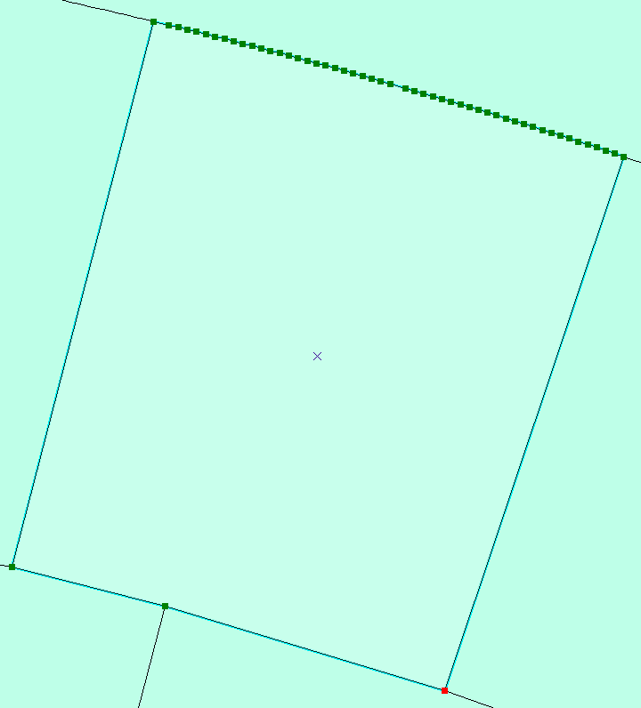
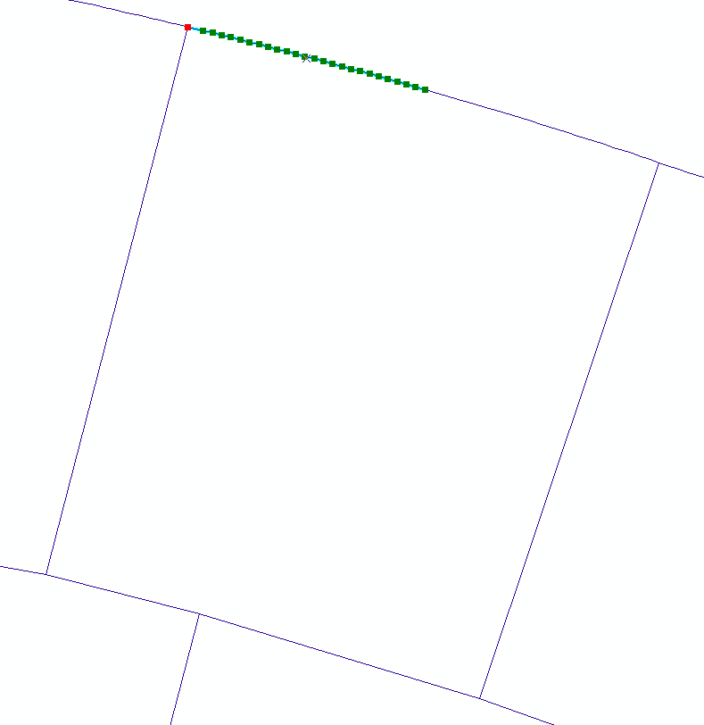
Input - Old BANKAL dataset
Polygon Polyline
Object as collection of vertices

Slide 8
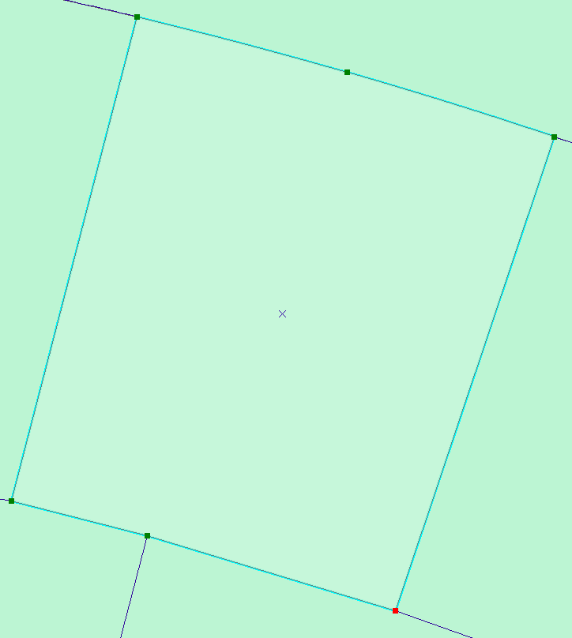
Out put - New Bankal
polygon as geometric Curve

Slide 9
Tool preprocessing
Before implement the tool ability to insert the curves to the parcel from the line segments, preprocesses of the polygon and lines array need to be either fixed or monitored, the stages are as follows:
Finding either line segment is a curve
Finding the order of curves relative to parcels
Fix parcel vertices that doesn't keep continuing form
Check the accuracy needed to match between the two layer

Slide 10
Fix Curves
Find either line segment is a curve
To find if a set of vertices are curve, three points on the line were chosen, and if they sit on the same radius, the line segment were considered a curve.
r
r
r
C
1. Find curves
2. Fix lines order
3. Fix close vertices
4. Fix GeomKeys
def IsOnCircle(x1, y1, a, b, r):
if round((x1 - a)*(x1 - a) + (y1 - b) * (y1 - b), 1) == round(r*r, 1):
return True
else:
return False

Slide 11
Fix Curves
curves relative to parcels
After inserted the line attribute with curve parameters, the segments containing curves were lined with there matching polygon.
7
Rebuild line so vertices will be replaced as polygon.
6
8
5
4
2
3
1
1
1. Find curves
2. Fix lines order
3. Fix close vertices
4. Fix GeomKeys
2
4
3
6
5
[pt1,pt2,pt3…]
[pt6,pt5,pt4…]

Slide 12
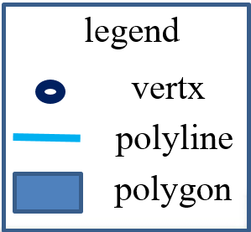
Fix Curves
Parcel keep continuing form
The Bankal dataset contain unclosed vertices which ranges between 0.001 to 0.5 meters, those changes interfere the use of x,y coordinates as primary keys (connecting lines and polygon). Fixed by checking angle and distance.
pt3
pt2
angle
pt1
1. Find curves
2. Fix lines order
3. Fix close vertices
4. Fix GeomKeys

Slide 13
Fix Curves
Check accuracy
Points will be submit to few attempts of rebuilding geometry with different accuracy levels. That will determine the accuracy needed for X and Y axis.
Y
match
legend
Polygon – 2 Decimal place
1. Find curves
2. Fix lines order
3. Fix close vertices
4. Fix GeomKeys
Polygon – 1 Decimal place
X
Polygon – 0 Decimal place
Polyline vertx
Default: precision_X,precision_Y = 2,2 ) Decimal place(

Slide 14
Fix Curves
After the data preparation completed, the tool will try two different options (not considering the already two attempts finding XY accuracy). The reason for those attempts are the different between curves and their placement on the polygon array. Next slide will explain some of the different cases studied.

Slide 15
Challenges Completed
Double curves
Snake Curves
Curves in the beginning
and end of the polygon array
Accuracy problems
pt3
pt4
pt2
pt1

Slide 16
Challenges to solve
There is still 8% curves that still without solution.
20% of curves solved will produce small holes and overlaps that will be take care in another operation.
Parcels with holes are not treated at the moment, and will be addressed later.

Slide 17
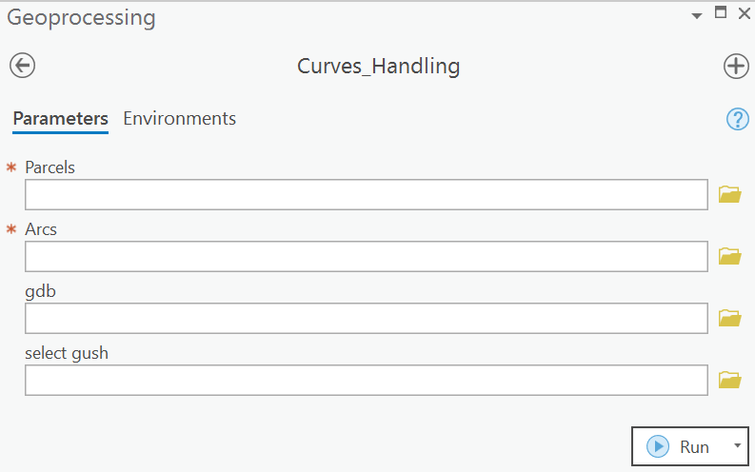
Tool interface
Bankal parcels
(polygon)
Require
Bankal arcs
(polyline)
Require
GDB (results of previous run, in case rerun is needed)
optional
Selecting specific gush's
optional

Slide 18
Tool structure
data
Placing of the
tool inputs
Optional
Results
Out put-
Gush name +date
Temp
Mandatory for the tool to work
Do not touch
Script

Slide 19
Results – converted curves
Fail, return to origin geometry

Slide 20
Results – vertices deleted
Around 75% of the over all vertices deleted, with a By-product of 20% holes/overlaps with the size from: 0.001 to 0.3.

Slide 21
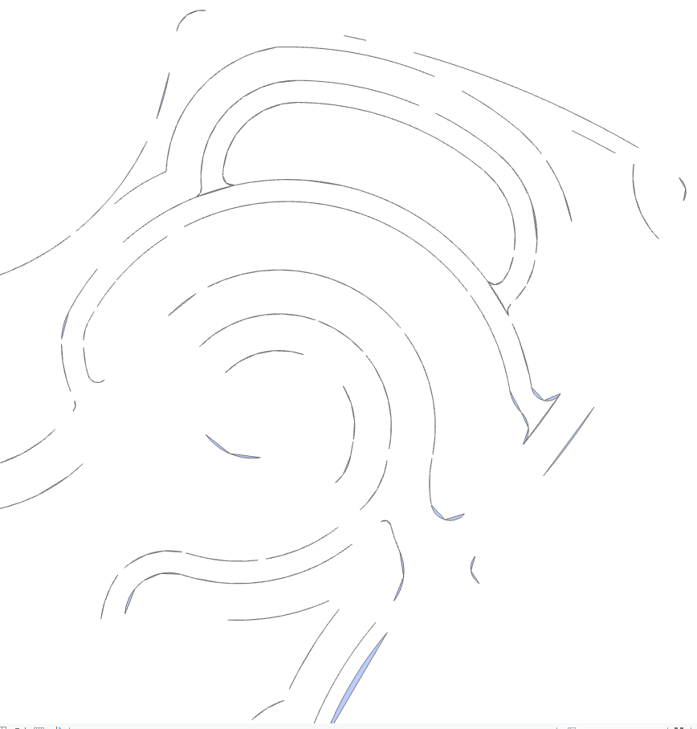
Results – successfully carves insertion

Slide 22
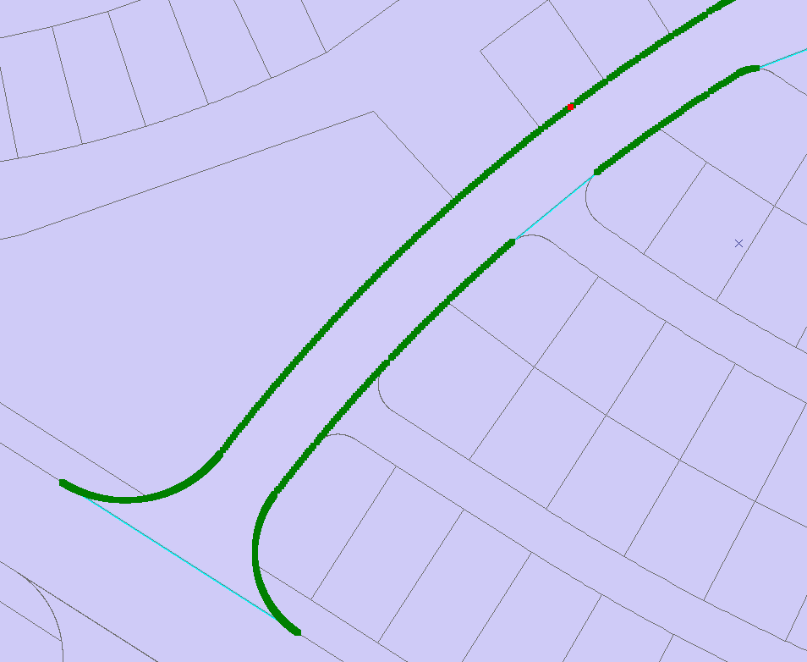
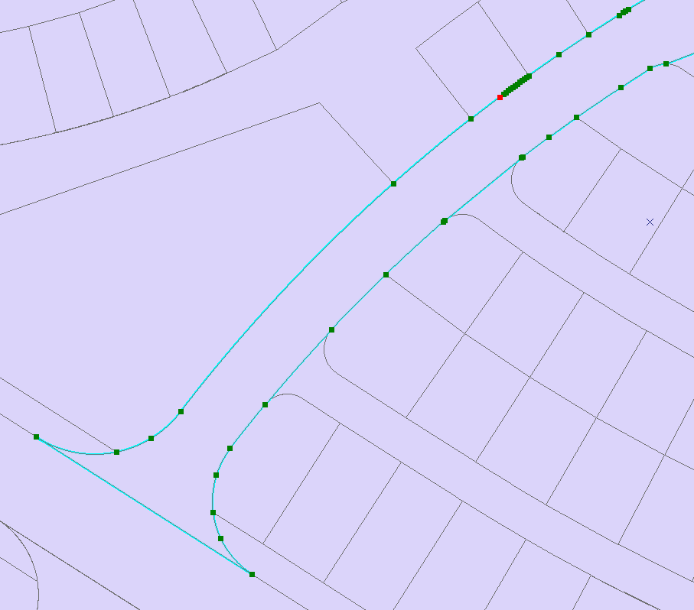
Before
Results – vertices deleted
After

Slide 23
What next?
Now, the tool should run over the PARCELS and ARCS dataset for a week (approximately on 10 computers). in the meanwhile I will complete the fixing of the holes and over laps. In this pace we can finish within a week.

Slide 24
end

