Slide 1

Slide Title
Subtitle
June 14, 2022 Prepared by First Name and Last Name

Slide 2
Picking 2 Top Faceoff Player (3 Aspects Strategy)
1St Aspect: Highest Faceoff win percentage & Number of Faceoff Plays
Reason:
Faceoff win Percentage is a direct indicator for player’s Faceoff skill and performance
Outcome:
Pick the top 5 players from the chart
﻿Jillian Dempsey
Tereza Vanisova
Shiann Darkangelo
Cailey Hutchison
Taytum Clairmont

Slide 3
Picking 2 Top Faceoff Player (3 Aspects Strategy)
1st Aspect: Highest Faceoff win percentage & Number of Faceoff Plays
Reason:
Win Percentage calculated from higher number of Faceoff played would be more convincing
This idea follows our common perception and statistical calculation
Outcome:
Pick top 3 players:
﻿Jillian Dempsey
Tereza Vanisova
Shiann Darkangelo

Slide 4
Picking 2 Top Faceoff Player (3 Aspects Strategy)
2nd Aspect: Faceoff win percentage per Game & Home/Away Win Percentage
Reason:
Some player might perform differently in Home and Away Game
Outcome:
All 3 players perform well in both Home and Away game (Faceoff win >60%)
Jillian perform exceptionally well in Away games.

Slide 5
Picking 2 Top Faceoff Player (3 Aspects Strategy)
2nd Aspect: Faceoff win percentage per Game & Home/Away Win Percentage
Reason:
Some player might have an inconsistent performance, such as only perform well in a few games.

Slide 6
Picking 2 Top Faceoff Player (3 Aspects Strategy)
2nd Aspect: Faceoff win percentage per Game & Home/Away Win Percentage
Outcome:
All 3 players have relatively consistent Faceoff win percentage (At lease 50% in each Game)
However, since Tereza has less Faceoff plays per game, we would temporally pick Jillian & Shiann over her

Slide 7
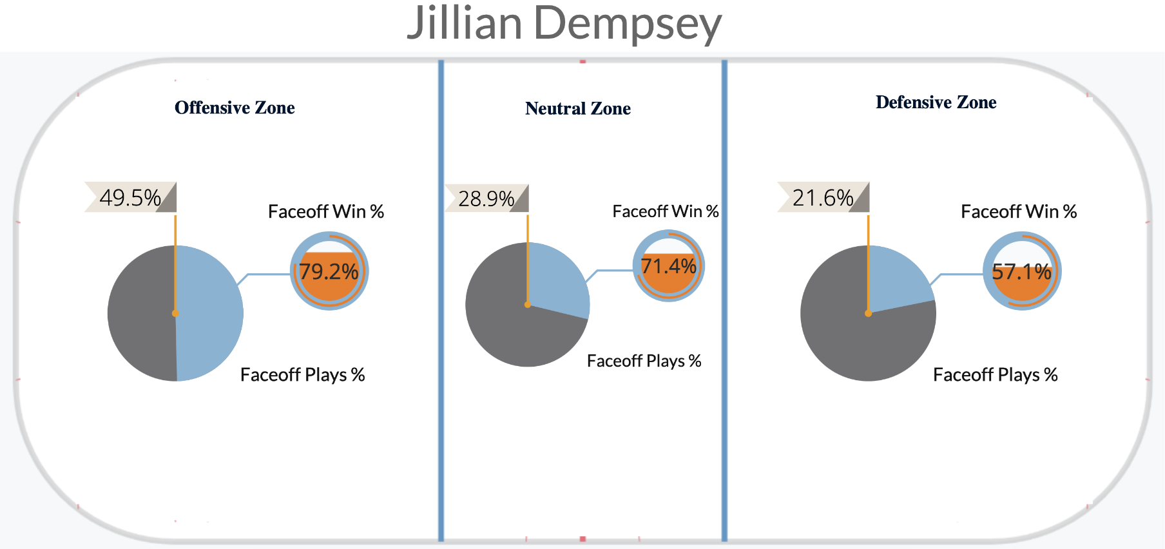
Picking 2 Top Faceoff Player (3 Aspects Strategy)
3rd Aspect: Faceoff Plays Percentage & Win Percentage in different zones
Reason:
Player might have different faceoff performance across different zone.
Using this analysis would help us identifying each player’s strongest faceoff zone.
Outcome (Jillian):
Outstanding in the Offensive & Neutral Zone
50% of total faceoff plays took place in Offensive zone → Comfortable to play in offensive zone
Relatively balanced in the Defensive Zone

Slide 8
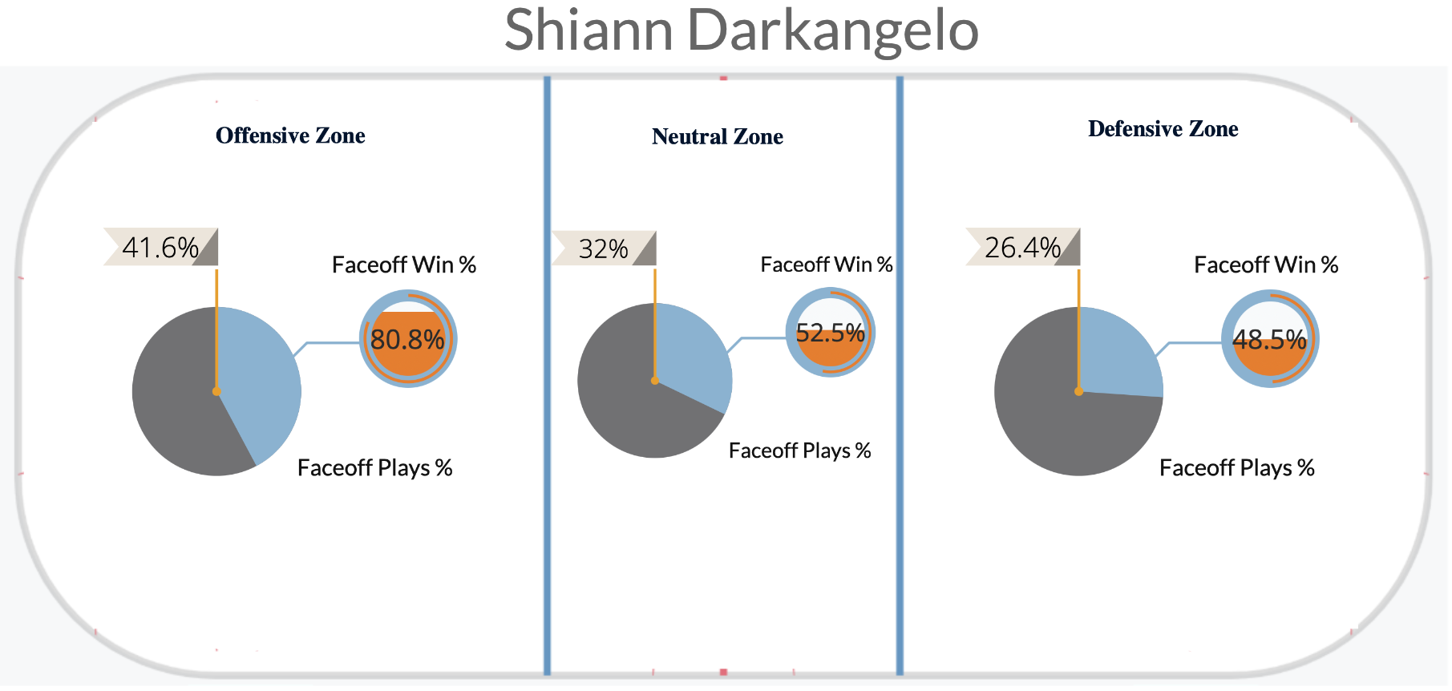
Picking 2 Top Faceoff Player (3 Aspects Strategy)
3rd Aspect: Faceoff Plays Percentage & Win Percentage in different zones
Outcome (Shiann):
Exceptional in offensive zone
Balanced in both Neutral & Defensive zone

Slide 9
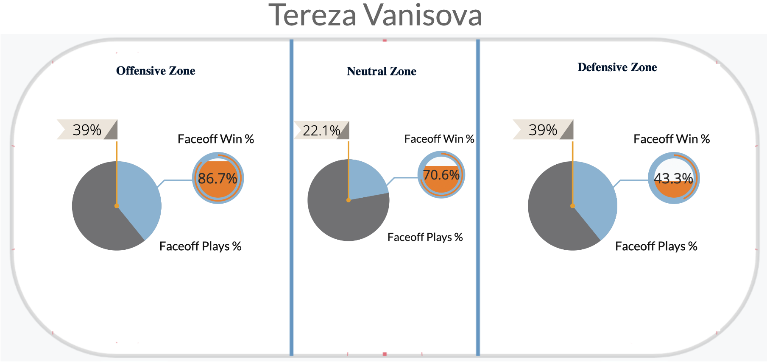
Picking 2 Top Faceoff Player (3 Aspects Strategy)
3rd Aspect: Faceoff Plays Percentage & Win Percentage in different zones
Outcome (Tereza):
Exceptional in both Offensive & Neutral zone
Weak in Defensive zone

Slide 10
Picking 2 Top Faceoff Player (3 Aspects Strategy)
Summary
Test | ﻿Jillian Dempsey | ﻿Shiann Darkangelo | ﻿Tereza Vanisova
Faceoff Win % | 1st (72.2%) | 3rd (63.2%) | 2nd (66.23%)
# of Faceoff Plays | 2nd (97) | 1st (125) | 3rd (77)
Home/ Away Faceoff win % | Higher performance in away games (lowest: 62.78%) | Balanced (lowest: 66.73%) | Balanced (lowest: 61.73%)
Per game Faceoff win % | Slightly higher fluctuation (lowest: 57.14%) | Consistent (lowest: 58.33%) | Consistent (lowest: 50%)
Per game Faceoff plays | Balanced (lowest: 13) | Balanced (lowest: 17) | Balanced (lowest: 8)
Offensive Zone | Win %: 3rd Plays %: 1st | Win %: 2nd Plays %: 2nd | Win %: 1st Plays %: 3rd
Neutral Zone | Win %: 1st Plays %: 2nd | Win %: 3rd Plays %: 1st | Win %: 2nd Plays %: 3rd
Defensive Zone | Win %: 1st Plays %: 3rd | Win %: 2nd Plays %: 2nd | Win %: 3rd Plays %: 1st

Slide 11
Picking 2 Top Faceoff Player (3 Aspects Strategy)
Result
1st pick: Jillian Dempsey
2nd pick: Shiann Darkangelo
Benefit:
High Faceoff win percentage proven by amount of Faceoff plays
Excellent Faceoff performance in both Home & Away games
Consistently perform well across all games
Jillian and Shiann together would bring a more balanced faceoff perform across all 3 zones.
Offensive: Shiann
Neutral: Shiann & Jillian
Defensive: Jillian

