Slide 1
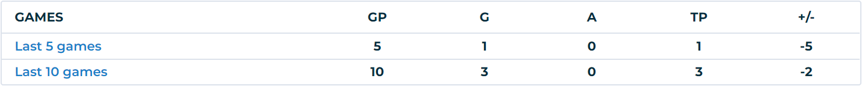
Takeaway Specialist
The selection process of our takeaway specialist
All players were ranked by their total number of successful takeaways performed during the season
We believe that the total number of successful takeaways is the best matrix to evaluate a player’s ability to perform takeaways, since we need someone who can constantly perform successful takeaways in an entire season when facing different teams with different styles in different conditions, instead of someone with a higher per game takeaway ratio but has only carried out those successful takeaways during limited games where favorable condition applies.
Takeaway specialist choice: Dominique Kremer
Current team: Buffalo Beauts
Successful takeaways during the 2020-2021 season: 29

Slide 2
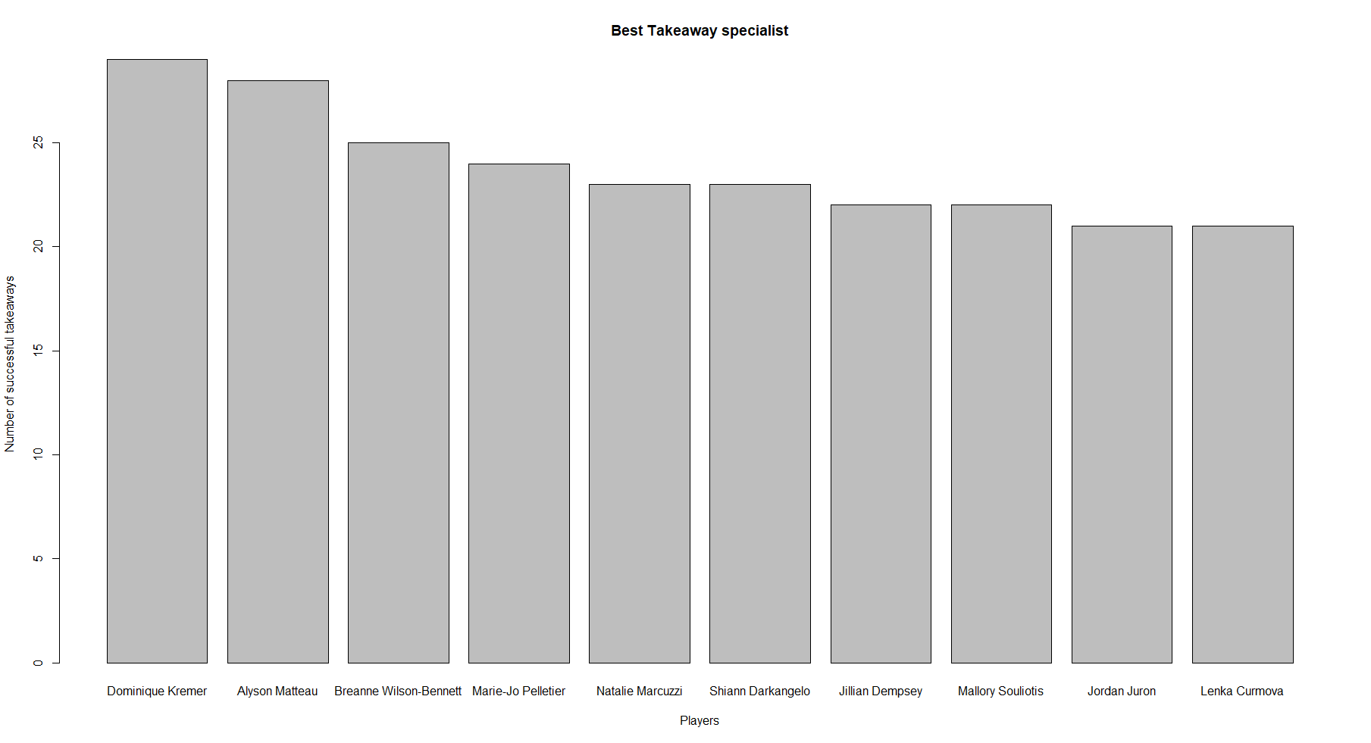
Takeaway Specialist
Top 10 best performing takeaway players including Dominique Kremer
Dominique Kremer
Alyson Matteau
Breanne Wilson-Bennett
Marie-Jo Pelletier
Natalie Marcuzzi
Shiann Darkangelo
Jillian Dempsey
Mallory Souliotis
Jordan Juron
Lenka Curmova

