Slide 1
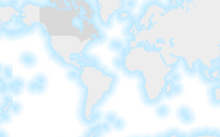
Origin
Tiled Coordinate Reference System aka “ OGC TileMatrixSet”
Projected CRS positive “northing” axis (meters)
Origin
Map CS
TCRS Positive “x” axis
Map CS positive “i” axis
GCRS, PCRS
Geodetic CRS positive “latitude” axis (dec. degrees)
Origin
Projected CRS positive “easting” axis (meters)
Example dynamic map extent zoom=1. Each extent has a map coordinate system.
Geodetic CRS negative “longitude” axis
Map CS positive “j” axis
TCRS Positive “y” axis

Slide 2
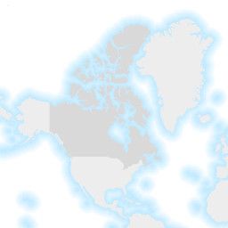
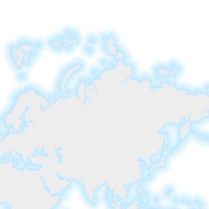
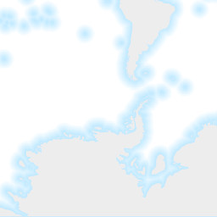
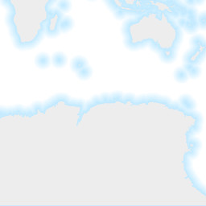
Origin
TileMatrix zoom=1 Positive “column” axis
0,0
1,0
0,1
1,1
TileMatrix zoom=1 Positive “row” axis
OSMTILE Tiled Coordinate Reference System

Slide 3
Origin
Projected CRS positive “northing” axis (meters)
Origin
Map CS
TCRS Positive “x” axis
Map CS positive “i” axis
GCRS, PCRS
Geodetic CRS positive “latitude” axis (dec. degrees)
Origin
Projected CRS positive “easting” axis (meters)
Example dynamic map extent zoom=1. Each extent has a map coordinate system.
Geodetic CRS negative “longitude” axis
Map CS positive “j” axis
TCRS Positive “y” axis
Tiled Coordinate Reference System aka “ OGC TileMatrixSet”

Slide 4
Origin
TCRS Positive “x” axis
Origin – Map CS
Map CS positive “i” axis
Origin – GCRS, PCRS
MapML response <extent>
Map CS positive “j” axis
TCRS Positive “y” axis
OSMTILE Tiled Coordinate Reference System, zoom=1

Slide 5
TCRS Positive “x” axis (px)
Origin of TCRS and TileMatrix
PCRS positive “northing” axis (m)
GCRS positive “latitude” axis (dd)
Map CS positive “i” axis (px)
TileMatrix Positive “column” axis (tile)
Origin of Map CS
top-left of viewport
1,0
0,0
<extent units="OSMTILE“ checked=“checked”> <!– a ‘form’ to cover viewport with map content -->
<input name="z" type="zoom" value=“1" min="0" max="18"/> <input name="xmin" type="location" units="pcrs" position="top-left" axis="easting"/> <input name="ymin" type="location" units="pcrs" position="bottom-right" axis="northing"/> <input name="xmax" type="location" units="pcrs" position=“bottom-right" axis="easting"/> <input name="ymax" type="location" units="pcrs" position="top-left" axis="northing"/> <input name="w" type="width"/> <input name="h" type="height"/>
<link rel="image" tref="https://wms.example.com/? SERVICE=WMS&amp;VERSION=1.1.1&amp;SRS=EPSG:3857&amp;LAYERS=basemap&amp;BBOX={xmin},{ymin},{xmax},{ymax}&amp;REQUEST=GetMap&amp;FORMAT=image/png&amp;WIDTH={w}&amp;HEIGHT={h} "/>
<input name="y" type="location" units="tilematrix" axis="row"/> <input name="x" type="location" units="tilematrix" axis="column"/> <input name="utc" type="datetime" min="2018-03-02T18:00:00Z" max="2018-03-12T00:00:00Z" value="2018-03-03T12:00:00Z" step="PT1H"/>
<link rel="tile" tref="https://tilecache.example.com/weather/tile/{z}/{y}/{x}?time={utc}"/>
<input name="i" type="location" units="map" axis="i"/> <input name="j" type="location" units="map" axis="j"/>
<link rel="query" tref=" https://wms.example.com /?SERVICE=WMS&amp;VERSION=1.1.1&amp;SRS=EPSG:3857&amp;LAYERS=weather&amp;QUERY_LAYERS=ex&amp;X={i}&amp;Y={j}&amp;INFO_FORMAT=text/plain&amp;BBOX={xmin},{ymin},{xmax},{ymax}&amp;REQUEST=GetFeatureInfo&amp;WIDTH={w}&amp;HEIGHT={h} "/>
</extent>
GCRS positive “longitude” axis (dd)
PCRS positive “easting” axis (m)
Map CS positive “j” axis (px)
Origin of GCRS+PCRS
Height h of extent
TileMatrix row
0,1
1,1
bottom-right of viewport
TileMatrix column
TileMatrix Positive “row” axis (tile)
TileMatrix tile edges (256 px)
TCRS Positive “y” axis (px)
OSMTILE Tiled Coordinate Reference System, zoom=1

Slide 6
Origin
Tiled Coordinate Reference System
TCRS Positive “x” axis
Origin
TCRS Positive “y” axis

Slide 8
row
TileMatrix Positive “column” axis
0,0
1,0
column
0,1
1,1
TileMatrix Positive “row” axis

