Slide 1
Limitations to use of OGC spatial web services
Jonathan Moules
Maps for the Web, September 2020

Slide 2
The Discovery Problem
GeoSeer
Thoughts/Conclusions

Slide 3
The Discovery Problem

Slide 4
WMS (Web Map Service)
  Serves pre-rendered, pre-styled maps
  1.0 – April 2000
  1.3.0 (latest) – March 2006
WMTS (Web Map Tile Service)
  Serves pre-rendered, pre-styled maps tiles
  For Basemaps
  1.0.0 (only) – April 2010
WFS (Web Feature Service)
  Serves raw vector data
  1.0.0 – May 2002
  2.0.2 (latest) – March 2014
WCS (Web Coverage Service)
  Serves raw raster data
  1.0.0 – Oct 2005
  2.1 (latest) – August 2018

Slide 5
Portal Type | Number | Appx. Number of Services
CKAN | 194 Instances | 10,000*
CSW | 151 Instances | 21,000
http://opendata.arcgis.com | - | 800
http://inspire-geoportal.ec.europa.eu | - | 13,000+
Spatineo | - | 36,000
GeoSeer | - | 186,170
Table shows the approximate number of live distinct Services that can be found within a certain data-portal or type of data-portal
* Over a third of these are the US NOAA
+ Over half of these are one German Agency (www.geoportal.rlp.de)
(Data from June 2019)

Slide 6
GeoSeer

Slide 7
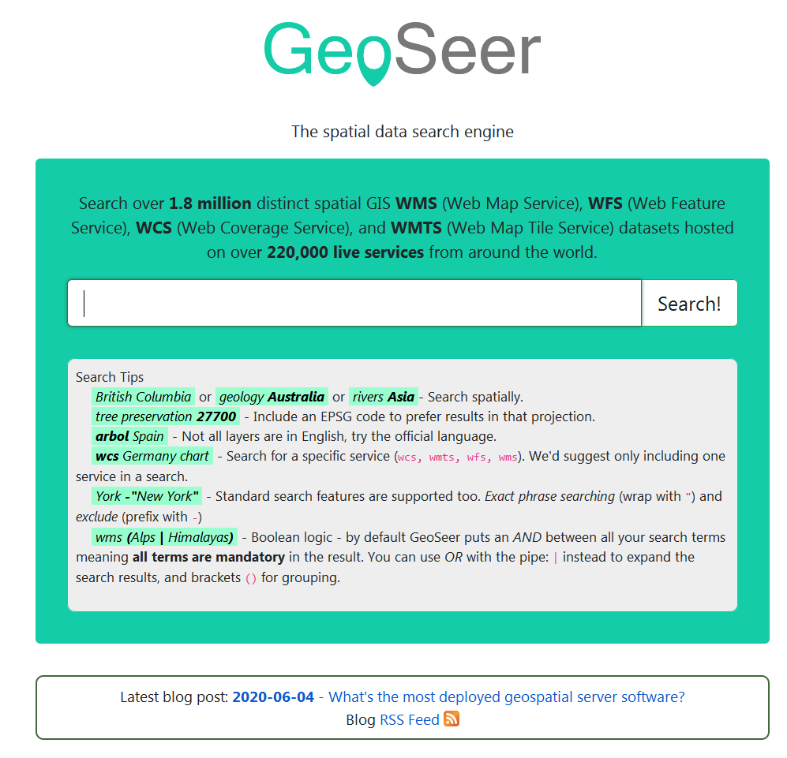

Slide 8
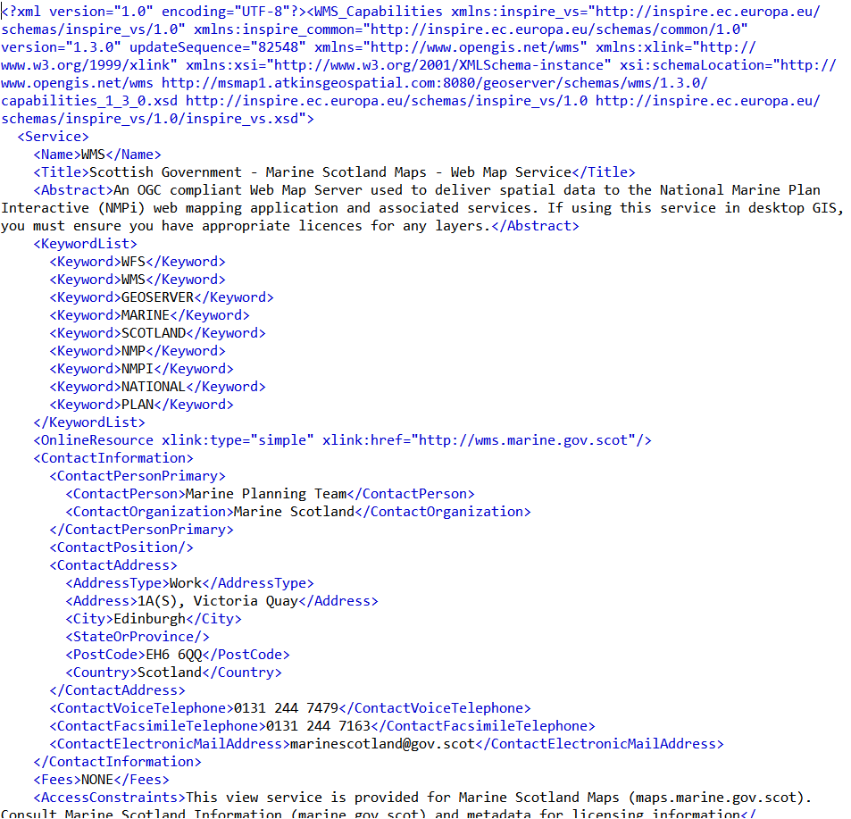
GetCapabilities Documents

Slide 9
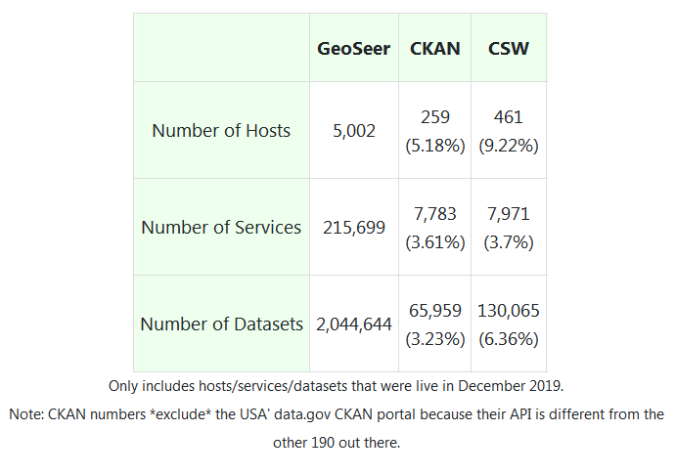
From: https://www.geoseer.net/blog/?p=2020-01-10_dataportal_problems

Slide 10
Dataset Metadata - Abstracts
Table showing Dataset percentages with meaningful abstracts, grouped by Service Type

Slide 11
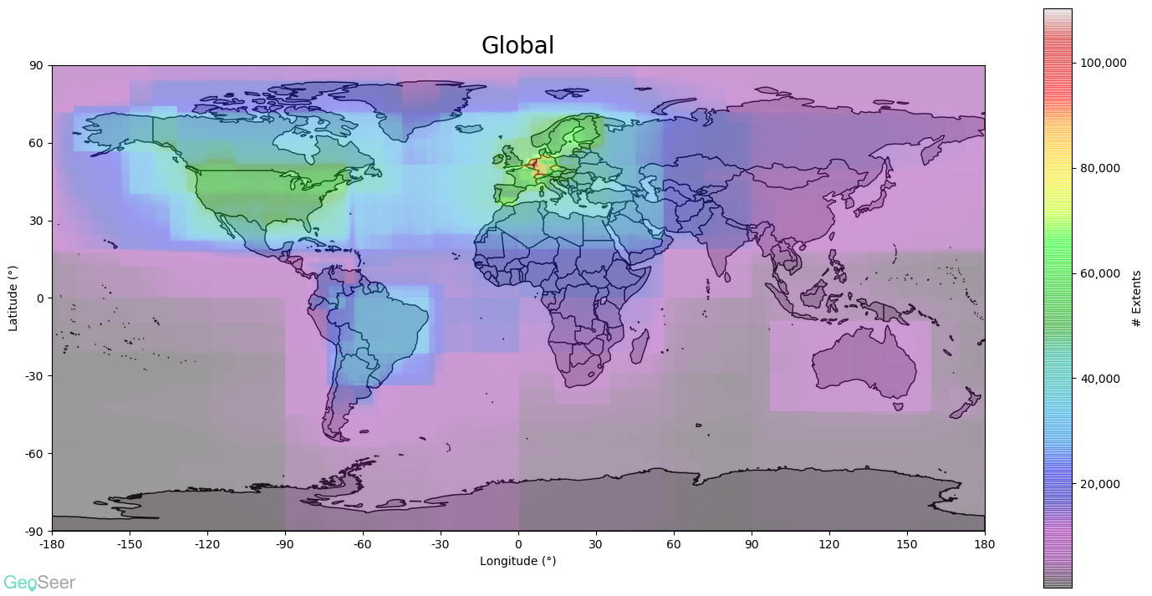
More @https://www.geoseer.net/stats/extents.php

Slide 12
GeoSeer Usage
Table showing number of GeoSeer web searches
(Note: completely free)

Slide 13
Thoughts/Conclusions
People are terrible at filling in metadata
Little call for service/data discovery
Federation of data portals = too many to be useful
Question: How many services exist to “share”? How many just for host data for own portals?

Slide 14
Questions, Comments, etc. Welcome!
GeoSpatial Web Service Search Engine:
www.geoseer.net
Contact:
jonathan.moules@geoseer.net

