Slide 1


Mapping With Cartodb

Slide 2
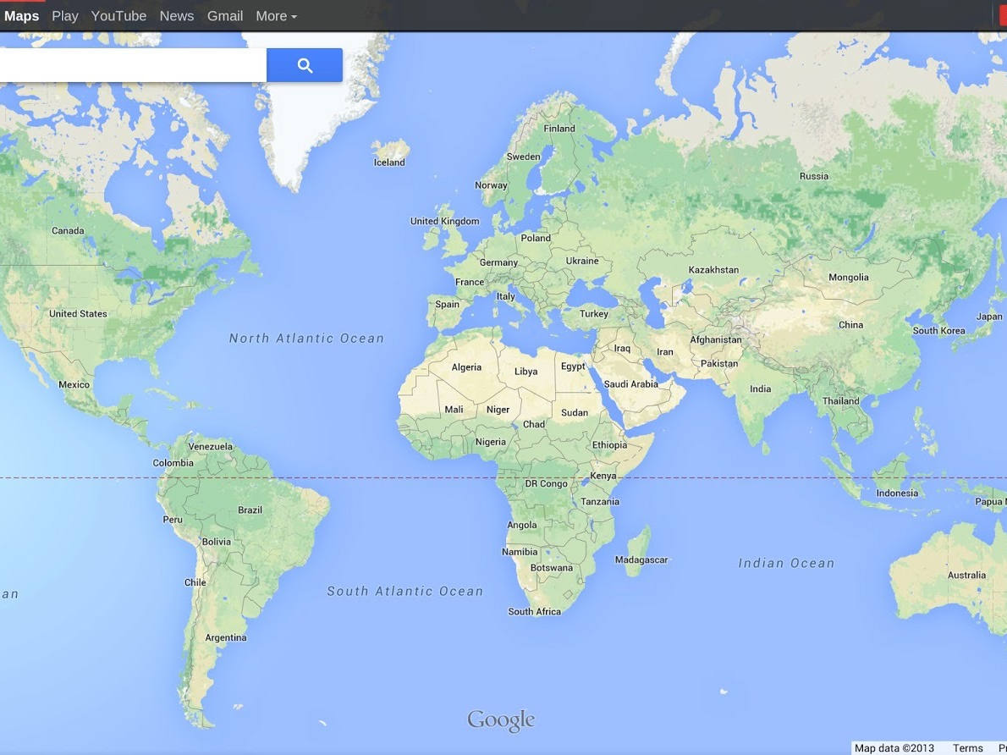
Fact: Maps are Awesome
Fact: Maps are Awesome

Slide 3
I bet maps are hard to make…
FALSE!

Slide 4
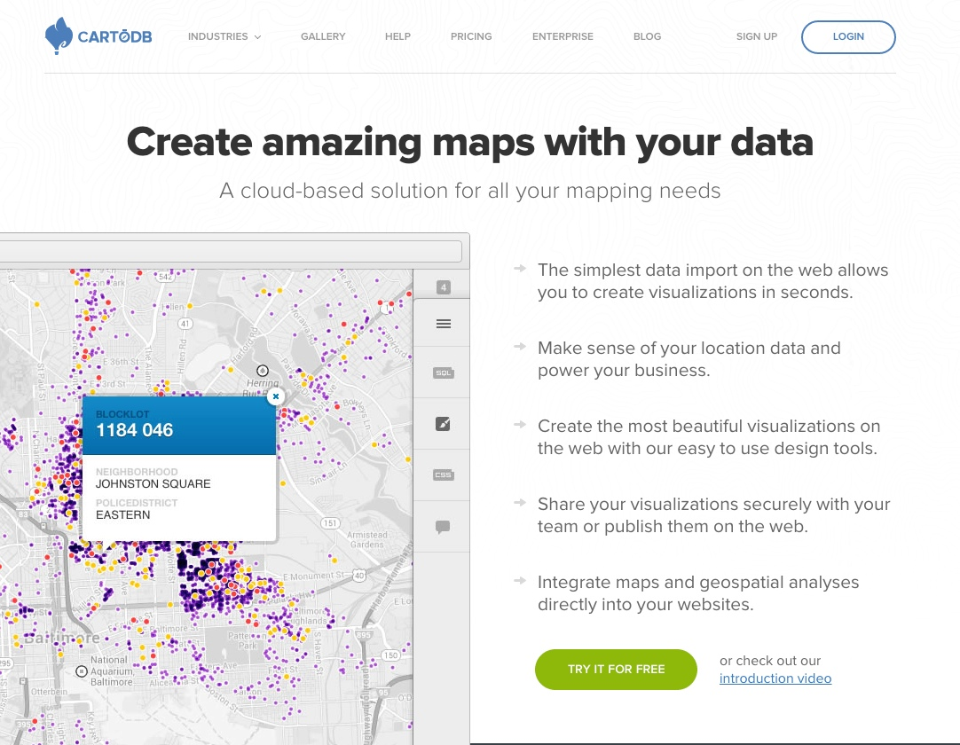
Why CartoDB?

Slide 5
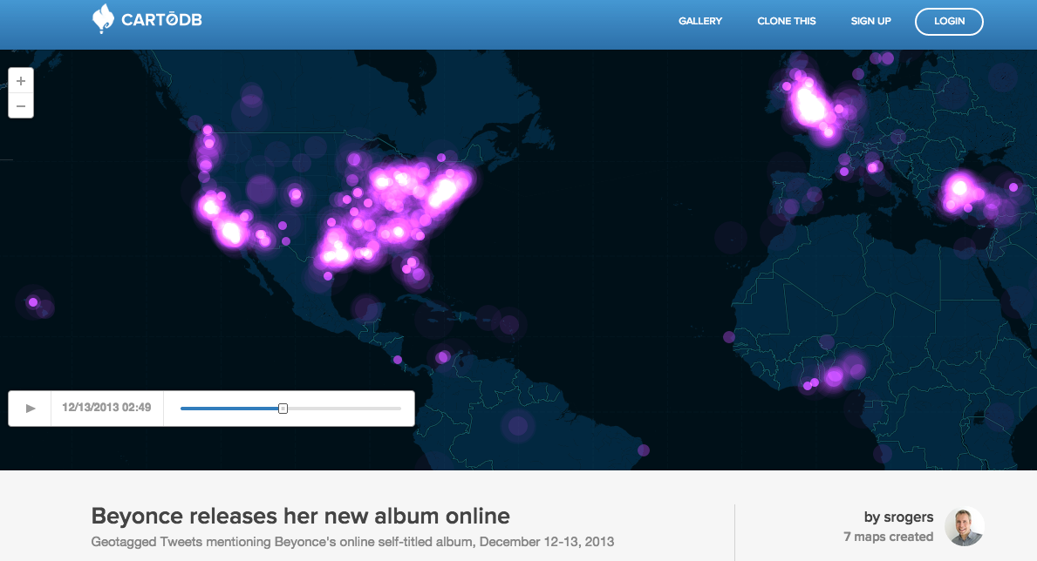
We can make awesome Things!

Slide 6
It takes care of the nitty gritty things that can make making maps hard!

Slide 7
Georeference your data
Animate your maps without Javascript
Import, merge, and edit data quickly
Customize info windows without HTML
Create multi-layered maps for the web!

Slide 8
You also don’t have to install anything!
*CartoDB is free up until 50MB of data

Slide 9
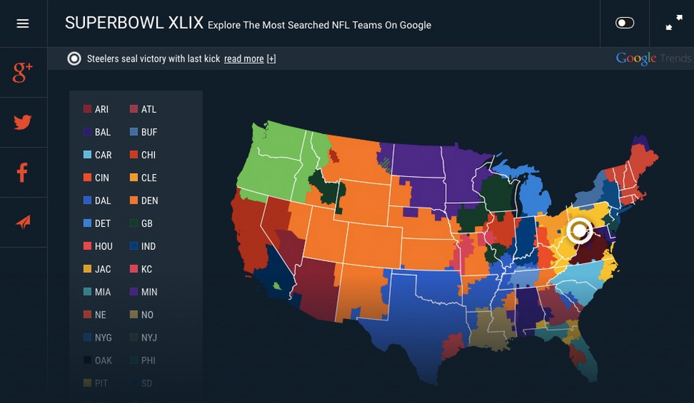
Awesome examples before we begin:

Slide 10





Where to find good data to map?
Look for ‘shapefiles’, geoJSON, or KML format!
Or build your own! Just need latitude + longitude

