Slide 1
Port 1
Port 2
C₁₁
L₁₁
C₂₁
L₂₁
C₃₁
L₃₁
G₁
J₁
L₁₂
J₂
L₂₂
J₃
L₃₂
J₄
G₄
C₁₂
C₂₂
C₃₂

Slide 2
0
-20
-40
|S₁₁|,|S₂₁| [dB]
-60
-80
|S₁₁|
|S₂₁|
-100
0
1
2
3
4
5
Frequency [GHz]

Slide 3
C
Port 1
Port 2
-C
L
-L
-C
-L

Slide 4
C₂
Port 1
Port 2
-C₁
L₂
-L₁

Slide 5
C_{J12}
C_{J2}
C_{J3}
C_{J42}
Port 1
Port 2
L_{J12}
C₁₁
L₁₁
L_{J2}
C₂₁
L₂₁
-C_{J3}
L_{J3}
C₃₁
L₃₁
-C_{J41}
L_{J42}
-C_{J2}
-L_{J2}
-L_{J3}
-L_{J41}
G₁
L₁₂
L₂₂
L₃₂
G₄
-C_{J11}
-C_{J2}
C₂₂
-C_{J3}
C₃₂
-L_{J11}
C₁₂
-L_{J2}
-L_{J3}

Slide 6
0
-20
-40
|S₁₁|,|S₂₁| [dB]
-60
-80
theoretical
proposed
|S₁₁|
|S₂₁|
-100
0
1
2
3
4
5
Frequency [GHz]

Slide 7
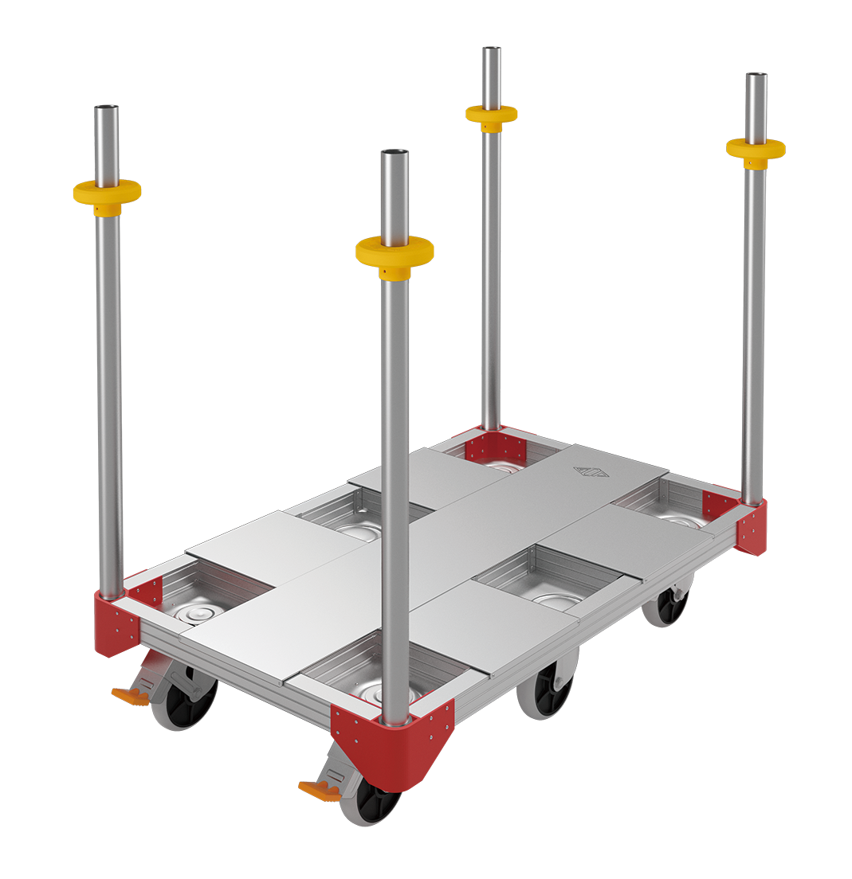
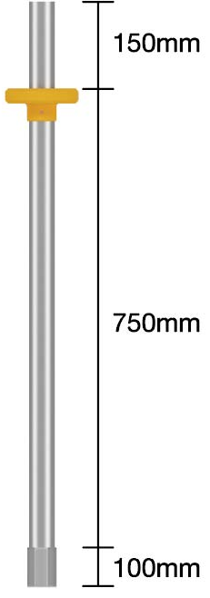
Unit : mm
150
RF Tag
750
40
1
43
100
125
(a) Metal pole that can be used as bogie handle
(b) A bogie of Temporary Equipment for Construction

Slide 8
5
Perfect Conductor
Unit : mm
Excite Point(IC)
20
(a) Loop antenna before folding
10
1.1
5
Dielectric
ε_{r} = 2.3
1
0.5
0.5
0.5
(b) folding loop antenna

Slide 9
3.84
22.0
25.0
Antenna
9.90
1.54
5.31
3.05
67.6
Unit : mm

Slide 10
0
5
0
-5
-10
-15
-20
-15
-10
-5
0
5
φ = 0 [deg]
-30
30
φ = 90 [deg]
-60
60
-90
90
-120
120
-150
150
180
Angle of θ [deg] ( -180 to 180)
Magnitude[dBi]
Notes:
はさみにとりつけ指向性利得

Slide 11
0
0
-4
-8
-12
-16
-20
-16
-12
-8
-4
0
φ = 0 [deg]
-30
30
φ = 90 [deg]
-60
60
-90
90
-120
120
-150
150
180
Angle of θ [deg] ( -180 to 180)
Magnitude[dBi]
Notes:
折り返しループアンテナを金属平面直上に配置 指向性利得

Slide 12
13
z
Perfect Conducor
0.5
0.5
θ
Excite Point (IC)
1.0
x
Polyethylene
φ
ε_{r} = 2.3
1.1
y
12.5
Unit : mm

Slide 13
13
z
Excite Point (IC)
0.5
θ
0.5
1.0
Perfect Conducor
0.5
x
Dielectric
φ
ε_{r} = 2.3
1.1
y
12.5
Unit : mm

Slide 14
unfolding
folding line

Slide 15
w
Narrowing W gradually

Slide 17
920 MHz
Z_{in} = 8.00 + j387 Ω

Slide 18
0
-4
-7
-10
-13
-16
-19
-16
-13
-10
-7
-4
φ = 0 [deg]
-30
30
φ = 90 [deg]
-60
60
-90
90
-120
120
-150
150
180
Angle of θ [deg] ( -180 to 180)
Magnitude[dBi]

Slide 19
Metal Surface : φ = 0 [deg]
0
10
2
-6
-14
-22
-30
-22
-14
-6
2
10
Metal Surface : φ = 90 [deg]
-30
30
Free Field : φ = 0 [deg]
Free Field : φ = 90 [deg]
-60
60
-90
90
-120
120
-150
150
180
Angle of θ [deg] ( -180 to 180)
Magnitude[dBi]

Slide 21
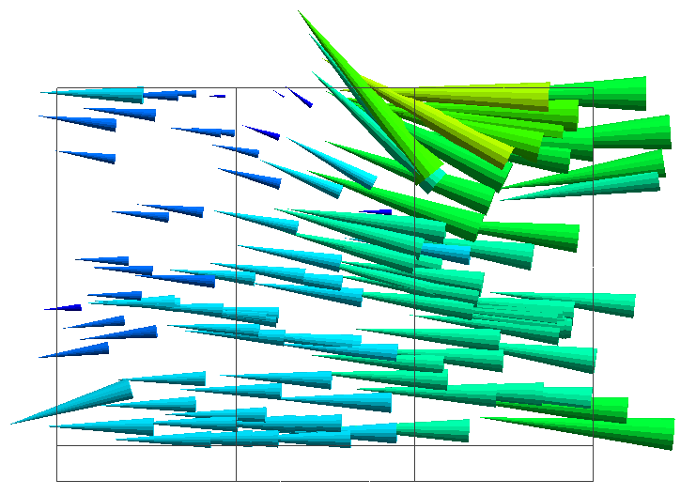
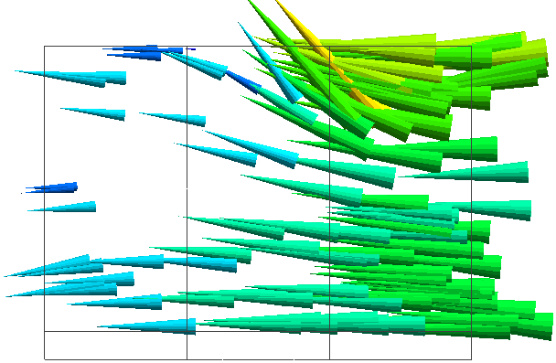
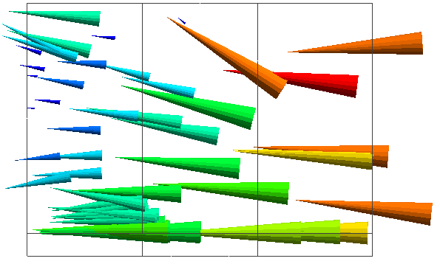
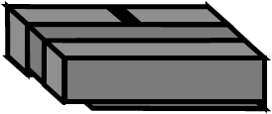
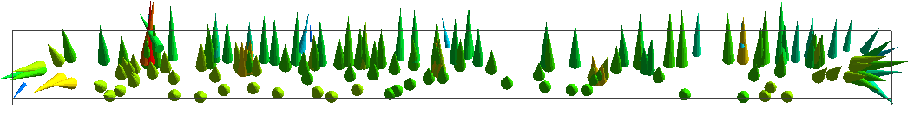
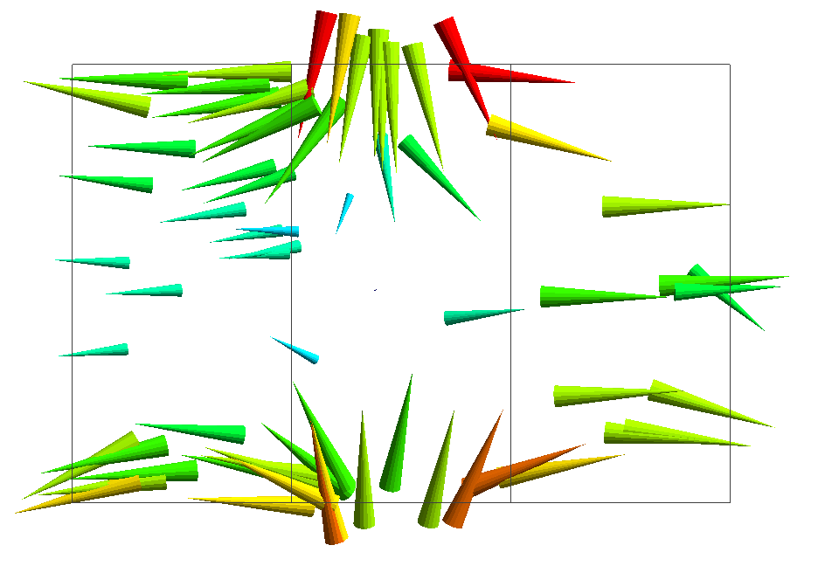
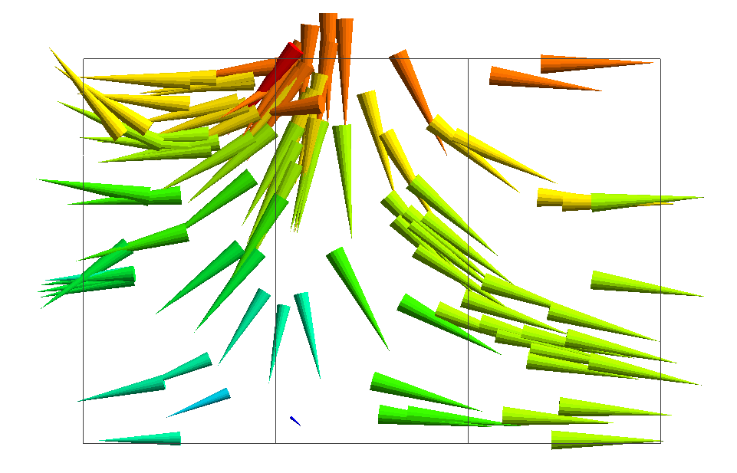
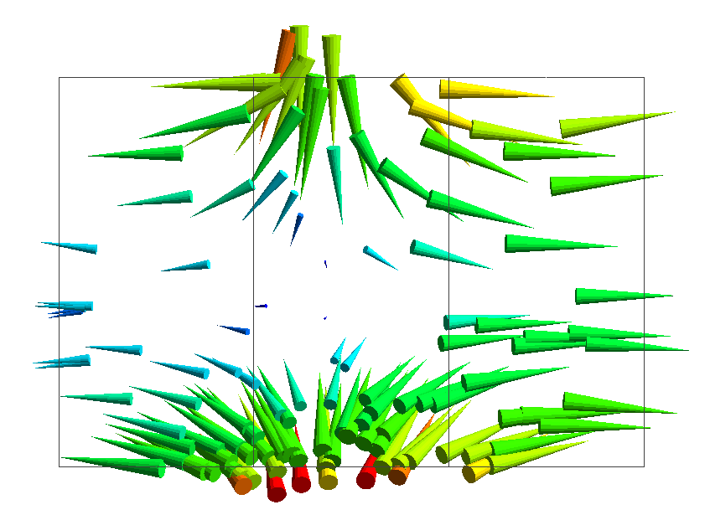
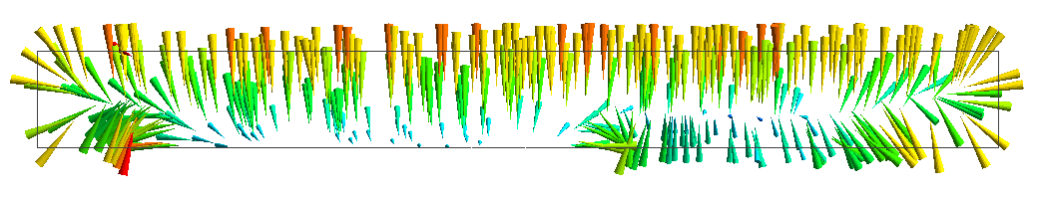
1
2
3
1
2
3
4
(a) Twisted Loop Antenna
1
2
3
4
z
θ
4
x
φ
y
(b) Folded Loop Antenna
Notes:
偏波
図も分かりやすく変える

