Slide 1
Mechanisms of Action (MoA) Prediction

Slide 2
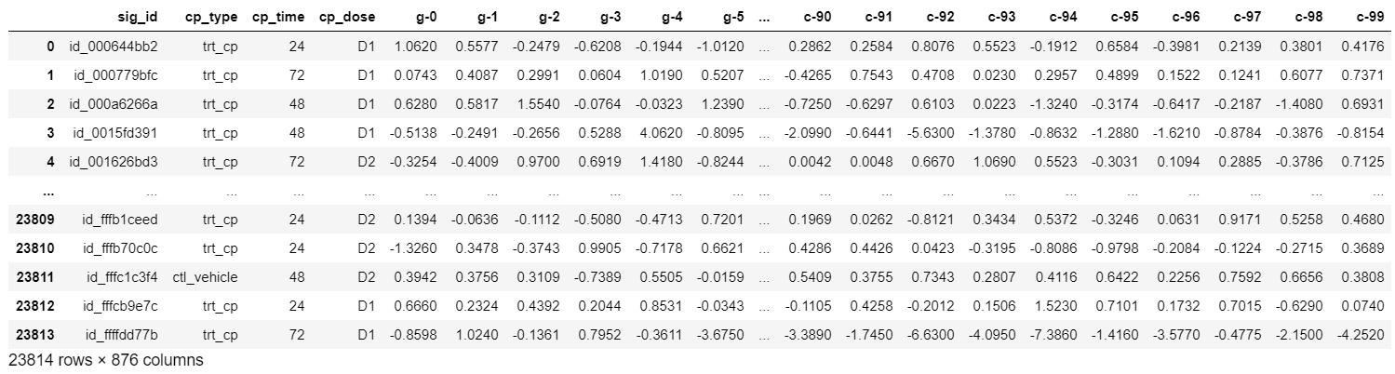
Train_X
Notes:
In this competition, you will be predicting multiple targets of the Mechanism of Action (MoA) response(s) of different samples (sig_id), given various inputs such as gene expression data and cell viability data.

Slide 3
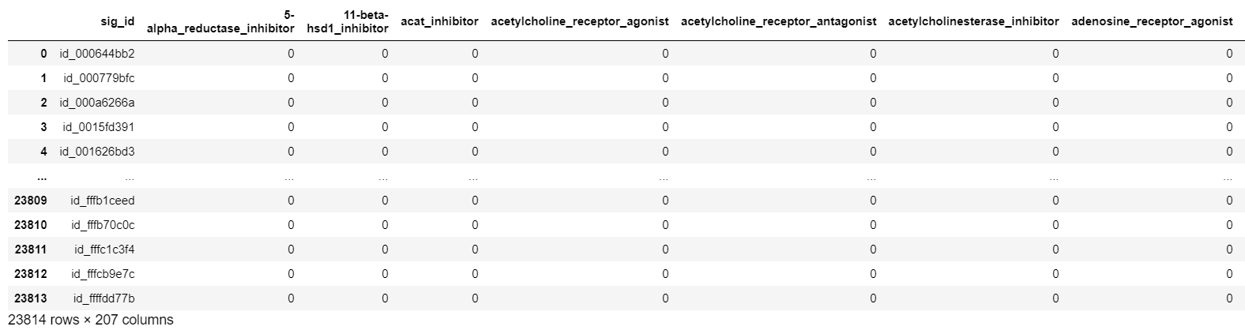
Train_y

Slide 4
Features
cp_type indicates samples treated with a compound (cp_vehicle) or with a control perturbation (ctrl_vehicle)
cp_time indicate treatment duration (24, 48, 72 hours)
cp_dose indicate dose (high or low)
g- signify gene expression data
c- signify cell viability data
Notes:
Gene expression is the process by which the instructions in our DNA are converted into a functional product, such as a protein.
Cell viability is a measure of the proportion of live, healthy cells within a population.

Slide 5
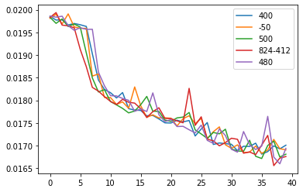
Dense layer
val loss:
0.01683
0.01703
0.01686
0.01683
0.0170
Notes:
Five model with different Dense (5 dense layers with different units plus 2 ones with 206 units):
Units equal 400
Units equal 500, 450, 400, 350, 300
Units equal 500
Units equal 824, 824, 824, 412, 412
Units equal 480

Slide 6
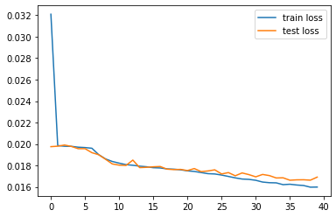
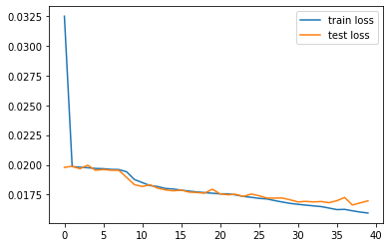
Only Dense
Add BatchNormalization
val loss: 0.0170 – val auc: 0.7710
val loss: 0.0169 – val auc: 0.7992
Notes:
Add BatchNormalization layers

Slide 7
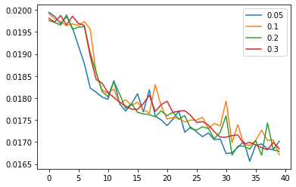
Add Dropout
val loss:
0.0170
0.0167
0.0168
0.0168
Notes:
Add Dropout layers with rate 0.05, 0.1, 0.2, 0.3

Slide 8
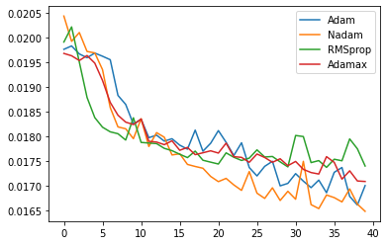
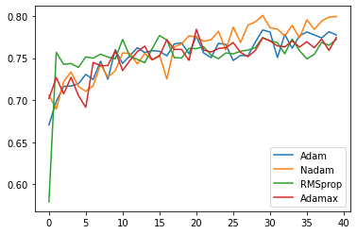
Choose an optimizer
val loss
val auc
Notes:
Val loss with different optimizer

Slide 9
Results
val loss - 0.0166; val auc - 0.7927
Public Score – 0.02056
Private Score – 0.01816

