Slide 1

Media Engineering and Technology Faculty
German University in Cairo
A Brain-controlled On-screen
Assistive Keyboard
Bachelor Thesis - Expository
Author: Maqarios Wagdy Tawadros Saleh Mohareb
Supervisor: Assoc. Prof. Seif Eldawlatly

Slide 2
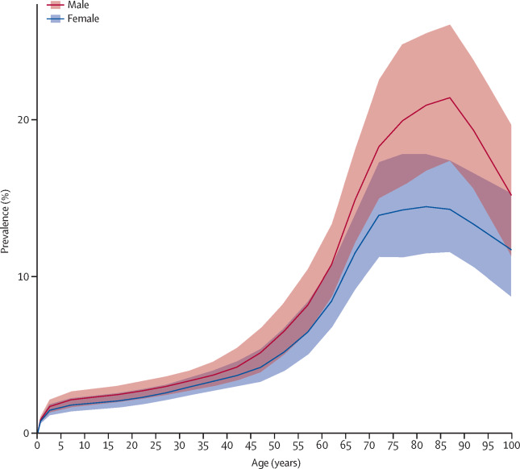
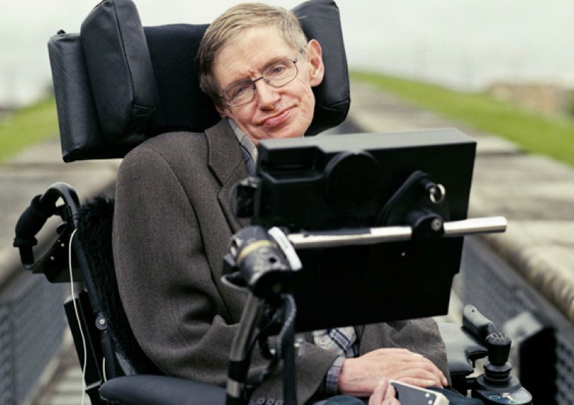
Disabled People
Ex. Motor Neuron Disease
(MND)

Slide 3
Objective
Designing an on-screen keyboard that allows
disabled people to interact with computer
without physical contact

Slide 4
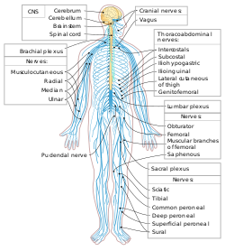
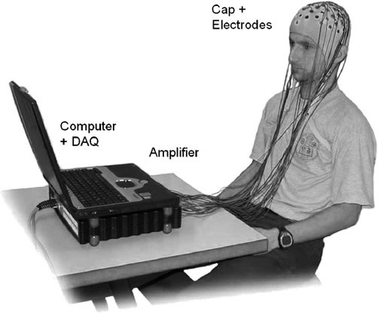
Introduction to BCI
What is a BCI?
Peripheral Nervous System
So, what is the relation?

Slide 5
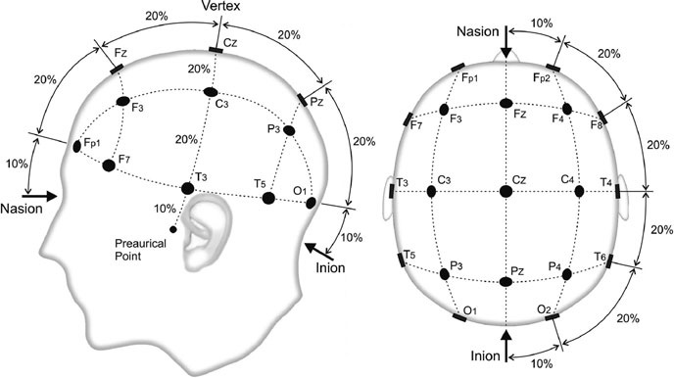
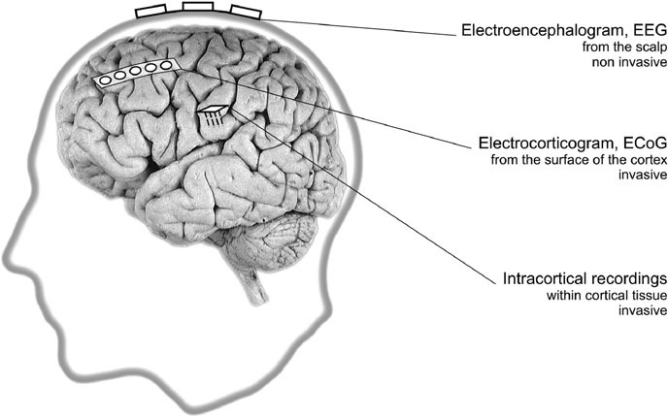
Introduction to BCI
10 – 20 system
Types of BCIs

Slide 6

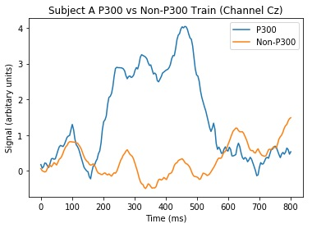
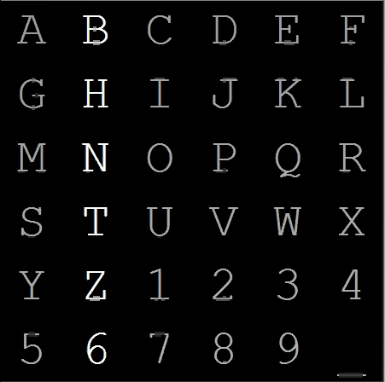
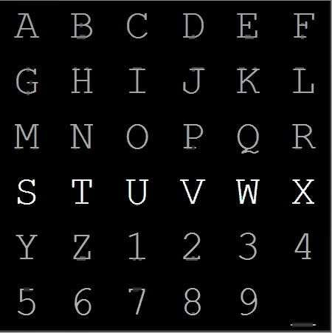
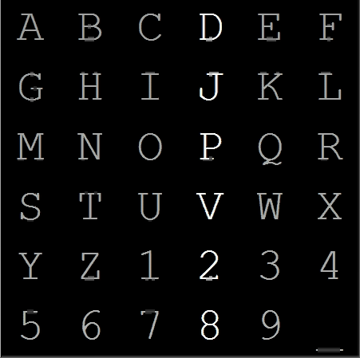
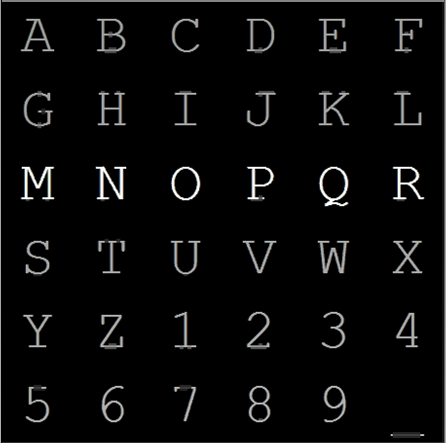
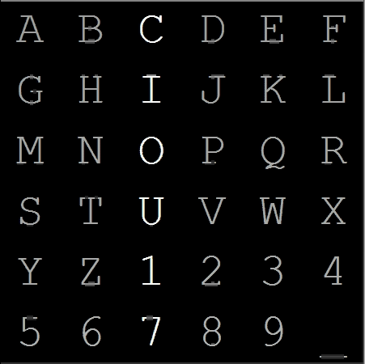
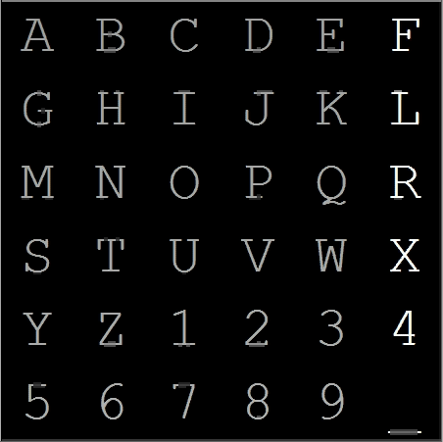
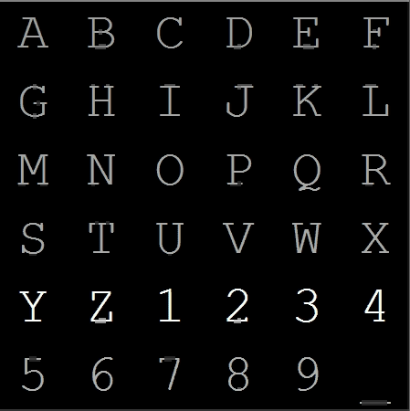
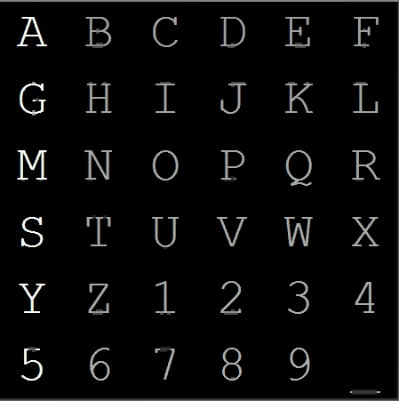
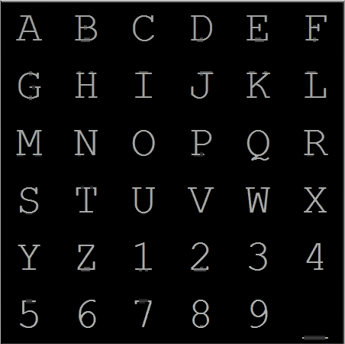
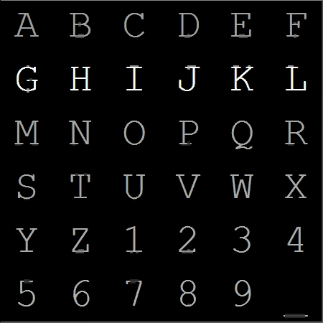
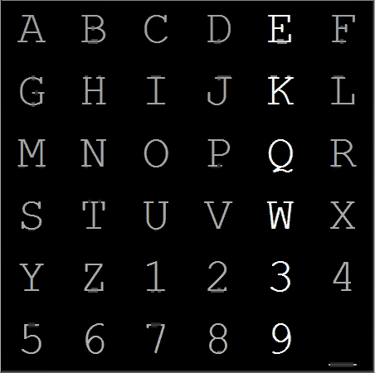
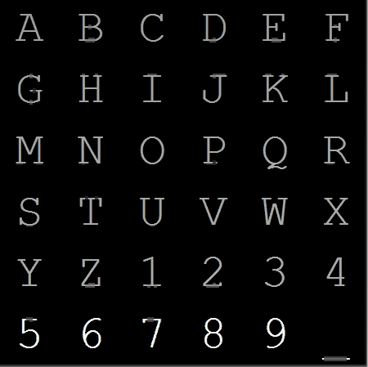
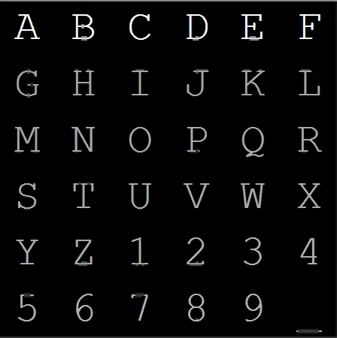
Introduction to BCI
P-300
Oddball Paradigm
Visual Stimuli

Slide 7
Methodology & Results

Slide 8
Flow of Operation
Pre-processing
Average of Repetitions
Common Average Reference (CAR)
Recording
P-300 Classification
Moving Average
Z-Score
Decimation

Slide 9
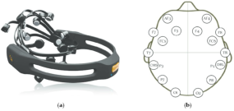
Flow of Operation - Recording
Emotiv EPOC+
Digitization Rate of 128/256Hz
14 Channels

Slide 10
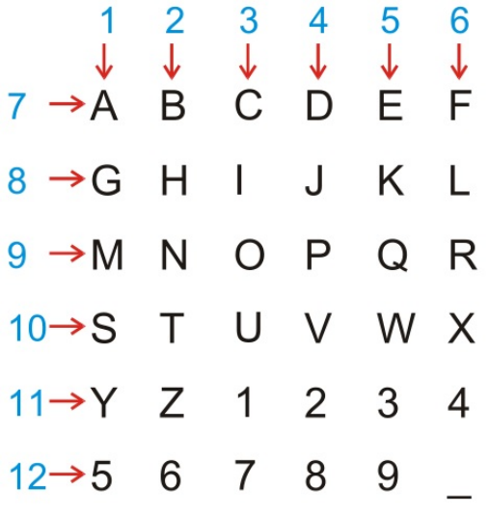
Flow of Operation - Preprocessing
Average of Repetitions
12 intensifications
100ms per intensification
75ms with no intensification
15 repetitions

Slide 11
Flow of Operation - Preprocessing
Common Average Reference (CAR)
Filtered signal for channel c at time t
Raw signal for channel c at time t
Average of raw signals of all channels at time t

Slide 12
Flow of Operation - Preprocessing
Moving Average
Filtered signal for channel c at time t
Average of M signal after time t

Slide 13
Flow of Operation - Preprocessing
Z-Score
Filtered Signal for channel c at time t
Signal for channel c at time t
Mean of signals for channel c
Standard deviation of signals for channel c

Slide 14
Flow of Operation - Preprocessing
Decimation
Dimensionality Reduction Technique
Take 1 Leave n
Without Decimation. Features = 14 * 128 = 1792
With Decimation=6. Features = 14 * 128/6 = 588

Slide 15
Flow of Operation – P300 Classification
Channel 2
Channel Z
Channel 1
Channel 2
x₁₁
x₁₂
...
x_{1f}
x₂₁
x₂₂
...
x_{2f}
…
x_{Z1}
x_{Z2}
...
x_{Zf}
Concatenation
x =
x₁
x₂
...
x_{zf}
--------------------------------------------------------------------------------------------
x₁
x₂
...
x_{zf}
Character 1
x₁
x₂
...
x_{zf}
Character 2
X =
…
x₁
x₂
...
x_{zf}
Character Y

Slide 16
Flow of Operation – P300 Classification
Line Equation
Score Equation
Row Equation
Column Equation

Slide 17
Flow of Operation – P300 Classification
Linear Discriminant Analysis (LDA)

Slide 18
Results
Competition's Dataset
BCI 2000, 3rd Competition, 2nd dataset
2 Subject; A and B
Digitization rate 256hz
64 Channels

Slide 19
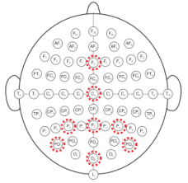
Results
Competition's Dataset

Slide 20
Results
Recorded Dataset

Slide 21
Conclusion
Brain controlled system that allows spelling
Accuracy obtained on the benchmark data is ~80%
Offline Accuracy obtained on the recorded data is ~70%
Online Accuracy obtained on the recorded data is ~80%

Slide 22
Thank You

