Slide 1
Multimodal AI
Multimodal models for a multimodal world

Slide 2
About me
Principal data scientist at a telecommunications company
Using multimodal models as part of a retrieval-augmented generation (RAG) on proprietary documents.
Previously worked in consulting, where I fine-tuned/trained vision models and language models for multiple clients. Some examples of models I was tasked with:
Detecting misplaced products on shelves through a live video feed
Detecting damaged merchandise on conveyor belts
Generating pictures of trees on empty streets
Simulating electrocardiogram curves through generative adversarial networks (GAN)
Determining the main themes in employee satisfaction comments
Search engine for employees (company with around 100,000 employees)

Slide 3
Presentation overview
State of the art today
Open source
Questions
Use-cases in industry
Brief history of multimodal
Breakthrough: CLIP
Improvements

Slide 4
Multimodality – what does it mean?
A modality is a form of data representation, such as text, audio, image, video, time series, etc.
Historically, AI models would receive data inputs of a single modality, and output in turn, a single modality.
Note: The input and output modality did not need to match.
State-of-the-art models, nowadays, combine multiple modalities both at the input and output level. For example, a user may want to ask a question about the content of an image and receive an answer in the form of a new image with text.

Slide 5
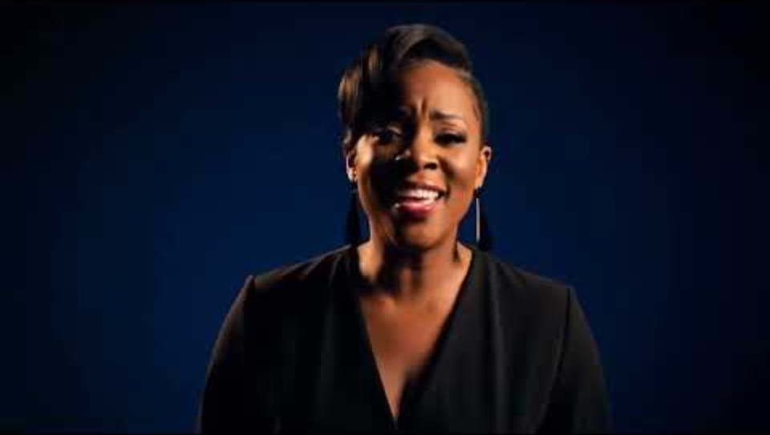
State of the art today
Videos
VEO 3
Image + text
Gemini flash 2.5
ChatGPT
Claude
A lot of other models…

Slide 6
"Open-weight" models
Gemma 3n from Google
“open weight” model (with limitations, training not disclosed)
Qwen2.5-VL
“open weight” model (training not disclosed)
MiniCPM-o-2_6(Based on a Qwen model)

Slide 7
Not multimodal, but…
OLMo 2 32B
https://playground.allenai.org/
Completely open-source model with open-source data and detailed training process.
Even tells you what data might have been used when answering.
Don’t expect state-of-the-art performance, but it’s a huge asset for academic advancement, and an impressive endeavor.

Slide 8
Use-cases in industry
Optical character recognition
Zero-shot classification
Text-to-speech and speech-to-text
Retrieval-augmented-generation (RAG) on documents with images

Slide 9

Optical character recognition
OCR is the task of recognizing text in an image or PDF.
Typically, the goal is to write down both the text and the location in the file.
Usable models:
Large, proprietary closed-source models like GPT and Gemini
Lightweight, open-source models like doctr
Demo:
multimodal_pres/notebooks/ocr.ipynb at master · Mar-Dal/multimodal_pres

Slide 10

Zero-shot classification
Zero-shot classification is the act of using a model without specifically having trained it for your classification task.
A typical use-case is to describe the content of an image using text
Demo using proprietary model, Gemini API
multimodal_pres/notebooks/oneshot.ipynb at master · Mar-Dal/multimodal_pres
Demo using a locally-runnable Gemma-3 model
Gemma 3 + Ollama on Colab
Gemma 3 + Ollama on Colab: A Developer’s Quickstart | by E. Huizenga | Google Cloud - Community | Medium

Slide 11
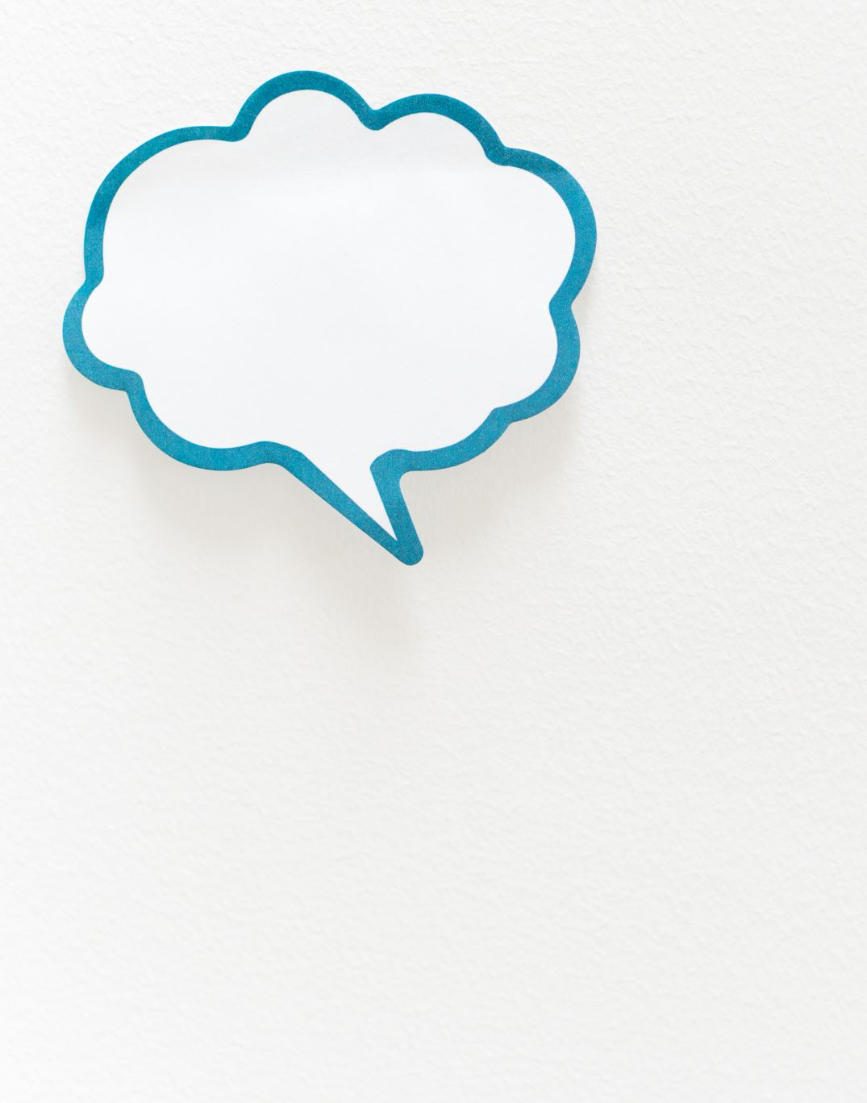
Speech-to-text and text-to-speech
Speech-to-text is the act of transforming speech into text.
Often used in industry to transcript meetings for efficient summarization and action-items
Open model:
openai/whisper-large-v3-turbo
Text-to-speech
Less immediately useful in industry, the act of transforming text into speech
Open model:
WhisperSpeech/WhisperSpeech

Slide 12
Retrieval-augmented generation with images
The most common use-case in industry for multimodal models.
What is RAG? RAG allows an AI system to access and reference your company's proprietary documents (like HR policies, technical manuals, or project reports) to provide accurate, up-to-date, and context-specific answers to employee queries, rather than relying solely on generic pre-trained knowledge.

Slide 13
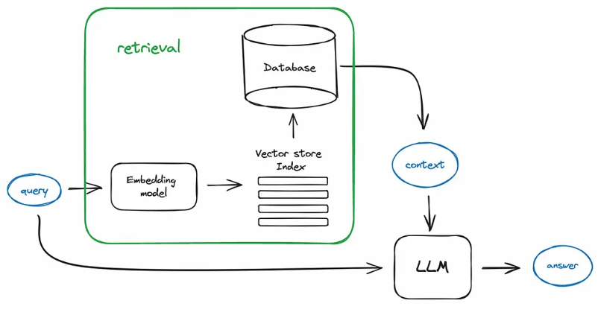
RAG explained
Components:
Embedding model to embed the documents and queries
Vector store for the pre-computed document embeddings
Database of documents with their associated vectors
LLM to answer a query based on query + retrieved documents

Slide 14
RAG explained
Steps:
Pre-embed all the documents
Store the embeddings in a vector store
At query time, embed the query
Use a fast method to compare the query embeddings against all the document embeddings to retrieve k candidates
Pass the original query and the k candidates to the LLM to answer

Slide 15
But how does it work?
Brief history lesson
Breakthrough: CLIP
Improvements

Slide 16
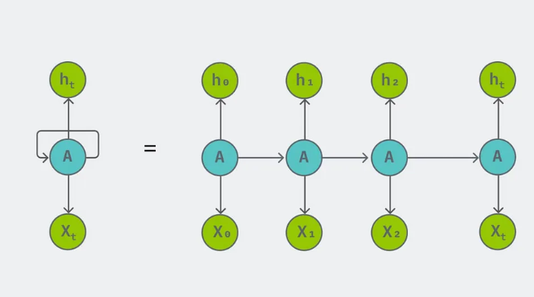
Recurrent neural networks

Slide 17
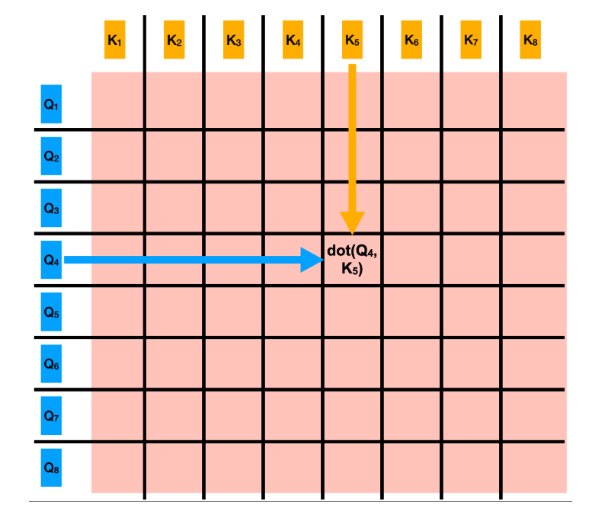
Attention mechanism found in transformers

Slide 18
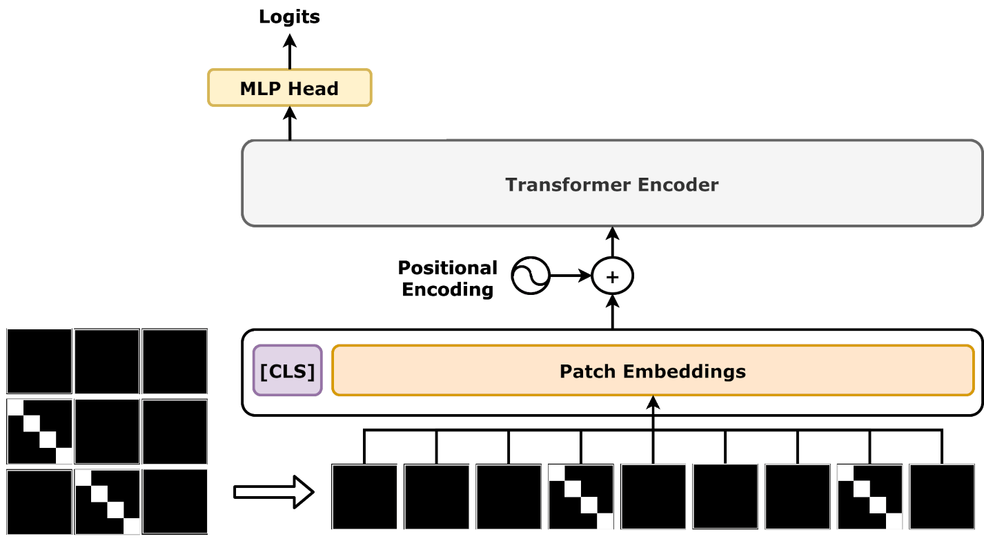
Vision transformers
ViT paper: 2010.11929

Slide 19
Pros and Cons of ViT versus CNNs
Inductive biases in CNNs serve as shortcut when not having a lot of data:
Translational Equivariance: an object can appear anywhere in the image, and CNNs can detect its features.
Locality: pixels in an image interact mainly with its surrounding pixels to form features.
CNN models are very good at these two biases. ViT do not have this assumption. Because of these simplifications, CNNs are often better at “smaller” datasets/tasks.
However, ViTs are richer representations, and direct interaction between areas of an image are baked in naturally through the attention mechanism.

Slide 20
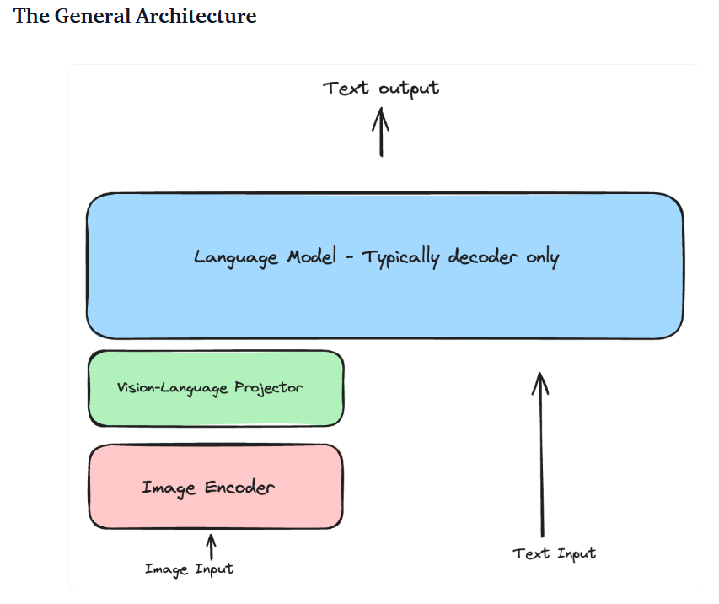
Vision-language model architecture
Source: seemore: Implement a Vision Language Model from Scratch

Slide 21
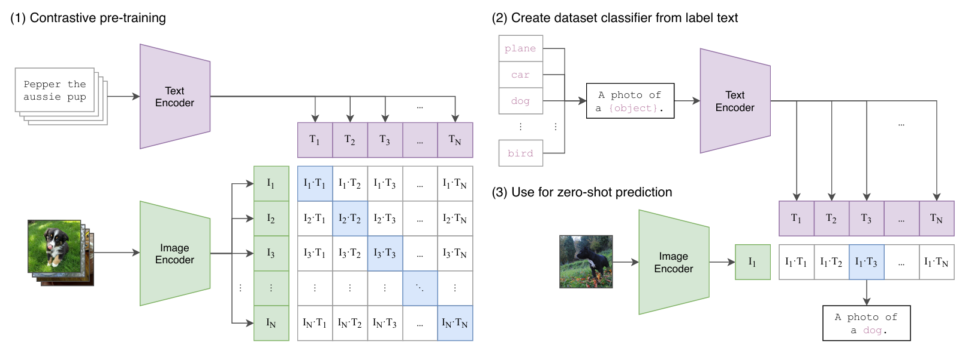
CLIP
Source: Learning Transferable Visual Models From Natural Language Supervision

Slide 22
Transfer learning
Transfer learning is the process of using a pre-trained model’s weights and training it again (fine-tuning) on a new task or dataset.
Doing this allows efficiently re-using a large language model pre-trained on a given task to train it on a vision-language task.
Clip_finetune.ipynb – Colab
Note: In practice, I believe it’s best to first train your language model and image model separately extensively, then alternate between a variety of tasks
image + question tasks
Text generation task only
contrastive task
generation task
segmentation task

Slide 23
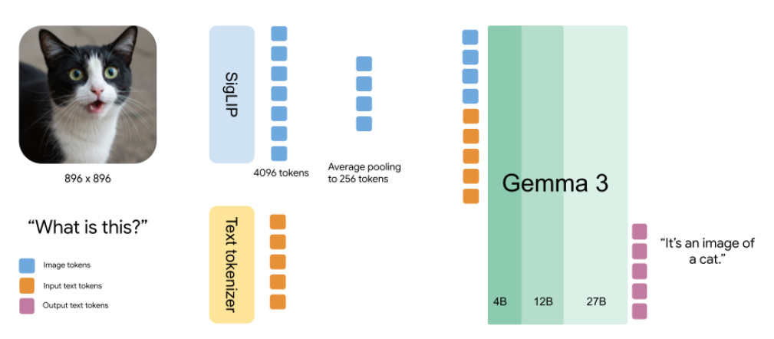
Gemma 3 architecture
Source: Gemma explained: What’s new in Gemma 3 - Google Developers Blog

Slide 24
Ressources
Datasets (academic use only):
Projects | LAION
kakaobrain/coyo-dataset: COYO-700M: Large-scale Image-Text Pair Dataset
google-research-datasets/conceptual-12m: Conceptual 12M is a dataset containing (image-URL, caption) pairs collected for vision-and-language pre-training.
[2412.17759] Survey of Large Multimodal Model Datasets, Application Categories and Taxonomy
Architecture:
Clip: Learning Transferable Visual Models From Natural Language Supervision
SigLIP: Sigmoid Loss for Language Image Pre-Training
Survey paper: Multimodal Learning with Transformers: A Survey

Slide 25
Bonus section: Fine-tuning
Fine-tuning a VLM is generally not recommended, unless you have a hyper-specific use-case, access to A100s and lots of high-quality data
Even then, you’re probably not beating Gemini 2.5 Pro with good prompting.
Very few companies have the data and expertise to fine-tune a model with good results.
If you still want to fine-tune:
You can fine-tune a 7 billion parameter model comfortably on an A100 in Google Colab (don’t buy your own!! Costs $10,000!) with a technique called LoRa. Training cost on Google Colab will be around 1 to 2 dollars an hour.
Most professionals have access to clusters through AWS, Azure or Google Cloud Platform, so they don’t have to pay their own compute.
You can train a 7B parameter model on a 24gb vram GPU, but it’s not going to be pleasant.
For reference, Deepseek R1’s state-of-the-art open weights model is 685 billion parameters
Example notebooks to fine-tune with:
LLaMA-Factory has a colab section
smol-vision/Fine_tune_PaliGemma.ipynb at main · merveenoyan/smol-vision
Fine-Tuning a Vision Language Model (Qwen2-VL-7B) with the Hugging Face Ecosystem
Hardware requirements:
hiyouga/LLaMA-Factory: Unified Efficient Fine-Tuning of 100+ LLMs & VLMs (ACL 2024)
For larger models, you need parallelization, which is supported in most frameworks.
vLLM is the best framework according to our business partners

Slide 26
Fine-tuning (Continued)
LLaMA-Factory
Example dataset formatting to fine-tune a vision-language model with LLaMA-Factory

Slide 27
Fine-tuning words of warning
Before jumping into fine-tuning, please make sure you have a really really good plan for your dataset, and your task is extremely specific.
When you fine-tune your model, use a very small learning rate.
Expect to have to try multiple times, as the model will probably lose a lot of its good reasoning abilities. Make sure your test set is solid and representative of your final use-case.
It’s unlikely that you will get both a model that is still a generalist model while also great at the new task you fine-tuned it for. More likely, you can make a model that is slightly better at your specific task, while much worst as a generalist model.
Use LoRa, use unsloth

Slide 28

Open discussion

