Slide 1
BUBT Online Photography Society
Welcome
to our presentation

Slide 2
Submitted By
NAME | ID | INTAKE
Md. Abdur Rahman | 14153103048 | 30
Md. Abdur Rahman Rakib | 14153103056 | 30
Supervised By
Sadah Anjum Shanto
Lecturer
Department of CSE, BUBT

Slide 3

What is Online Photo Society?

Slide 4
Introduction
The word PHOTOGRAPHY literally means 'drawing with light', which derives from the Greek photo, meaning light and graph, meaning to draw. By building an online photography site for BUBT we can collect huge photograph. Photo id, photo name, photographers name will be provided that users and viewers could gain knowledge about one's photo.
Photographer information will be provided that user can get professional for any event. Different type of photographer will be fond here easily the Online photography club of BUBT members also use this site.

Slide 5
Contd.
Aim
Instant Uploading and Sharing photos.
Ultimate viewing of Photo on a gallery.
Get Professional photographer.
Photographers information.
instantly send mail from this site to users.

Slide 6
Contd.
This system will be available on an online platform for 24*7 access towards people (users) and the administration.
This system will support online uploading and sharing of photos.

Slide 7
Additional Features
Unlike traditional photo gallery, photo lovers in present time have the great opportunity to view many more photographs and to appreciate them at their own leisure.
Photographers information will be found, like photographer name, type, id, intake, contact ect.
People can buy photographs of their choice and can take photography advisory from the professionals.

Slide 8
Audience
Bubt Photography Club Members
Students of all department.
People who like photographs
Love Photography
Art lover people will eagerly use this site.
Travelers
Explorers

Slide 9
Application
Photo Gallery based site that people keep in touch with photography
How to Photograph
Easily people can hire professional photograph.
Sharing Photograph
Buy Photographs

Slide 10
Goal
To combine different type of photographer in one platform.
To spread Photograph all over the world.
Share beautiful, Unique, Natural, Attractive, Street etc photo among people.
Make realization about photograph
Make a learning a opportunity about photography and click.

Slide 11
Tools
Xampp
Apache
Mysql

Slide 12
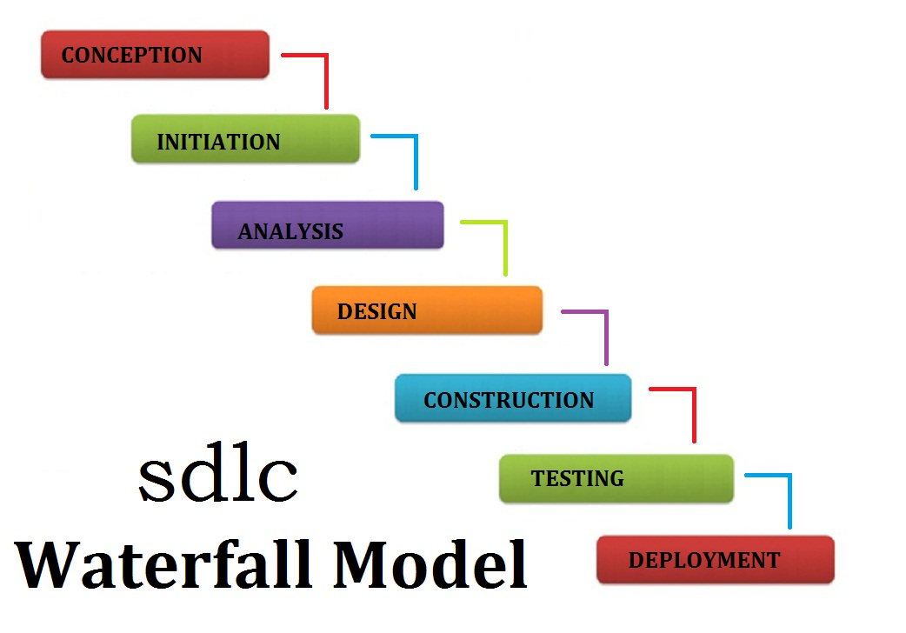
Architecture

Slide 13
Implementation
PHP
CSS
Bootstarp

Slide 14
Limitations
Could not view when user are offline.
Not live now to verify real photographer.
User comment or like option.

Slide 15
Conclusions
If you’re serious about photography, then it’s vital you have an online portfolio for your very best work. Having your own contact profile is the best way of showing off your photographs, standing out from the crowd, and get hire by new client. And roaming deeply into photo gallery.

Slide 16
References
https://www.w3schools.com/
https://tutsplus.com/
https://www.youtube.com/
https://www.overleaf.com

Slide 17
Thank you

