Slide 1
SOCIAL COMPLAINER WEB FORM
A Website for all your Complains against System, Society, People…

Slide 2
Developed By
Md. Abdur Rahman Md. Touhidul Islam
ID:14153103048 ID:14153103082
Oyshorjo Nur Oyshi Suborna Nondi
ID:14153103090 ID:14153103055
Supervised By
Md. Mijanur Rahman
Asst. Professor
Dept. of CSE, BUBT

Slide 3
Introduction
Social Complainer Web Form(SCWF) is complaining web form site for any social issues or occurrence.
It is Web form site where mass people can complain their complains without providing personal information.
A security officer manages all the complains and takes necessary action.

Slide 4
Concept used
We used html, php, javascript languages for the structures of website.
Css is used for the designing of outlook of website.
Mysqli, Apache server is used for the database to store, check, analyze information .

Slide 5
objectives
To help security system and people in our country.
To provide an internet medium of receiving complaint from mass people.
To make it easy to complain without using forms and giving identity.
To provide immediate action.
To gather information of complaints and means of settlement.
To build a complaint management system faster and more effective.

Slide 6

CRIME and PROBLEMS

Slide 7


Slide 8


Slide 9

CRIME InCidence ?

Slide 10
Application
This web form can be very much helpful for mass people.
Anyone can complain from this web form site.
Complains are monitored by security officers who are admins.
Complains can be posted anonymously, no personal information is required here.
Selected Admins can login and take action according to valid complains.

Slide 11
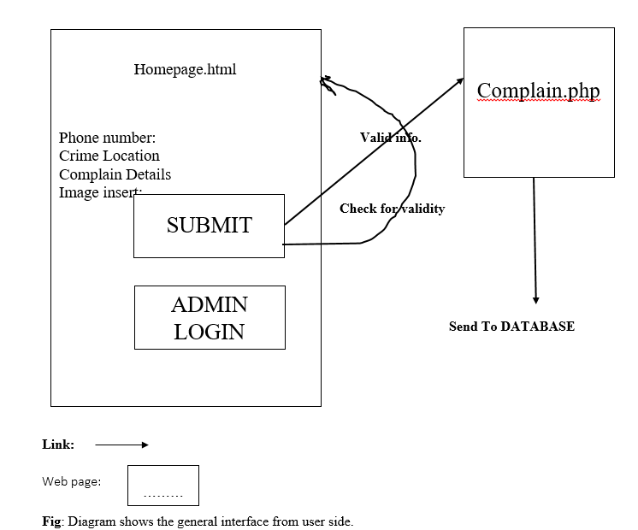
User interface of web form

Slide 12
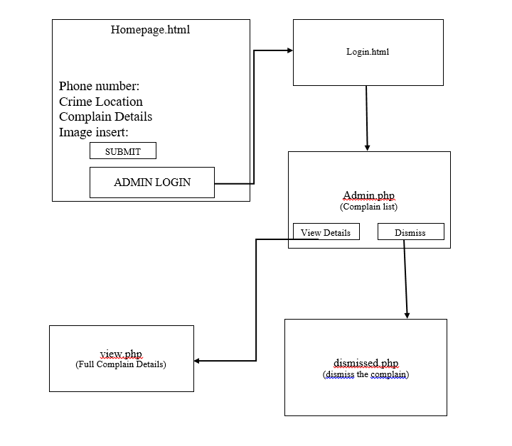
Admin interface of web form

Slide 13
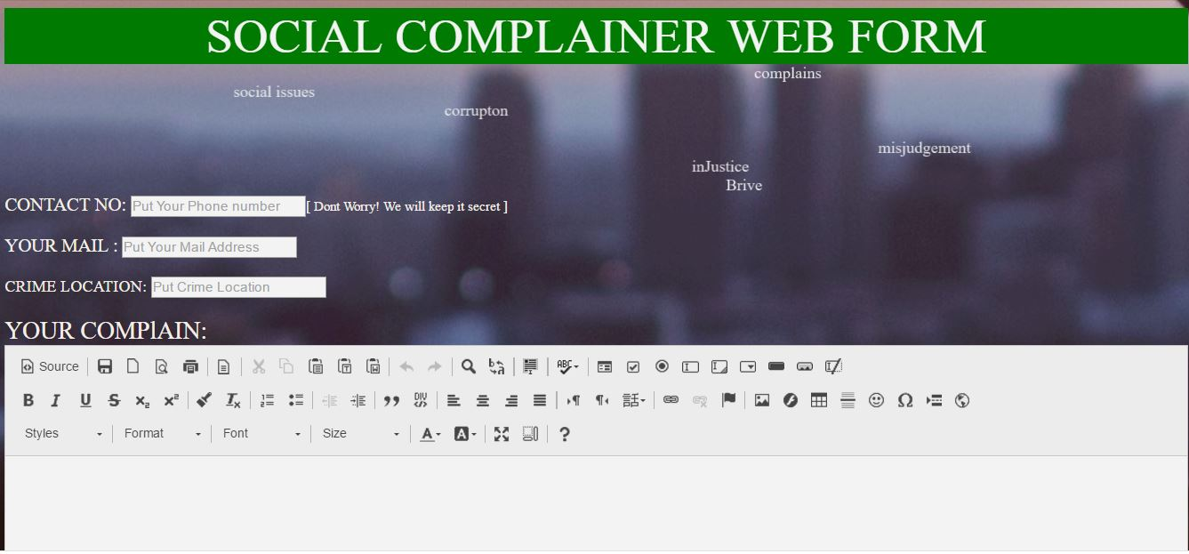
outlook of our project

Slide 14
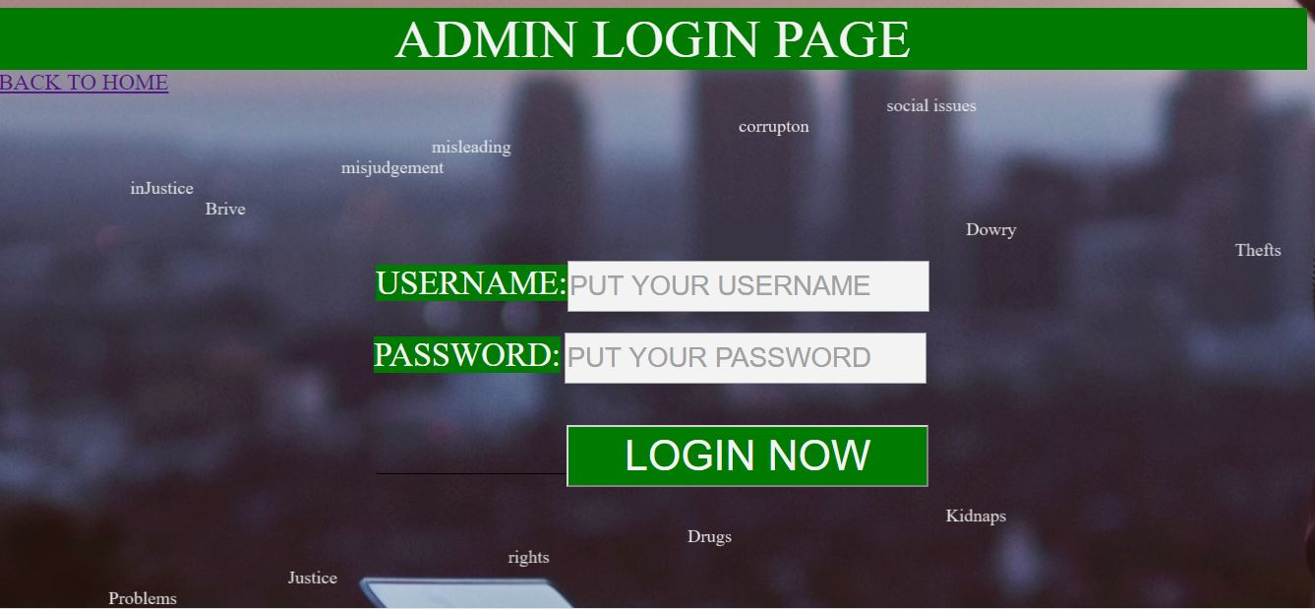

Slide 15
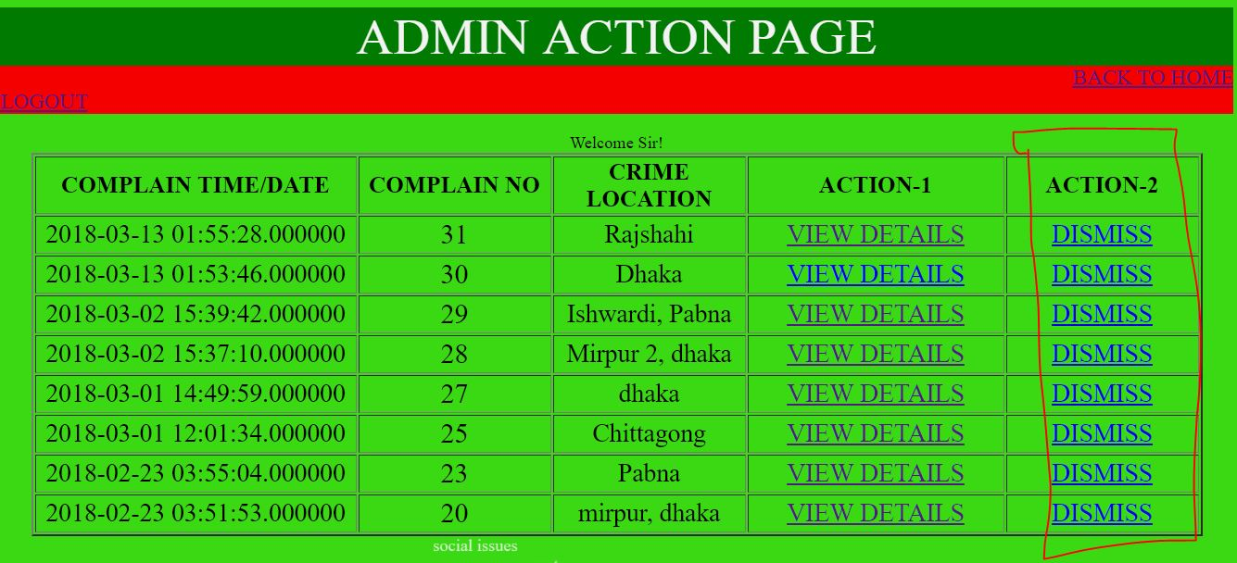
Summary
Discuss the topics covered.
Reiterate your welcome.
Remind the participants to submit paperwork.
Wrap up the orientation session.

Slide 16
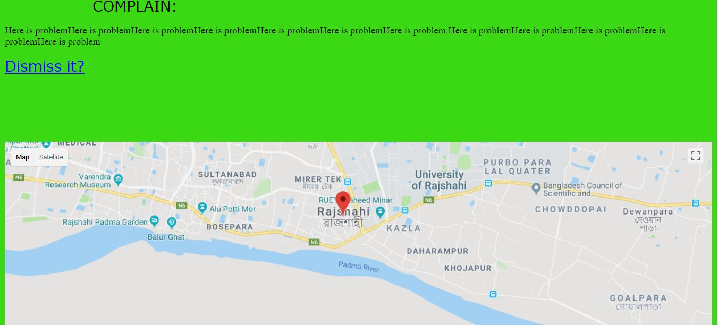

Slide 17
Limitation
Designing of the outlook of website should be more standard and professional.
Admin panel should be more enhanced, there should be moderators to dismiss invalid complains.
A function that automatically detects Invalid mail/phone number should be included here.

Slide 18
Further enhancement
We will enhance Admin panel, add moderators.
We will Add js function that automatically detects Invalid mail/phone number.
We will Design more standard and professional web form for our web form.

Slide 19
Guidelines & references
Learning and implementation of html, css, php, js, and mysqli.
Sincere implementation of all suggestions from our teacher.
Analyzing the concept that can be used to help the society.
‘PHP and MySQL A2 Project Starter Guide’
Complaint_Management_System_Wan_Nor_Munirah_Binti_Wan_Yusof_QA76.9.D3.W56_2009_-_24_Pages
Stackoverflow.com
Google
youtube

Slide 20
conclusion
In this project we made the social complainer web form more user friendly, more helpful, money and time saving, and more secured.
It is helpful, secure, extendable and reusable.
The purpose of this web form is to make the system easier to make a complain against corruption and illegal activity of society , we hope it will satisfy the demand of our users and make better improvement in near future.

Slide 21
conclusion
We believe that, it will remove the monotony/bindings/risk of the mass people to complain in police station.
It will help the admin/security officer to about the crime and can take steps Where he will manage his activities, he can also find his benefit.
Social complainer web form will be helpful to perform paperless work and manage all data. This provides easy, accurate, unambiguous and faster data access

Slide 22
Thanks for watching

