Slide 1
myCNV
steps

Slide 2
get the coverage info
run on command line
samtools view $bam chr7 | extracts the reads for that chromosome
bamCoverage [minCoverage=0] | would be better to have chromCoverage (where is it)
would make it more performant
rollingCoverage [rollingWindow=100] | every half windowSize a mean coverage is written out
filterbed $BED chr7 [writeout exomCoords=1] filters the output for positions covered by the bedfile
samtools view /Users/martinscience/Dropbox/Icke/Work/somVar/testdata/bam/002_A.bam chr7 | bamCoverage | rollingCoverage 50 | filterBed $BED 1 chr7 | head -100

Slide 3
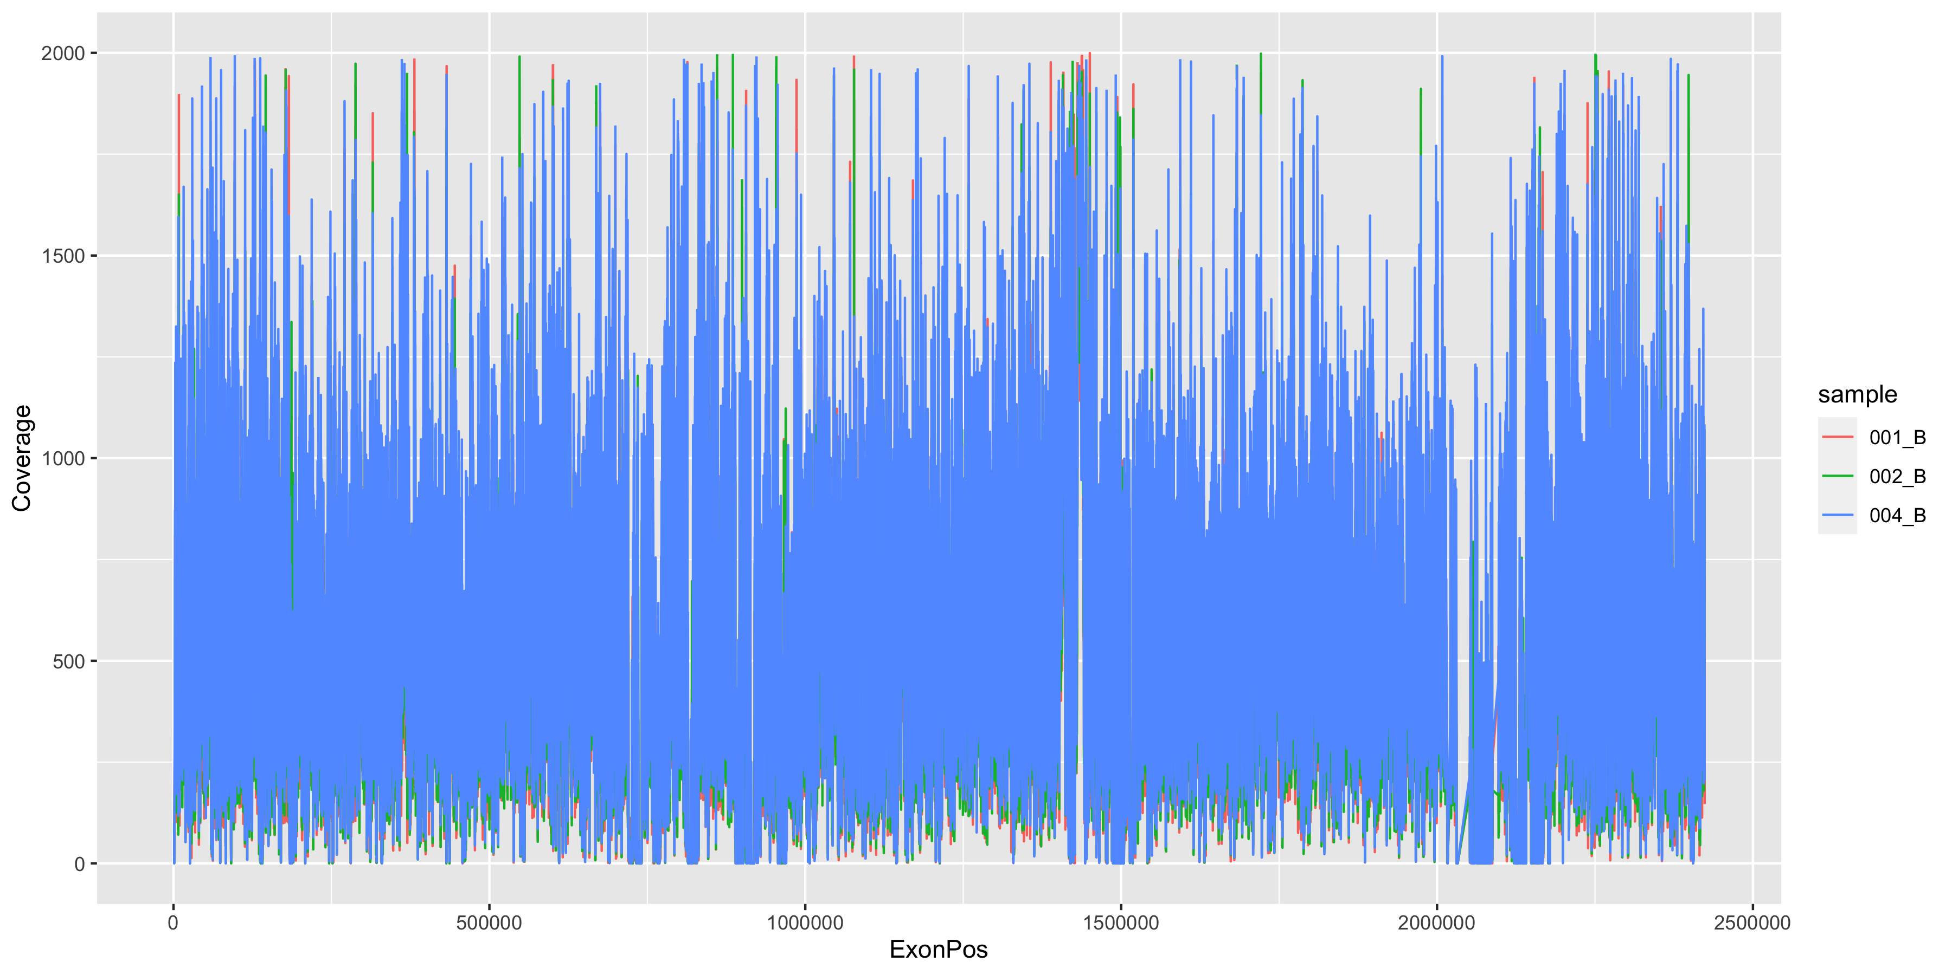
coverage over chr7

Slide 4
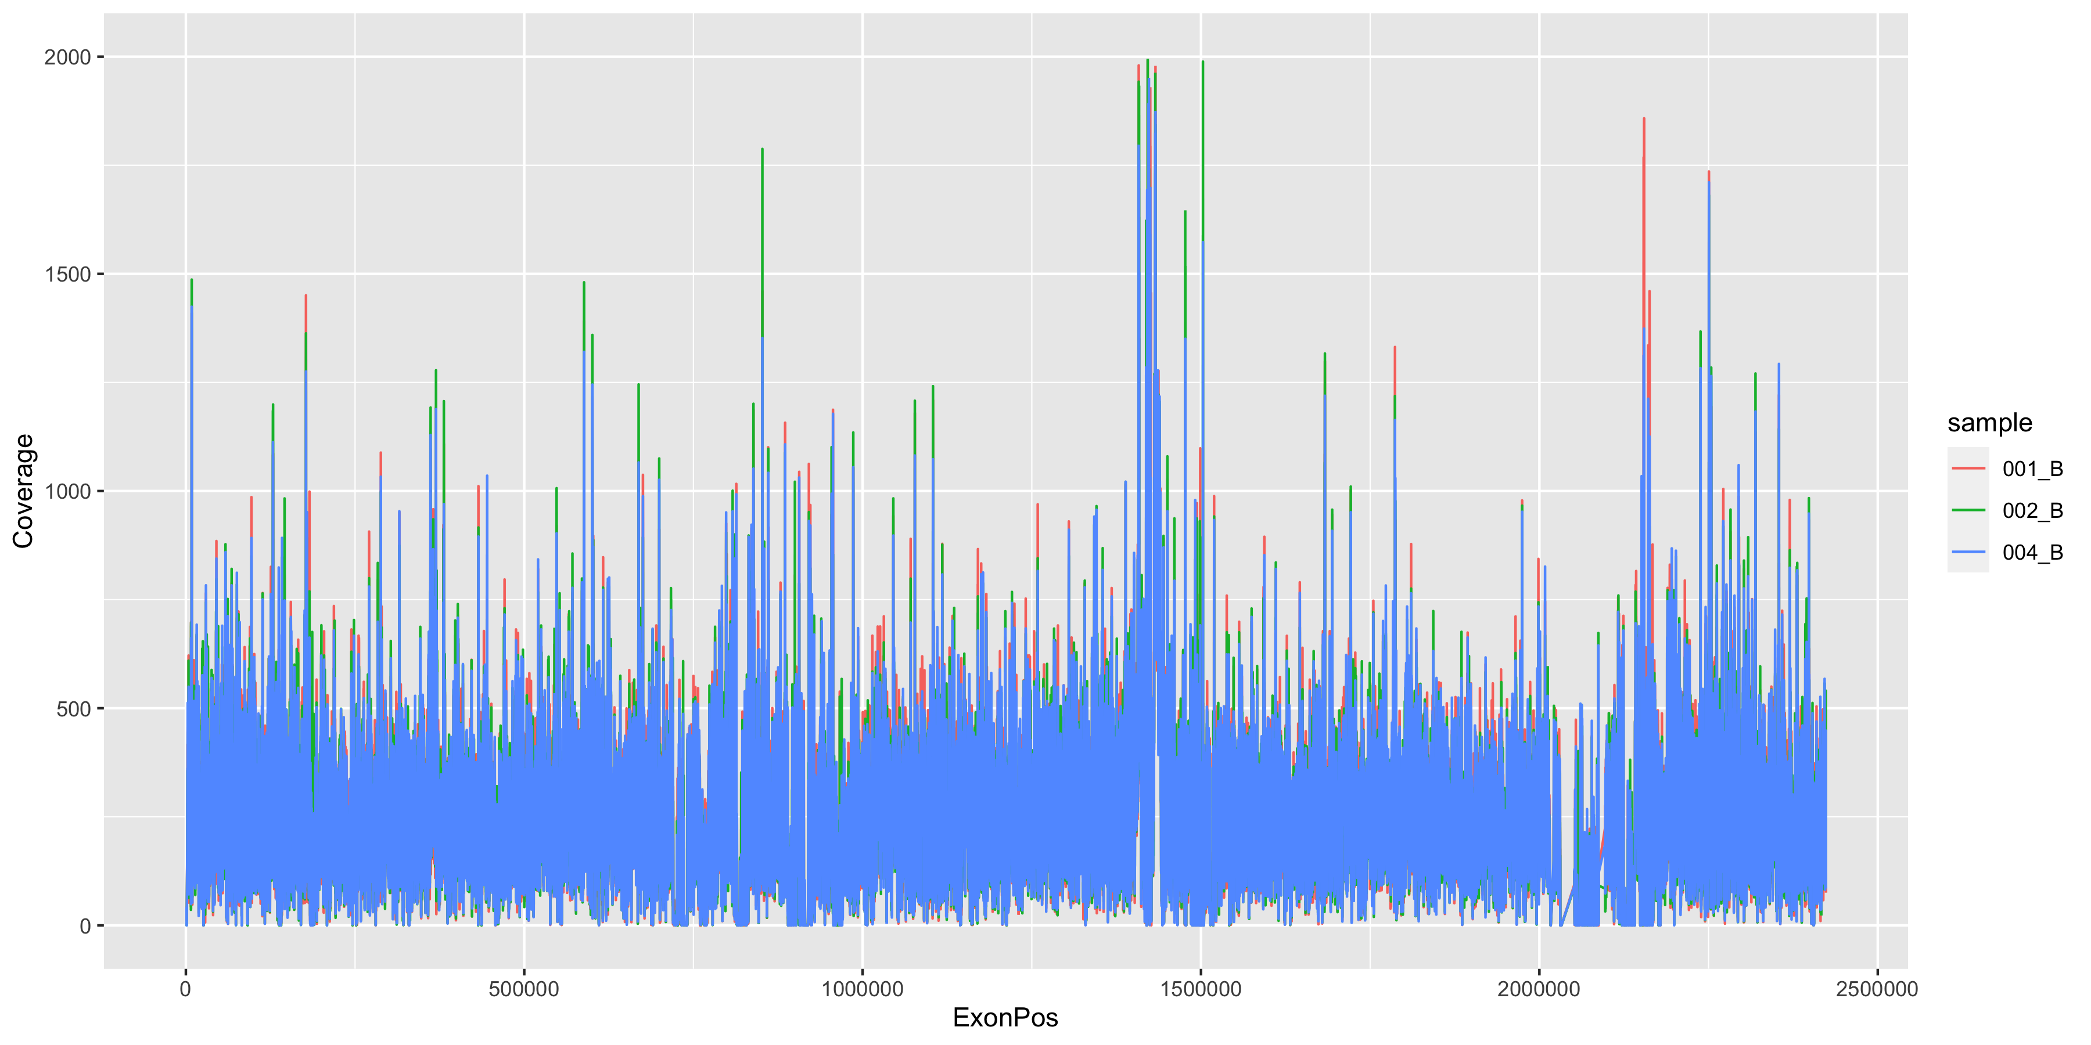
normalized coverage over chr7

Slide 5
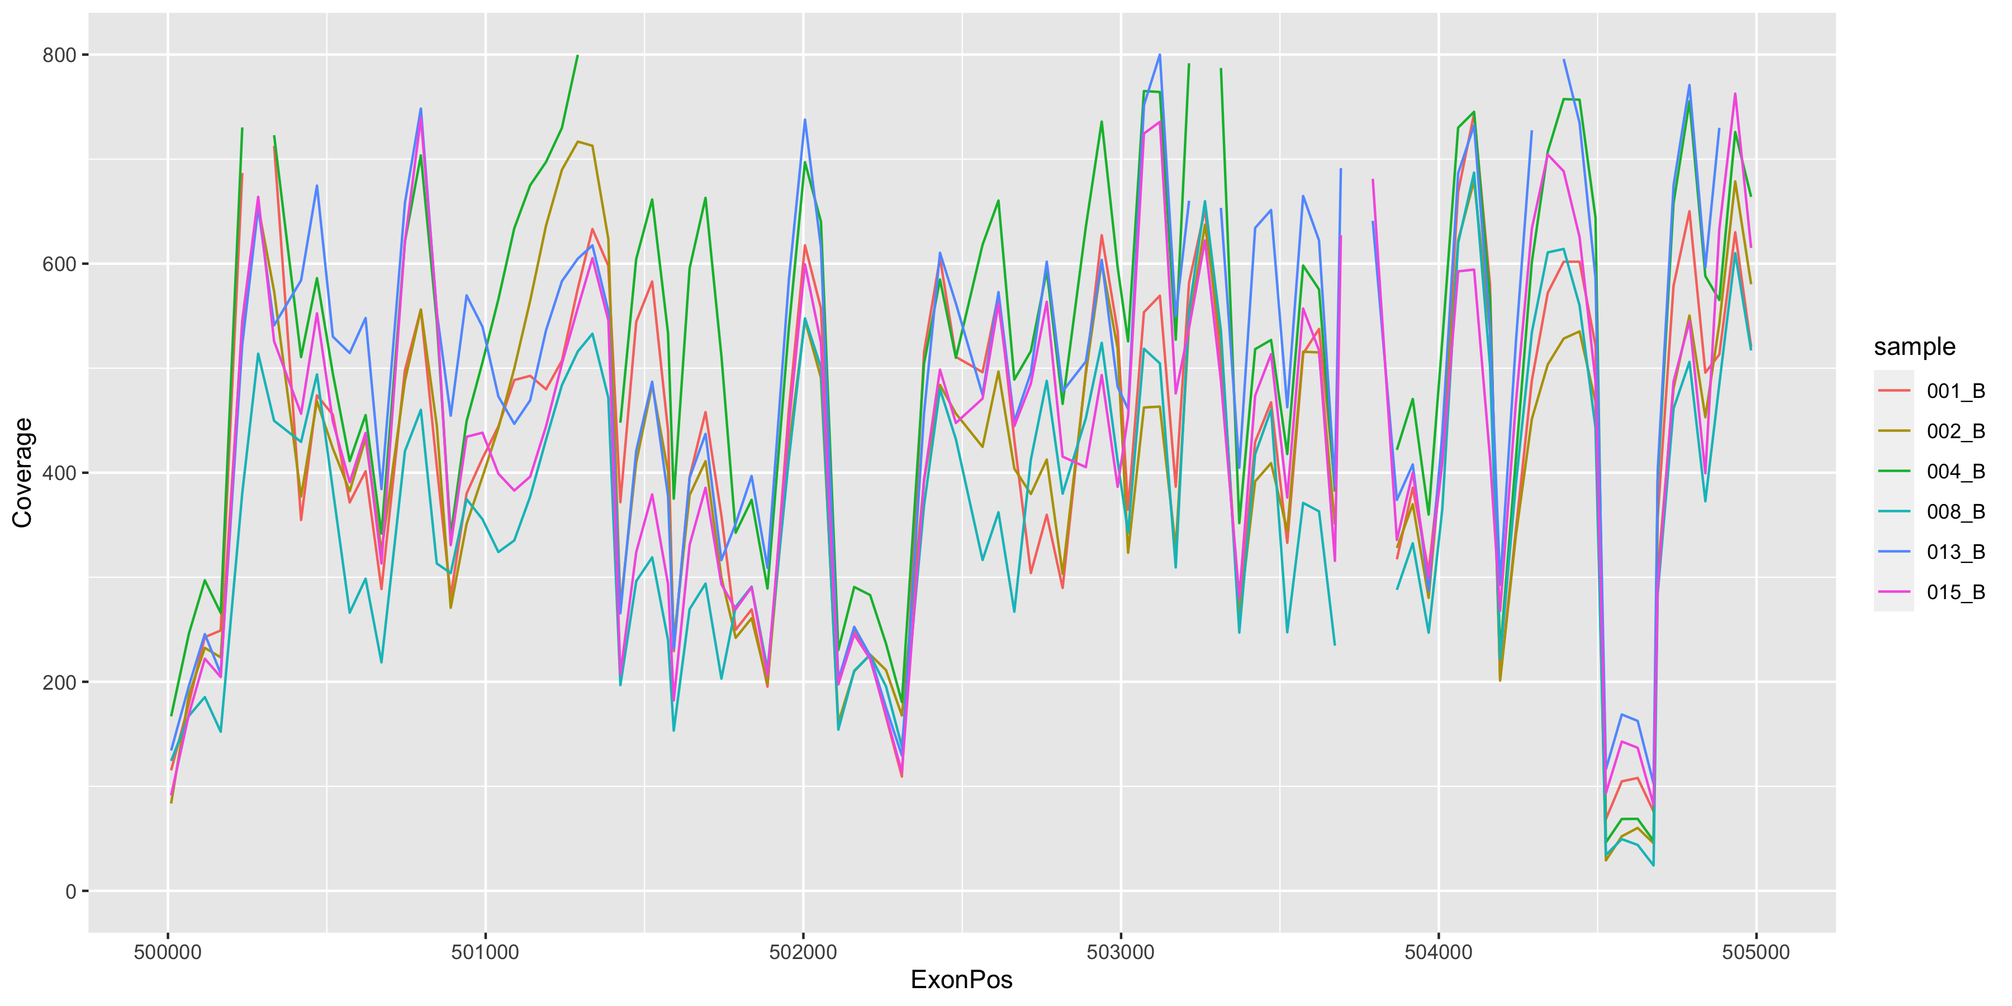
coverage over chr7

Slide 6
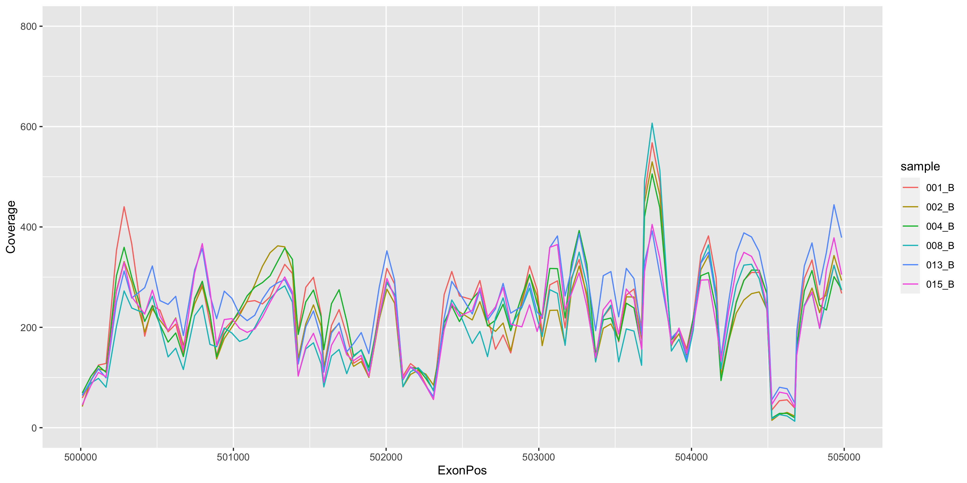
normalized coverage over chr7

Slide 7
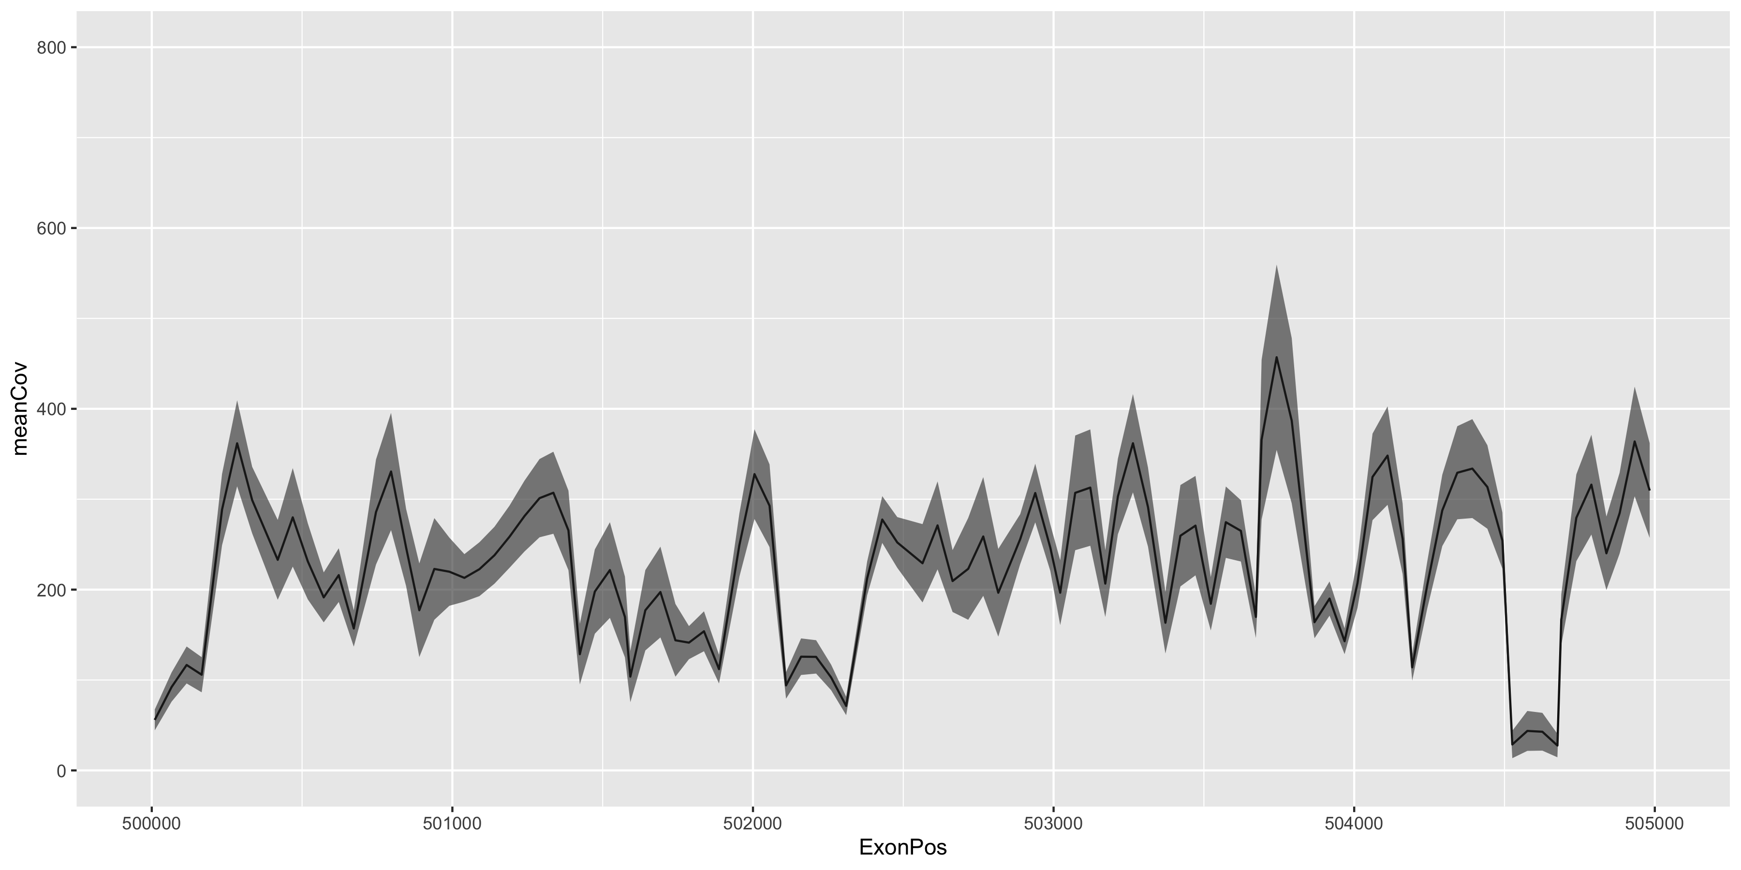
normalized PONcoverage (20 samples)

Slide 11
compare coverage to mean coverage of PON
run on command line
samtools view $bam chr7 | extracts the reads for that chromosome
bamCoverage [minCoverage=0] | would be better to have chromCoverage (where is it)
would make it more performant
rollingCoverage [rollingWindow=100] | every half windowSize a mean coverage is written out
filterbed $BED chr7 [writeout exomCoords=1] filters the output for positions covered by the bedfile
samtools view /Users/martinscience/Dropbox/Icke/Work/somVar/testdata/bam/002_A.bam chr7 | bamCoverage | rollingCoverage 50 | filterBed $BED 1 chr7 | head -100

