Slide 1
LinkedIn

Slide 2


AUTOCONTENT LINKER
ContentFusion AI
Poland
AutoContent Linker is an AI-powered tool for automating high-quality, verifiable marketing materials. It integrates public data sources like news articles and social media with internal resources such as product details and whitepapers. Its core feature is cross-linking information to ensure content credibility and interconnectedness.
Designed for multi-platform distribution, AutoContent Linker optimizes content for blogs, newsletters, and social media. It uses advanced algorithms to merge diverse data sources, enhancing content relevance and engagement. While initially focused on text, the tool can scale to include multimedia in the future.
The web-based platform supports both English and German, enabling marketing teams to independently manage and tailor content to their specific needs.
My name is Marek Grzesiak, and I lead ContentFusion AI as a Software & Machine Learning Engineer. With extensive experience in Python, Java, and advanced machine learning frameworks like TensorFlow and PyTorch, I bring valuable expertise to the project. My skills in developing and optimizing software solutions, combined with a meticulous approach to problem-solving, position me to drive significant innovation in content automation.
As the sole member of ContentFusion AI, I focus on leveraging advanced AI techniques to create a high-quality, verifiable content generation tool that seamlessly integrates public and internal data sources. My strong commitment to technological innovation and operational efficiency is key to delivering a solution that meets complex marketing automation needs.
Rzeszow University of Technology
n/a
https://github.com/Mar3eczek17
n/a

Slide 3
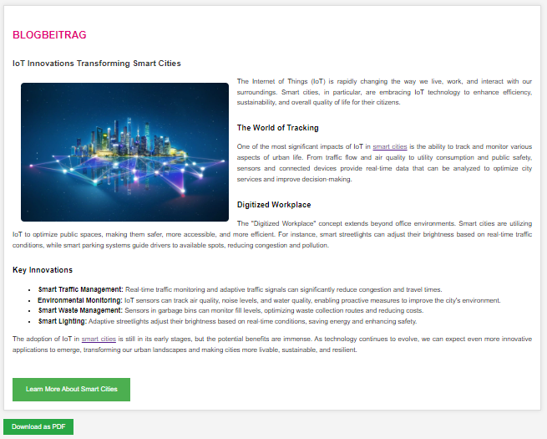
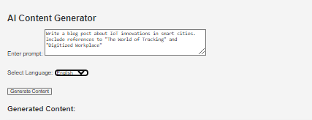
AutoContent Linker is an advanced AI-powered tool designed to streamline the creation of high-quality marketing content. It automates the generation of engaging and credible materials for newsletters, blog posts, and social media updates. Leveraging sophisticated AI models, the tool ensures that all content is relevant, accurate, and authoritative, while also being optimized for readability.
Key features of AutoContent Linker include its AI-driven content generation capabilities, which produce diverse formats with a focus on readability and relevance. The tool's cross-linking technology integrates external public data sources with internal resources, linking related content to enhance connectivity and provide a comprehensive user experience. It also offers multi-platform optimization, adapting content to fit various distribution channels and ensuring it is formatted correctly for each platform. Supporting both English and German, AutoContent Linker caters to international marketing needs and operates as a web-based platform, allowing marketing teams to independently manage, customize, and update content efficiently. Overall, it simplifies the content creation process while maintaining high standards of quality, credibility, and reader engagement.

Slide 4
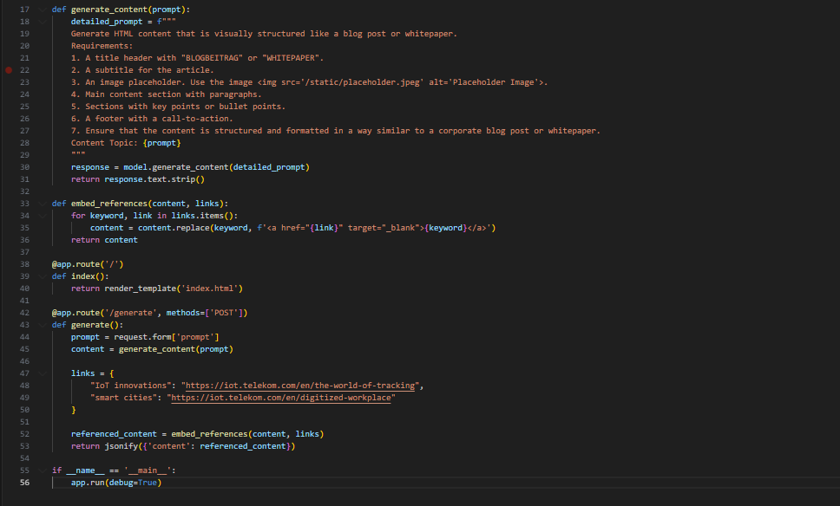
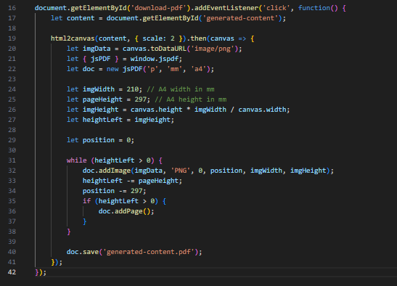
OVERVIEW OF THE AI CONTENT GENERATOR SOLUTION
User Interface:
Form: Users input their prompts here.
Content Display: Generated content appears below the form.
Download Option: Users can download the generated content as a PDF.
Visual Design:
Styling: The design ensures a clean and professional appearance with headers, well-formatted content sections, and styled buttons.
Functionality:
Content Generation: Based on the user’s prompt, our AI generates structured content similar to a blog post or whitepaper.
Dynamic Links: We include references to relevant materials. For example, the content can automatically link to resources like "IoT innovations" and "smart cities" using your specified URLs.
Technology:
HTML and CSS: Used for the layout and styling of the content.
JavaScript: Handles user interactions and PDF creation.
Backend (Flask): Manages content generation and integrates references.
This setup not only generates high-quality content but also incorporates links to your materials, ensuring that the generated content is both informative and relevant.

Slide 5
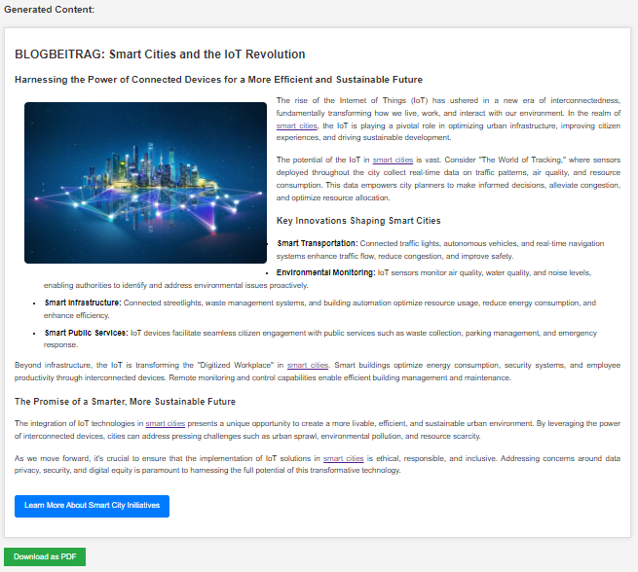
BLOGBEITRAG: Smart Cities and the IoT Revolution
Example of Usage:
AI Content Generator
Enter Prompt: Describe the blog topic. The AI will generate detailed content.
Select Language: Choose English or German.
Button: Generate Content
Explanation:
Prompt Input: Specify the blog topic. The AI uses this to create content.
Language Selection: Pick English or German.
Generate Content Button: Click to generate the blog post with selected references.
Additional Notes:
Includes links to references such as "The World of Tracking" and "Digitized Workplace.„
Option to download the content as a PDF.

Slide 6
Phase 1: MVP focuses on developing a prototype to generate high-quality textual content and integrate public data sources, including AI models, cross-linking technology, and a web interface in English and German.
Phase 2: Enhanced Features adds internal data integration and multimedia support, including images and videos, with beta testing to refine these capabilities.
Phase 3: Optimization and Launch optimizes the tool for platforms, ensures scalability, and involves marketing campaigns and ongoing support.
Business Model: Offers subscription plans (Basic, Standard, Premium), pay-per-use options, and enterprise licensing for organizations.
Cost Analysis: Covers development, operational expenses, maintenance, and marketing. Revenue comes from subscriptions, pay-per-use fees, and enterprise licenses.
I am motivated to participate in the challenge to demonstrate AutoContent Linker’s potential as a key technology for my business and refine the solution based on real-world feedback. I aim to validate the tool's effectiveness, establish market credibility, and drive advancements in content automation.
I am interested in forming strategic partnerships with industry leaders, developing enterprise solutions for large organizations, integrating with other technology tools, and engaging in R&D collaborations to advance AI capabilities.
My goals include proving the tool’s effectiveness, achieving user adoption, establishing a strong market presence, and gaining recognition for innovation in AI-driven content generation, all supporting the launch and growth of my business.
I am well-prepared to develop AI solutions with DT IoT due to my background in software engineering and machine learning. My passion for programming grew through Python and Data Science training, as well as hands-on work with Python and Java. I am skilled in Django, Spring, PyTorch, and TensorFlow.
My experience includes leading projects on accessibility and process optimization, notably improving computational speed for quantum computers. At Ekipa/SENLA, I honed my skills in machine learning technologies like NumPy and Scikit-learn and programming.
These experiences demonstrate my ability to solve problems and manage projects effectively, making me well-suited to collaborate with DT IoT.

