Slide 1
Air Quality Monitoring Dashboard
Real-time Insights into Environmental Conditions
Student ID: 202255632 Name: Boldbaatar Amartuvshin

Slide 2
Introduction
The Air Quality Monitoring Dashboard provides real-time insights into air quality levels, helping individuals, communities, and organizations monitor environmental conditions. It tracks various pollutants such as PM2.5, PM10, NOx, CO, and others.

Slide 3
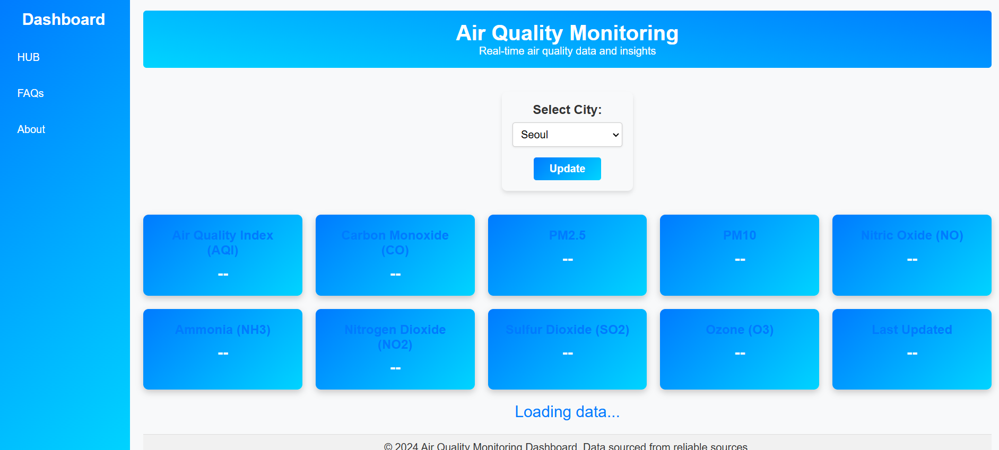
main.html

Slide 4
Features
- Real-time data updates on air quality metrics
- Interactive charts for easy data visualization
- Responsive design for mobile and desktop devices
- Accessibility features for a better user experience

Slide 5
main.html on my notebook ☺

Slide 6
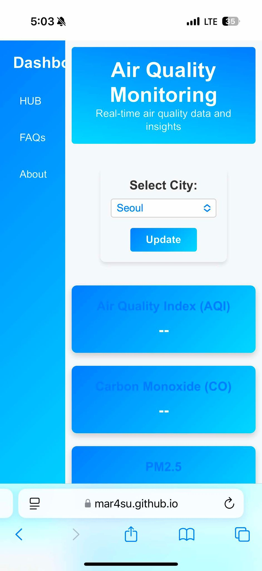
Main.html on phone

Slide 7
Technical Overview
- Technologies used:
* HTML, CSS, JavaScript
* Chart.js for visualizations
* OpenWeatherMap API for data
- Project structure includes:
* Main dashboard (main.html)
* About and FAQ pages
* JavaScript functionality in app.js

Slide 8
Implementation
- Fetches live air quality data using OpenWeatherMap API
- Displays data through cards and interactive charts
- Allows users to filter data by location
- Real-time updates and responsive interface

Slide 9
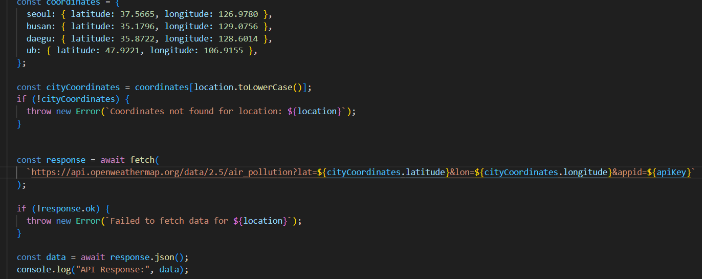
App.js

Slide 10
User Interface
- Sidebar navigation for easy access to pages
- Filters for selecting city and updating data
- Cards displaying real-time air quality metrics
- Charts for detailed pollutant analysis

Slide 11
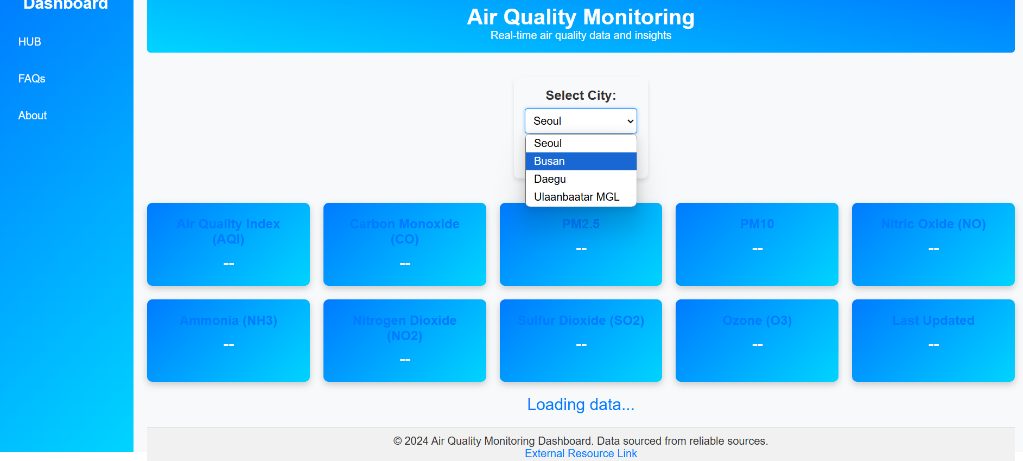
Main.html accessing app.js

Slide 12
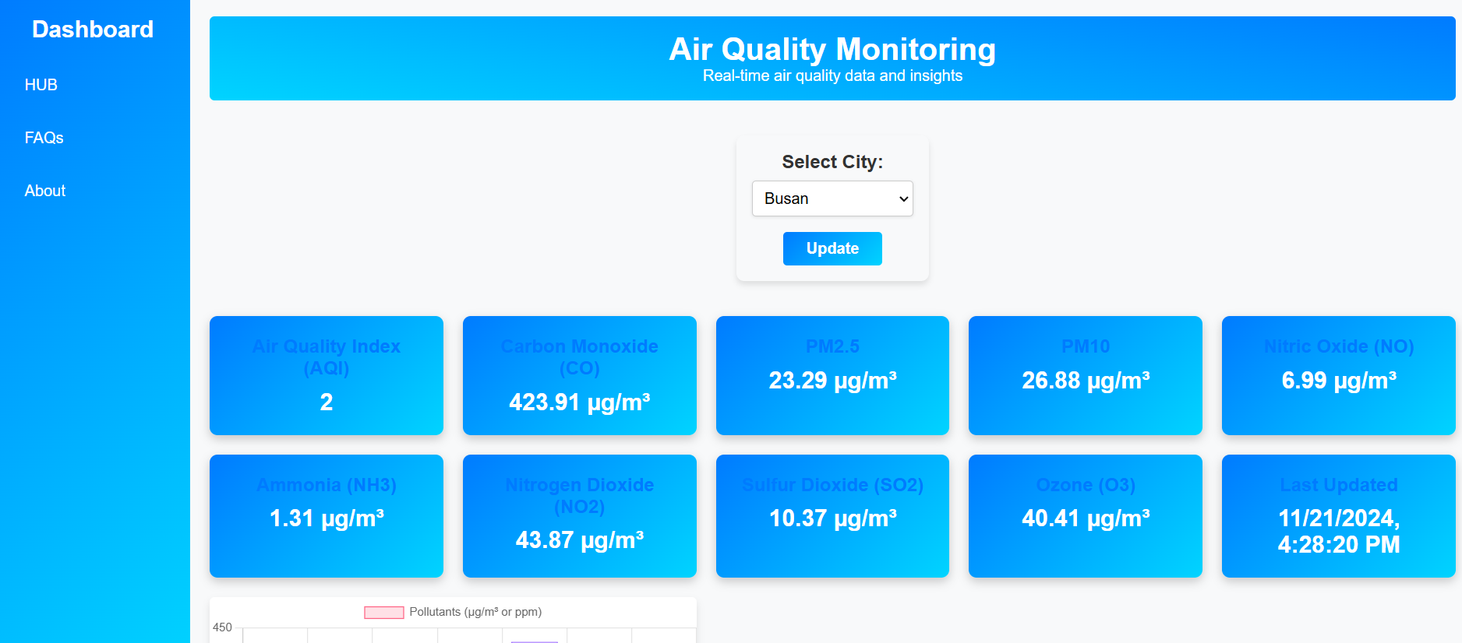
Main.html displaying cards

Slide 13
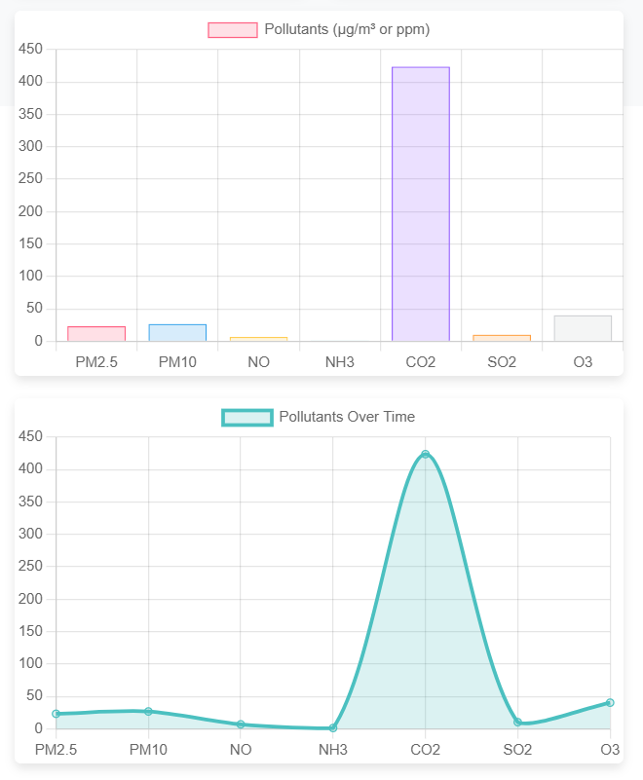

Slide 14
Challenges and Solutions
- Integrating OpenWeatherMap API and ensuring data accuracy
- Updating charts dynamically without reinitializing
- Ensuring responsiveness across devices
- Solutions included debugging scripts and optimizing CSS

Slide 15
Conclusion
The Air Quality Monitoring Dashboard successfully provides users with real-time air quality insights. Future improvements could include:
- Expanding data sources
- Adding predictive analytics
- Enhancing visualizations
- World Map visualization using Google API

