Slide 1
Paramaribo-Wanica Online Viewer Tool
Sofie Ruysschaert
February 4, 2016

Slide 2
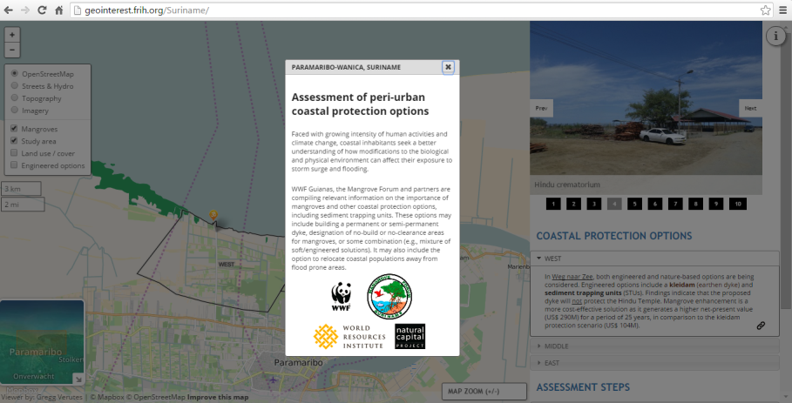
Welcome Page

Slide 3
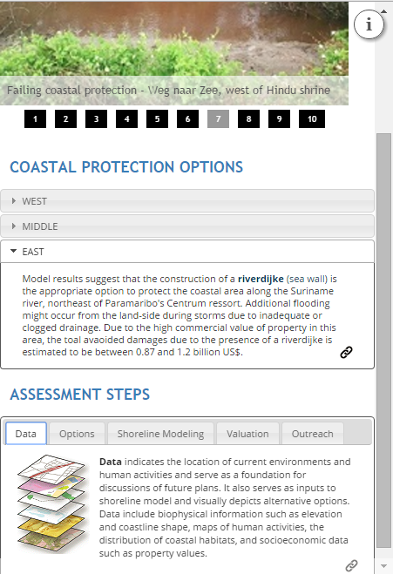
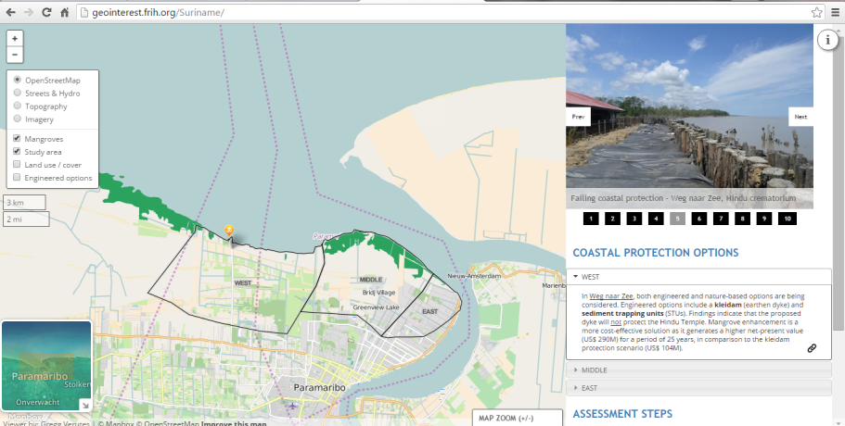
Side Panel
Image Gallery
Coastal Protection Options
Assessment Steps

Slide 4
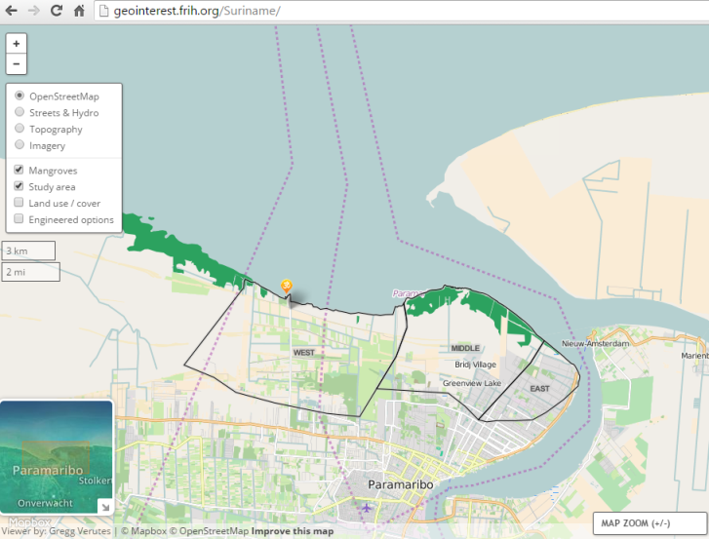
Map Layers Pallete
Base maps and overlays

Slide 5
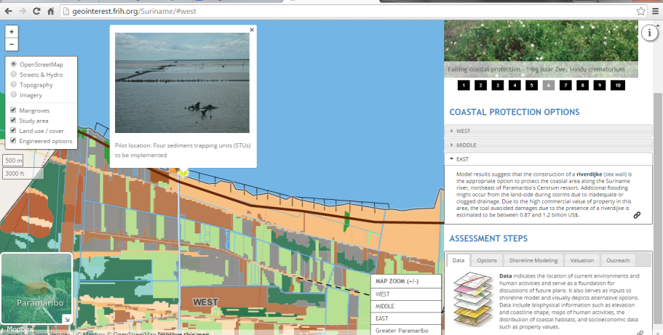
Map Window
Map layers
Reference information
Shoreline Modeling outputs, including biophysical and economic values
Metadata and annotations

