Slide 1

Image Quilting for Texture Synthesis Christof Leutenegger Lukas Nüesch Marco Heiniger Piero Neri

Slide 2
Quick recap: Base Implementation
Phase 1: Choose block
with best SSD overlap
3 cases for calculation of overlap in phase 1:
output image:
input image:
…
…
Phase 2: Perform optimal cut
on overlap region
output image:
Case 1:
Case 2:
Case 3:
Error: SSD
Error: SSD
Error: SSD + SSD - SSD

Slide 3
Base Impl.: Runtime and performance
Put performance and runtime plots here...
Explain flops count…
Maybe show some VTune measurements

Slide 4
Optimization 1: Simple optimization
Case 3:
Removed unnecessary function calls (e.g., pow() )
The green square is computed only once
Iterate once over the error matrix for each block
Generated ILP when calculating SSD for an overlap
Before:
After:
pixel_t s1_data = s1.data[i * s1.jumpsize + j];
pixel_t s2_data = s2.data[i * s2.jumpsize + j];
int diff = s1_data - s2_data;
error += diff * diff;
diff11 = in[(i + k) * inj + (j + m) * 3 + 0] - out[(row_out + k) * outj + (col_out + m) * 3 + 0]; diff12 = in[(i + k) * inj + (j + m) * 3 + 1] - out[(row_out + k) * outj + (col_out + m) * 3 + 1]; diff13 = in[(i + k) * inj + (j + m) * 3 + 2] - out[(row_out + k) * outj + (col_out + m) * 3 + 2]; error1 = error1 + diff11 * diff11 + diff12 * diff12 + diff13 * diff13;

Slide 5
Optimization 1: Runtime and performance
Put performance and runtime plots here...
Explain flops count…
Maybe show some VTune measurements

Slide 6




Optimization 2: Integral Images 1/3
Integral images are a technique to calculate the sum of pixel intensities within a rectangular region of an image
Creation: Each pixel in an integral image contains the sum of all pixel intensities above and to the left of it, including itself. This process starts in the top-left corner and is repeated recursively.
Example:
integral image:
input image:
0 0 0 0 0 0
1 2 2 4 1
0 1 3 5 9 10
3 4 1 5 2
0 4 10 13 22 25
2 3 3 2 4
0 6 15 21 32 39
4 1 5 4 6
0 10 20 31 46 59
6 3 2 1 3
0 16 29 42 58 74
To calculate this area, do:
46 – 20 – 22 + 10

Slide 7

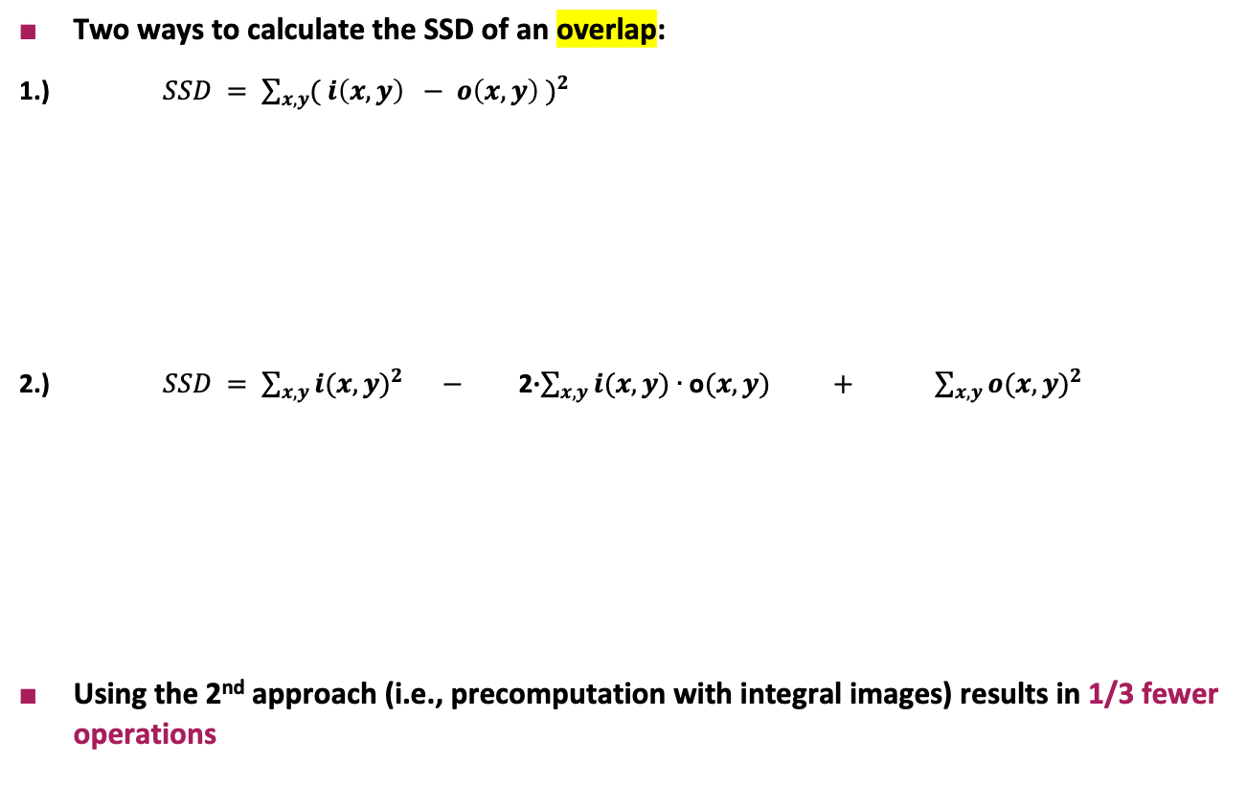
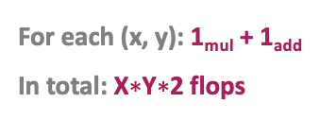
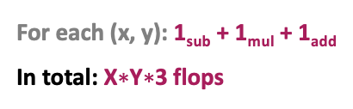
Optimization 2: Integral Images 2/3
output image:
X values
Two ways to calculate the SSD of an overlap:
1.) $SSD = \sum_{x,y}{{( i\left(x,y\right) − o\left(x,y\right) )}^{2}}$
2.) $SSD = \sum_{x,y}{{i(x,y)}^{2}}$ $−$ 2∙$\sum_{x,y}{i(x,y)∙\text{o}(x,y)}$ $+$ $\sum_{x,y}{{o(x,y)}^{2}}$
Using the 2nd approach (i.e., precomputation with integral images) results in 1/3 fewer operations
Y values
For each (x, y): 1_{sub} + 1_{mul} + 1_{add}
In total: X$∗$Y$∗$3 flops
Integral: 4_{adds}
For each (x, y): 1_{mul} + 1_{add}
In total: X$∗$Y$∗$2 flops
negligible, as this integral is
calculated once for all overlaps
in the input image
In total: ≈ X$∗$Y$∗$2 flops

Slide 8
Optimization 2: Integral Images 3/3
SSD calculation with integral images can only be applied if the overlap of the block in the output image can be found in the input image
We distinguish between 4 cases:
Integral SSD
Normal SSD
Case 1:
Case 2:
Case 3:
Case 4:

Slide 9
Optimization 2: Runtime and performance
Put performance and runtime plots here...
Explain flops count…
Maybe show some VTune measurements

Slide 10
Optimization 3: Vectorization
output image:
errors matrix:
input image:
16 values
16 overlaps
…
compute
compute
16 overlaps
Vector with
8 ints
. . .

