Slide 1
Elastisearch

Slide 2

Um pouco sobre mim
Físico Biomolecular (USP)
Mestre em física aplicada
Desenvolvedor de Software
Engenheiro de dados
Pythonista
Jogador de MTG
dados

Slide 3
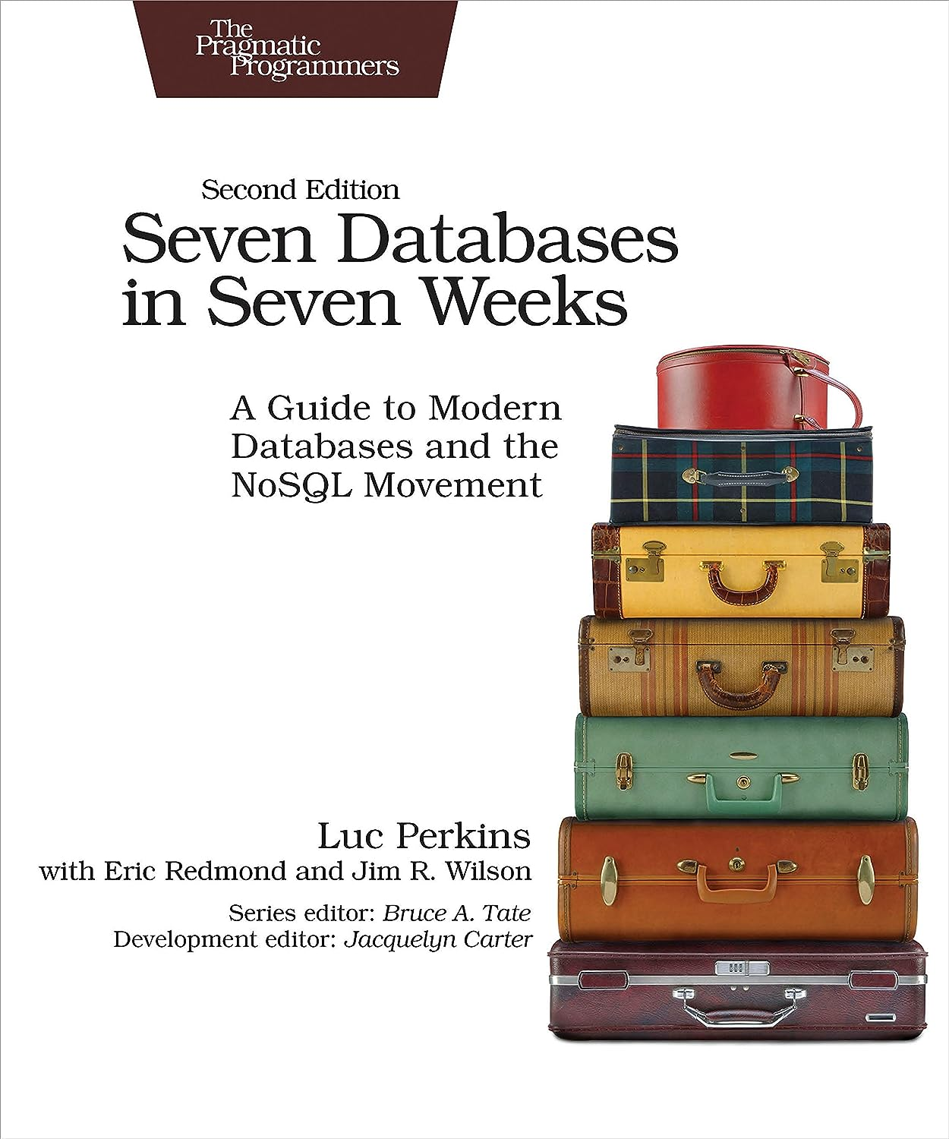

Slide 4
Motivação
. Transmitir conhecimento
Mostrar bancos diferentes do Postgres/MySQL
Incentivar a procurar soluções mais apropriadas para o problema
Converter pessoas para a comunidade do Elastisearch

Slide 5

Elastisearch
Elasticsearch is a distributed search and analytics engine, scalable data store, and vector database built on Apache Lucene. It’s optimized for speed and relevance on production-scale workloads. Use Elasticsearch to search, index, store, and analyze data of all shapes and sizes in near real time.
https://www.elastic.co/

Slide 6

Neo4j
Neo4j is a native graph database, which means that it implements a true graph model all the way down to the storage level. Instead of using a "graph abstraction" on top of another technology, the data is stored in Neo4j in the same way you may whiteboard your ideas.
https://neo4j.com/

