Slide 1

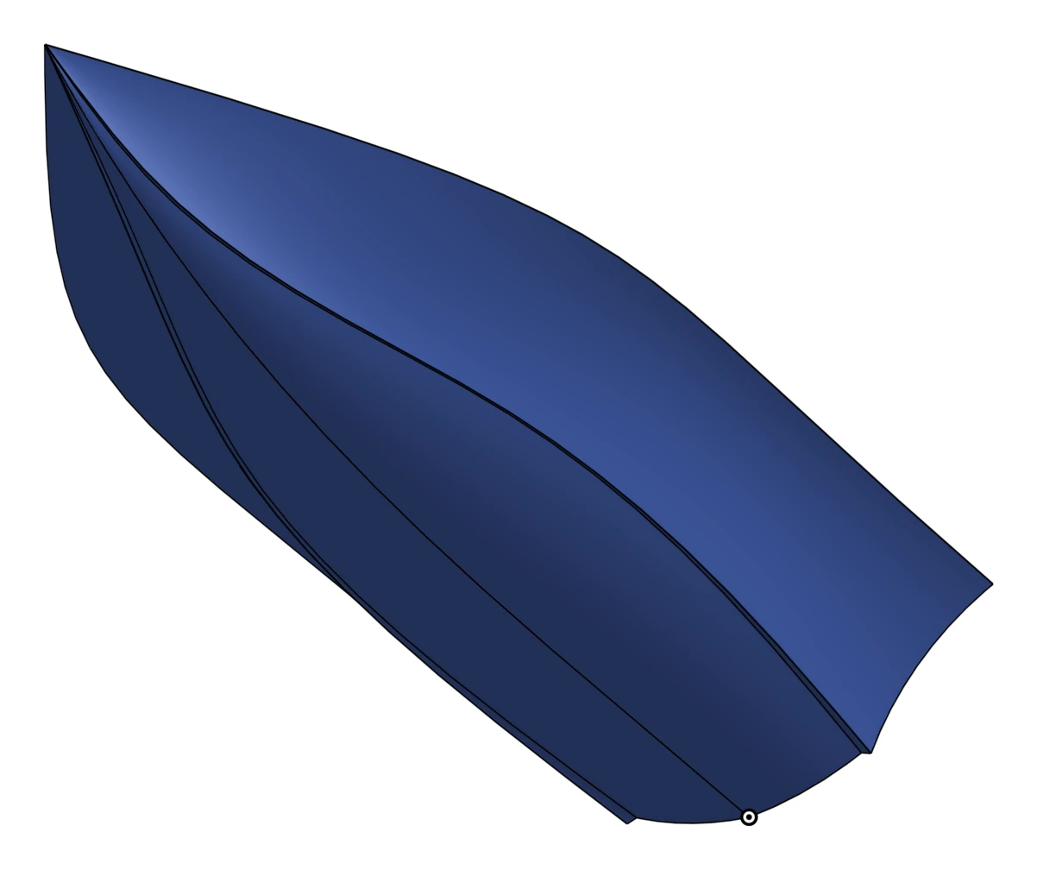
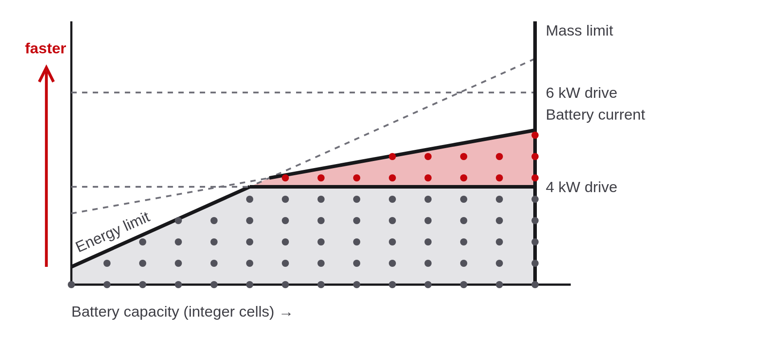
Haav
HIGHLY AMPHIBIOUS / AUTONOMOUS VEHICLE
A student team building an autonomous boat from the ground up.
HOW WE MODEL IT
First-principles mixed-integer linear programming
We build the model from physics up. Each constraint cuts the space of possible boats, and the optimizer finds the fastest one left. Hull resistance comes from Savitsky's planing-hull model. As we build and test, we keep updating the model and adding constraints: a hybrid of simulation and empirical data.
Illustrative: lines are constraints, dots are integer choices, red is what the 6 kW drive adds.
ENGINEERS FROM ACROSS UW–MADISON
Each segment of the boat is covered, and members have worked at Tesla, Northrop Grumman, Xcel Energy and Milwaukee Tool.
Industrial
Mechanical
Electrical
Computer
Optimization, composites and manufacturing
Structures, CAD and fabrication
Power, battery and high voltage
Embedded, firmware and software
OUR APPROACH
Hull
Electric
Autonomous
Plane well and stay light.
Every watt-hour to speed.
Find the way, unaided.
● Hybrid planing composite hull
● Shape tuned by optimization
● Resistance checked in CFD first
● High-voltage battery storage
● Propulsion sized by the model
● Propulsion and cooling co-designed
● GPS, IMU and LIDAR sensing
● Firmware protects the battery
● Software plans the route
TIMELINE
Oct 25
Nov 15
Nov 25
Jan 25
Feb 15
Mar 15
Hull design
Electrical design
Hull built
First drive
First fast drive
Tuning and testing
Sponsor the build
LEARN MORE
CONTACT
We are looking for funds, parts and advisors.
bit.ly/haav
Marley Barrett, Project lead
mhbarrett@wisc.edu

