Slide 1
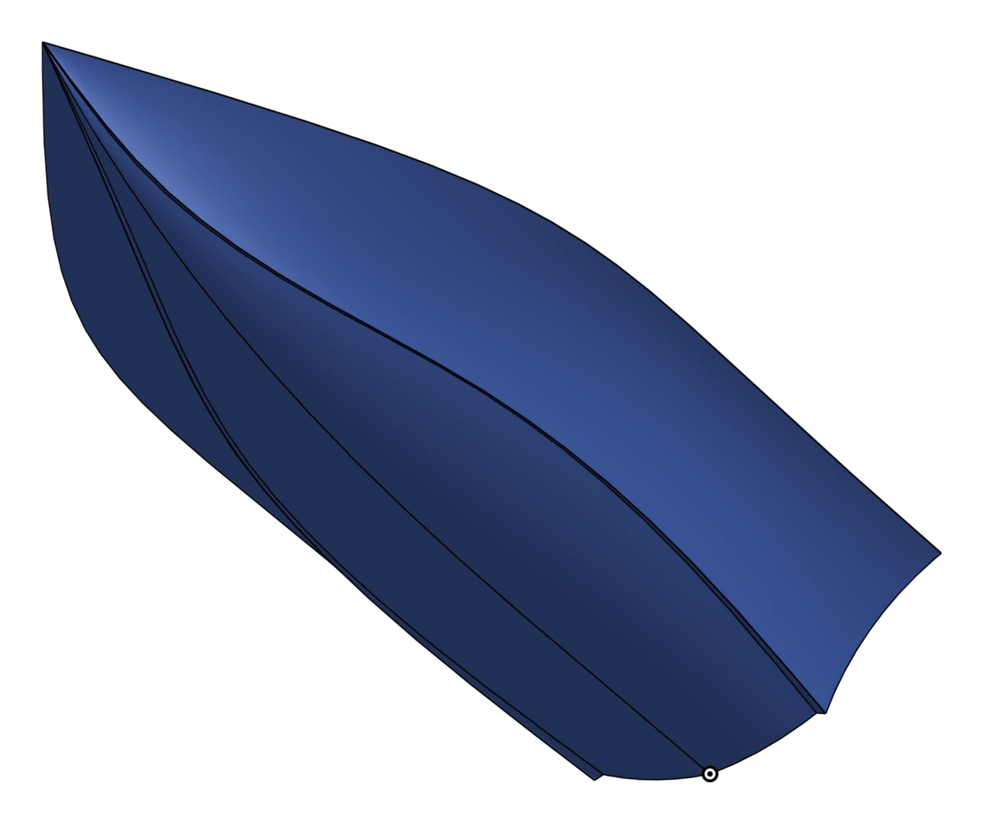
Haav
UW–Madison
College of Engineering
Highly Amphibious / Autonomous Vehicle
A student team building an autonomous boat from the ground up.
First-principles mixed-integer linear programming
We build the model from physics up. Each constraint cuts the space of possible boats, and the optimizer finds the fastest one left. Hull resistance comes from Savitsky's planing-hull model. As we build and test, we keep updating the model and adding constraints: a hybrid of simulation and empirical data.
Engineers from across UW–Madison
Each segment of the boat is covered, and members have worked at Tesla, Northrop Grumman, Xcel Energy and Milwaukee Tool.
Industrial
Mechanical
Electrical
Computer
optimization, composites and manufacturing
structures, CAD and fabrication
power, battery and high voltage
embedded, firmware and software
Our approach
Hull
Electric
Autonomous
Plane well and stay light.
Every watt-hour to speed.
Manage drift and controls.
Hybrid planing composite hull
Shape tuned by optimization
Resistance checked in CFD first
High-voltage battery storage
Propulsion sized by the model
Propulsion and cooling co-designed
GPS, IMU and LIDAR sensing
Firmware protects the battery
Software plans the route
Timeline
Oct 25
Hull design frozen
Jan 8–30
Manufacture and assemble everything
Nov 1
Preliminary design review
Jan 8–30
Build likely spare parts, in parallel
Nov 10
Critical and long-lead parts are ordered
Jan 31
First nautical mile
Nov 20
Mechanical and electrical design frozen
Feb 1–14
Slow drives on the water
Nov 20–Dec 20
Build the hull, composite parts and any custom-milled parts
Feb 15
Start increasing speed
Jan 8
First float and tow test
Until April
Testing / Tuning
Want to help build it?
bit.ly/haav
We are looking for funds, parts, advisors and people to build our BOM as we design.
Marley Barrett, Project lead
mhbarrett@wisc.edu

