Slide 1

Estimation of DC Motor Load
Project Members: Marco Menchetti, Adrija Sen, Andrea Malaguti
Guided By: Prof. Claudia Califano
Course: Digital Systems Control

Slide 2
Goal of the project :
Estimation of DC Motor parameters
Estimation of DC Motor load
Realisation of a PI Controller

Slide 3
HARDWARE AND SOFTWARE USED:
Arduino Uno R3
DC Motor (2x12V)
H-Bridge(LM298-N)
Hall-Effect Encoder
Operational Amplifier(LM324N)
Resistors()
Potentiometer 1KΩ
Power Supply – (12V, 2A max.)
Matlab 2019a
Matlab Arduino support package

Slide 4
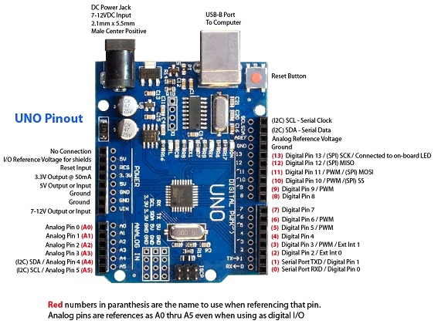
Arduino UNO R3

Slide 5
Arduino Uno is a microcontroller board based on the ATmega328P (datasheet). It has 14 digital input/output pins (of which 6 can be used as PWM outputs), 6 analog inputs, a 16 MHz quartz crystal.
Tech Specifications of Arduino UNO R3:
Operating Voltage | 5V
Input Voltage (recommended) | 7-12V
Input Voltage (limit) | 6-20V
Digital I/O Pins | 14 (of which 6 provide PWM output)
PWM Digital I/O Pins | 6
Analog Input Pins | 6
DC Current per I/O Pin | 20 mA
DC Current for 3.3V Pin | 50 mA
Flash Memory | 32 KB (ATmega328P) of which 0.5 KB used by bootloader
SRAM | 2 KB (ATmega328P)
EEPROM | 1 KB (ATmega328P)
Clock Speed | 16 MHz
LED_BUILTIN | 13

Slide 6
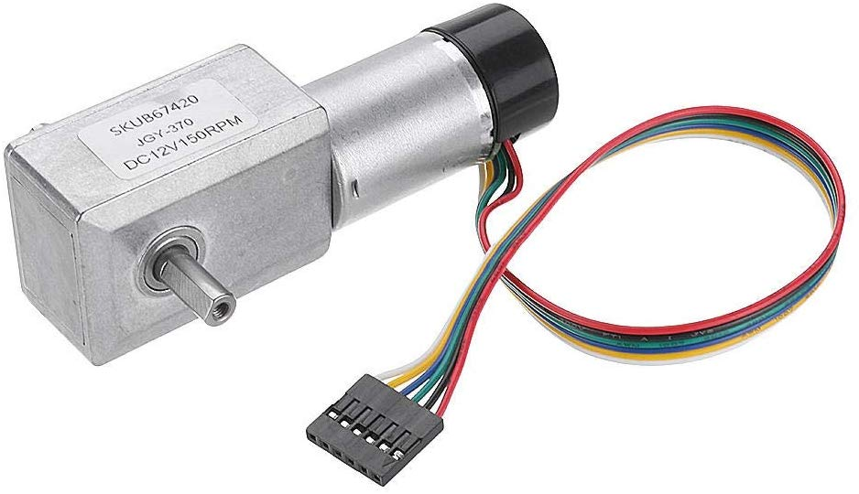
DC Motor + Encoder

Slide 7
TECHNICAL SPECIFICATIONS FOR ENCODER-MOTOR DUO
Operating voltage: 6V to 18V
Rated voltage: 12V
Reduction ratio: 40:1
No-load current: 40 mA
No-load speed: 150 RPM
Rated torque: 1.5 kg cm
Maximum torque: 6.4 kg cm
Stop current: 1.3 A
Hall Incremental Encoder
Encoder resolution: 440 CPR
Weight: 150 g
Red: Motor power +
Black: Encoder GND
Green: Encoder Phase A
Yellow: Encoder Phase B
Blue: Encoder power supply 5V
White: Motor power

Slide 8
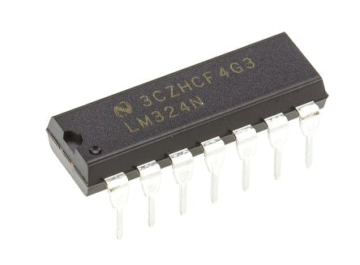
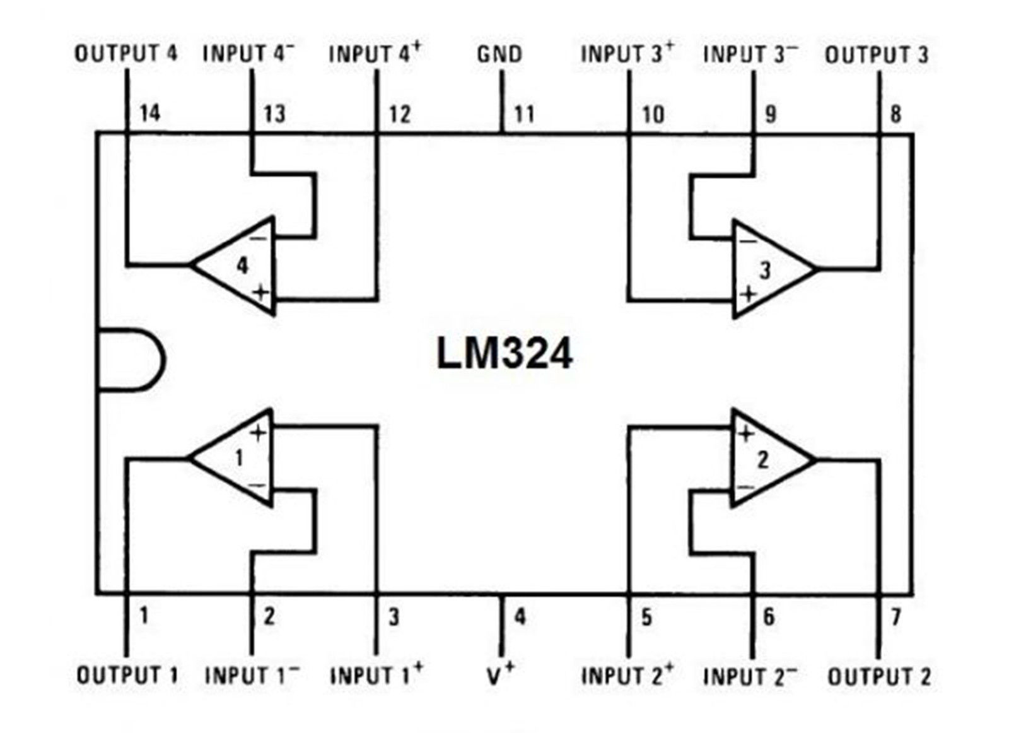
LM324N (OPERATIONAL AMPLIFIER)
Slew Rate | 0.5V/µs
Gain Bandwidth Product | 1,2MHz
Current - Input Bias | 20nA
Voltage - Input Offset | 3mV
Current - Supply | 1.4mA
Current - Output / Channel | 40mA
Voltage - Supply, Single/Dual (±) | 3V ~ 32V, ±1.5V ~ 16V
Operating Temperature | 0°C ~ 70°C
Pin-out for LM324N

Slide 9
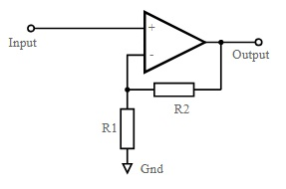
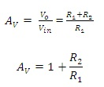
LM324N-NON-INVERTING AMPLIFIER
The gain of the non-inverting op-amp is calculated as:
We took the value of the resistors as :
R2= 1000 Ω
R1= 1000 Ω
Therefore, the gain Av= 2

Slide 10
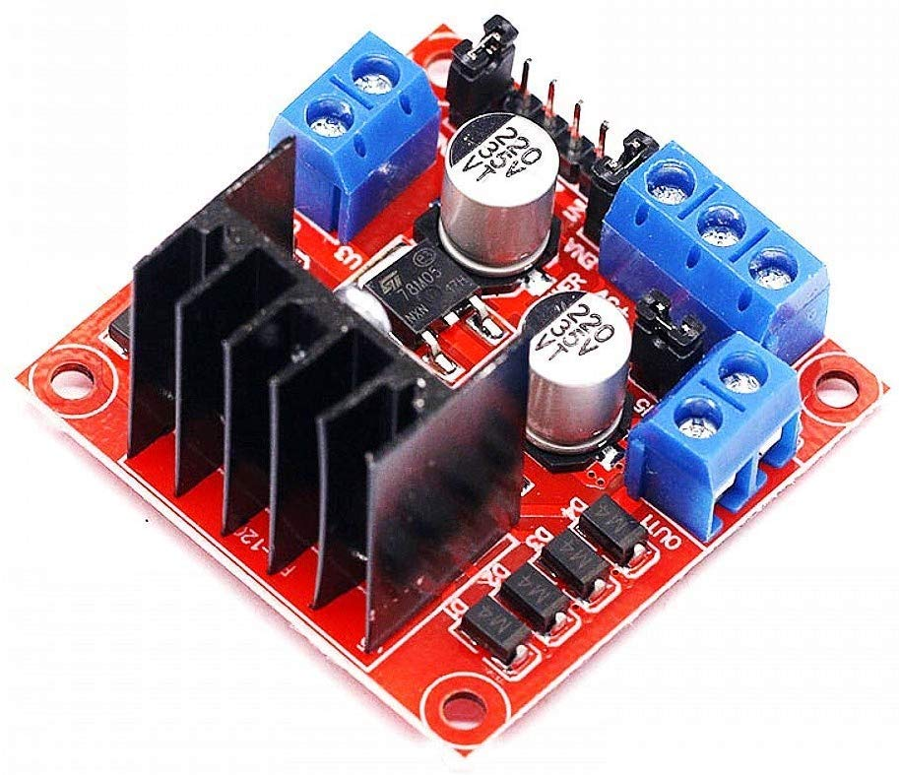
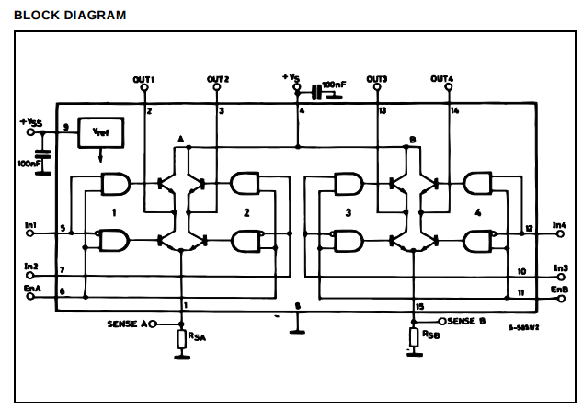
L298N (H-BRIDGE DRIVER)

Slide 11
L298N (TECHNICAL SPECIFICATIONS )
Technical
Bandwidth | 1 MHz
Common Mode Rejection Ratio | 70 dB
Dual Supply Voltage | 9 V
Gain | 100 dB
Gain Bandwidth Product | 1.3 MHz
Input Bias Current | 150 nA
Input Offset Voltage (Vos) | 7 mV
Max Dual Supply Voltage | 15 V
Max Operating Temperature | 70 °C
Max Supply Voltage | 30 V
Min Dual Supply Voltage | 1.5 V
Min Operating Temperature | 0 °C
Min Supply Voltage | 3 V
Nominal Supply Current | 1.2 mA
Number of Amplifiers | 4
Number of Channels | 4
Number of Circuits | 4
Number of Elements | 4
Operating Supply Current | 1.5 mA
Operating Supply Voltage | 15 V
Output Current | 70 mA
Output Current per Channel | 70 mA
Slew Rate | 0.4 V/µs
Voltage Gain | 100 dB

Slide 12
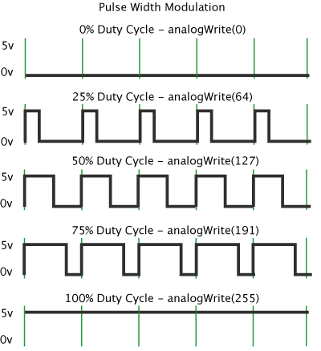
PULSE WIDTH MODULATION
Pulse Width Modulation(PWM) allows us to vary how much time the signal is high in an analog fashion. While the signal can only be high (usually 5V) or low (ground) at any time, we can change the proportion of time the signal is high compared to when it is low over a consistent time interval.

Slide 13
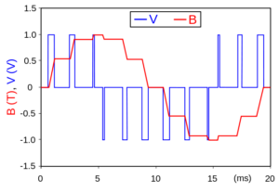
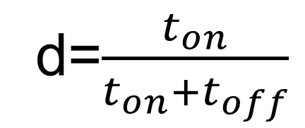
Duty Cycle is given by:
d=$\frac{t_{on}}{t_{on}+t_{off}}$
Sample output of PWM modulated signal

Slide 14
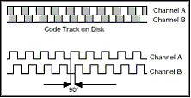
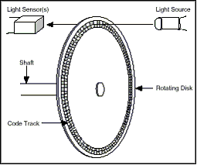
INCREMENTAL ENCODERS
An incremental encoder generates a pulse for each incremental step in it's rotation. The most common type of incremental encoder uses two output channels (A and B) to sense position. Using two code tracks with sectors positioned 90° out of phase, the two output channels of the quadrature encoder indicate both position and direction of rotation. If A leads B, for example, the disk is rotating in a clockwise direction else vice versa.

Slide 15

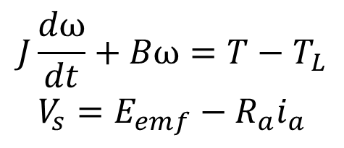
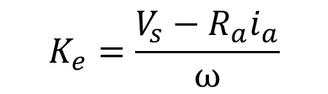

Motor Parameters Estimation
$$J\frac{dω}{dt}+Bω=T−T_{L}$$
$$V_{s}=E_{emf}−R_{a}i_{a}$$
ω: rated speed
J: motor inertia
B: friction
Ra: armature resistance
ia: armature current
Eemf: back-ElectroMotiveForce
Since,
$$E_{emf}=K_{e}ω$$
$$V_{s}=K_{e}ω−R_{a}i_{a}$$
Therefore,
$$K_{e}=\frac{V_{s}−R_{a}i_{a}}{ω}$$

Slide 16
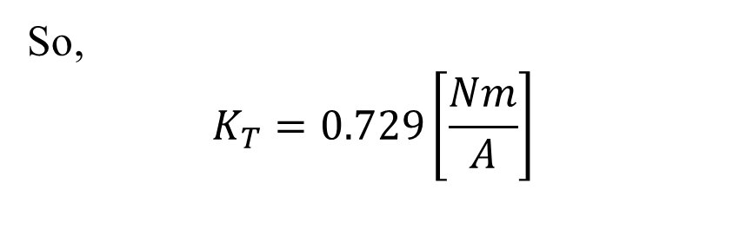

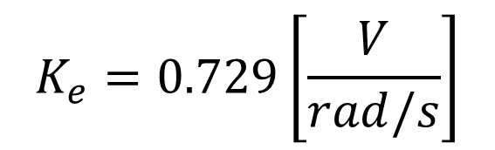
Where, Vs= 12 V
ia = 40 mA (rated)
Ra= 13.7 Ω (estimated)
ω = 150 RPM = 15,7 rad/s
Back-EMF constant and Torque constant have the same numerical value for DC motors:
$$K_{e}=0.729\left[\frac{V}{rad/s}\right]$$
$$K_{e}\left[\frac{V}{rad/s}\right]=K_{T}\left[\frac{Nm}{A}\right]$$
&
So,
$$K_{T}=0.729\left[\frac{Nm}{A}\right]$$

Slide 17
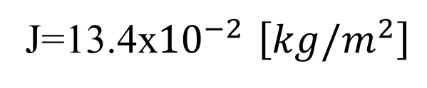
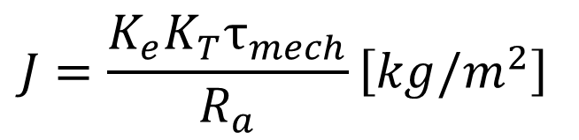


MECHANICAL TIME CONSTANT ESTIMATION
Mechanical time constant:
Time needed by the angular velocity to reach 63% of final value.
$τ_{mech}$=30ms
Now using, $τ_{mech}$=$\frac{R_{aJ}}{K_{e}K_{T}} [ms]$
$$J=\frac{K_{e}K_{T}τ_{mech}}{R_{a}}\left[kg/m^{2}\right]$$
Gives us,
J=13.4x${10}^{−2}$ $\left[kg/m^{2}\right]$

Slide 18
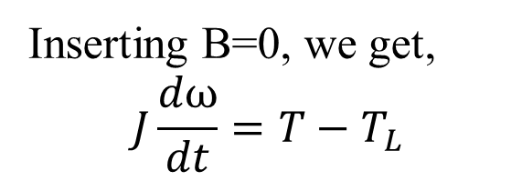
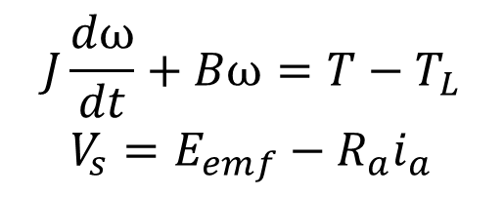
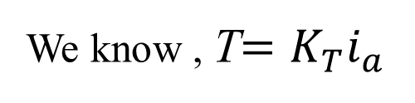

LOAD TORQUE ESTIMATION
$$J\frac{dω}{dt}+Bω=T−T_{L}$$
$$V_{s}=E_{emf}−R_{a}i_{a}$$
Inserting B=0, we get,
$$J\frac{dω}{dt}=T−T_{L}$$
Also at steady state, $J\frac{dω}{dt}$=0. Therefore, $T−T_{L}$=0.
This gives, $T=T_{L}$.
We know , T$=K_{T}i_{a}$
Torque-Current relationship

Slide 19
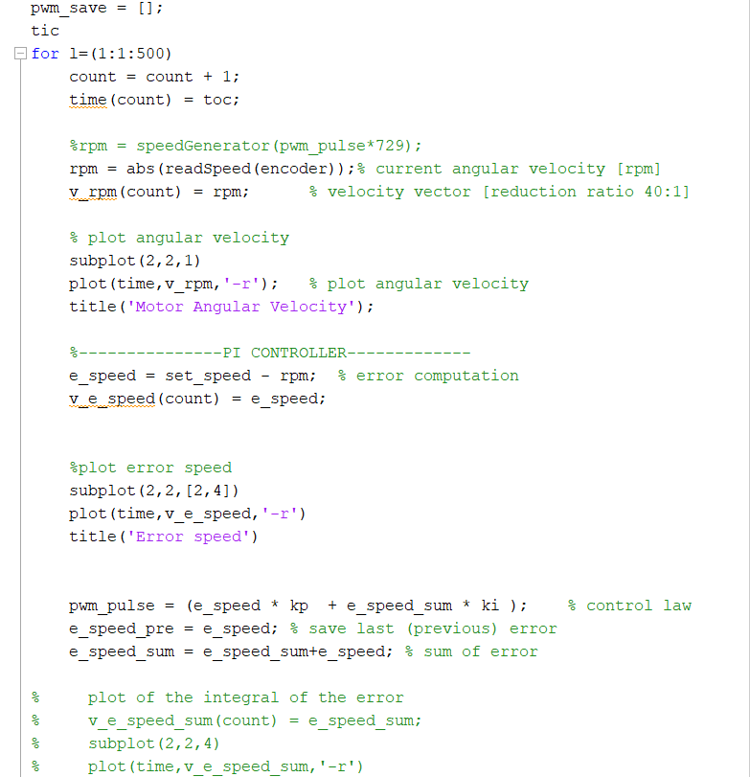
MATLAB CODES FOR PI-CONTROLLER

Slide 20
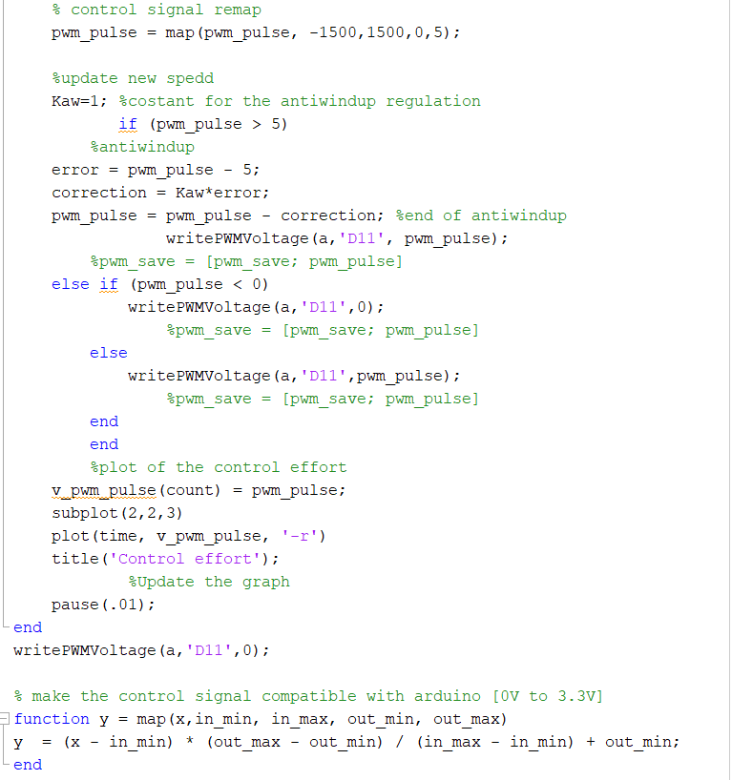
MATLAB CODES FOR PI-CONTROLLER(CONTD.)

Slide 22
CONCLUSIONS
During the development of this project we have learnt the following:
Learned how to interface Arduino and Matlab for real time
simulation and analysis
Estimated the DC motor parameters in order to obtain an estimate
of the motor torque
Implemented a PI speed controller and seen the effects of the
proportional and integral gains.
Future work: possibly, an implementation of a position controller
introducing external sensors to create a zero reference signal
(mechanical or magnetic switch).

