Slide 1

Estimation of DC Motor Load
Project Members: Marco Menchetti, Adrija Sen, Andrea Malaguti
Guided By: Prof. Claudia Califano
Course: Digital Systems Control

Slide 2
Goal of the project :
Estimation of DC Motor parameters
Estimation of DC Motor load
Estimation of a PI Controller
Estimation of DC Motor Load
Pagina <number>

Slide 3
HARDWARE AND SOFTWARE USED:
Arduino Uno R3
DC Motor (2x12V)
H-Bridge(LM298-N)
Hall-Effect Encoder
Operational Amplifier(LM324N)
Resistors()
Potentiometer 1KΩ
Power Supply – (12V, 2A max.)
Matlab 2019a
Matlab Arduino support package
Estimation of DC Motor Load
Pagina <number>

Slide 4
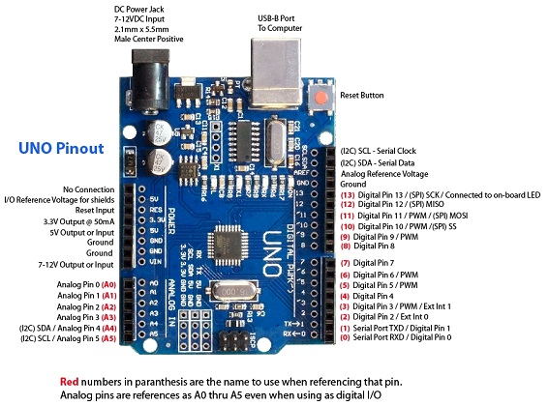
Arduino UNO R3
Estimation of DC Motor Load
Pagina <number>

Slide 5
Arduino Uno is a microcontroller board based on the ATmega328P (datasheet). It has 14 digital input/output pins (of which 6 can be used as PWM outputs), 6 analog inputs, a 16 MHz quartz crystal.
Tech Specifications of Arduino UNO R3:
Operating Voltage | 5V
Input Voltage (recommended) | 7-12V
Input Voltage (limit) | 6-20V
Digital I/O Pins | 14 (of which 6 provide PWM output)
PWM Digital I/O Pins | 6
Analog Input Pins | 6
DC Current per I/O Pin | 20 mA
DC Current for 3.3V Pin | 50 mA
Flash Memory | 32 KB (ATmega328P) of which 0.5 KB used by bootloader
SRAM | 2 KB (ATmega328P)
EEPROM | 1 KB (ATmega328P)
Clock Speed | 16 MHz
LED_BUILTIN | 13
Estimation of DC Motor Load
Pagina <number>

Slide 6
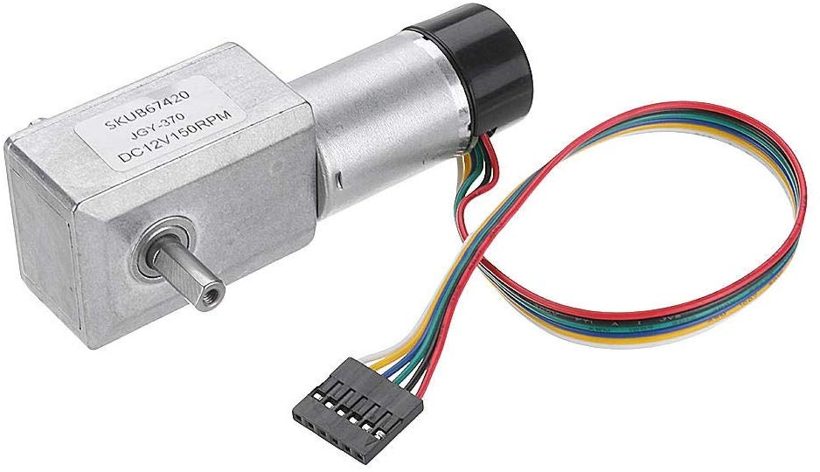
DC Motor + Encoder
Estimation of DC Motor Load
Pagina <number>

Slide 7
TECHNICAL SPECIFICATIONS FOR ENCODER-MOTOR DUO
Operating voltage: 6V to 18V
Rated voltage: 12V
Reduction ratio: 40:1
No-load current: 40 mA
No-load speed: 150 RPM
Rated torque: 1.5 kg cm
Maximum torque: 6.4 kg cm
Stop current: 1.3 A
Hall Incremental Encoder
Encoder resolution: 440 CPR
Weight: 150 g
Red: Motor power +
Black: Encoder GND
Green: Encoder Phase A
Yellow: Encoder Phase B
Blue: Encoder power supply 5V
White: Motor power
Estimation of DC Motor Load
Pagina <number>

Slide 8
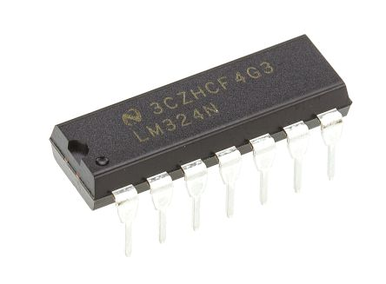

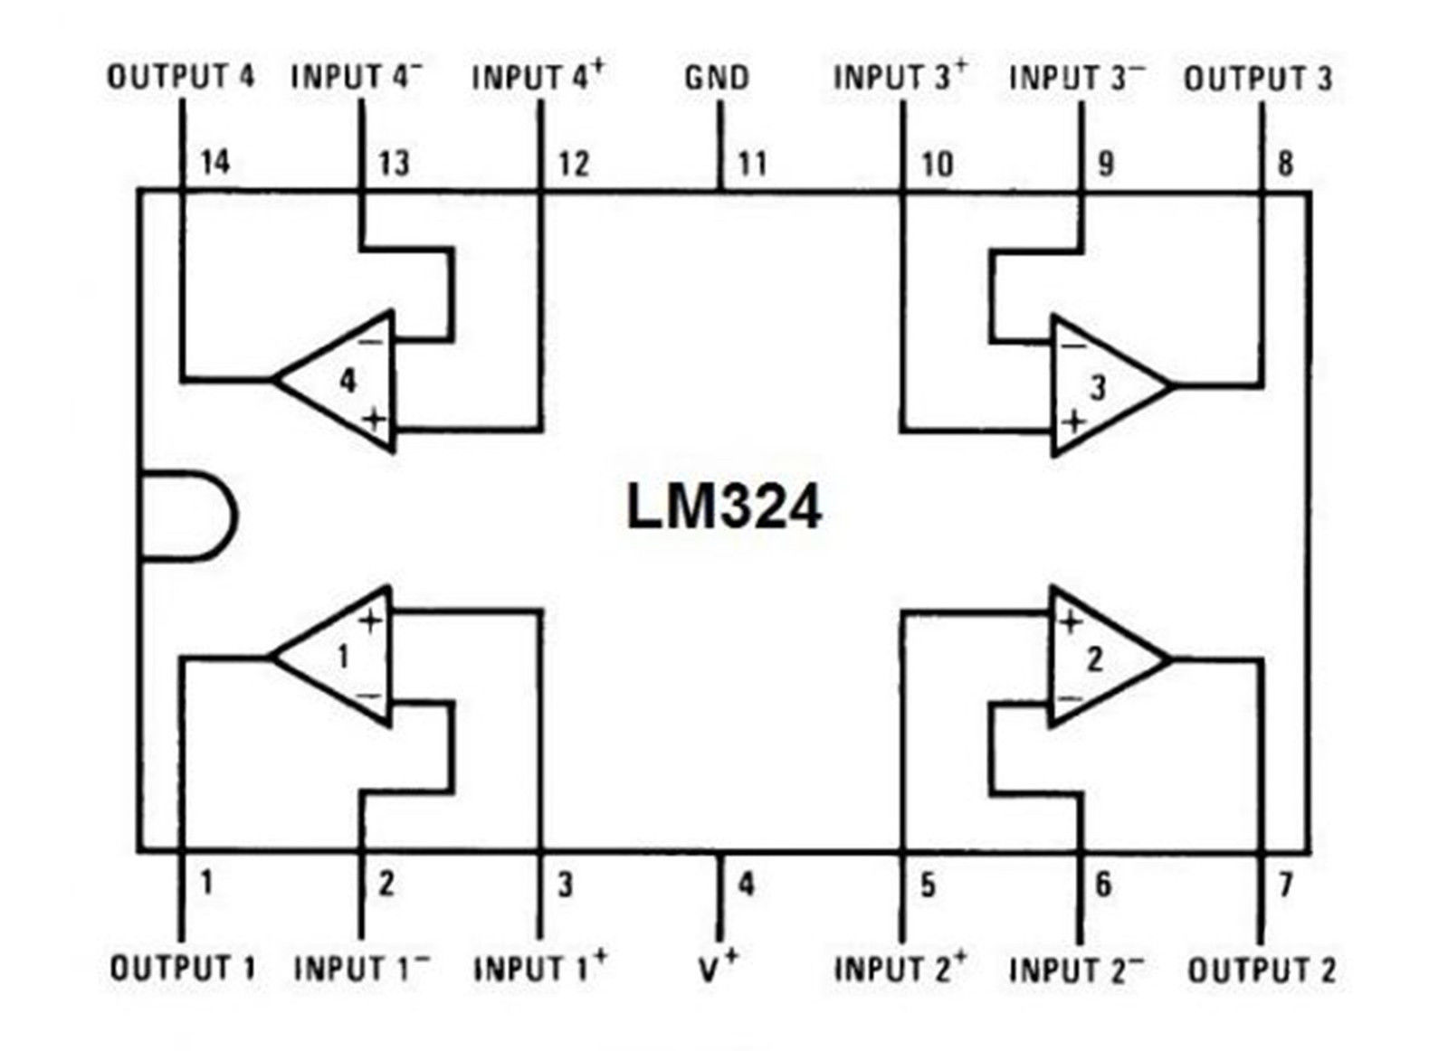
LM324N (OPERATIONAL AMPLIFIER)
Slew Rate | 0.5V/µs
Gain Bandwidth Product | 1,2MHz
Current - Input Bias | 20nA
Voltage - Input Offset | 3mV
Current - Supply | 1.4mA
Current - Output / Channel | 40mA
Voltage - Supply, Single/Dual (±) | 3V ~ 32V, ±1.5V ~ 16V
Operating Temperature | 0°C ~ 70°C
Pin-out for LM324N
Estimation of DC Motor Load
Pagina <number>

Slide 9
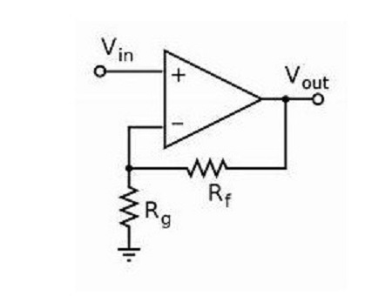
LM324N-NON-INVERTING AMPLIFIER
Estimation of DC Motor Load
Pagina <number>

Slide 10
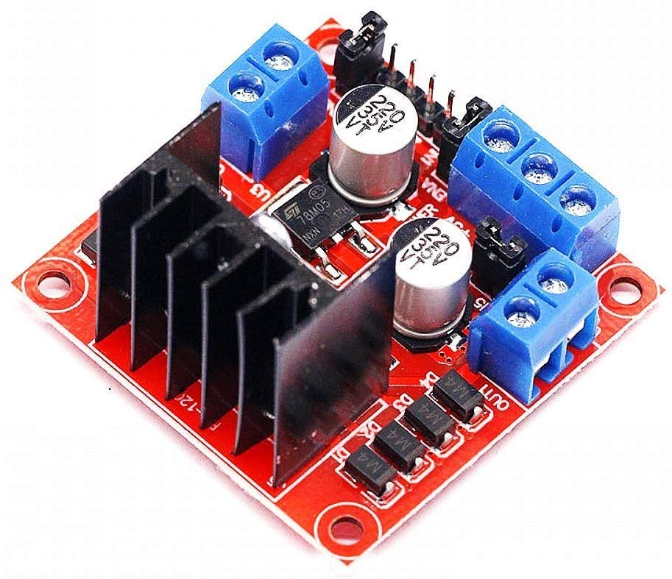
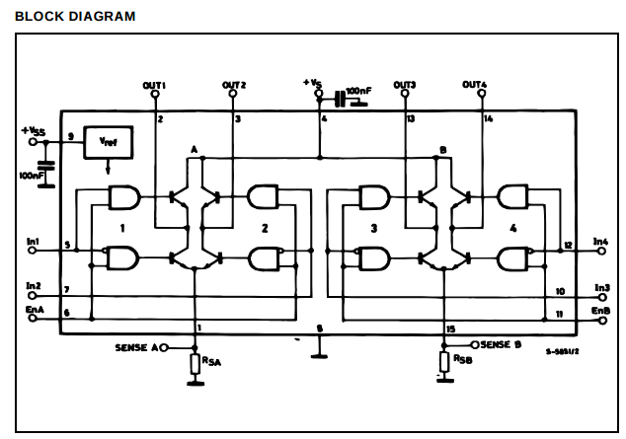
L298N (H-BRIDGE DRIVER)
Estimation of DC Motor Load
Pagina <number>

Slide 11
L298N (TECHNICAL SPECIFICATIONS )
Technical
Bandwidth | 1 MHz
Common Mode Rejection Ratio | 70 dB
Dual Supply Voltage | 9 V
Gain | 100 dB
Gain Bandwidth Product | 1.3 MHz
Input Bias Current | 150 nA
Input Offset Voltage (Vos) | 7 mV
Max Dual Supply Voltage | 15 V
Max Operating Temperature | 70 °C
Max Supply Voltage | 30 V
Min Dual Supply Voltage | 1.5 V
Min Operating Temperature | 0 °C
Min Supply Voltage | 3 V
Nominal Supply Current | 1.2 mA
Number of Amplifiers | 4
Number of Channels | 4
Number of Circuits | 4
Number of Elements | 4
Operating Supply Current | 1.5 mA
Operating Supply Voltage | 15 V
Output Current | 70 mA
Output Current per Channel | 70 mA
Slew Rate | 0.4 V/µs
Voltage Gain | 100 dB
Estimation of DC Motor Load
Pagina <number>

Slide 12
Estimation of DC Motor Load
Pagina <number>

