Slide 1

Gender Categorization
M.Sc. Program in Business Analytics
Department of Management Science and Technology
Team members:
Gkiali Aleksandra
Gkinakos Athanasios
Koutsioumpa Paraskevi
Malliari Konstantina
Salemi Maria

Slide 2
Gender Categorization
Goal: Algorithms for identifying the gender of a human figure
Applications on several domains
Face recognition
Security
Demographic studies
Law enforcement
etc

Slide 3
Data and Preprocessing
Dataset we worked with available at :
https://www.crowdflower.com/data-for-everyone/
Contains approx. 63,000 images
In the form of a CSV file with url locations for the images
Preprocessing steps:
Removed rows with “unsure” label
Ignored rows with no response from the server
Converted images to greyscale
Stored images as arrays

Slide 4
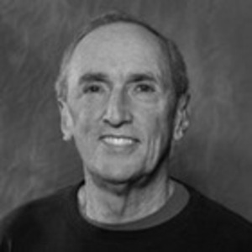
Example
Representation:
array([[86, 86, 86, ..., 79, 79, 79],
[84, 84, 85, ..., 79, 79, 79],
[81, 82, 84, ..., 79, 78, 78],
...,
[13, 12, 11, ..., 14, 14, 14],
[13, 12, 11, ..., 13, 13, 13],
[13, 12, 11, ..., 13, 13, 13]], dtype=uint8)

Slide 5
Methodologies Applied

Slide 6
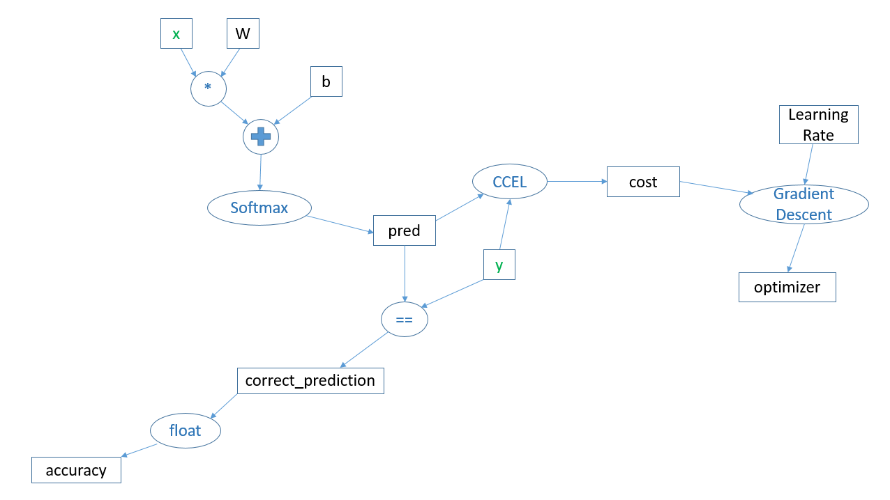
Logistic Regression
Placeholders: x, y
Weights and biases initiated to zero
Activation Function: Softmax
Cost Function: Categorical Cross Entropy with Logits
Learning Rate: 5*10⁻⁹
Optimizer: Gradient Descent
 | Training Accuracy | Test Accuracy
50000 Training – 4392 Test | 87% | 83%
6500 Training – 6500 Test | 64% | 60%

Slide 7
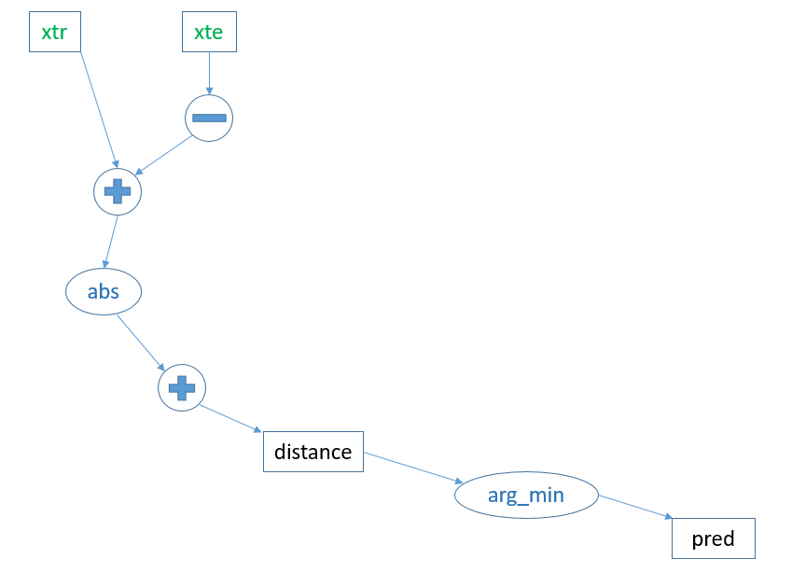
KNN
Placeholders: xtr, xte
Distance Measure: Euclidean
 | Test Accuracy
5000 Training – 100 Test | 81%
2500 Males, 2500 Females Training – 100 Test | 62%

Slide 8
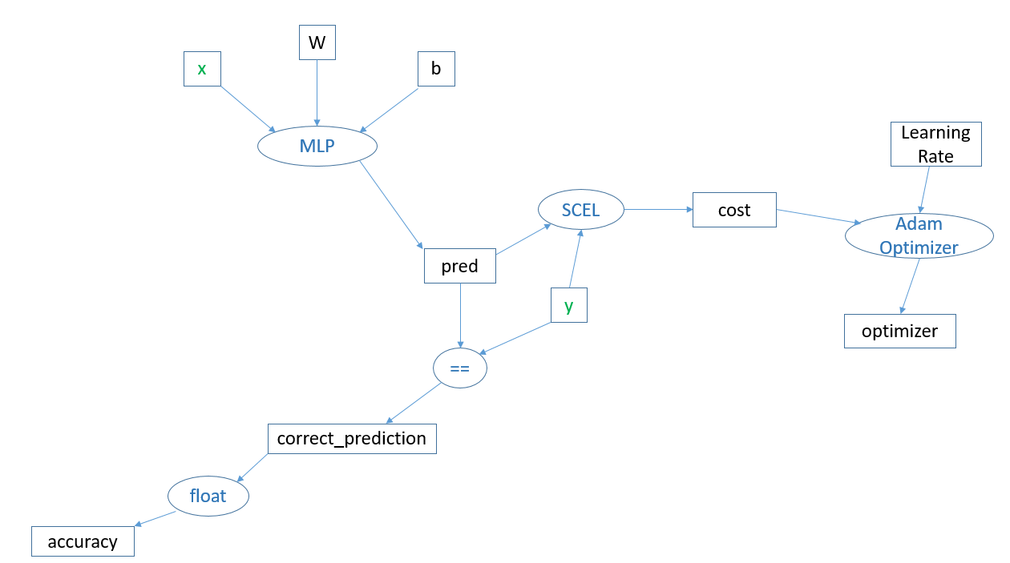
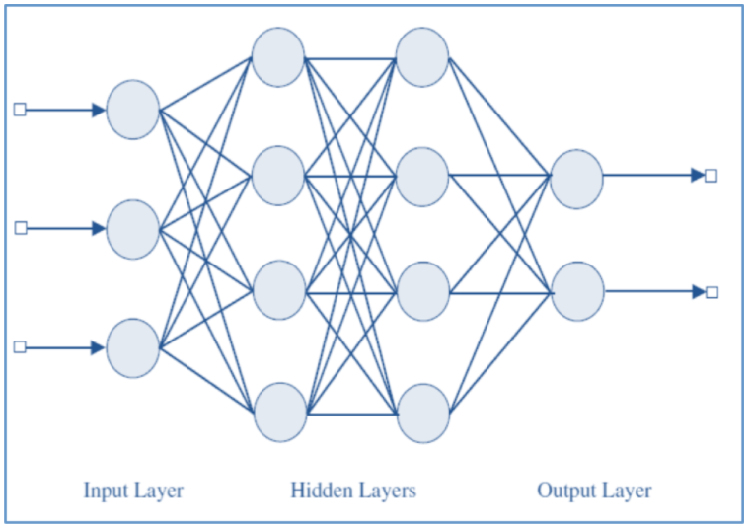
Multi-Layer Perceptron MLP
Placeholders: x, y
Weights and biases randomly initiated
Activation Function for Hidden Layers: ReLU
Activation Function for Output Layer: Softmax
Cost Function: Softmax Cross Entropy with Logits
Learning Rate: 0.0001
Optimizer: Adam Optimizer

Slide 9
Multi-Layer Perceptron MLP - Continued
 | Train Accuracy | Test Accuracy
3 Hidden Layers – 60 neurons each – 300x300 Images – 50000 Training – 4392 Test | 78% | 83%
3 Hidden Layers – 256 neurons each – 300x300 Images – 50000 Training – 4392 Test | 85% | 83%
3 Hidden Layers – 256 neurons each – 100x100 Images – 50000 Training – 4392 Test | 87% | 83%
3 Hidden Layers – 256 neurons each – 30x30 Images – 50000 Training – 4392 Test | 87% | 83%
5 Hidden Layers – 200, 100, 60, 30, 10 neurons respectively – 30x30 Images – 50000 Training – 4392 Test | 81% | 83%
5 Hidden Layers – 200, 100, 60, 30, 10 neurons respectively – 30x30 Images – 6550 Males, 6550 Females Training – 4392 Test | 100% | 57%

Slide 10
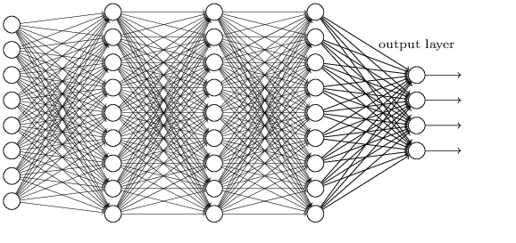
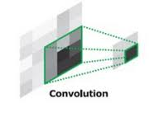
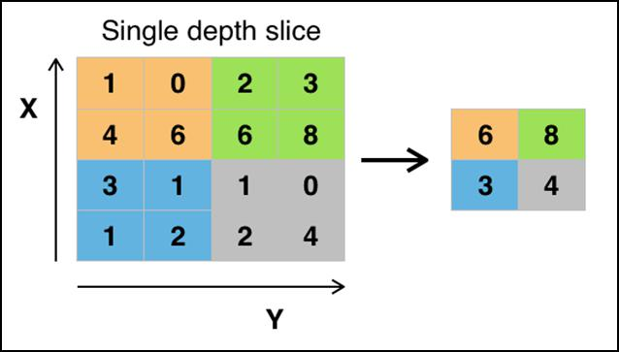
CNN

Slide 11
Model’s Structure
Convolution Layers
Weights and biases based on number of filters
Max pooling
Activation Function for Hidden Layers: ReLU
Optimizer: Adam Optimizer
Cost Function: Softmax Cross Entropy

Slide 12
Parameter Definition
Input Data
Processing Parameters
Filter Features
54.392 images
Number -
Color Channels - gray scale
Dimensions -
Learning rate
Training iterations
Batch size
Display step
Dropout
Convolution Layers
Data in batches
100*100 resolution
64, 128, 256
3*3, 5*5

Slide 13

RESULTS
System’s Features
Tested Parameters
Learning Rate
Convolution Layers
Batch Size
Percentages of men and women in batches

Slide 14
RESULTS Learning Rate
Fixed parameters :
Results from logs :
4 convolution layers
100000 training iterations
128 batch size
50 display step
2/3 men - 1/3 women
Learning Rate | Train Accuracy | Test Accuracy
0.1 | 57% | 96%
0.01 | 70% | 83%
0.001 | 74% | 84%
Conclusion :
Smaller learning rates give better results. However, they demand much more training iterations for better predictions !

Slide 15
RESULTS Convolution Layers
Fixed parameters :
Results from logs :
0.001 learning rate
100000 training iterations
128 batch size
50 display step
2/3 men - 1/3 women
Convolution Layers | Train Accuracy | Test Accuracy
2 | 67% | 76%
4 | 70% | 84%
5 | 75% | 80%
Conclusion :
An increase in the number of convolution layers helps CNN to learn better !

Slide 16
RESULTS Batch Size
Fixed parameters :
Results from logs :
4 convolution layers
0.001 learning rate
100000 training iterations
50 display step
2/3 men - 1/3 women
Batch Size | Train Accuracy | Test Accuracy
64 | 64% | 72%
128 | 70% | 84%
256 | 66% | 74%
Conclusion :
An intermediate number of batch size gives better results !

Slide 17
RESULTS Percentages of men and women in batches
Fixed parameters :
Results from logs :
4 convolution layers
0.001 learning rate
100000 training iterations
128 batch size 50 display step
Percentage | Train Accuracy | Test Accuracy
50 % - 50 % | 74% | 51%
64 % - 36 % | 70% | 84%
Conclusion :
Random selection was not tested at all due to the larger number of men in the input data. The way that the batch is fed affects the results !

Slide 18
PROBLEMS
Significantly larger number of men in the input data
Complexity of input images
Resolution of images
Selection of learning rate for better results
Needs in resources/time consuming runs

Slide 19
Thank you!

