Slide 1
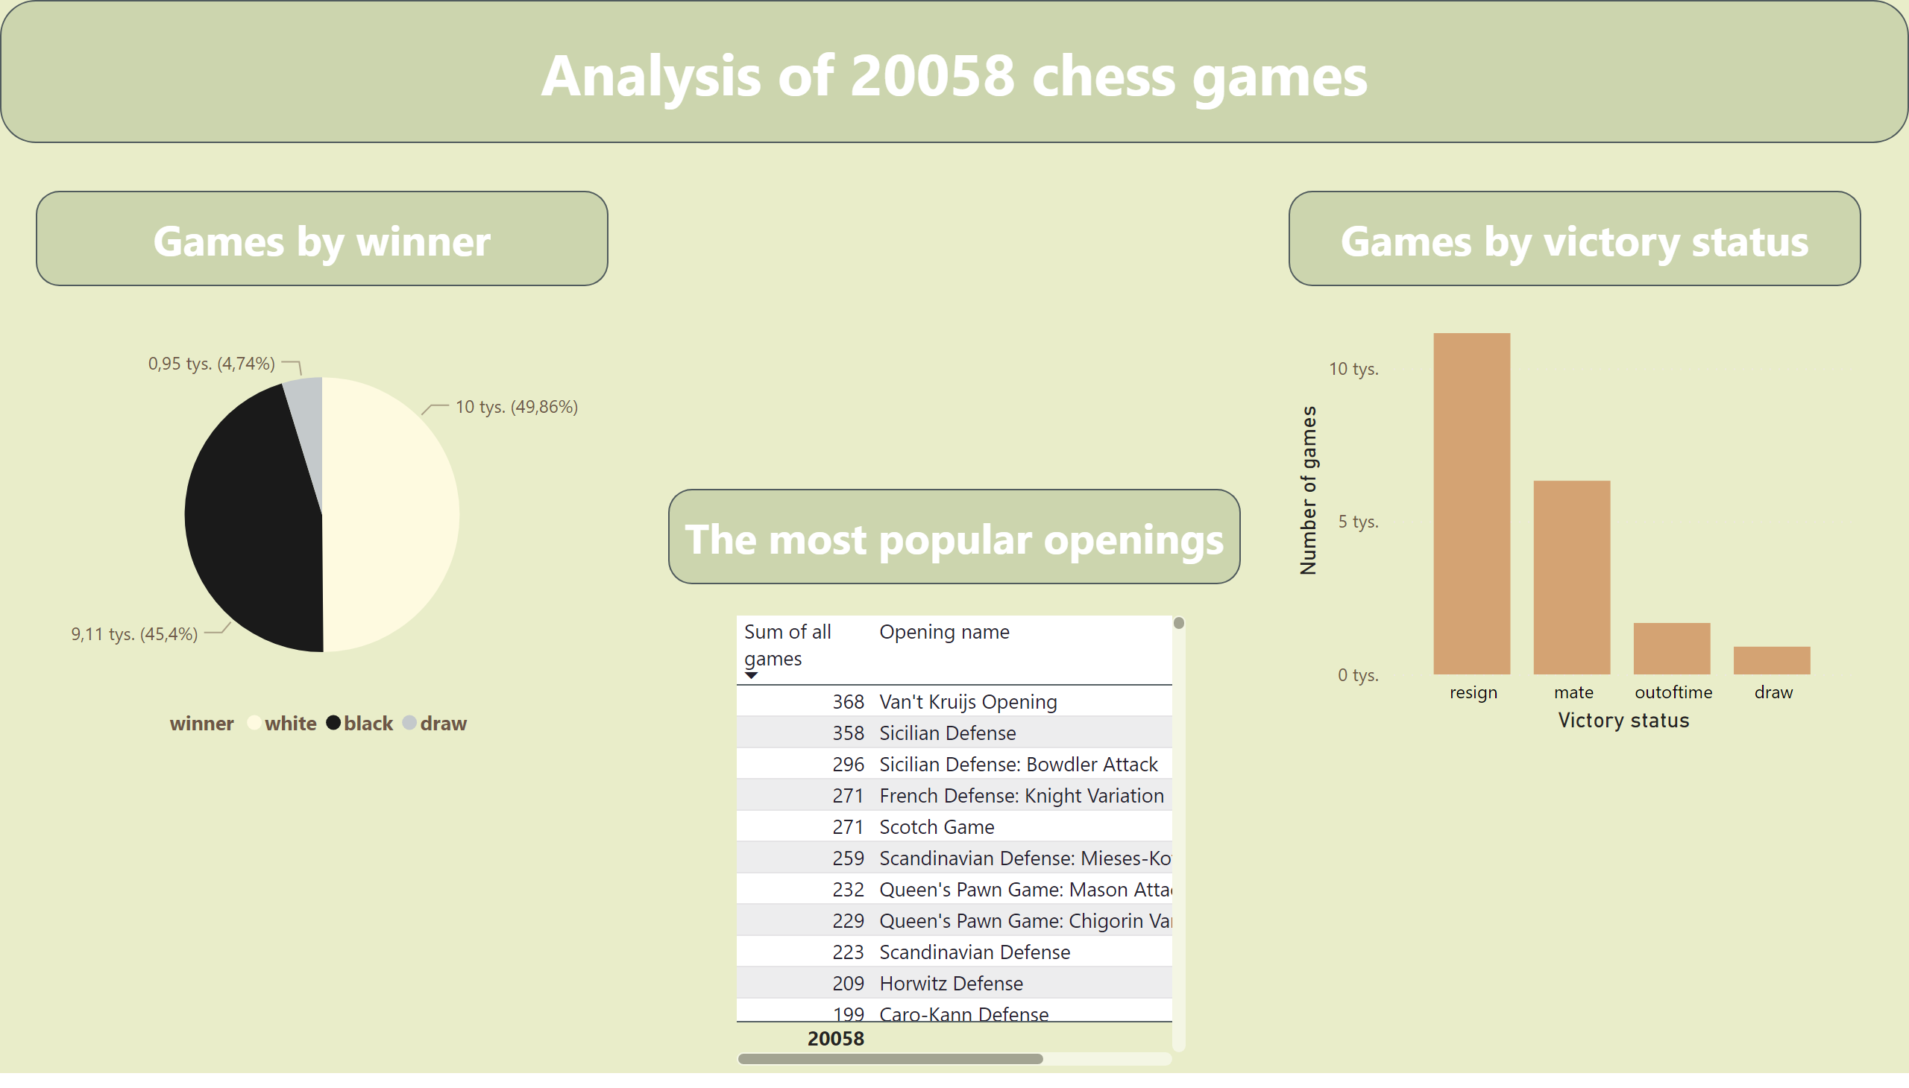

Strona 1
Notes:
Division of 2058 games by winner
No alt text provided
Distribution of 2058 games by victory status
No alt text provided
The most popular openings
No alt text provided
shape
No alt text provided
shape
No alt text provided
shape
No alt text provided
shape
No alt text provided

