Slide 1

AR Escape Quiz
Melvin Klang, Sebastian Pareiss & Mara Sandner

Slide 2


Current Status
Custom App design/theme
App Icon
Multiple Pages (Start Page, Instruction Page, Hint Pages for each Quiz)
Timing for the game from start till end
Image detection as core of the game
Drag and drop game as first quiz
Door simulation as end of the game and trigger to stop the timing
Established a sequence of quizes to complete the game

Slide 3


App Video
Launch App
Read instructions
Start game
Read first hint
Search and scan the right image
Complete game
Read next hint
Search and scan the door
9. Game end

Slide 4
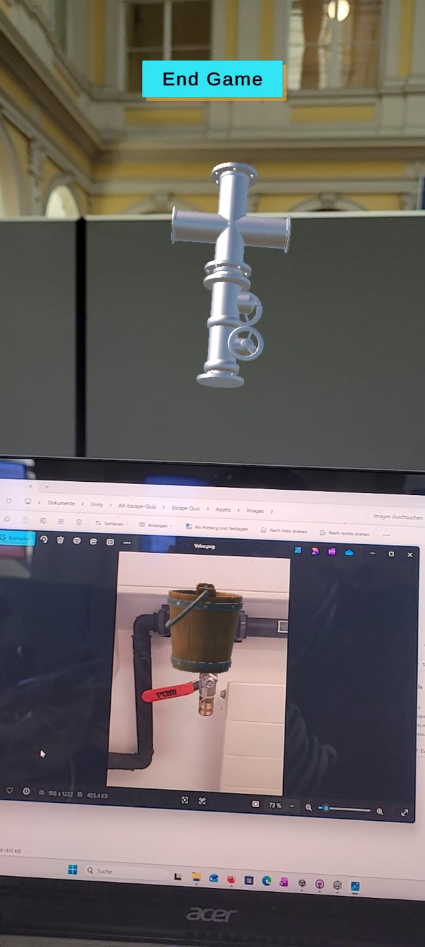
Further Work
Include 2 more Quizes
1 Interactive Game
1 knowledge quiz
More Objects/Images in the classroom to detect

Slide 5

Thank you for your attenion! Questions?

