Slide 1
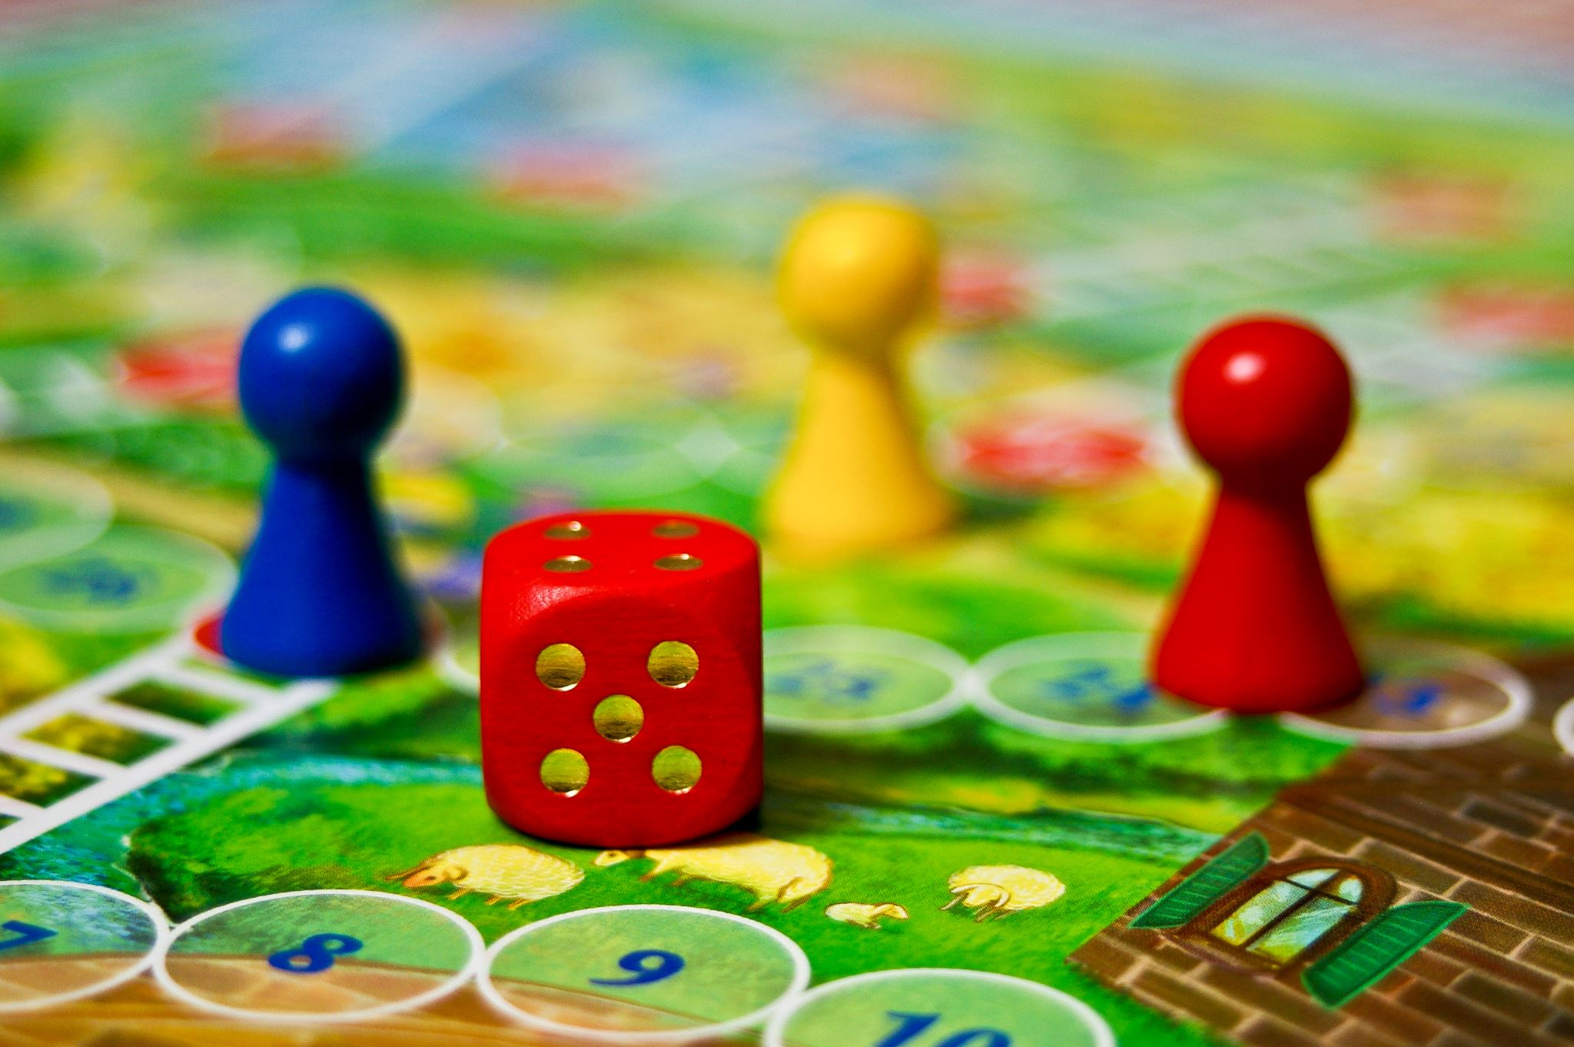
AR Escape Game
Melvin Klang, Sebastian Pareiss & Mara Sandner

Slide 2
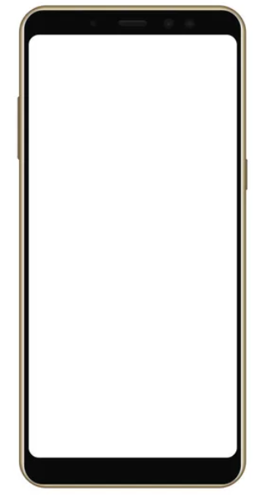
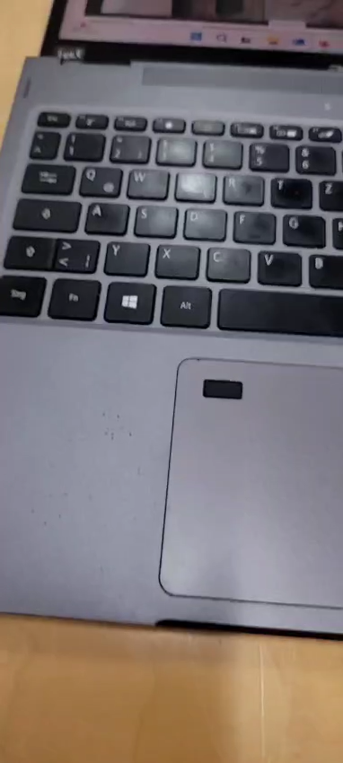

Current Status
AR Image Matching
Door spawns when image is detected
Door opens/closes when tapped
Sound effects

Slide 3
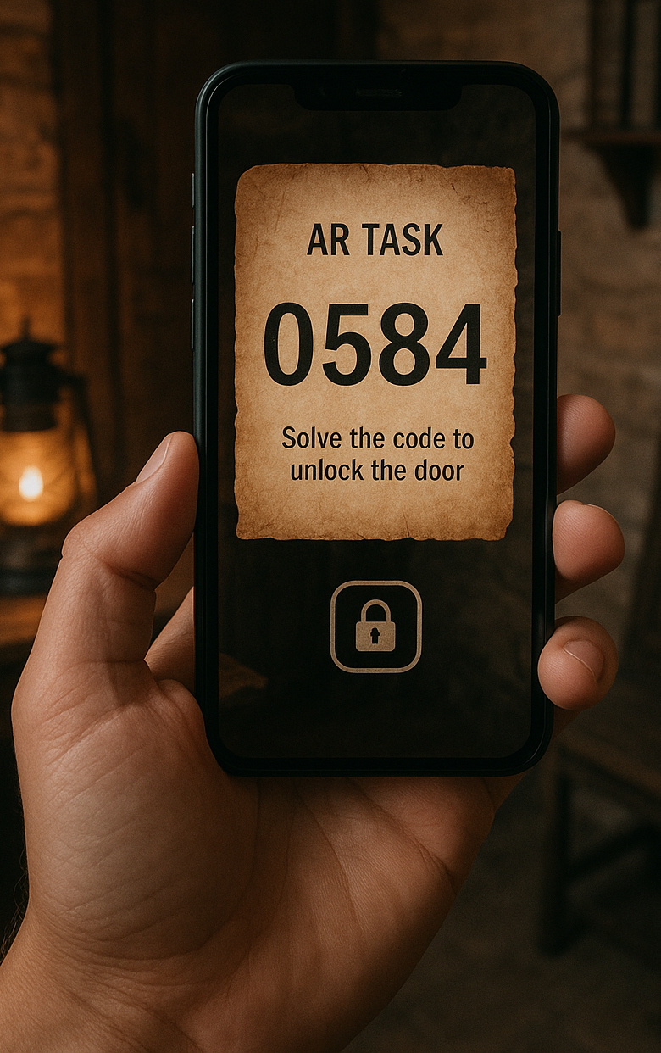
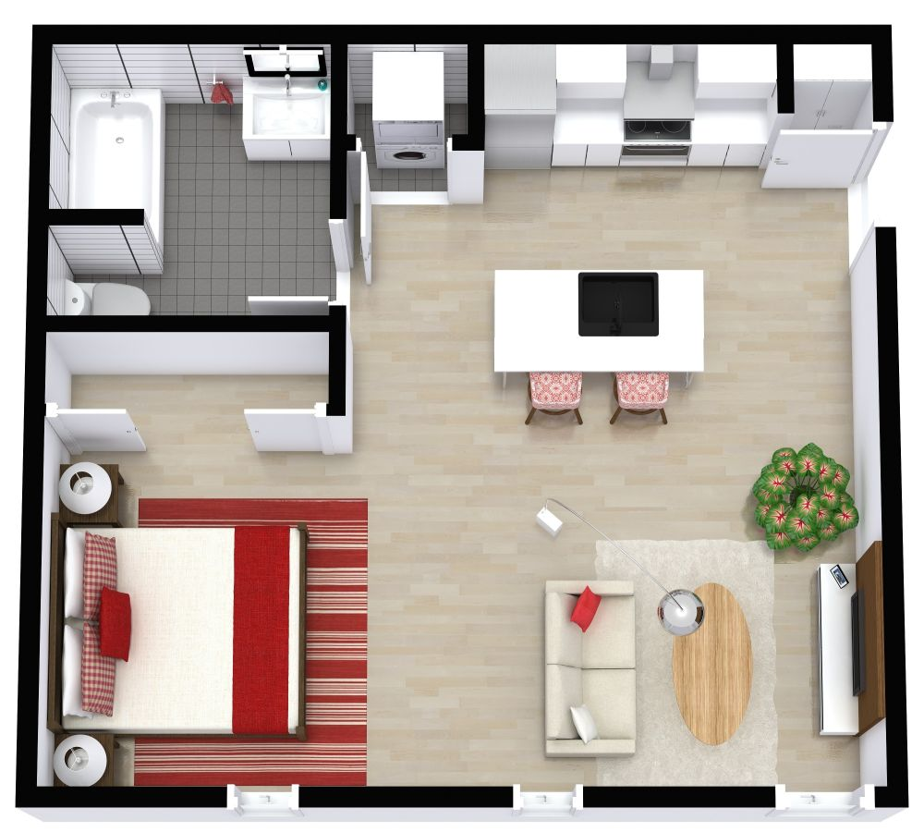
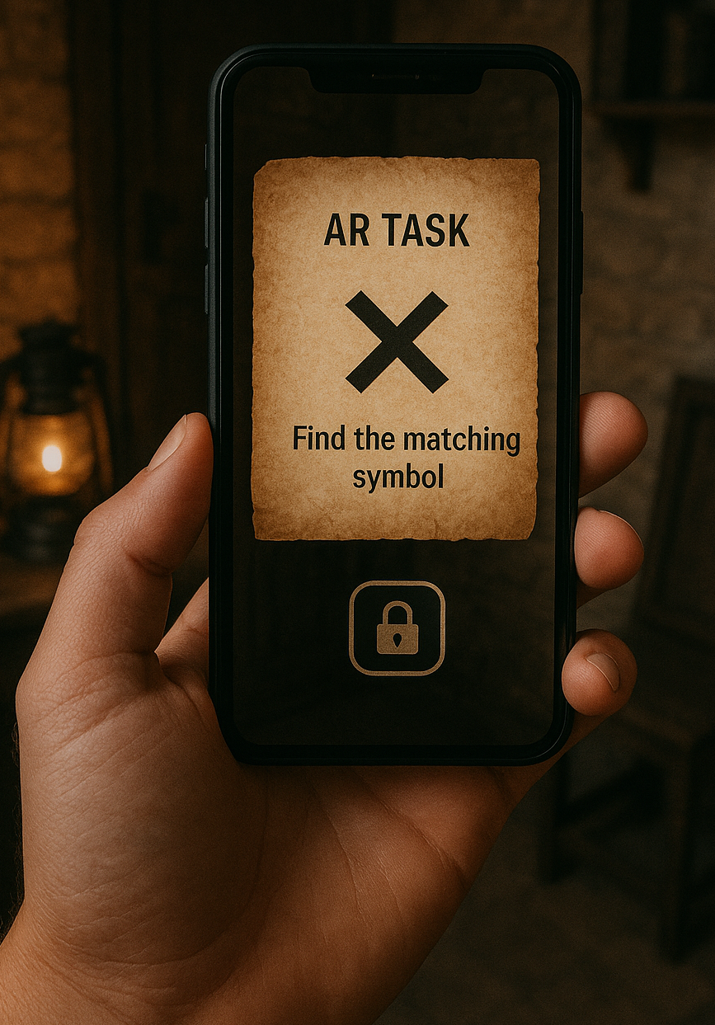
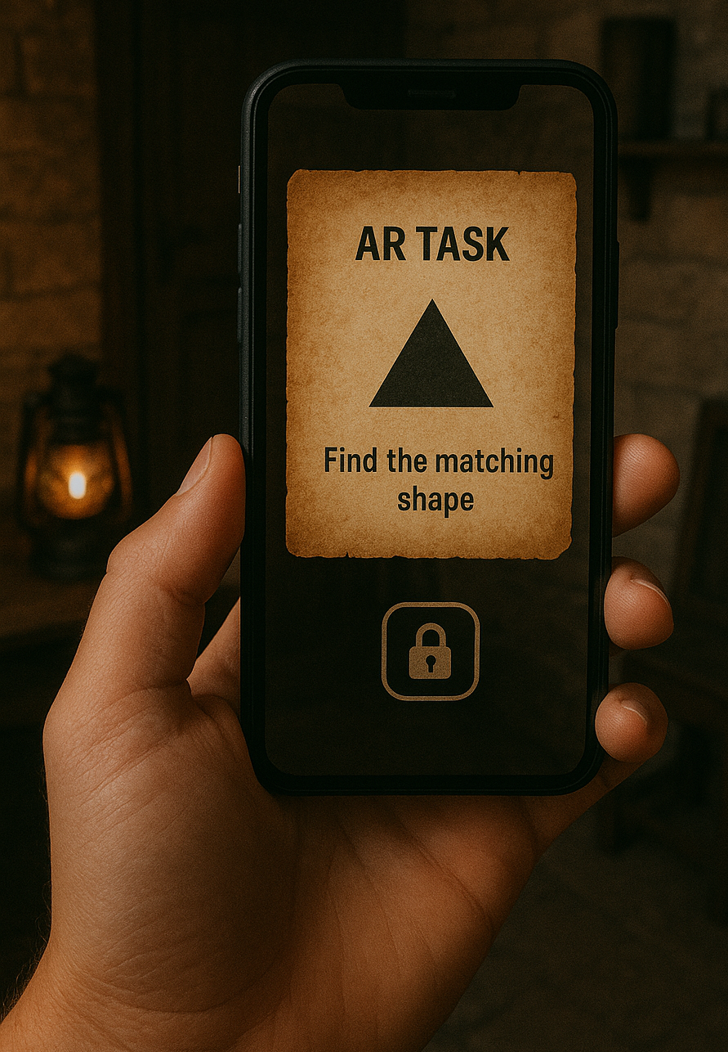
Next Steps
Add a Start Screen behind the open door
Implement multiple images for image tracking → each triggering next quiz
Design a quiz or challenge for every image to guide players through the experience
1
3
2

Slide 4
Thank you for your attention! Questions?

