Slide 1

Exploring multilingual instruction understanding
in zero-shot reasoning

Slide 2
To what extent do the multilingual zero-shot reasoning abilities of LLMs differ across languages?

Slide 3
01
02
03
How do the instruction understanding abilities of LLMS in zero-shot reasoning differ across languages?
To what extent does chain-of-thought reasoning manifest itself across languages?
Can we identify languages that typically fail and languages that typically succeed?

Slide 4
01
02
03
How do the instruction understanding abilities of LLMS in zero-shot reasoning differ across languages?
To what extent does chain-of-thought reasoning manifest itself across languages?
Can we identify languages that typically fail and languages that typically succeed?

Slide 5


LLMs
Bloomz-7b1-mt
Llama-2-7b-chat

Slide 6
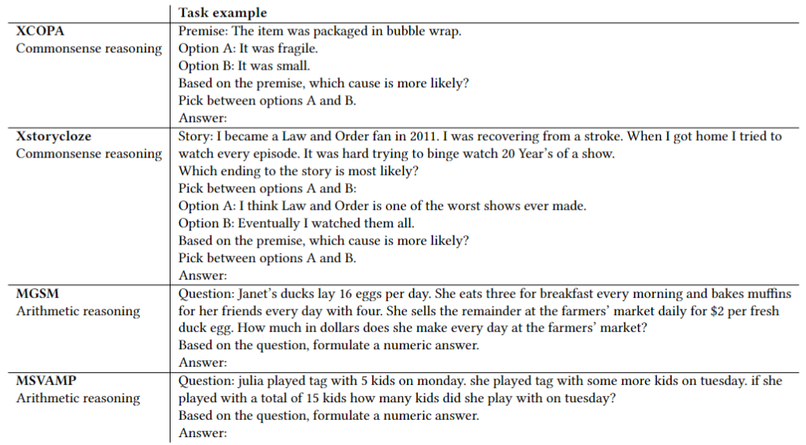
Tasks

Slide 7
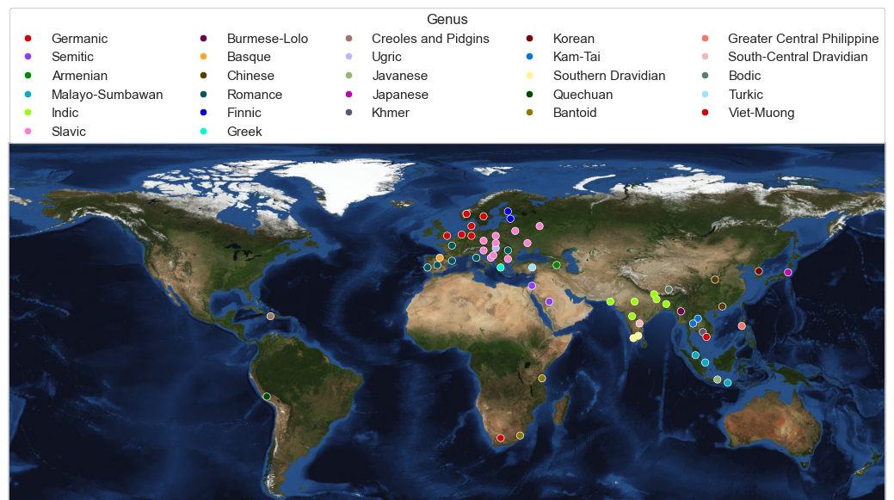

Slide 8
Machine translation with NLLB-200-3.3B

Slide 9
01
How do the instruction understanding abilities of LLMS in zero-shot reasoning differ across languages?

Slide 10
01
How do the instruction understanding abilities of LLMS in zero-shot reasoning differ across languages?
Native versus English instructions

Slide 11
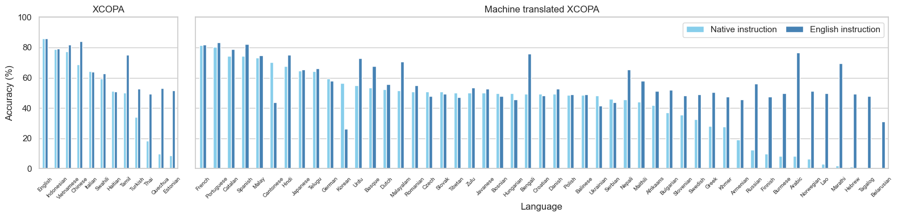
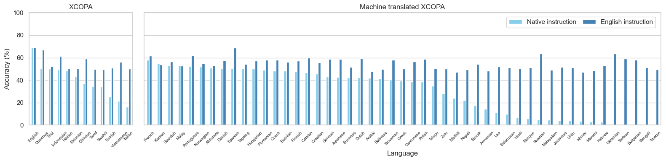
Bloomz
Llama-2

Slide 12
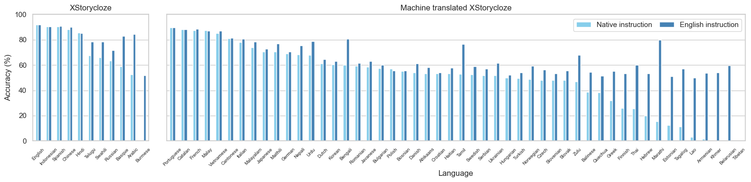
Bloomz

Slide 13
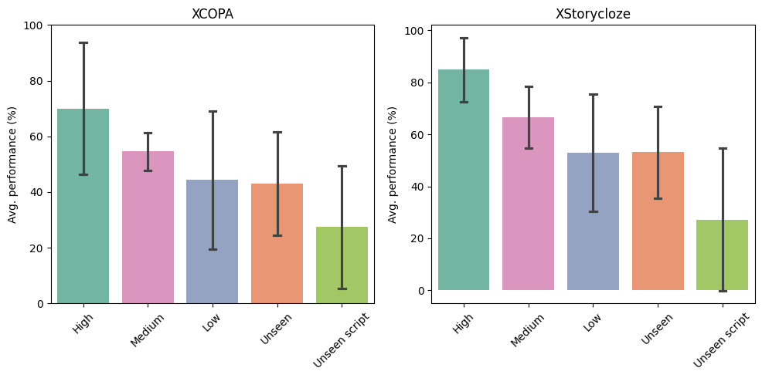
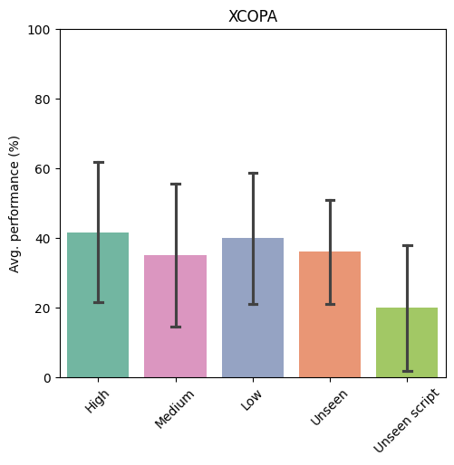
Bloomz
Llama-2

Slide 14
01
How do the instruction understanding abilities of LLMS in zero-shot reasoning differ across languages?
English task with varying instruction languages

Slide 15
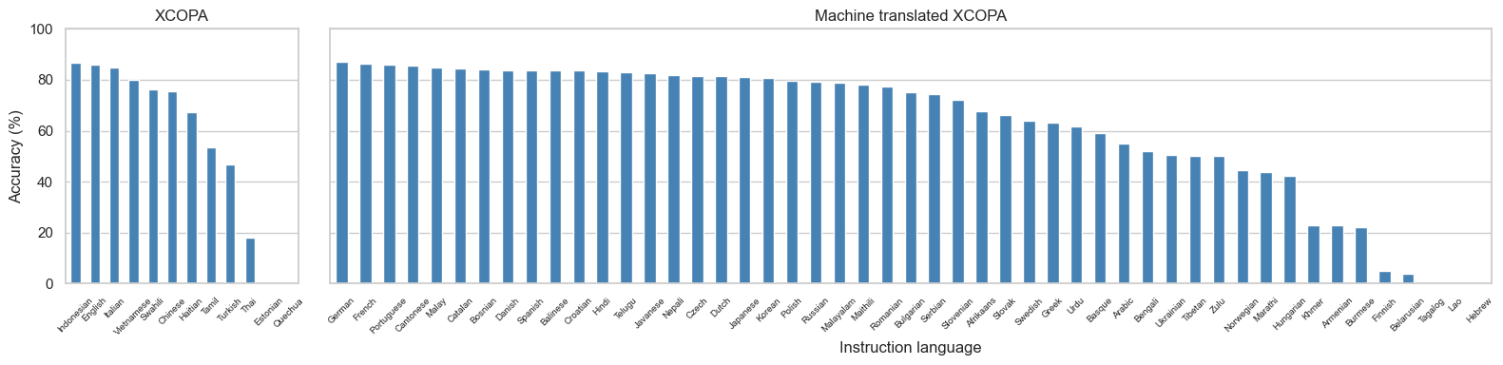
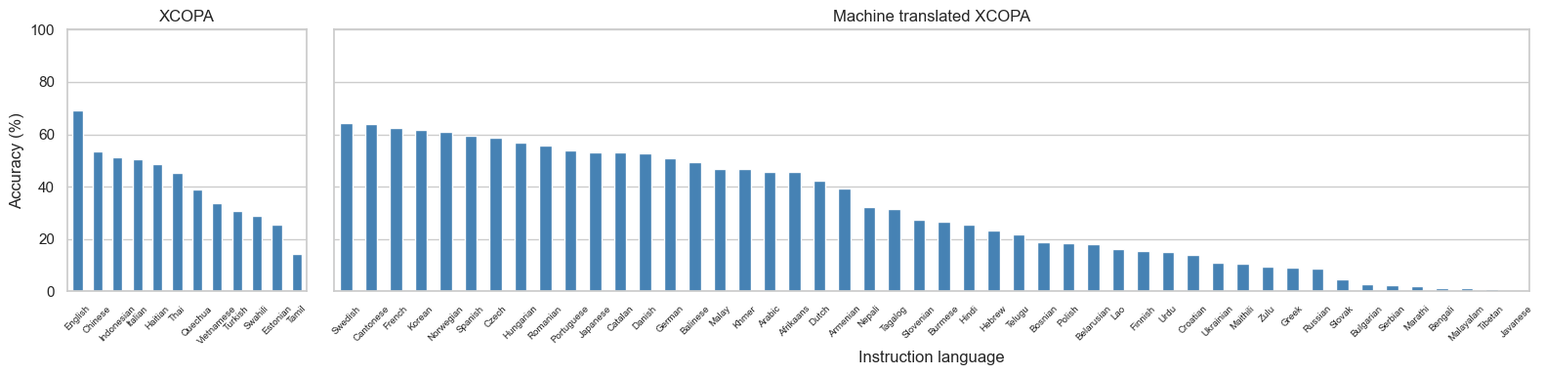
Bloomz
Llama-2

Slide 16
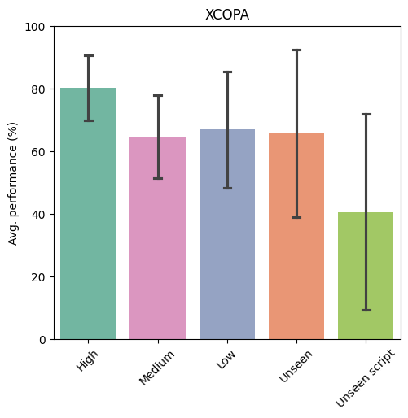
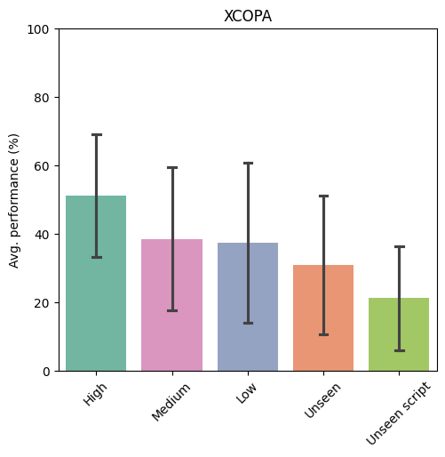

Slide 17
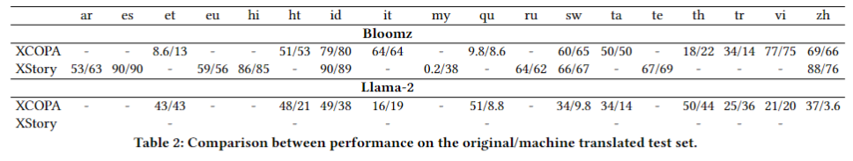

Slide 18
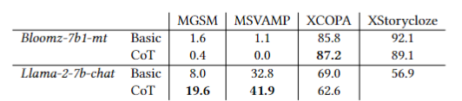

Slide 19
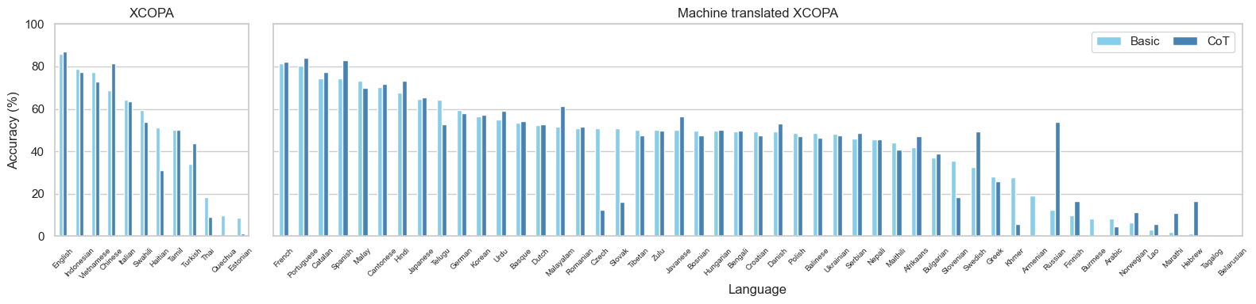
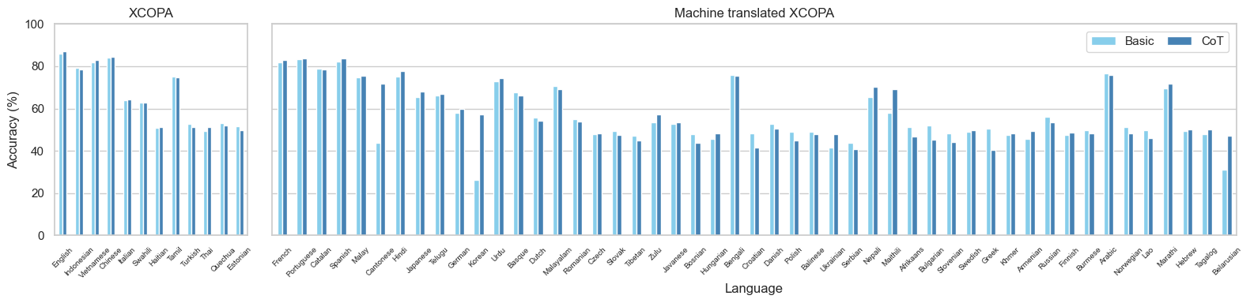
Basic vs Cot Bloomz Native (top), English (bottom)

Slide 20
CoT results much more interesting with Llama-2 on MGSM and MSVAMP

Slide 21
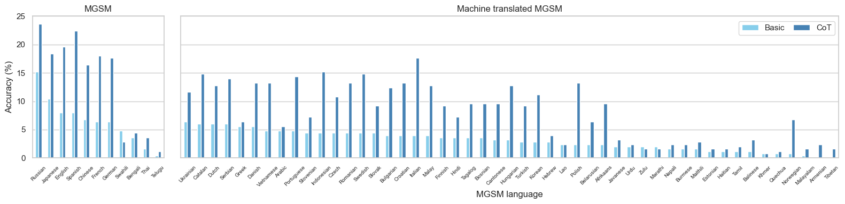
Basic vs Cot Llama-2 Native (top), English (bottom)
MGSM show languages native that I have?
Sort on where CoT effect is largest?

Slide 22
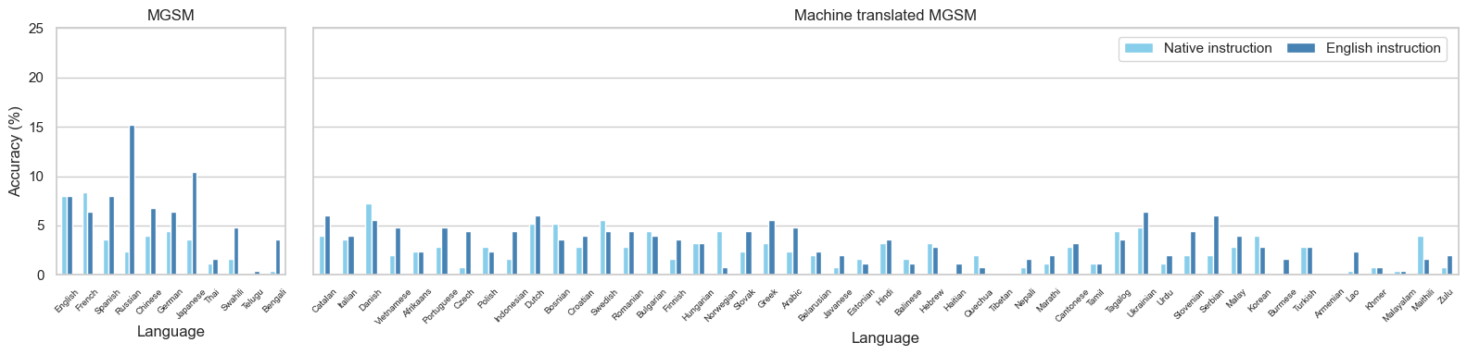
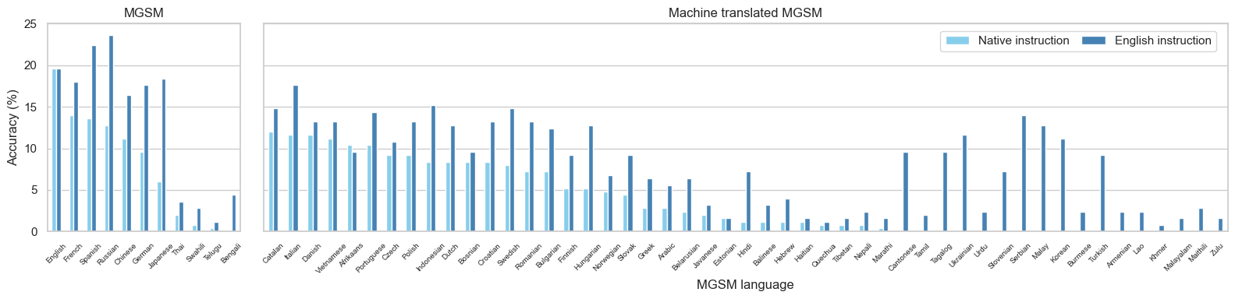
Native vs English instruction Llama basic (top), CoT (bottom)
CoT MGSM

Slide 23
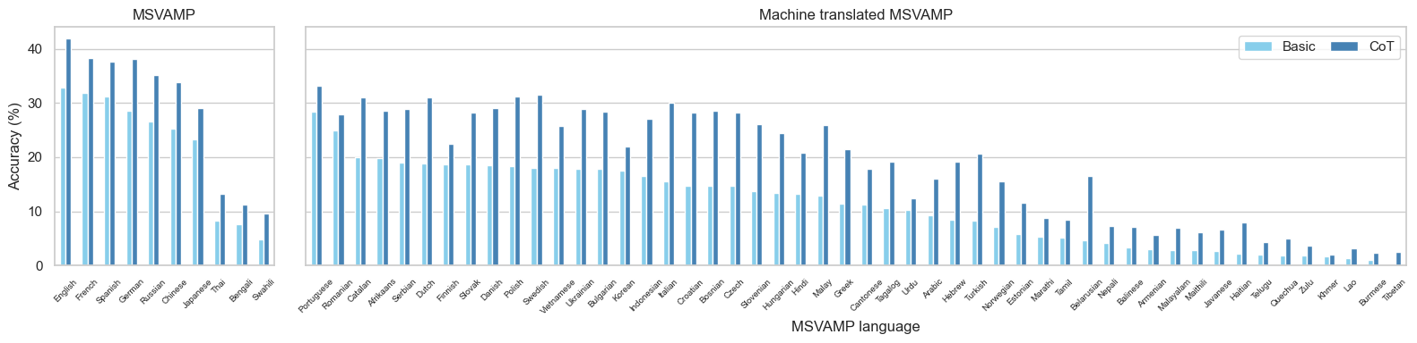
Native vs English instruction Llama basic (top), CoT (bottom)
MSVAMP show languages native that I have?

