Slide 1

Exploring multilingual instruction understanding of LLMs
in zero-shot reasoning
Mara Smeets MSc Data Science – thesis project

Slide 2
To what extent do the multilingual zero-shot reasoning abilities of LLMs differ across languages?

Slide 3

How do the instruction understanding abilities of LLMS in zero-shot reasoning differ across languages?
To what extent does chain-of-thought reasoning manifest itself across languages?
Can we identify languages that typically fail and languages that typically succeed?

Slide 4


LLMs
Bloomz-7b1-mt
Llama-2-7b-chat

Slide 5
Tasks
Commonsense reasoning
XCOPA (n=500)
Xstorycloze (n=1510)
Arithmetic reasoning
MGSM (n=250)
MSVAMP (n=1000)

Slide 6
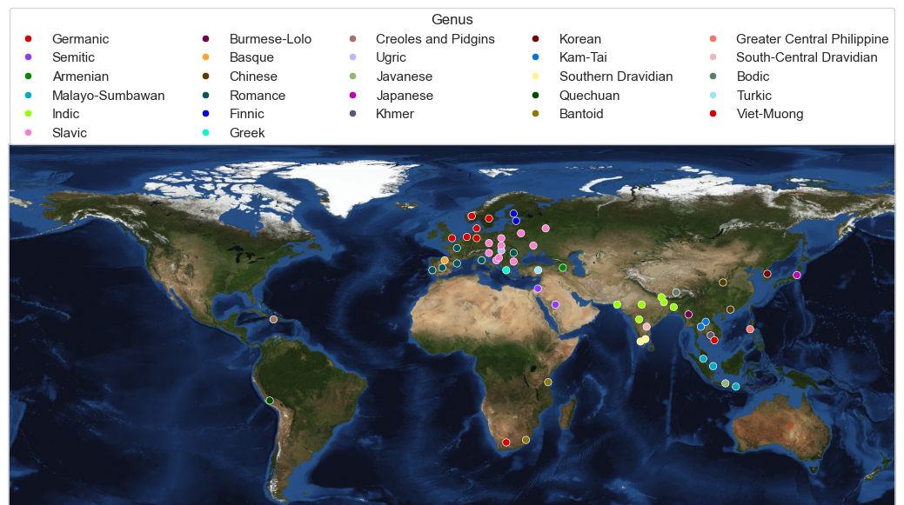

Slide 7
Machine translation with NLLB-200-3.3B

Slide 8
How do the instruction understanding abilities of LLMS in zero-shot reasoning differ across languages?

Slide 9
How do the instruction understanding abilities of LLMS in zero-shot reasoning differ across languages?
Native versus English instructions

Slide 10
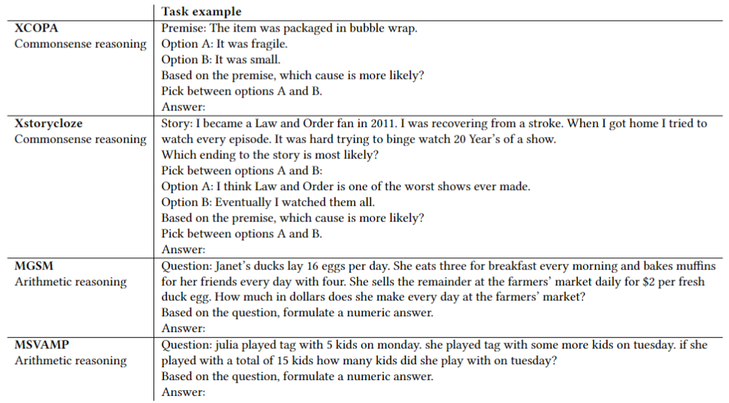
Commonsense reasoning

Slide 11
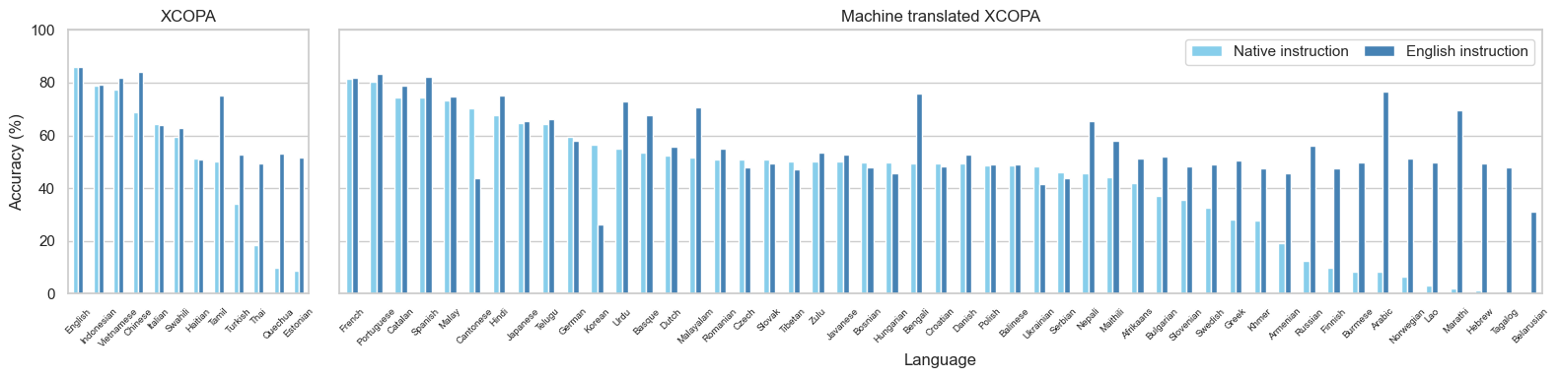
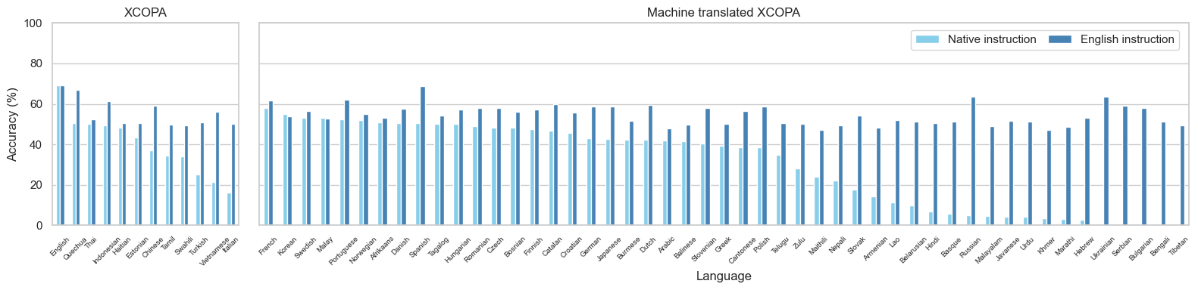
Bloomz
Llama-2
Notes:
XCOPA – basic – Native vs English instruction
Bloomz & Llama-2

Slide 12
Bloomz-Basic
85.8%
87.2%
Can we see the same effect for CoT reasoning?
Notes:
XCOPA – basic – Native vs English instruction

Slide 13
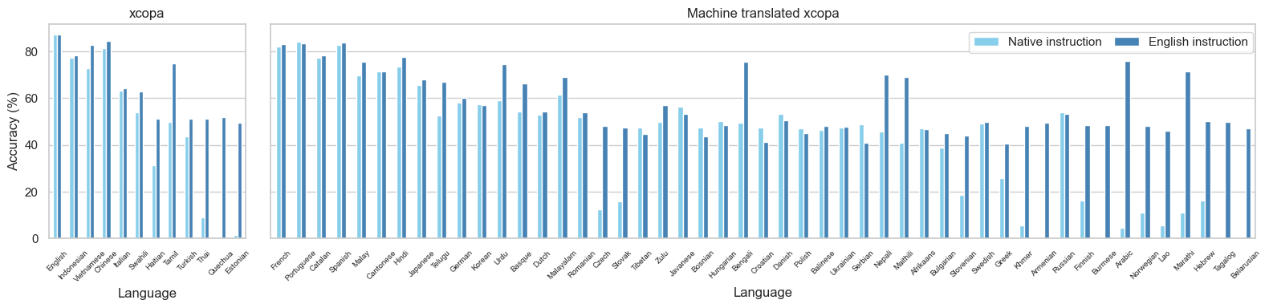
Bloomz-Basic
Bloomz-CoT

Slide 14
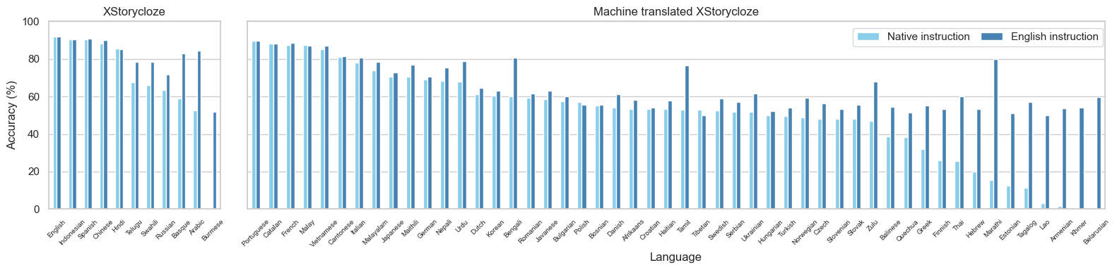
Bloomz
No results for Llama

Slide 15
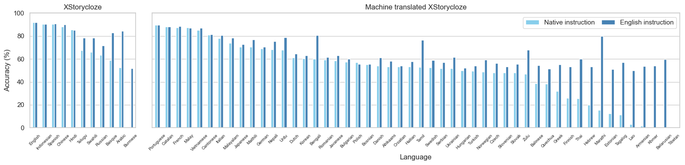
Bloomz
92.1%
89.1%
No CoT effect identified

Slide 16
Can we identify languages that typically fail and languages that typically succeed?

Slide 17
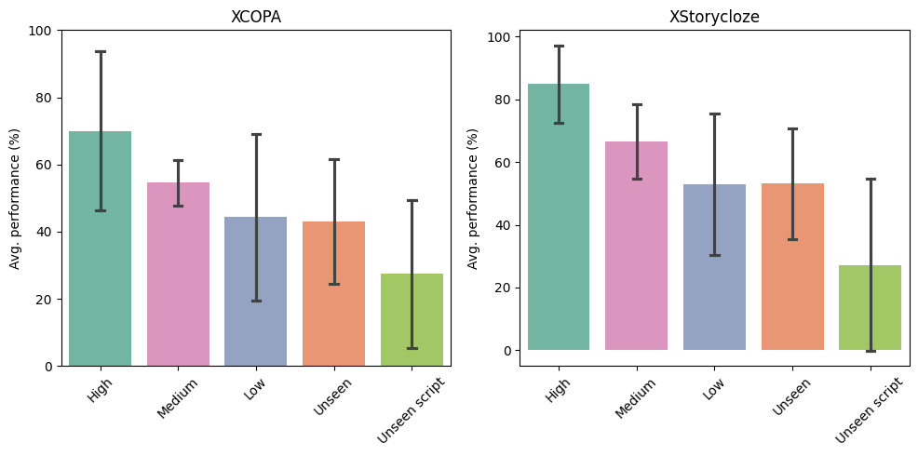
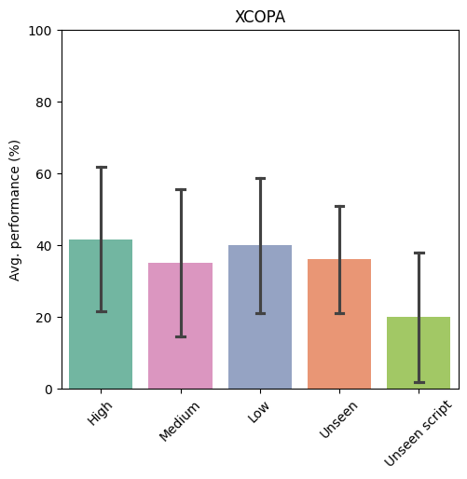
Bloomz
Llama-2

Slide 18
How do the instruction understanding abilities of LLMS in zero-shot reasoning differ across languages?
English task with varying instruction languages

Slide 19
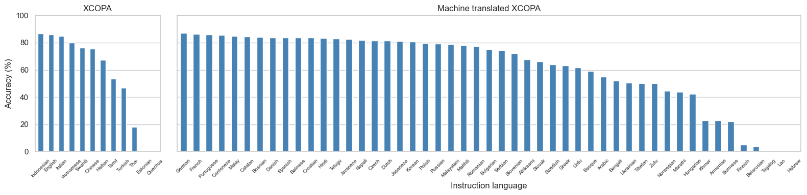
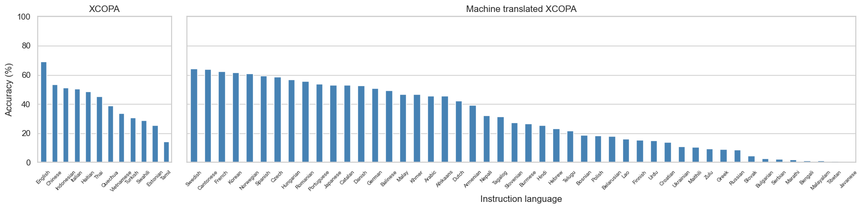
Bloomz
Llama-2

Slide 20
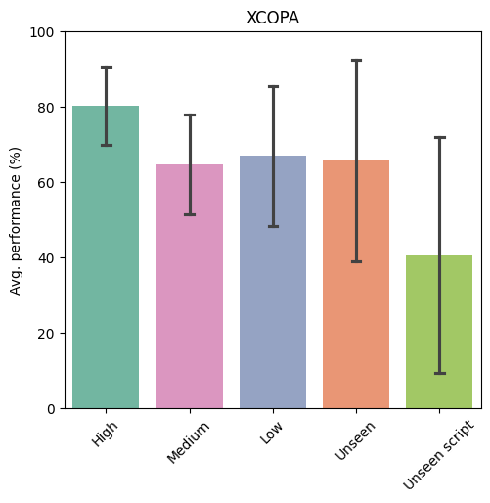
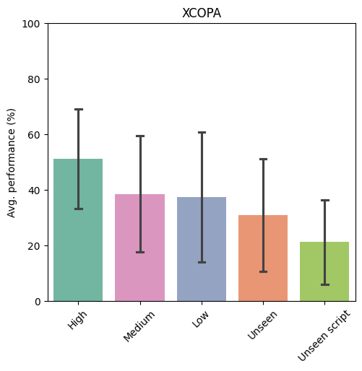
Bloomz
Llama-2

Slide 21
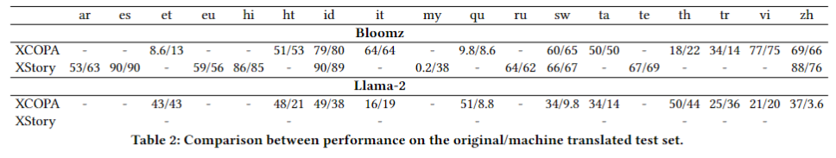
Sanity check
Original / machine translated

Slide 22
Sanity check
Original / machine translated

Slide 23
Sanity check
Original / machine translated

Slide 24
Arithmetic reasoning

Slide 25
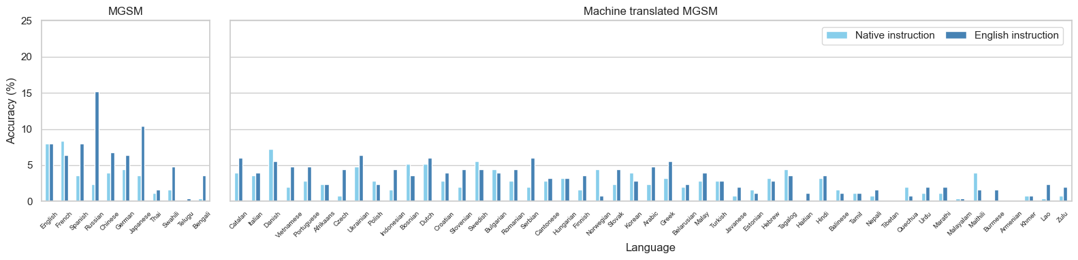
Llama-Basic
8.0%
19.6%
Can we see an effect for CoT reasoning?

Slide 26
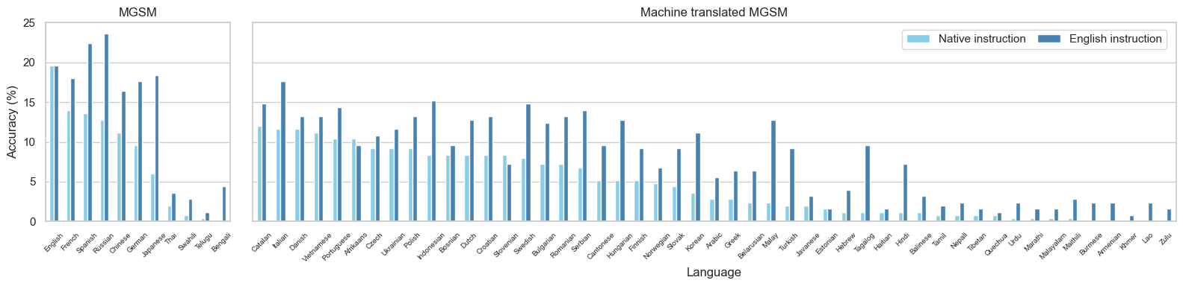
Llama-Basic
Llama-CoT

Slide 27
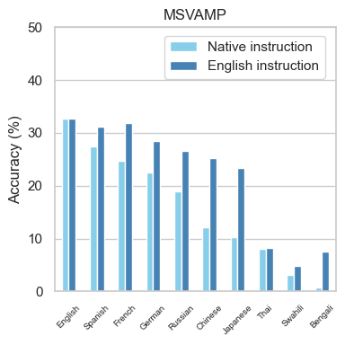
Llama-Basic

Slide 28
Llama-Basic
32.8%
41.9%
Can we see the same effect for CoT reasoning?

Slide 29
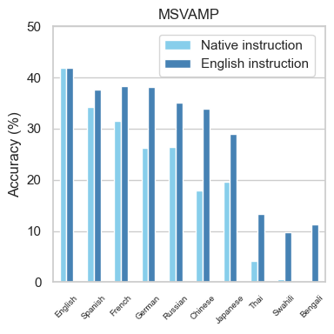
Llama-Basic
Llama-CoT

Slide 30
Conclusion & discussion
English instruction boosts performance compared to native instructions
XCOPA Bloomz and Llama-2
Xstorycloze Bloomz
MGSM Llama-2 effect only for CoT
MSVAMP Llama-2 tested only on orginal dataset

Slide 31
Conclusion & discussion
English instruction boosts performance compared to native instructions
XCOPA Bloomz and Llama-2
Xstorycloze Bloomz
MGSM Llama-2 effect only for CoT
MSVAMP Llama-2 tested only on orginal dataset

Slide 32
Conclusion & discussion
Downward trend for lower resource languages and significant drop for unseen scripts
Mainly for Bloomz on XCOPA and XStorycloze
Similar language representations in the pretraining corpus of Llama-2

Slide 33
Conclusion & discussion
On arithmetic reasoning tasks, CoT significantly boosts the performance across languages for Llama-2
Run all experiments on MSVAMP and Xstorycloze for Llama-2
Bad results sanity check Llama-2
CoT effect larger for larger model scales

Slide 34
Suggestions
Increasing running speed for inference with Llama-2?
Interesting analysis for identifying languages that typically fail or succeed?
Any suggestion is much appreciated ☺

Slide 35

Questions Feedback Tips

