Slide 1


SIR CR REDDY COLLEGE OF ENGINEERING, ELURU(A)
DEPARTMENT OF INFORMATION TECHNOLOGY
Implementation of an Explainable Deep Learning Model for Transparent and Ethical Decision Support Systems
GUIDED BY :
T. SATYA NAGAMANI
B.Tech, M.Tech, (Ph.D)
ASST. PROFESSOR
PRESENTED BY :
M. RATNAKARUN – 22B81A1274
P. HARIKA – 22B81A1293
Y. KUNDANA KOTESH – 23B85A1212
Y. MEGHANA – 22B81A12D0

Slide 2

Content Overview
1.Abstract
2.Literature Review
3.Problem statement
4.Existing Methodology
5.Proposed Methodology
6.System Architecture
7.Core System Modules
8.Methodology
9.Implementation Details
10.Demonstration
11.Testing and Validation
12.Output Screens
13.Conclusion

Slide 3
Abstract
The project addresses the black-box nature of deep learning, which often lacks the transparency required for critical, high-stakes decisions. To solve this, we implemented an explainable deep learning framework that balances high predictive performance with robust interpretability. Our methodology integrates neural network architectures with post-hoc explanation techniques like SHAP and LIME to transform complex outputs into human-understandable justifications. Quantitatively, the system achieved competitive accuracy while qualitatively providing the rich explanatory insights necessary for ethical accountability. Ultimately, this work establishes transparency as a fundamental requirement for building trustworthy and responsible AI-driven decision support systems.

Slide 4

Literature Review
S.No | Author | Year | Algorithm Used | Advantages | Limitations
1 | T. Vengatesh | 2025 | SHAP, LIME, Attention Mechanism | Enhances model transparency | Maintaining accuracy
2 | M. Salimparsa | 2025 | XAI in Clinical DSS | Identifies research gaps | Lack of current solutions
3 | T. Ahmad | 2024 | SHAP, LIME | Builds trust in AI models | Ethical concerns
4 | G.K. Kostopoulos | 2024 | XAI Taxonomy | Proposes future research paths | Challenges in standardization

Slide 5
Problem Statement
Traditional deep learning models operate as black boxes, providing accurate predictions without explaining the underlying logic. This lack of transparency prevents users from identifying hidden biases, verifying reliability, or complying with legal regulations like the right to explanation. Consequently, the inability to interpret model decisions creates a significant barrier to trust in critical sectors like healthcare and finance.

Slide 6
Existing Methodology
Current decision support systems primarily rely on standard deep learning architectures that focus almost exclusively on maximizing predictive accuracy and computational efficiency. These models operate as black boxes, where input data is processed through multiple hidden layers of neurons to produce an output without any associated reasoning or explanation. While effective at identifying complex patterns, these systems lack internal mechanisms to show which features influenced a specific result, making it impossible for users to audit the decision for bias, errors, or ethical inconsistencies. Consequently, the existing approach results in a take-it-or-leave-it scenario that fails to meet the transparency requirements necessary for high-stakes applications.

Slide 7
Proposed Methodology
We propose an Explainable Deep Learning (XDL) framework designed to bridge the gap between high-performance predictive modeling and human interpretability.
The system moves beyond traditional black-box limitations by incorporating post-hoc interpretability tools, specifically SHAP and LIME (Local Interpretable Model-agnostic Explanations), to quantify and visualize the influence of each input feature on the final output. To ensure ethical reliability, the framework includes a Transparent & Ethical Audit module that performs real-time bias detection and fairness verification. Finally, these results and evidence-based justifications are presented through an intuitive decision support interface, enabling users to make transparent, informed, and verifiable decisions in high-stakes environments.

Slide 8
System Architecture
End User
User Interface
1. Submits Data
6. Sends Final Results
2. Send Request
3. Sends Preprocessed data
5. Sends Results and Explanations
Data Preprocessing
Model Service
4. Sends Prediction
Explainability Service
Audit Service

Slide 9
Core System Modules
The system is divided into functional modules that handle the lifecycle of a transparent decision support system.
Data Management Module: Responsible for data collection, cleaning (handling missing values), and feature scaling for efficient training.
Deep Learning Model: The engine of the system (using DNN architectures) that performs pattern learning and prediction generation.
Explainability Module: The Glass-Box component that identifies feature importance using tools like SHAP, LIME, or attention mechanisms to reveal how inputs influenced the outcome.
User Interface (UI) Module: The interaction layer that displays final results alongside visual explanations for the user.
Audit & Compliance Module: Ensures ethical use by performing fairness checks for bias and generating performance reports for regulatory accountability.

Slide 10
Methodology – Data Management
The methodology begins with the Data Management Module, where structured input data is collected from the dataset.
The collected data undergoes preprocessing, including data cleaning, handling missing values, and removing inconsistencies.
Feature scaling and normalization are applied to ensure all input features are on a common scale.
The processed data is then stored and prepared for model training.
This step ensures high-quality input data, which is essential for accurate model performance.

Slide 11
Methodology – Model & Prediction
The preprocessed data is given to the Deep Learning Model, which is the core component of the system.
A Deep Neural Network (DNN) is used to learn complex patterns and relationships between input features.
The model is trained using backpropagation and optimized using the Adam optimizer.
After training, the model generates predictions for new input data provided by the user.
These predictions form the decision output of the system.

Slide 12
Methodology – Explainability & Output
The Explainability Module is used to interpret the predictions made by the deep learning model.
Techniques such as SHAP and permutation feature importance are applied to identify the contribution of each feature.
Feature contribution analysis helps in understanding how input features influence the final decision.
The system provides both prediction results and explanation outputs to the user.
This ensures transparency, improves user trust, and supports ethical and explainable decision-making.

Slide 13
Implementation – Tools & Technologies
Programming Language: Python
Frameworks Used: TensorFlow / PyTorch for deep learning model development
Backend Framework: Flask for building the web-based user interface
Explainability Libraries: SHAP and LIME for interpreting model predictions
Data Processing Libraries: Pandas, NumPy, and Scikit-learn for efficient data handling

Slide 14
Implementation – Data & Model Training
Dataset used: loan_approval_dataset.csv collected from Kaggle
Data preprocessing includes feature scaling, cleaning, and transformation
A Deep Neural Network (DNN) is trained using the processed dataset
Model training involves learning patterns and relationships between features
The model is evaluated using performance metrics to ensure accuracy

Slide 15
Implementation – System Integration
The trained model is integrated with the explainability module
SHAP and LIME are used to analyze feature importance and decision reasoning
The system is connected to a Flask-based user interface
Users can input data and receive predictions in real time
The output includes both prediction results and explanation for better understanding

Slide 16
Demonstration – System Workflow
The demonstration begins with the user interacting with the system through a simple and user-friendly interface.
The user enters input details required for the prediction process.
The input data is then passed to the preprocessing module for cleaning and transformation.
The processed data is forwarded to the trained deep learning model.
This step ensures that the system follows a structured flow from input to prediction.

Slide 17
Demonstration – Prediction Process
The trained deep learning model analyzes the input data and generates a prediction.
The predictiaon indicates the final decision, approval or rejection.
The system ensures that predictions are generated quickly and efficiently.
The output is based on patterns learned during the training phase.
This step highlights the decision-making capability of the model.

Slide 18
Demonstration – Explanation & Output
After generating the prediction, the explainability module is activated to interpret the result.
Techniques such as SHAP and feature importance are used to analyze the contribution of each input feature.
The system displays both the prediction result and graphical explanations.
Feature importance graphs help users understand the reason behind the decision.
This improves transparency, builds trust, and makes the system more user-friendly.

Slide 19
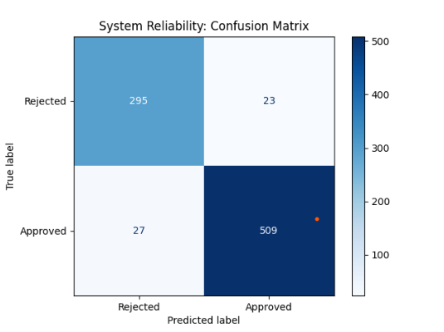
Testing and Validation
The confusion matrix is used to evaluate the classification performance of the model.
It shows correct and incorrect predictions in terms of true positives, true negatives, false positives, and false negatives.
A higher number of correct predictions indicates better model accuracy.
Lower misclassification values show that the model performs well on unseen data.
This analysis helps in understanding the strengths and weaknesses of the model.
Fig:Confusion Matrix

Slide 20
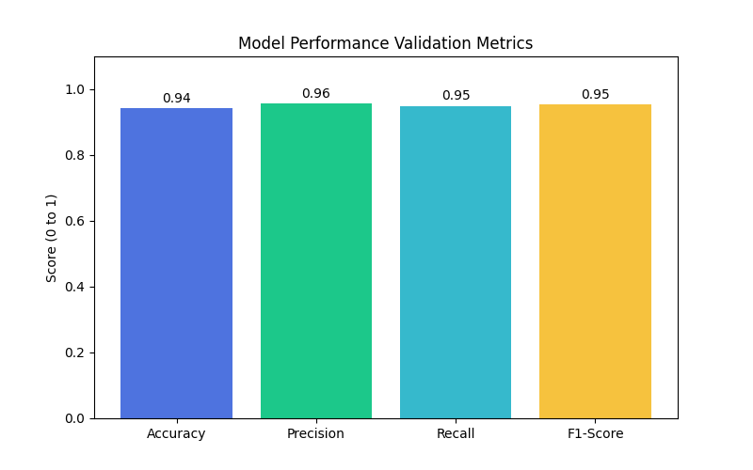
The training graph shows the variation of accuracy and loss during the model training process.
Accuracy increases gradually with epochs, indicating that the model is learning effectively.
Loss decreases over time, showing that prediction errors are reducing.
Stable curves indicate that the model is well-trained without overfitting or underfitting.
This validates that the model achieves good learning performance.
Fig:Model Performance Validation Metrics

Slide 21
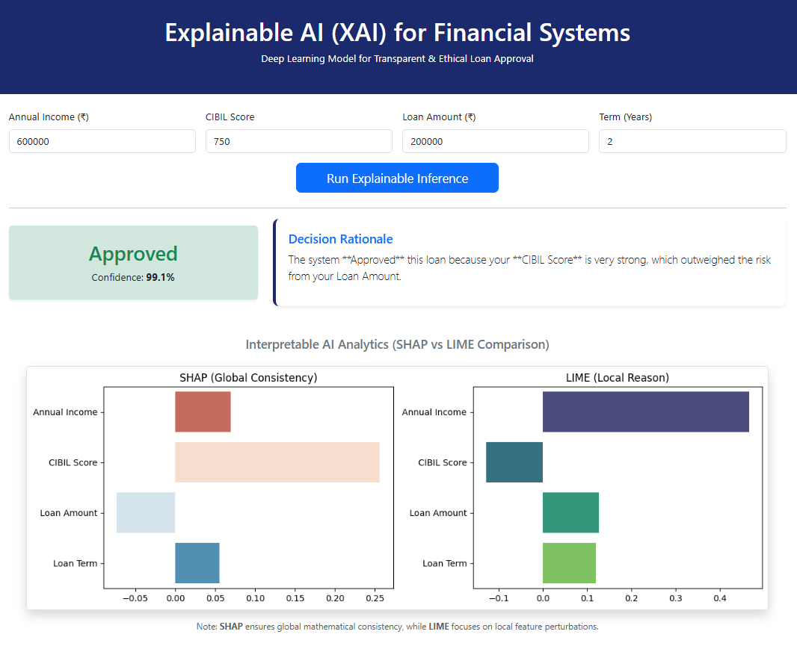
Output Screens
Fig:Loan Approval

Slide 22
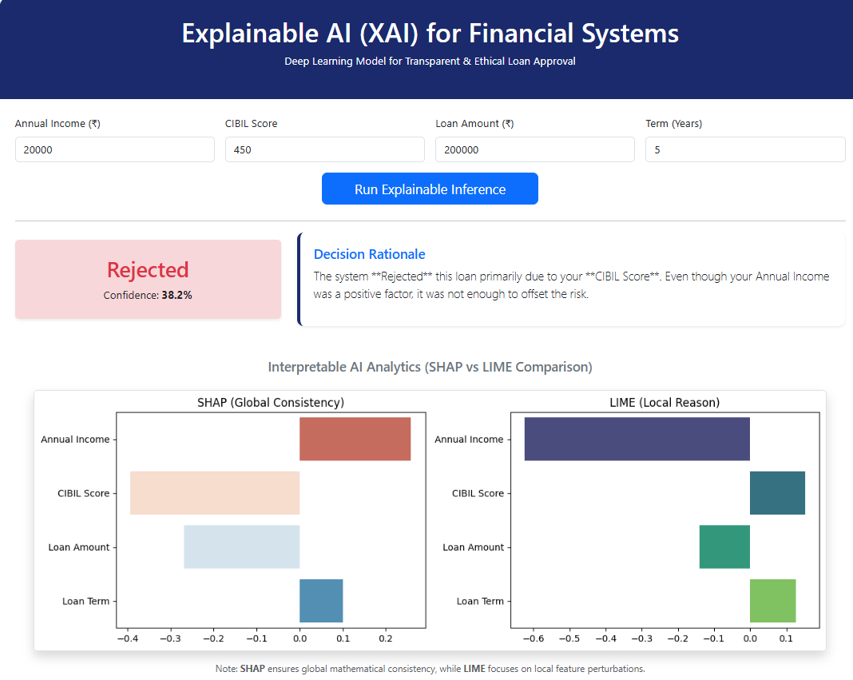
Fig:Loan Rejection

Slide 23
Conclusion
The project successfully implements an explainable deep learning–based decision support system that addresses the limitations of traditional black-box models. By integrating a deep neural network with explainability techniques feature importance analysis, the system is able to provide both accurate predictions and clear insights into how decisions are made. This improves transparency, builds user trust, and supports ethical decision-making. The system also demonstrates effective data preprocessing, model training, and performance evaluation using standard metrics. Overall, the proposed approach achieves a good balance between accuracy and interpretability, making it suitable for real-world applications where understanding the reasoning behind decisions is essential.

Slide 24
THANK YOU

Slide 25
ANY QUERIES?

