Slide 1

Fake News detection

Slide 2
About me
NAME QUALIFICATION
: Charishma Maradapu
: MCA

Slide 3
Contents :
Introduction
Tools (Libraries) used
Project Methodology
EDA (Uni, Bi Data analysis using graphs)
Model Building
Model Evaluation
Model Deployment
Conclusion

Slide 4

Introduction :
Fake news is a big problem online. It makes it hard to trust what you read..
Fake news spreads fast and can cause confusion.
It's important to spot fake news to make sure we're getting accurate information.
We need to be careful about what we believe and share online to avoid being misled.

Slide 5
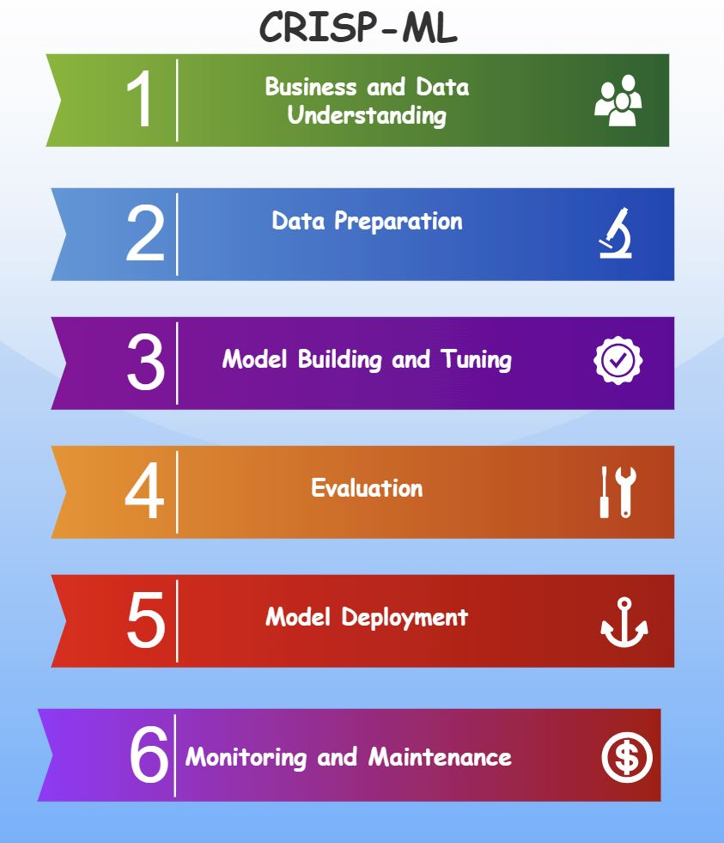
Project Methodology
CRISP MLQ

Slide 6









Tools (Libraries) Used :
Pandas
Numpy
Matplotlib
Seaborn
Sklearn
nltk
Streamlit

Slide 7
Business Problem :
Step - 1
Making it easier for people to know if news online is real or fake
Objective :
Building a smart tool that can tell if news articles are true or not, helping people make better choices and stop fake news from spreading.

Slide 8
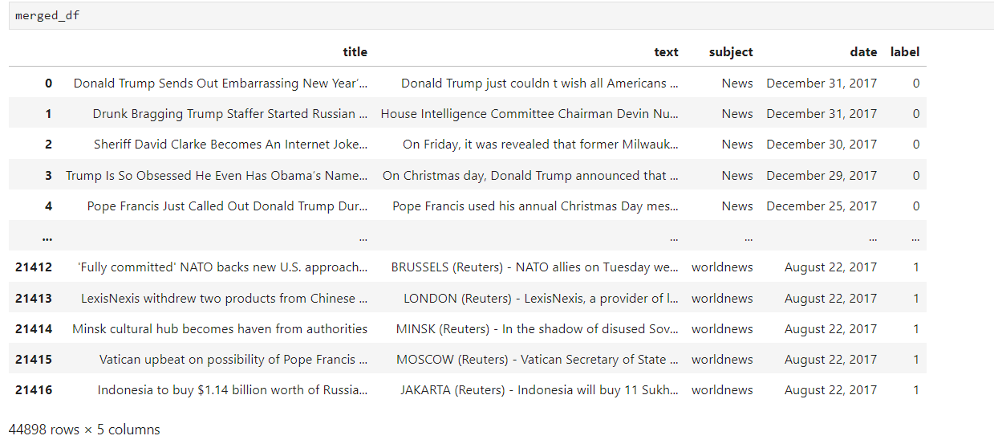
Raw data :
Insights : We got 44898 rows and 5 columns in the Raw data.

Slide 9
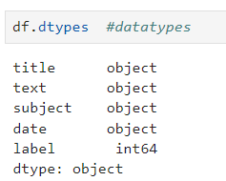
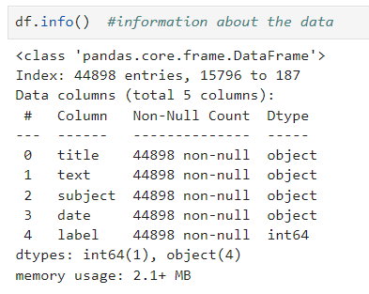
Data Understanding :
Information about the Data :
Data types:

Slide 10
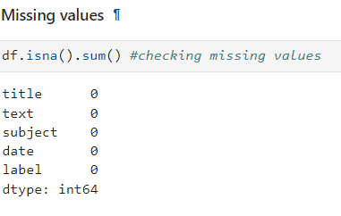
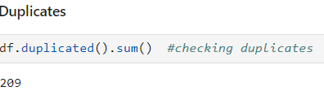
Data Preparation :
Step - 2
1.Exploratory Data Analysis
2.Data Cleaning
3.Feature Selection
1.Exploratory Data Analysis :

Slide 11
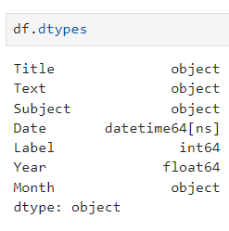
Data Cleaning Steps :
We have Segrigated values as required.
Dropped duplicate rows.
Updated datatypes of a columns into as required.

Slide 12
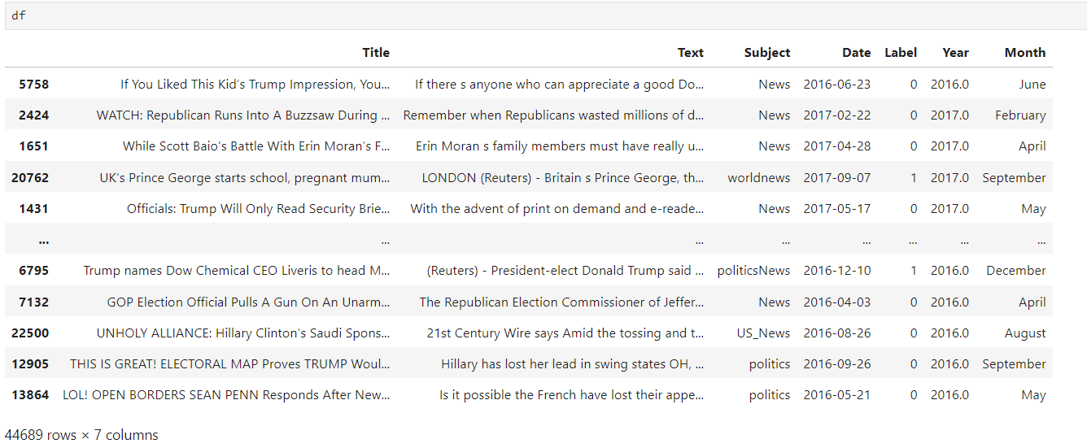
Cleaned Dataframe :

Slide 13

Data Visualization :
Representing data into pictorial format.
We have used Uni-variate , Bi- variate and Multi Variate for analysis and Visualization of the data.

Slide 14
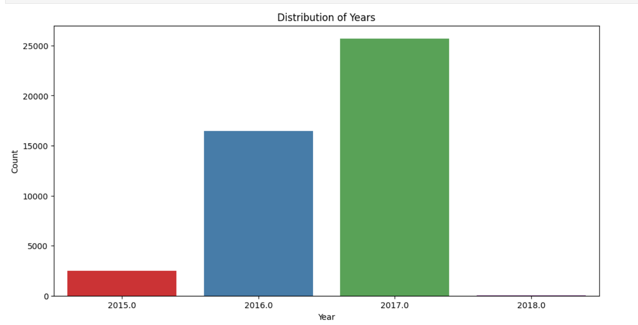

Distribution of Years :
There are more news from year 2017
But why

Slide 15
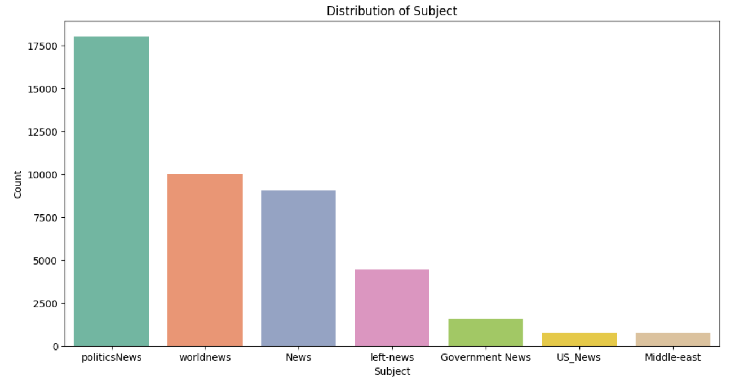

Different type’s of News(subjects).
Since there's more political news in the data, it's crucial to focus on spotting fake information specifically in political stories.

Slide 16
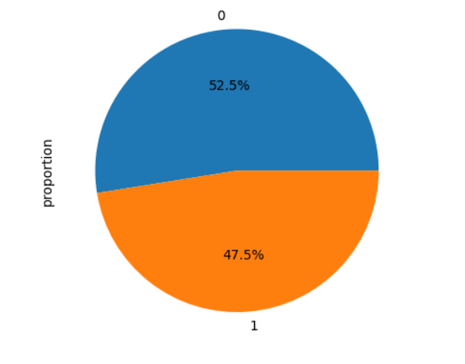
Data Distribution of Output Variable
The Data is balanced, we almost equal ratio of fake and real News
0 – Fake News
1 – Real News

Slide 17
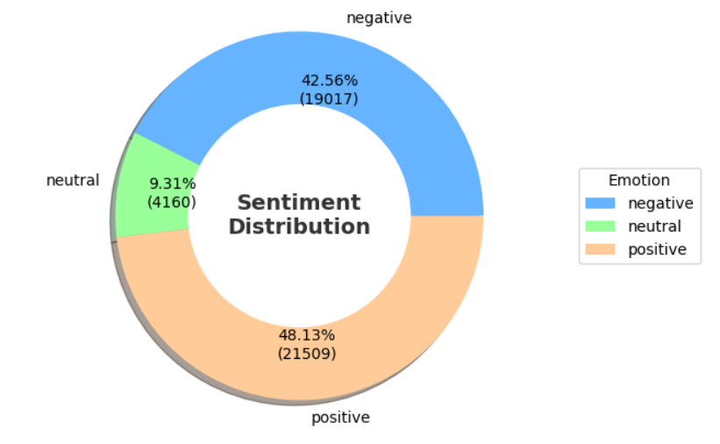
Sentiment Distribution of the Data :
There are more data with positive sentiment in our dataset

Slide 18
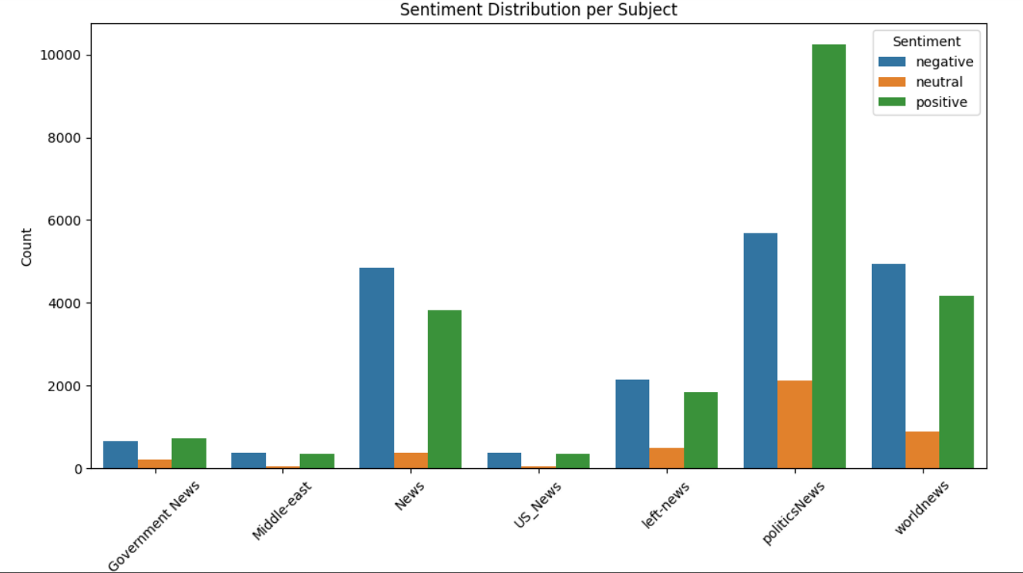
Sentiment Distribution With Subject :
There are more Positive news in politics, and remaining are having approximately equal ratios of positive and negative sentiment

Slide 19
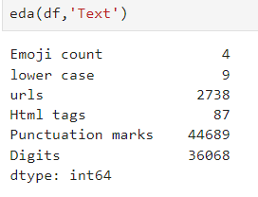
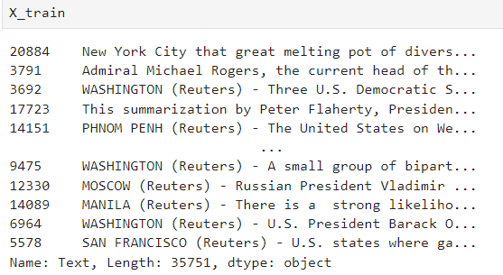
EDA of Text :

Slide 20
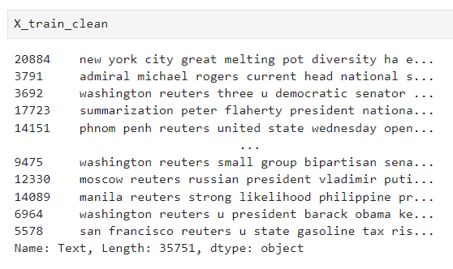
Preprocessing X_train, X_test
Text Lower Casing
Removing Punctuations and Special Characters
Stopwords, Emoji Removal
Stemming and Lemmatization
Removing urls, html tags

Slide 21
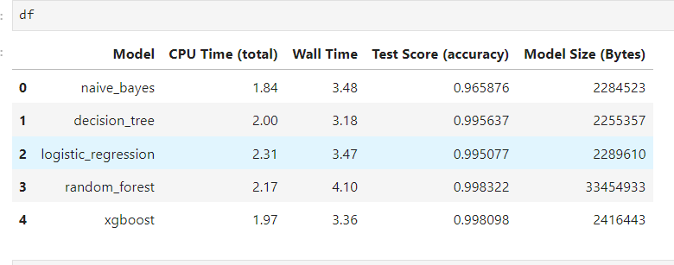
Model Building And Evaluation :
Step – 3&4
Utilized Naive Bayes, Random Forest, Decision Tree, and Logistic Regression, Xgboost algorithms for fake news detection.
Each model offers unique advantages: Naive Bayes for simplicity, Random Forest for complexity handling, Decision Tree for rule-based classification, and Logistic Regression for interpretability.
Evaluated models using metrics like accuracy, precision, recall, and F1-score, ensuring robust performance.

Slide 22

Model Deployment :
Step - 5

Slide 23


Result :

Slide 24
Challenges faced :
Reducing Time Complexity.
Conclusion :
By using smart technology, we've built a tool that can spot fake news, helping people navigate the internet with confidence.

Slide 25

Thank You

