Slide 1
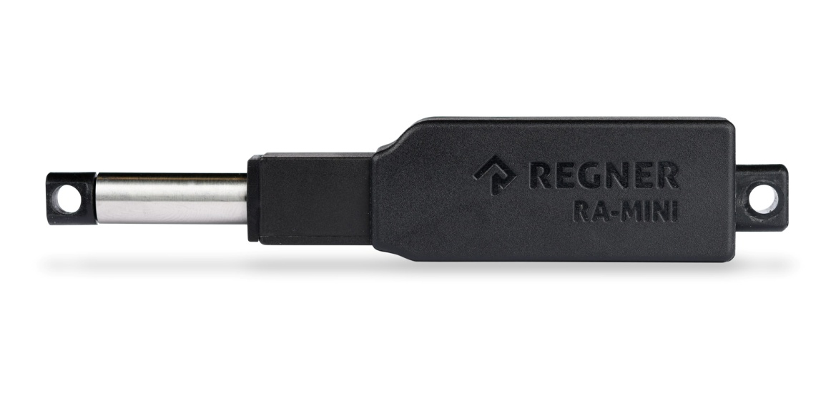
1-SPDT relay
2-RA-MINI PLAST Linear Actuator

Slide 2
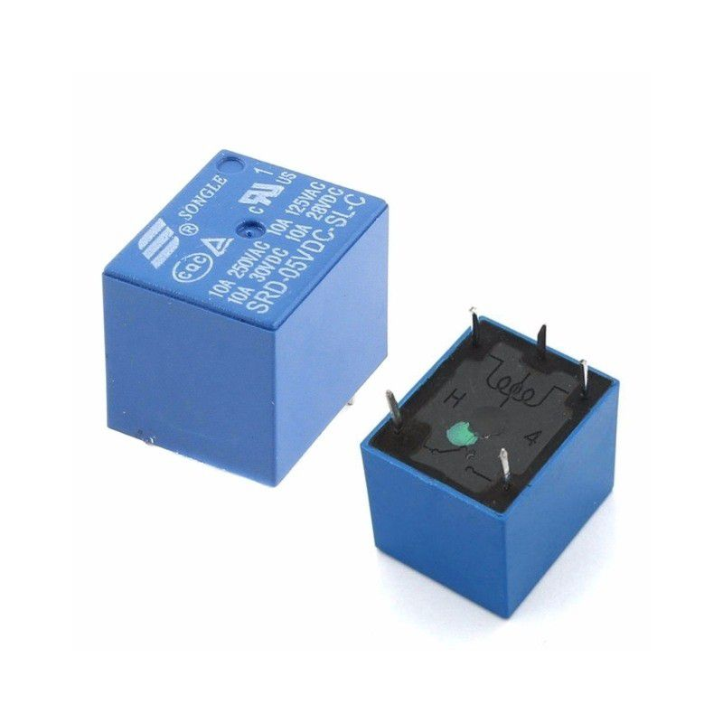
What the relay
A relay is an electromagnetic switch that can be operated by a smaller current
As the control circuit is energized, current flows through a coil that causes a magnetic field which is used to open and close the switch

Slide 3
Why SPDT relay
to stop in between the fully extended and fully retracted positions

Slide 4
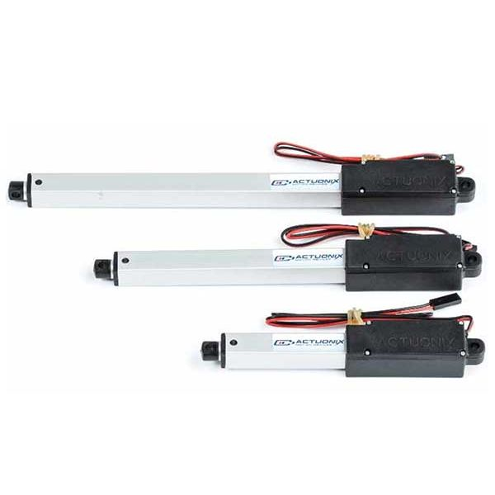
Linear Actuator
A linear actuator is an actuator that creates motion in a straight line

Slide 5
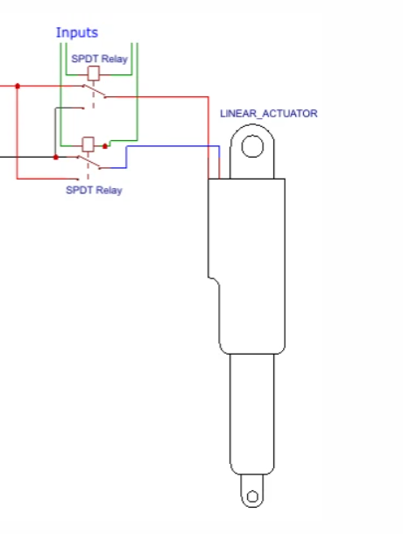
Connected relay with linear acutator

