Slide 1
Detecting the Change Points in a Time Series

Slide 2
Change Point Detection
Change point detection (or CPD) detects abrupt shifts in time series trends (i.e. shifts in a time series’ instantaneous velocity).
CPD is great for the following use cases:
Detecting anomalous sequences/states in a time series
Detecting the average velocity of unique states in a time series
Detecting a sudden change in a time series state in real time
There are two different categories of CPD — offline and online.
The ruptures package, a Python library for performing offline change point detection
The changefinder package, a Python library for online change point detection

Slide 3
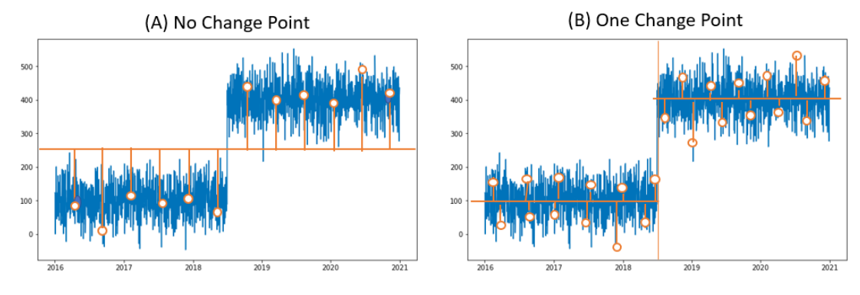
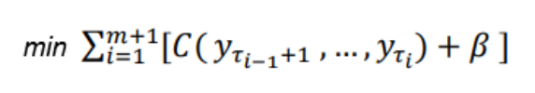

The Ruptures Module (PELT, offline)

Slide 4
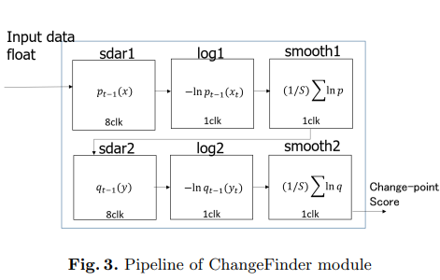
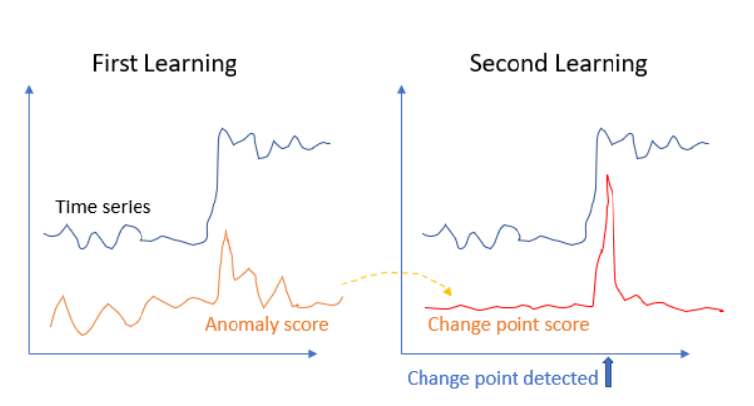
The Changefinder Module (Online)

Slide 5
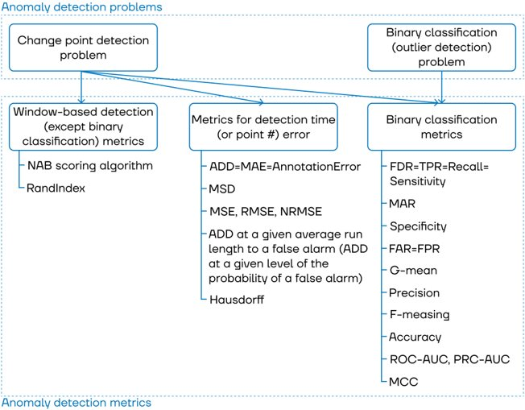

Slide 6
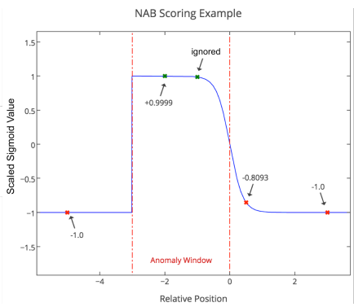
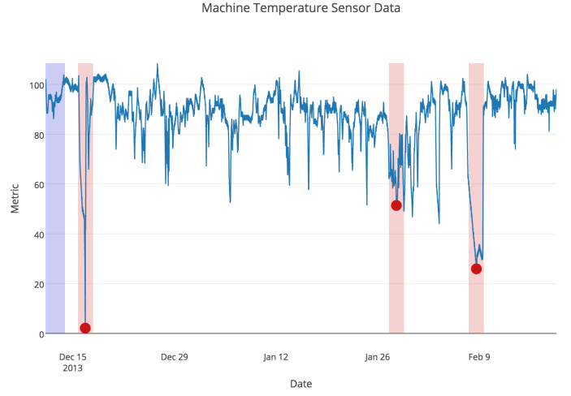
Window-based detection metrics
NAB scoring algorithm

Slide 7


Window-based detection metrics
Rand Index
Rand Index измеряет сходство между двумя сегментациями и равен доле согласия между двумя разделами T₁ T₂ из
N0 число пар образцов, принадлежащих к одному сегменту соответственно к T₁ и T₂
N1 число пар образцов, принадлежащих к разным сегментам соответственно к T₁ и T₂

Slide 8




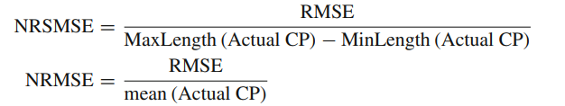
Metrics for detection time error
ADD (average detection delay) = MAE (mean absolute error) = AnnotationError
Mean signed difference (MSD)
MSE (mean squared error), RMSE (root mean squared error)
NRMSE (normalized root mean squared error)

Slide 9


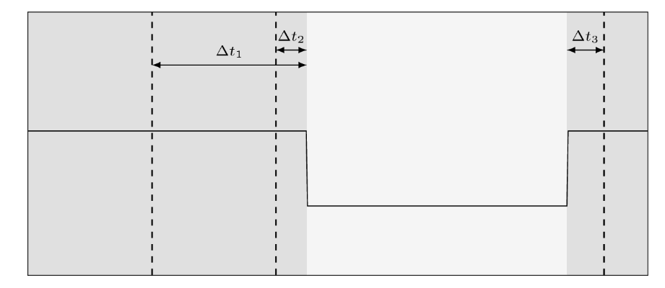
Metrics for detection time error
Hausdorff
Предположим, что имеется набор индексов точек изменения и их оценки

Slide 10


Covering metric (Cover)
Индекс Жаккара

Slide 11
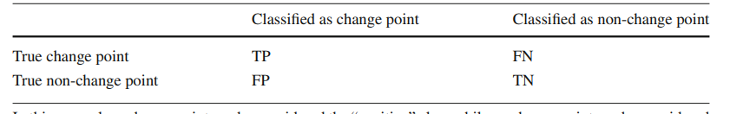





Binary classification metrics
Accuracy
Recall
Precision
F-measure
MCC - The Matthews correlation coefficient

