Slide 1
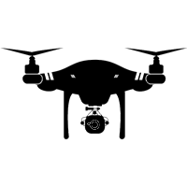
Drone
Pilot Training
Certificate

