Slide 1
Smartphone Recommendation System
Maram Alshehri

Slide 2
Smartphone Recommendation System
01
02
03
04
Introduction
Data
Models
Results

Slide 3
Introduction
The use of mobile devices in combination with the rapid growth of the internet has generated an information overload problem. Recommender systems are essential for determining which data are useful to the user.

Slide 4
Data
Name
Features
Number
Phone user reviews
11 featurest
Size
Originated
by
374910 rows
Kaggle website

Slide 5
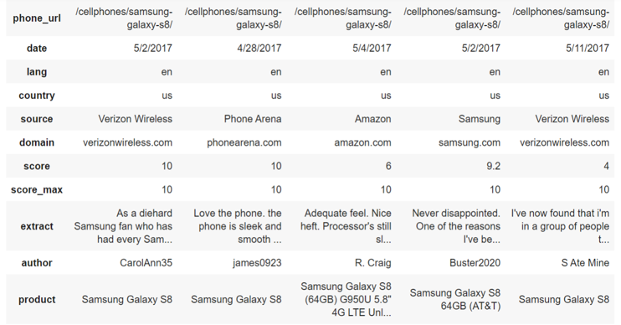
Example of The Data

Slide 6
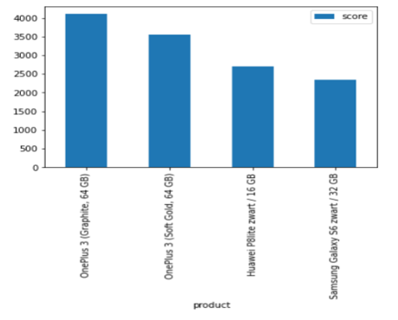
Example of The Data

Slide 7
Model
Build the model
Data Preprocessing
Splitting the data

Slide 8
Data Preprocessing
Check
Check missing values
Fill
Fill in null values in the "score" and "score_max" columns
Drop
Drop irrelevant features
Split
Split the data into training and testing

Slide 9
Model used
Collaborative filtering model using SVD.
Collaborative filtering model using kNN with means

Slide 10
Model Evaluation
ROOT MEAN SQUARED ERROR (RMSE) is similar to MAE but the only difference is that the absolute value of the residual(see above image) is squared and the square root of the whole term is taken for comparison. The advantage of using RMSE over MAE is that it penalizes the term more when the error is high.

Slide 11
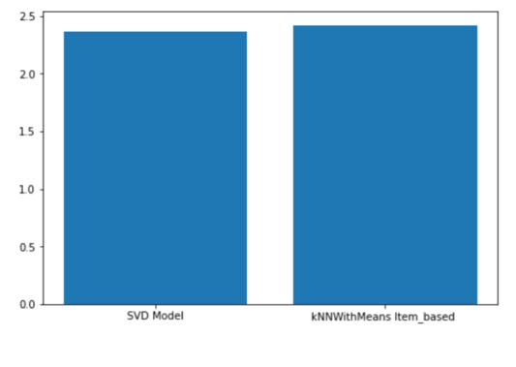
Results

Slide 12
Thanks
Any Questions!

