Slide 1

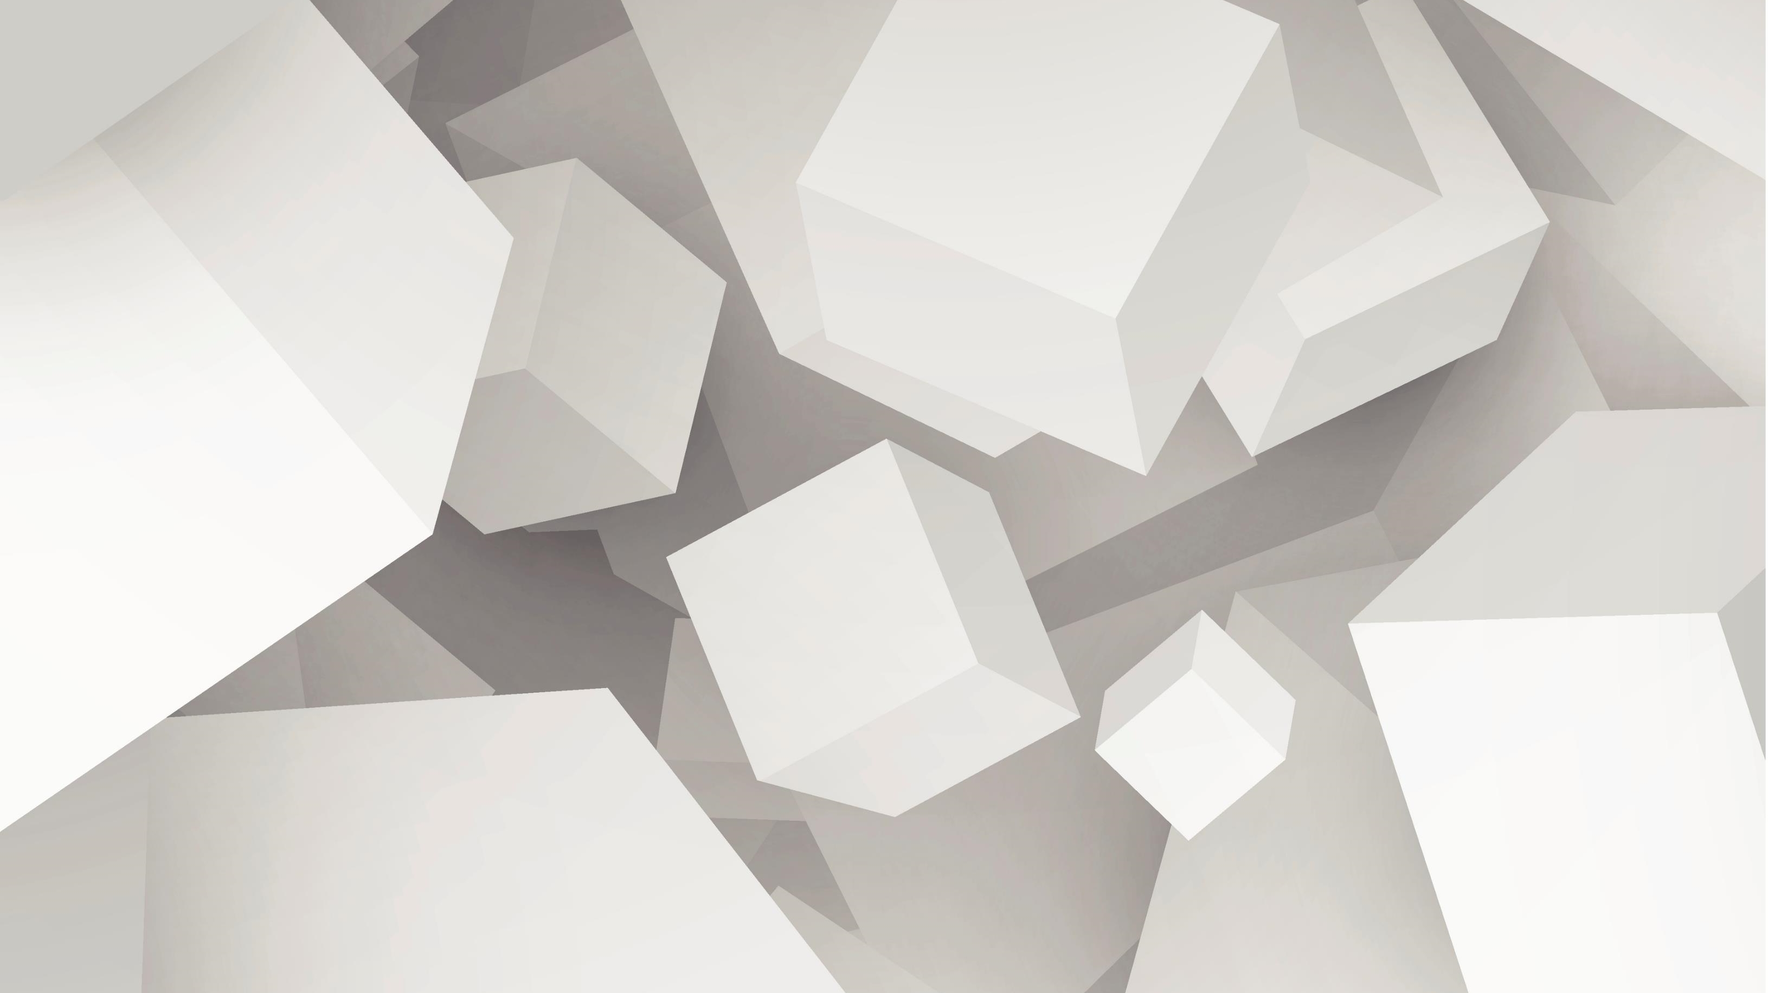
Coevolving Intelligent ANN-based Gomoku Players
Helwan University
Faculty of Computers & Artificial Intelligence – General Programme
Artificial Intelligence Department – Module: AI420 Evolutionary Algorithms – Spring “Semester 2” 2023-2024
byAmrS.Ghoneim

Slide 2
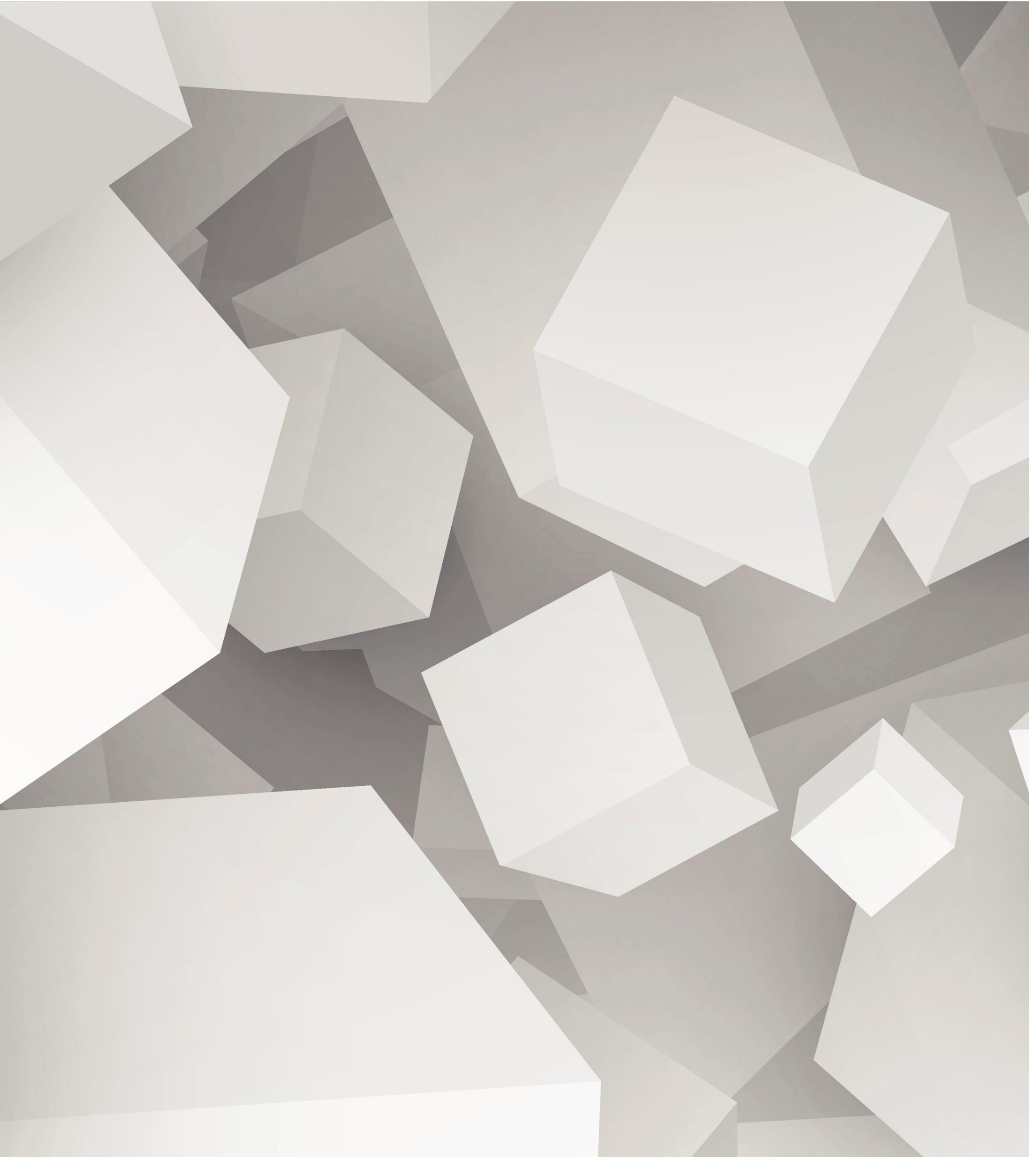
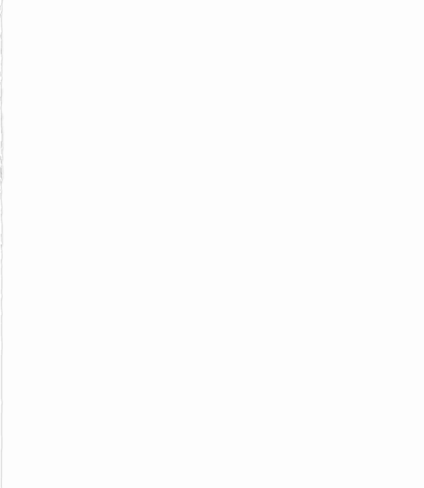
agenda
Course information
General definition
General important concept
game specifications
Implementation definitions
Implementation Details

Slide 3
Course information
Course name : E V O L U T I O N A R Y A L G O R I T H M S
Course code : AI420
Coordinating : Unit the Department of Artificial Intelligence and the Department of Computer Science,Faculty of Computers & Artificial Intelligence, Helwan University
Level : Undergraduate - Level 3

Slide 4
General definition
Gomoku is a traditional board game that originated in East Asia, particularly in Japan and China. It's played on a grid typically ranging from 15x15 to 19x19, where two players take turns placing their stones on the intersections of the grid. The objective is to form a continuous line of five stones horizontally, vertically, or diagonally. Gomoku combines elements of strategy, tactics, and pattern recognition, making it a popular game for both casual players and serious enthusiasts.

Slide 5
General important concept
Genetic Algorithm:
A genetic algorithm (GA) is a computational technique inspired by the principles of natural selection and genetics. It belongs to the class of evolutionary algorithms and is used for optimization and search problems. In a genetic algorithm, a population of potential solutions evolves over successive generations. Each solution is represented as a chromosome, typically encoded as a string of binary digits (genes). The algorithm applies genetic operators such as selection, crossover, and mutation to produce new generations of solutions. Through repeated iterations, the algorithm converges towards optimal or near-optimal solutions to the given problem.
Neural Network:
A neural network is a computational model inspired by the structure and function of the human brain's interconnected neurons. It consists of interconnected nodes organized into layers. Information flows through the network from input nodes, through intermediate hidden layers, to output nodes. Each connection between nodes is associated with a weight that modulates the signal's strength. Neural networks are capable of learning from data through a process called training, where they adjust their weights based on input-output pairs to minimize a predefined error or loss function. They are used for a wide range of tasks, including pattern recognition, classification, regression, and reinforcement learning.
Coevolution
is the process by which two or more species reciprocally influence each other's evolution through interactions over time. This mutual influence often leads to adaptations in both species that enhance their ability to interact effectively with one another.

Slide 6
game specifications
Objective Function: A way of assigning a value to a possible solution that
reflects its quality on a scale;
Constraint: Binary evaluation telling whether a given requirement holds or
not;
Constraint Satisfaction Problem : (Optimisation + Constraint)

Slide 7
game specifications
Clearly define and formalize
Problem Type : Optimization
Optimization type : Constrained Optimization
constrain : In order to win, an individual must place five balls horizontally, vertically, or diagonally

Slide 8
game specifications
coevolutionary approach : Competitive
In a competitive scenario, individuals or entities strive to outperform others and gain an advantage over them.
Competition typically involves limited resources or opportunities, where one's success comes at the expense of others.
Competitive interactions can be zero-sum, meaning that gains for one participant directly result in losses for another.
Examples include competitive sports, business rivalries, and zero-sum games like chess or poker.
In artificial intelligence, competitive agents are designed to pursue their goals independently and may engage in strategies to outwit or defeat other agents.

Slide 9
General used concept(Genetic Algorithm)
1. *Representation (Definition of Individuals)*: Each individual in the population is represented by a neural network. The neural network's weights (both input-hidden and hidden-output) serve as the genotype of the individual.
2. *Evaluation Function (Fitness Function)*: The fitness of an individual (neural network) is determined by its performance in the game. Fitness is calculated based on the number of wins obtained by playing games using the individual as a player. - In the provided code, the adjusted fitness is calculated, which considers the performance relative to the population and the genetic diversity.
3. *Population*: The population consists of a fixed number of individuals (neural networks). In the provided code, there are separate populations for black and white players, each with the same size.

Slide 10
General used concept(Genetic Algorithm)
4. *Parent Selection Mechanism*: Parents are selected for crossover based on their fitness. In the provided code, parent selection is done using a weighted random selection mechanism, where individuals with higher fitness have a higher probability of being selected as parents.
5. *Variation Operators (Mutation and Recombination)*:
*Crossover (Recombination)*: Single arithmetic crossover is used to combine the weights of two parent neural networks to create offspring.
*Mutation*: Mutation is applied to introduce small random changes in the weights of the neural networks. Both crossover and mutation contribute to creating genetic diversity in the population.
6. *Survivor Selection Mechanism (Replacement)*: After generating offspring, individuals from the current population are replaced with the new offspring. In the provided code, the entire population is replaced with the new offspring

Slide 11
General used concept(Genetic Algorithm)
7. *Initialization*: The initial population is created by generating random neural networks with random initial weights.
8. *Termination Condition(s)*: The algorithm terminates after a certain number of generations or when a satisfactory solution (e.g., a neural network with high enough performance) is found. In the provided code, the termination condition is not explicitly defined. The game loop runs for a fixed number of iterations, and the evolutionary process may be repeated for multiple runs.

Slide 12
General used concept
the Black-box Model: Optimization
Model and desired output (or a description of the desired output) are known, task is to find inputs
Examples:
o Timetables for universities, call centers, hospitals, or ..
o Design specifications,
o Traveling Salesman Problem (TSP),
o Eight-Queens Problem

Slide 13
Implementation definitions
*Game Logic*: The game is played on a 15x15 board where players take turns placing their pieces (black and white) on the intersections of the grid. The objective is to get five of your pieces in a row horizontally, vertically, or diagonally before your opponent does.
2. *Neural Network*: The neural network is used to make decisions for the AI players (black and white). - It's a simple feedforward neural network with a single hidden layer. The input layer has 15x15 = 225 neurons, representing the board state. The output layer has 15 neurons, each representing a column where a piece can be placed. The network uses the sigmoid activation function.
3. *Genetic Algorithm*: The genetic algorithm is used to evolve populations of neural networks for both black and white players. The algorithm selects parents based on their fitness (win rate) and performs crossover and mutation to generate offspring. Crossover is performed using a single arithmetic crossover method. Mutation occurs with a low probability (0.01) and adds random noise to the weights of the networks.

Slide 14
Implementation definitions
4. *Game Loop*: The game loop iterates until a winning move is made by either player. In each iteration, the AI players (black and white) select moves based on the output of their neural networks. The board is updated after each move, and the game state is checked for a winning condition.
5. *Tkinter Interface*: Tkinter is used to create a simple GUI for the game. The game board is drawn using rectangles and ovals to represent the grid and pieces.
6. *Multiple Runs*: The game is run multiple times (30 runs in this case), each with a different random seed. After each run, the winning player (or a tie) is displayed along with the seed used for initialization.

Slide 15
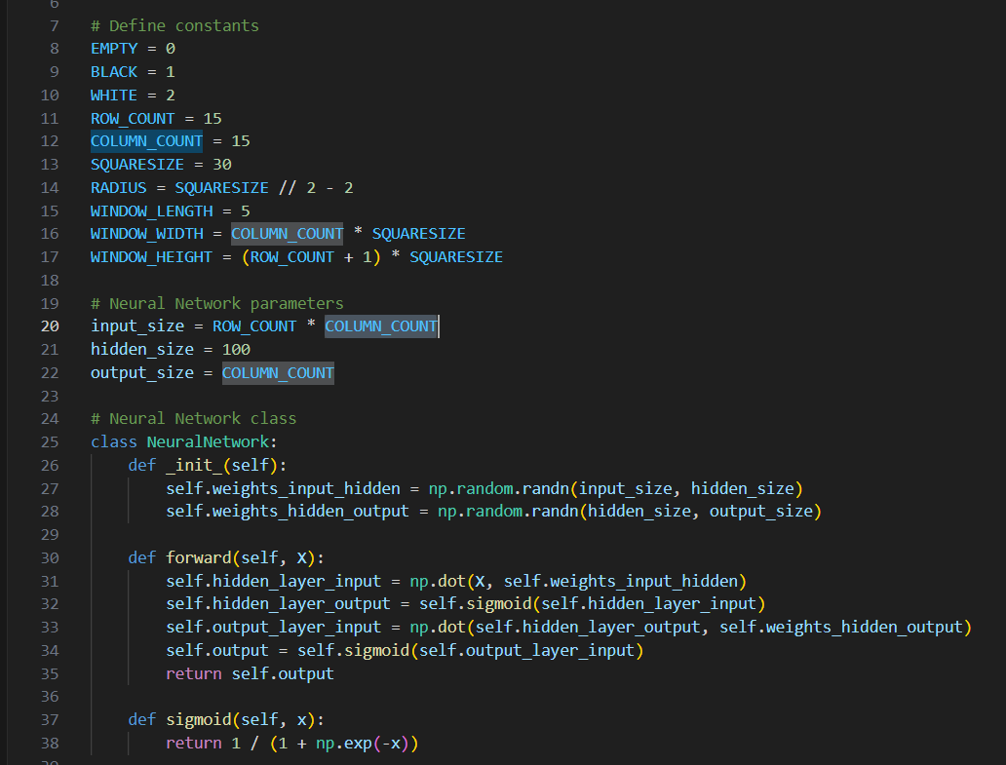
Implementation Details
Constants Definition: These are variables representing constants used throughout the code. For example, EMPTY, BLACK, and WHITE are integer constants representing different states on the game board. ROW_COUNT and COLUMN_COUNT represent the dimensions of the game board, SQUARESIZE represents the size of each square on the game board, and so on.
Neural Network Parameters: These variables define the architecture of the neural network. input_size represents the size of the input layer, hidden_size represents the number of neurons in the hidden layer, and output_size represents the size of the output layer.
Neural Network Class: This is a class named NeuralNetwork that defines a neural network. It has methods to initialize the network (__init__()), perform forward propagation (forward()), and apply the sigmoid activation function (sigmoid()).

Slide 16
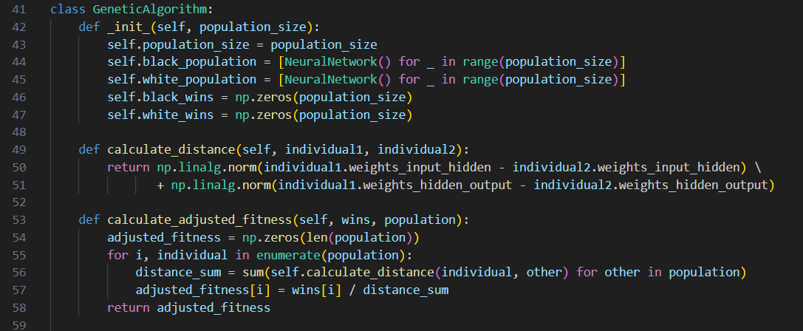
Implementation Details
__init__(self, population_size)
This method initializes a GeneticAlgorithm object with a given population size.
It creates two populations of neural networks, one for black players and one for white players, each with the specified population size.
The arrays black_wins and white_wins are initialized with zeros to keep track of wins for each population.
calculate_distance(self, individual1, individual2)
This method calculates the distance between the weight matrices of two neural network individuals.
The distance is computed using the Euclidean distance (L2 norm) between the flattened weight vectors of the two individuals.
calculate_adjusted_fitness(self, wins, population):
This method calculates the adjusted fitness scores for individuals in a population based on their wins and distances to other individuals.
For each individual in the population, it computes a fitness score that takes into account both the individual's wins and its distance to other individuals in the population.

Slide 17
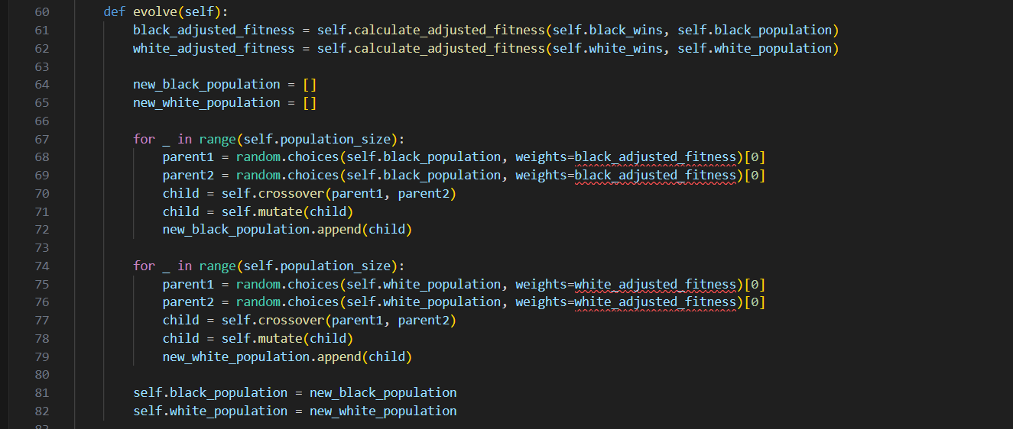
Implementation Details
evolve(self):
This method executes one generation of evolution for the genetic algorithm.
Fitness Calculation:
The first step in the evolution process is to calculate the adjusted fitness scores for both the black and white populations. This is done using the calculate_adjusted_fitness method. Adjusted fitness takes into account both the number of wins and the distances between individuals in the population.
Parent Selection:
After calculating adjusted fitness scores, the method selects parents for crossover based on these scores. Parents are chosen probabilistically, with individuals having higher adjusted fitness scores being more likely to be selected as parents. This selection process is performed using the random.choices function.
Crossover:
Once parents are selected, the method performs single-point arithmetic crossover to generate new individuals. Crossover involves combining the weights of two parent neural networks to create a child neural network. The crossover point is randomly chosen, and weights before the crossover point are inherited from one parent, while weights after the crossover point are inherited from the other parent.
Mutation:
After crossover, the method applies mutation to the child neural networks. Mutation introduces random changes to the weights of the neural networks, thereby increasing genetic diversity in the population. The mutation rate determines the probability of mutation for each weight in the neural network.
Population Update:
Finally, the method updates the populations of black and white neural networks with the newly generated individuals. The old populations are replaced with the new ones, containing the offspring of the previous generation.

Slide 18
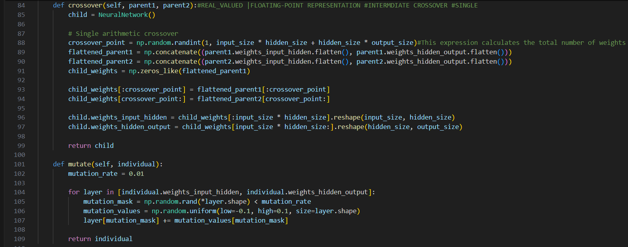
Implementation Details
crossover(self, parent1, parent2):
This method performs single-point arithmetic crossover between two parent neural networks
Single-Point Arithmetic Crossover:
The method implements a single-point arithmetic crossover technique. In this type of crossover, a single crossover point is randomly selected along the weights of the neural networks.
This crossover method is applied separately to both the input-hidden and hidden-output weight matrices of the neural networks
Certainly! Let's delve into more technical details about the crossover(self, parent1, parent2) method:
Single-Point Arithmetic Crossover:
The method implements a single-point arithmetic crossover technique. In this type of crossover, a single crossover point is randomly selected along the weights of the neural networks.
This crossover method is applied separately to both the input-hidden and hidden-output weight matrices of the neural networks.
Flattening and Concatenation:
Before performing crossover, the weight matrices of the parent neural networks are flattened into 1-dimensional arrays. This makes it easier to manipulate the weights during crossover.
The flattened weight vectors of the parents are concatenated to form a single long vector that represents both parents' weights.
Crossover Point Selection:
A random crossover point is chosen within the range of indices representing the flattened weight vectors. This point determines where the weights of the parents are combined to create the child's weights.
Combining Parent Weights:
Once the crossover point is determined, the weights of the child neural network are formed by taking the weights from one parent up to the crossover point and the weights from the other parent after the crossover point.
This process effectively mixes genetic material from both parents to create offspring with traits inherited from each parent.
Reshaping Child Weights:
After combining the weights from both parents, the child's weight vector is split back into the input-hidden and hidden-output weight matrices, maintaining the original shape of the weight matrices.
Child Generation:
The resulting child neural network inherits a combination of weights from its parents, representing a compromise between the characteristics of the two parent networks.
This process helps introduce diversity into the population and allows for exploration of different combinations of weights that may lead to improved performance.

Slide 19
Implementation Details
mutate(self, individual):
This method introduces random mutations to the weights of an individual neural network.
Mutation Rate:
The mutation rate represents the probability of mutation for each weight in the neural network. A higher mutation rate implies a higher likelihood of introducing random changes to the weights.
Random Mutation:
The method applies mutations to both the input-hidden and hidden-output weight matrices of the individual neural network. This ensures that mutations can occur across all connections in the network.
Mutation Operation:
For each weight matrix, the method generates a binary mask using np.random.rand(), where values less than the mutation rate indicate positions where mutation will occur.
Random mutation values are then generated using np.random.uniform() within a specified range, typically small values around zero.
These random mutation values are added to the weights of the individual neural network only at positions where the mutation mask is activated.
Effect of Mutation:
Mutations introduce stochastic changes to the weights of the neural network, leading to variations in its behavior and potentially affecting its performance.
The magnitude of mutation values and their distribution around zero determine the extent of the changes introduced to the weights.
Exploration vs. Exploitation:
Mutation plays a crucial role in balancing exploration and exploitation within the genetic algorithm. By introducing random variations, mutation allows the algorithm to explore new regions of the search space, potentially discovering better solutions.
However, excessive mutation can lead to chaotic behavior and hinder convergence to optimal solutions. Therefore, the mutation rate should be carefully chosen to strike a balance between exploration and exploitation.
Maintaining Diversity:
Mutation helps maintain genetic diversity within the population of neural networks. Without mutation, the population may converge prematurely to suboptimal solutions, as individuals with similar characteristics dominate the population.

Slide 20
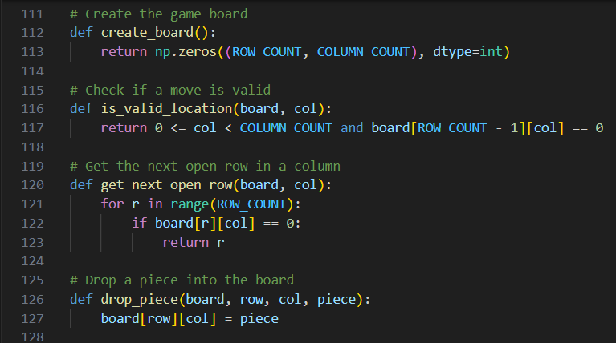
Implementation Details
create_board():
This function creates a game board as a two-dimensional NumPy array filled with zeros. The dimensions of the board are specified by the constants ROW_COUNT and COLUMN_COUNT.
The board is initialized with zeros, where each zero represents an empty space on the board.
is_valid_location(board, col):
This function checks if a column index col is within the bounds of the game board and if the top row of that column is empty.
It returns True if the move is valid (i.e., the column is within bounds and not full), and False otherwise.
get_next_open_row(board, col):
This function returns the index of the next available (empty) row in a given column col.
It iterates through the rows of the specified column, starting from the bottom, and returns the index of the first empty row encountered.
drop_piece(board, row, col, piece):
This function drops a game piece (denoted by the value piece) into the specified row and column on the game board.
It updates the value at the specified row and column of the board array to the value of the given piece, indicating that a piece has been placed in that position.

Slide 21
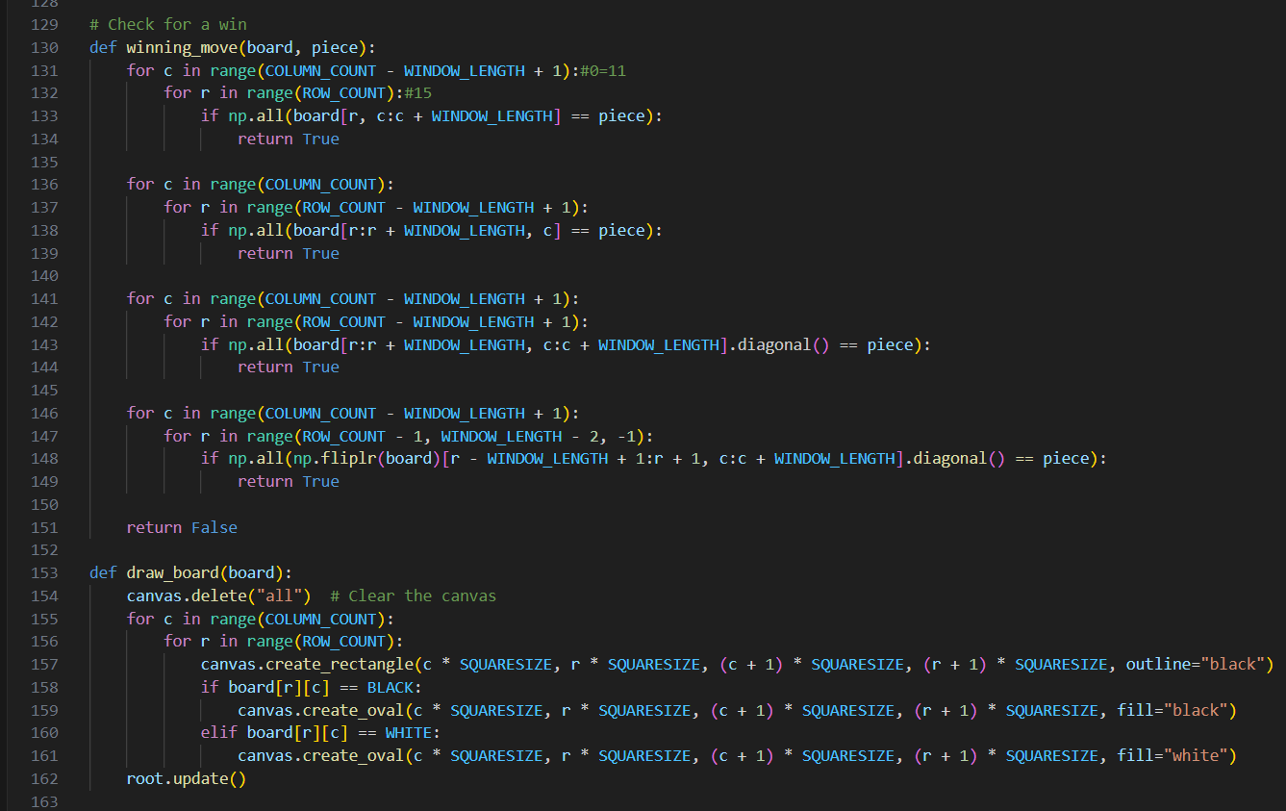
Implementation Details
Horizontal Check:
The function iterates over each column (c) from left to right, up to COLUMN_COUNT - WINDOW_LENGTH + 1. This ensures that the window being checked doesn't exceed the boundaries of the board.
For each column, it iterates over each row (r).
It then checks if there's a contiguous sequence of WINDOW_LENGTH pieces of the given piece in that row. This is done using NumPy's np.all() function, which checks if all elements in a given array are equal to a specified value (piece). If all elements in the window are equal to piece, it returns True, indicating a winning move.
Vertical Check:
Similar to the horizontal check, the function iterates over each row (r) from top to bottom, up to ROW_COUNT - WINDOW_LENGTH + 1.
For each row, it iterates over each column (c).
It then checks if there's a contiguous sequence of WINDOW_LENGTH pieces of the given piece in that column. This is done using the same np.all() function.
Diagonal Check (Main Diagonal):
The function iterates over each starting position (r, c) of a potential main diagonal sequence of length WINDOW_LENGTH.
It then checks if there's a contiguous sequence of WINDOW_LENGTH pieces of the given piece along the main diagonal (from top-left to bottom-right) starting from that position. This is done using NumPy's diagonal() function.
Diagonal Check (Secondary Diagonal):
Similar to the main diagonal check, the function iterates over each starting position (r, c) of a potential secondary diagonal sequence of length WINDOW_LENGTH.
It then checks if there's a contiguous sequence of WINDOW_LENGTH pieces of the given piece along the secondary diagonal (from top-right to bottom-left) starting from that position. This is done by first flipping the board horizontally (np.fliplr(board)) to make the secondary diagonal equivalent to the main diagonal, and then applying the same diagonal check as before.
Returning the Result:
If any of the above checks detect a winning move, the function returns True, indicating that the given piece has formed a winning sequence.
If none of the checks find a winning move, the function returns False, indicating that there's no winning move for the given piece on the current board configuration.

Slide 22
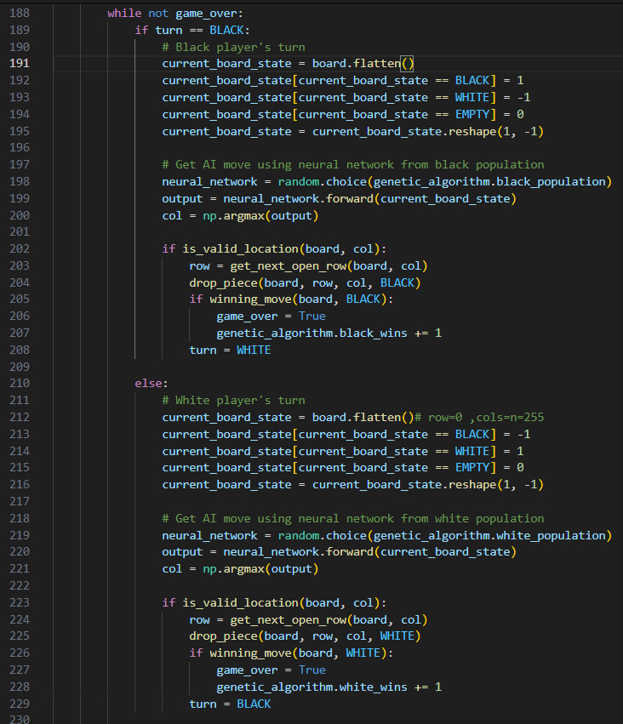
Implementation Details
Loop Condition:
The loop continues as long as game_over is False, meaning the game is not finished yet.
Black Player's Turn:
If it's the black player's turn (turn == BLACK), the current state of the game board is flattened and encoded into a format suitable for input to the neural network.
The black player's neural network is randomly selected from the population of black neural networks.
The neural network predicts the best move (column index) to play based on the current board state.
If the predicted move is valid, a piece is dropped into the corresponding column, and the board is updated.
If the black player wins with this move, game_over is set to True, and the black player's win count is incremented.
White Player's Turn:
If it's the white player's turn (turn == WHITE), the current state of the game board is flattened and encoded, similar to the black player's turn.
The white player's neural network is randomly selected from the population of white neural networks.
The neural network predicts the best move (column index) to play based on the current board state.
If the predicted move is valid, a piece is dropped into the corresponding column, and the board is updated.
If the white player wins with this move, game_over is set to True, and the white player's win count is incremented.
Switching Turns:
After each player's turn, the turn is switched to the opposite player (turn = WHITE if it was black's turn, and vice versa).
Game Termination:
The loop terminates when either player wins the game (game_over == True).

