Slide 1
New residential targets for young Jewish families IN the U.S
Applied Data Science Capstone

Slide 2
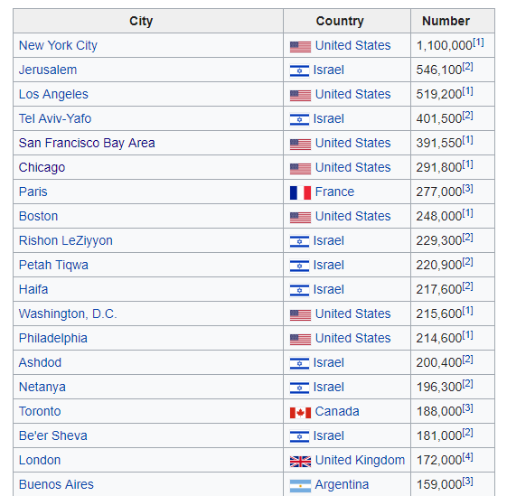
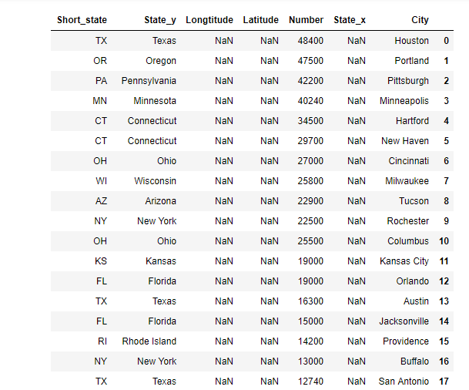
Jewish communities around the world.
From this table, I screened only communities in the United States with a population of less than 50,000
https://en.wikipedia.org/wiki/List_of_urban_areas_by_Jewish_population

Slide 3
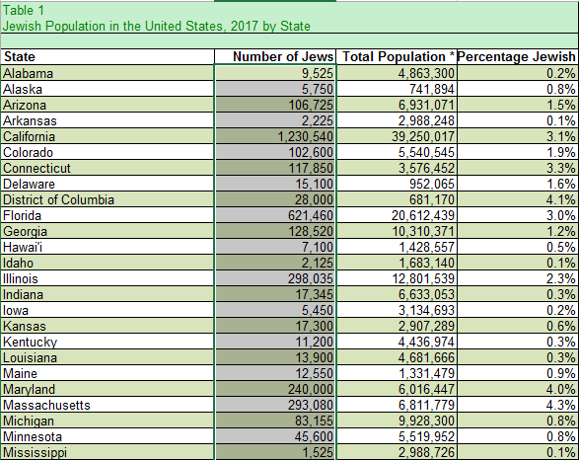
Data file of the
BERMAN JEWISH DATABANK
https://www.jewishdatabank.org/databank/search-results/study/897

Slide 4
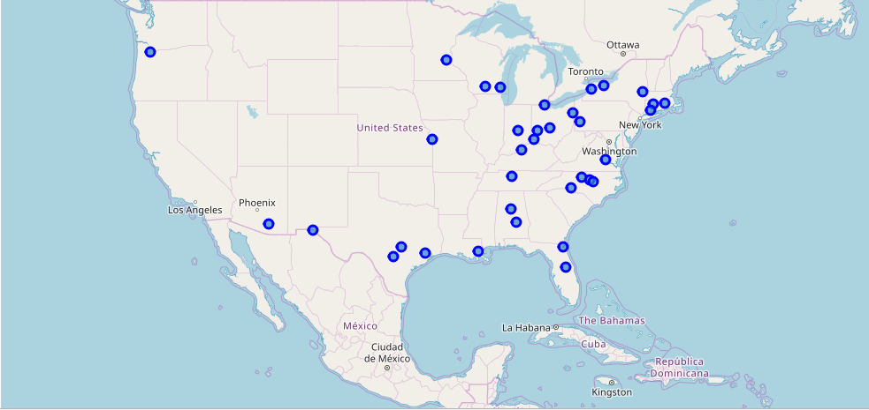
Small-scale communities throughout the United States
Focus on communities with a population of less than 50,000 people.

Slide 5
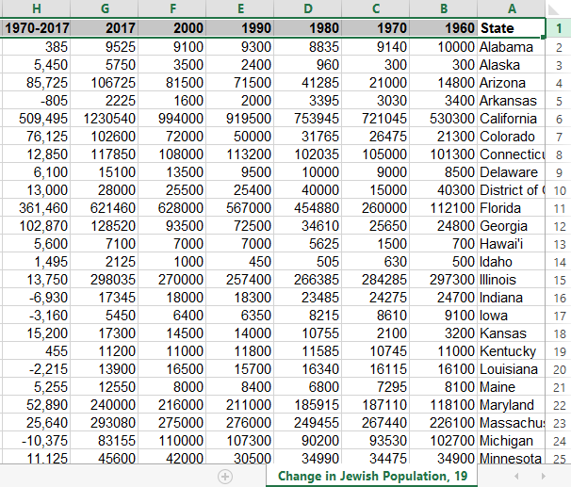
Changes in Jewish population over the past 20 years.

Slide 6
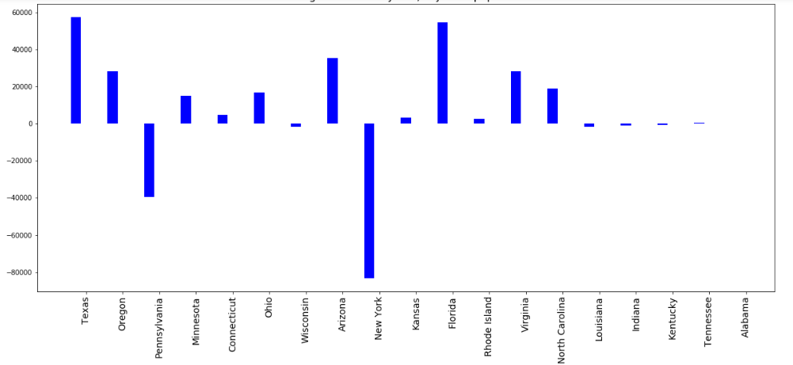
Developing areas and areas where the population is diminishing.

Slide 7
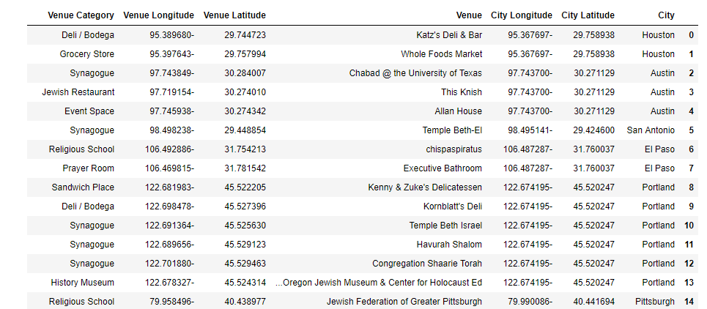

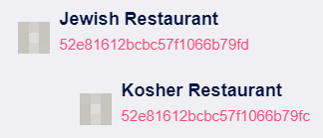

Find Venus of the Jewish categories.
I choose to look for Venus in 2 KM, but maybe, 3 Km was also good.

Slide 8
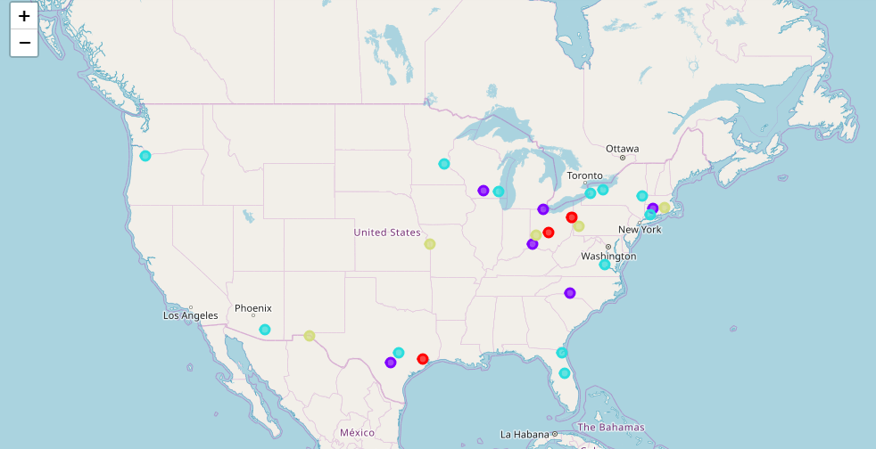
Group and cluster the communities by category of the Venus

