Slide 1
NightOut AI
Less Planning. More Living.
A generative-AI night-out planner built end-to-end with AI coding agents
MBAX 6418 · Final Project · Group I
Julian Goodfellow · Katie Frickel · Maranda Smith · Sam Drew · Thomas Boyle
November 2026
Notes:
Opening (sec 0-30): 'Group planning is a disaster — 47 messages, 12 links, no plan. NightOut AI turns a few preferences into a complete, real-venue itinerary in seconds — and lets you change it by talking. Built from scratch, by our group, with AI coding agents.'

Slide 2
The problem: group plans are a group project
Different budgets, diets, interests, and ideas of fun — then someone has to research every place, hour, and location
Existing apps recommend individual venues; the group still does all the deciding and the searching
Result: the planning itself — not the night — becomes the project
Opportunity: an app that does more than recommend — it builds a complete night out, end to end
Notes:
Framing from proposal. Emphasize the search/searching pain, then the pivot: we recommend individual things; our app assembles.

Slide 3
Our answer: one form in, a full night out
Enter city, date, group size, budget per person, dietary needs, activities, atmosphere, transport, and free-text notes
The app retrieves REAL venues for that city, then an LLM picks and orders them into a timed, budget-checked itinerary
Change it by talking: "make dinner cheaper", "we finish by 10 PM", "swap the bar for dessert" — only what you asked to change changes
Every number comes from venue data, every pick comes from a real retrieved list, and demo data is always labeled — the app never pretends
Notes:
THE pitch. Mention the honesty architecture briefly here; the deep-dive comes on the testing slide.

Slide 4
Core features — what you can actually do
Preference form: 1–20 people, $5–$1,000/person, 13 activity types, 7 atmospheres, after-midnight end times
AI itinerary: real venues with arrival/departure times, travel minutes, per-person costs, and an AI-written reason for every pick
Budget guard: plans are never presented over the cap — trailing stops get trimmed with an honest note
Edit by chat, 🔁 swap stops, 🔒 lock stops against regeneration
Mini-map + one-click Google Maps route; save to browser; share-link and group-chat copy; Surprise Me
🎨 AI promo poster (FLUX) and 🔊 spoken voice-over (Chatterbox) for every itinerary — honestly labeled
Notes:
Keep this slide fast; the live demo follows.

Slide 5
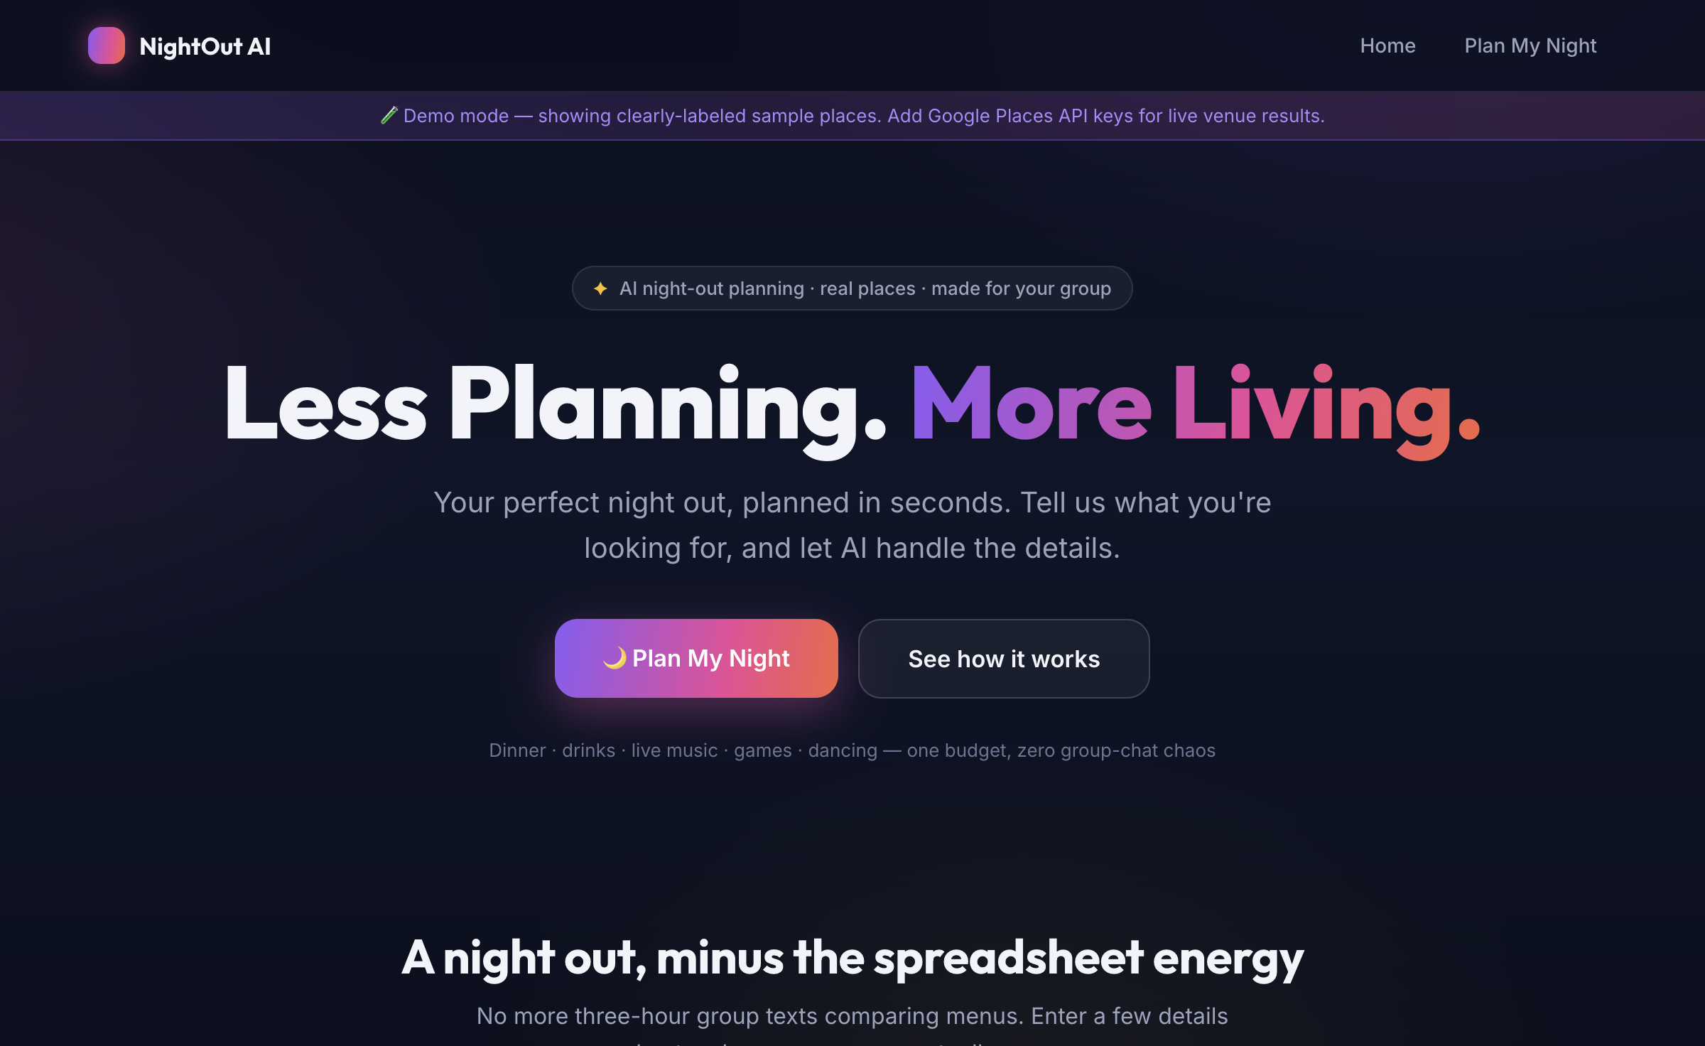
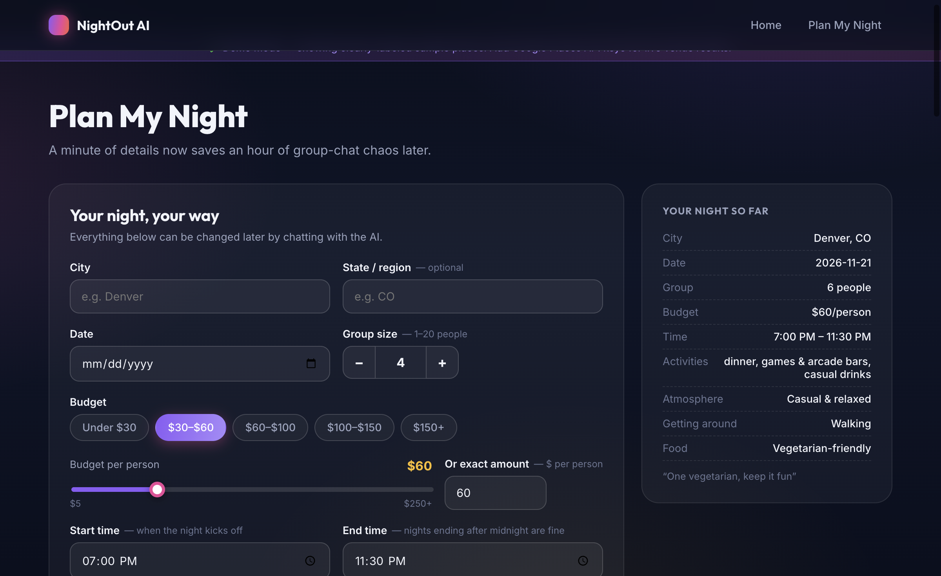
App demonstration — the real app, real places
Homepage — "Less Planning. More Living."
A generated night: venues, times, travel, budget — with AI reasons for each pick
Notes:
Live demo for the class; screenshots are the safe backup. Follow docs/DEMO_SCRIPT.md (~5 min): form -> generate -> walk the itinerary -> chat edits -> save/share -> poster & voice-over.

Slide 6
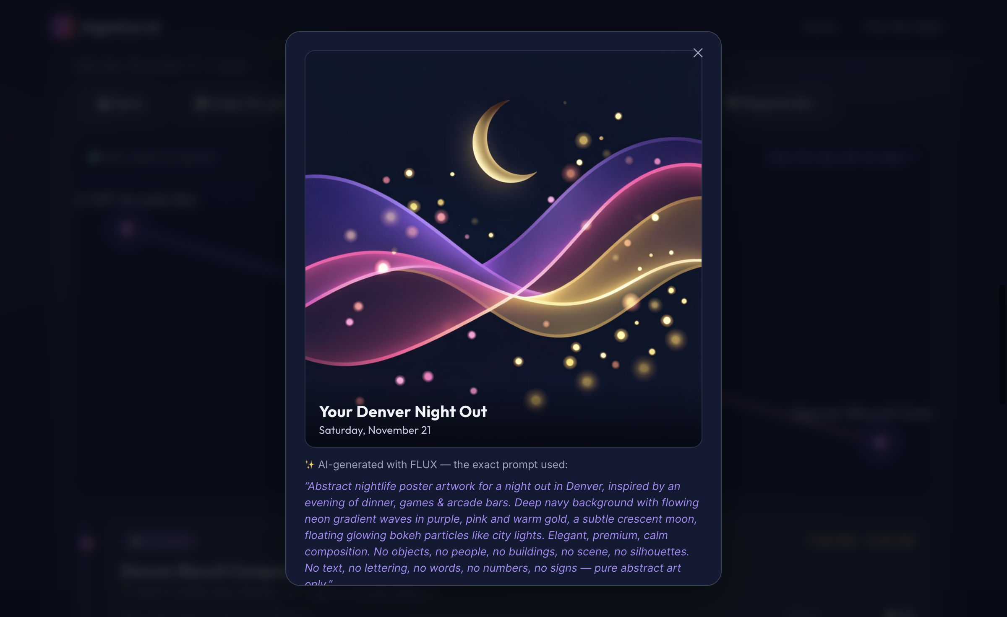
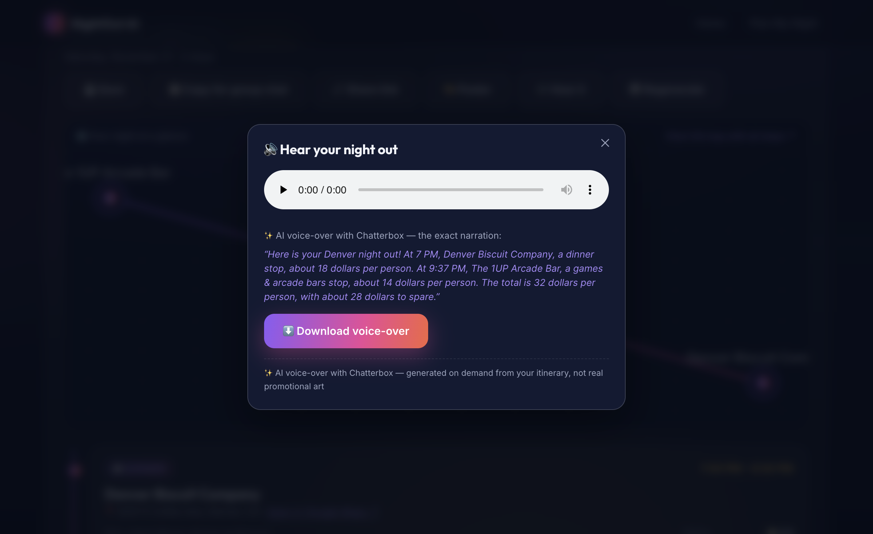
Multimodal extras: the app makes the media too
🎨 Promo poster — FLUX generates abstract nightlife art; the app's UI owns all typography (image models garble words, so we never let them spell)
🔊 Voice-over — Chatterbox reads the night aloud from itinerary facts (times, venues, costs)
Honesty in every artifact: the modal shows the exact prompt / narration and names the model
Both run on free class endpoints; both degrade politely when unconfigured
Notes:
DEMO moment: click Poster, then Hear it — live if keys are configured locally, else show the screenshots.

Slide 7
Build stack — how we built it
AI coding agents drove the build: Hermes Agent with DeepSeek-V4-Flash-0731 for development (Katie's sessions)
Disciplined git workflow from day one: branches + pull requests, CONTRIBUTING.md, PR templates, GitHub Actions CI
Autonomous QA passes: a scripted real-browser click-through harness caught bugs API tests could not
Team tooling — [Julian]: ________ · [Maranda]: ________ · [Sam]: ________ · [Thomas]: ________ (to fill)
Repo: github.com/Marandacsmith96/nightout-ai — full history, BUILD_LOG, and evidence in-repo
Notes:
IMPORTANT: ask each teammate what AI tools THEY used and fill the blanks honestly — the professor explicitly wants harness + model per member. Do not invent.

Slide 8
App stack — software, APIs, and models
Layer | Technology | Role
Frontend | React + Vite (plain CSS, no UI framework) | Form, itinerary, chat, map, media modals
Backend | FastAPI + Pydantic v2 | Validated API contract; every boundary checked
Planning AI | DeepSeek-V4-Flash-0731 (class endpoint) | Picks venues from our retrieved list; interprets chat edits
Image gen | FLUX.2-klein-4B (class endpoint) | Promo poster (abstract art; UI owns text)
Voice gen | Chatterbox v3 (class endpoint) | Spoken itinerary summary (MP3)
Places (optional) | Google Places / Routes APIs | Live venues + travel times when keyed
Persistence | Browser localStorage | Saved nights + share links (no server DB)
Notes:
Emphasize the 'honesty stack': the model may only reference retrieved venue ids; numbers come from venue data, never prose; schemas validate everywhere.

Slide 9
Sources and data
Built from scratch — no existing app was copied or screenshotted as a starting point
Venue data: Google Places API when a key is configured; otherwise a labeled demo catalog of real, well-known places (Denver / Boulder / Austin)
Travel times: Google Routes when keyed; otherwise clearly-labeled estimates
Every AI artifact — picks, poster, voice-over — states its source and shows exactly what was sent upstream
Notes:
The assignment asked for sources; we are clean: no derivative app, and the demo mode is never disguised as live.

Slide 10
Build process, bug testing, and the two best bugs
Eight build phases in BUILD_LOG.md — scaffold → retrieval → AI planning → chat edits → map/share → tests/docs → multimodal → CI/polish
62 automated tests (offline), GitHub Actions CI on every push/PR, independent QA report + real-browser click-through
Bug #1: the form sent camelCase, the API wanted snake_case — a real browser click exposed what API tests missed; one adapter file now owns the mapping
Bug #2 (found by our click-through QA): every conversational edit threw 'request is not a function' — a destructured param shadowed the fetch helper; invisible to API tests, would have failed the live demo
Lesson: the user is the first true integration test — click the buttons before class
Notes:
These two war stories are the strongest slide — tell both briefly. QA evidence lives in docs/evidence/katiefrickel/.

Slide 11
Contributions (CRediT-style)
Maranda Smith — project lead; Phases 1–6 implementation (backend, frontend, tests, README, build log)
Katie Frickel — Phase 7 multimodal media (FLUX poster + Chatterbox voice-over); CI, start.sh, PR templates; click-through QA that found the critical edit bug; docs/evidence
Sam Drew — independent QA pass; date off-by-one fix; Python 3.9 compatibility fix (PR #1)
Julian Goodfellow — [to fill: e.g., review, testing, slides]
Thomas Boyle — [to fill: e.g., review, testing, slides]
Slide deck & presentation — [to fill]
Notes:
Adapt from CRediT taxonomy. Confirm roles with the whole group before presenting — everyone should agree on this slide.

Slide 12
Lessons learned, limitations, and future work
Validation layers pay for themselves: id allow-lists, budgets, and schemas keep the AI honest even when it misbehaves
Image models garble words — give the model art and the UI typography
Browser QA finds what API tests cannot — click everything before the demo
Limitations: no bookings/payments; demo-mode places without keys; live Google mode not smoke-tested; single-user (no group voting yet)
Future: group voting on swaps, live events (Ticketmaster), real accounts, deployments
Notes:
Close with the honesty one-liner from DEMO_SCRIPT: 'the app never pretends — every number, pick, and artifact is checkable.'

