Slide 1
Enhancing Image Super-Resolution Using CNN and GAN
Team Details
JAGANNATH RAO ARE (20EG105456)
Project Supervisor
Mr.B.Ravinder Reddy
Asst.Professor CSE

Slide 2
Introduction
Images play a crucial role in preserving memories, but low-resolution photos often lack detail, especially on larger screens. To enhance such images, the process of "premastering" aims to improve their quality. Traditionally, convolutional neural networks (CNNs) have been used for this, employing mathematical techniques to upscale images. However, Generative Adversarial Networks (GANs), introduced in 2014, offer a new approach. GANs consist of two networks – one generates images, and the other distinguishes between real and generated ones. Through training, GANs can create high-quality images. In super-resolution enhancement, GANs outperform CNNs by producing visually pleasing, high-resolution images with finer details. This study compares GAN-based methods, like Enhanced Super Resolution GAN (ESR-GAN), with traditional CNN-based techniques, analyzing their strengths, limitations, and practical applications in industries such as movie premastering and image production.

Slide 3
Problem Statement
The problem statement revolves around the limitations of low-resolution images, which often lack crucial details for a satisfactory viewing experience, particularly on larger screens . Traditional methods like convolutional neural networks (CNNs) utilize mathematical interpolation techniques to enhance image resolution but may not effectively restore missing details . Generative Adversarial Networks (GANs) offer promising advancements in super-resolution enhancement by generating high-quality, realistic images with finer texture details and improved fidelity . Thus, the problem statement focuses on improving the visual quality of low-resolution images through innovative deep learning techniques, particularly GAN-based super-resolution.

Slide 4
Proposed Method
Gather a dataset of paired low-resolution and high-resolution images. These pairs are essential for training the CNN model to learn the mapping between low and high-resolution images.
Resize all images to a uniform size suitable for training the CNN model.
Select appropriate loss functions to measure the discrepancy between predicted and ground truth high-resolution images. Common choices include Mean Squared Error (MSE) for pixel-wise similarity and perceptual loss, which incorporates high-level feature differences.
Apply random blur to images using techniques such as Gaussian blur or motion blur.
Blur images to simulate motion or out-of-focus effects commonly encountered in real-world scenarios.
The evaluation metrics used to assess the performance of the super-resolution model.
Include quantitative metrics like Peak Signal-to-Noise Ratio (PSNR) and Structural Similarity Index (SSIM).
Discuss qualitative evaluation through visual comparison of super-resolved images.

Slide 5
Proposed Method
Input (Low-Resolution Image)
|
| [Convolutional Layers]
| |
| [Activation Functions]
| |
| [Pooling Layers]
| |
| [Upsampling Layers]
| |
| [Output Layer] (High-Resolution Image)
Input Layer:Accepts low-resolution images as input.
Convolutional Layers: Use multiple convolutional layers with increasing depth to extract hierarchical features from the input images.
Activation Functions: Apply ReLU activation functions after each convolutional layer to introduce non-linearity.
Pooling Layers: Optionally insert pooling layers to down sample feature maps and reduce spatial dimensions.
Upsampling Layers: Use upsampling layers (e.g., transposed convolution or nearest neighbor interpolation) to increase the spatial resolution of feature maps.
Output Layer: The output layer generates high-resolution images reconstructed from the learned features of the network.

Slide 6

Experiment Environment
The environment used is python,command propmt
Created website using html,css and javascript,flask framework
Numpy:It provides support for multidimensional arrays and matrices,
along with a collection of mathematical functions to operate on these arrays.
Matplotlib.pyplot:
Matplotlib is a comprehensive library for creating static, animated, and interactive visualizations in Python.
Tensorflow:
It provides a comprehensive ecosystem of tools, libraries, and resources for building
and deploying machine learning models.
os:It allows you to perform various operating system-related tasks, such as file operations,
directory manipulations, and environment variable access.

Slide 7
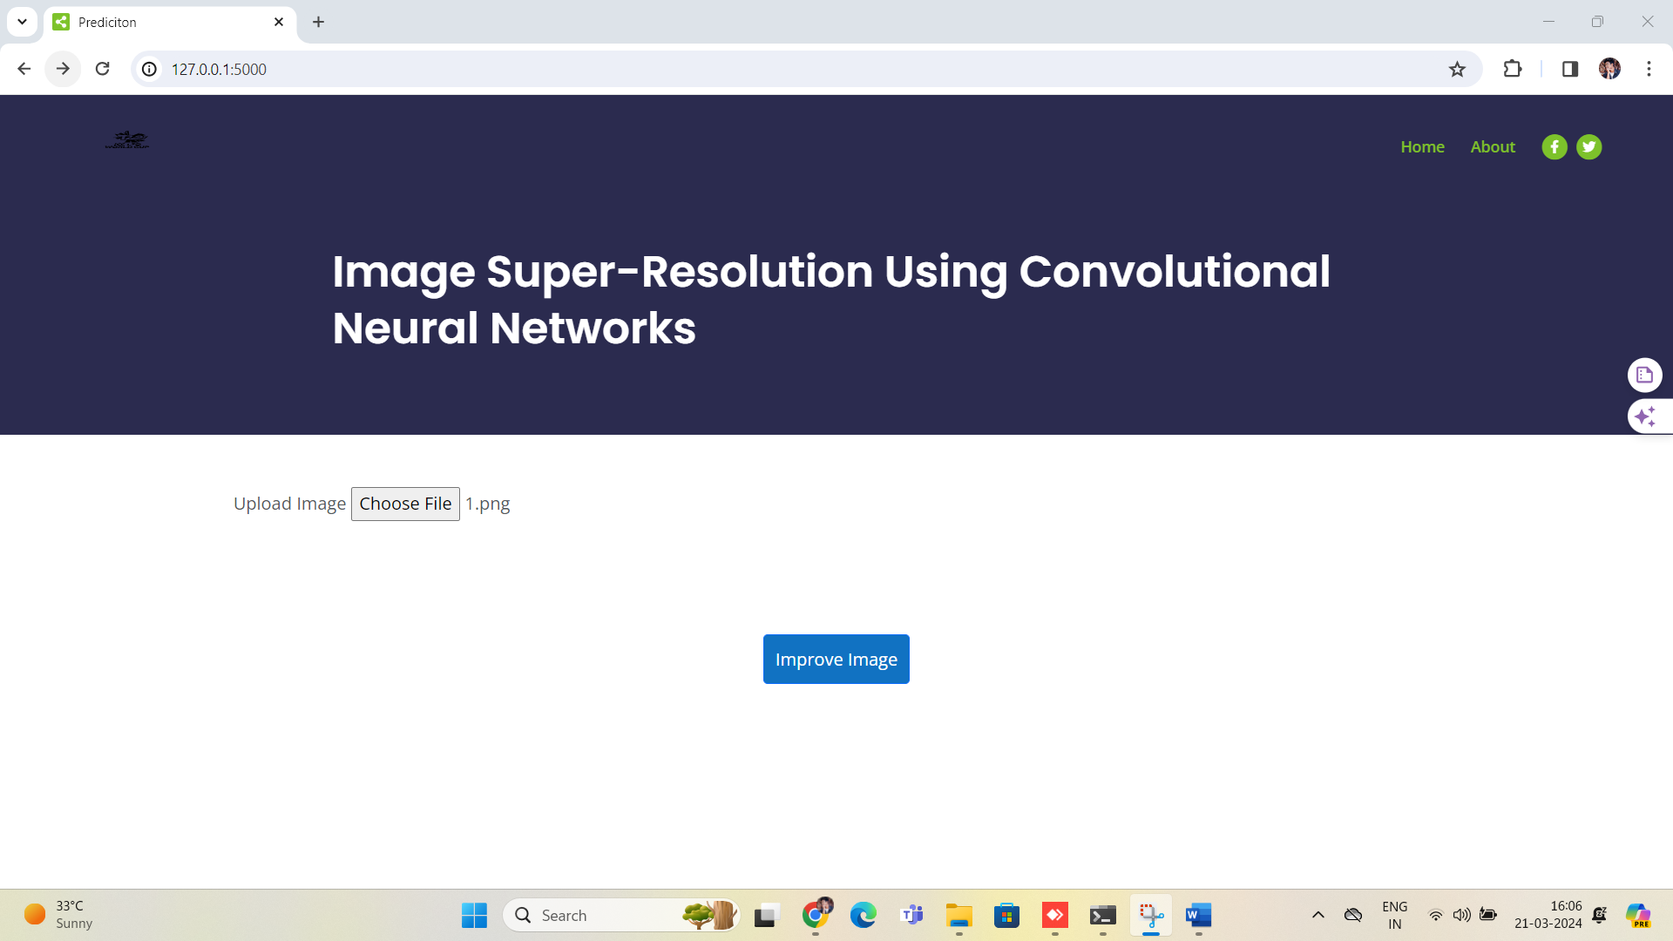
Experiment Screen shorts
To begin the web application and initiate the blur image filtering process,
need to start the application.

Slide 8
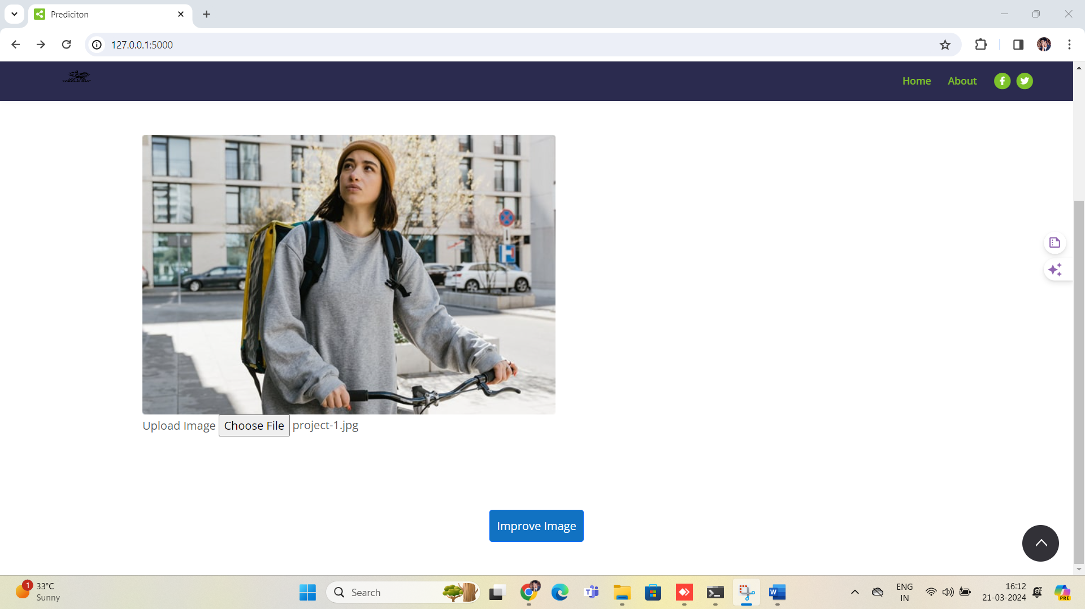
Experiment screen shorts
Click on choose file and select a blur image from local device once the image is uploaded click on improve to start the execution.

Slide 9

Experiment Results
After applying advanced image enhancement algorithms, the image has undergone significant improvement in clarity and detail. The algorithms effectively mitigate the blurriness present in the original image, resulting in enhanced sharpness, definition, and overall visual quality.

Slide 10
Finding
Super-Resolution Enhancement: Generative Adversarial Networks (GANs) offer promising advancements
in super-resolution enhancement, generating high-quality images with finer details and improved fidelity .
Complex Scenarios Adaptation: GAN-based super-resolution reconstruction faces
challenges in adapting to complex real-world scenarios
Transfer Learning: Utilizing super-resolution GAN models and transfer learning can
achieve enhanced periapical images in medical applications .
Preservation of Details: Image super-resolution aims to increase image dimensions while
preserving details, matching the original image as closely as possible .
Network Architecture: Super-Resolution Generative Adversarial Network (SRGAN) employs a
convolutional neural network to improve the network effect in generating realistic high-resolution images.

Slide 11
Justification
Improved Parameters: Our method enhances parameters related to image super-resolution, including
image quality metrics (PSNR, SSIM), network architecture complexity, and computational efficiency .
Mathematical Formulas: Mathematical formulations for parameter values vary based on specific
metrics and network architectures. For instance, PSNR calculation involves mean square error (MSE),
SSIM includes luminance, contrast, and structure comparison, while network complexity may be
quantified by the number of parameters or layers in the model .
Reasons for Parameter Improvements: this method improves parameter values through optimization
of network architectures, training strategies, loss functions, and regularization techniques.
By fine-tuning these aspects, we achieve better performance in terms of image quality,
model complexity, and computational efficiency .

