Slide 1
Data Model

Slide 2
IN THIS CHAPTER, YOU WILL LEARN:
Why data models are important
About the basic data-modeling building blocks
What business rules are and how they affect database design
How the major data models evolved, and their advantages and disadvantages
How data models can be classified by level of abstraction
Database Systems 6e / Rob & Coronel
2- <number>

Slide 3
THE IMPORTANCE OF DATA MODELS
Data model
  Relatively simple representation, usually graphical, of complex real-world data structures
  Communications tool to facilitate interaction among the designer, the applications programmer, and the end user
Good database design uses an appropriate data model as its foundation
Database Systems 6e / Rob & Coronel
2- <number>

Slide 4
IMPORTANCE OF DATA MODELING
End-users have different views and needs for data
Data model organizes data for various users
Database Systems 6e / Rob & Coronel
2- <number>

Slide 5
DATA MODEL BASIC BUILDING BLOCKS
Entity is anything about which data are to be collected and stored
Attribute is a characteristic of an entity
Relationship describes an association among (two or more) entities
  One-to-many (1:M) relationship
  Many-to-many (M:N or M:M) relationship
  One-to-one (1:1) relationship
Database Systems 6e / Rob & Coronel
2- <number>

Slide 6
BUSINESS RULES
Brief, precise, and unambiguous description of a policy, procedure, or principle within a specific organization’s environment
  A company airplane must be inspect after 100 hours of flight time
  A customer may generate many invoices
  Each invoice is generated by only one customer
Apply to any organization that stores and uses data to generate information
Description of operations that help to create and enforce actions within that organization’s environment
Database Systems 6e / Rob & Coronel
2- <number>

Slide 7
BUSINESS RULES (CONTINUED)
Must be rendered in writing
Must be kept up to date
Sometimes are external to the organization
Must be easy to understand and widely disseminated
Describe characteristics of the data as viewed by the company
Database Systems 6e / Rob & Coronel
2- <number>

Slide 8
SOURCES OF BUSINESS RULES
Company managers
Policy makers
Department managers
Written documentation
  Procedures
  Standards
  Operations manuals
Direct interviews with end users
Database Systems 6e / Rob & Coronel
2- <number>

Slide 9
IMPORTANCE OF BUSINESS RULES
Promote creation of an accurate data model
Standardize company’s view of data
Constitute a communications tool between users and designers
Allow designer to understand the nature, role, and scope of data
Allow designer to understand business processes
Allow designer to develop appropriate relationship participation rules and constraints
Database Systems 6e / Rob & Coronel
2- <number>

Slide 10
THE EVOLUTION OF DATA MODELS
Hierarchical
Network
Relational
Entity relationship
Object oriented
Database Systems 6e / Rob & Coronel
2- <number>

Slide 11
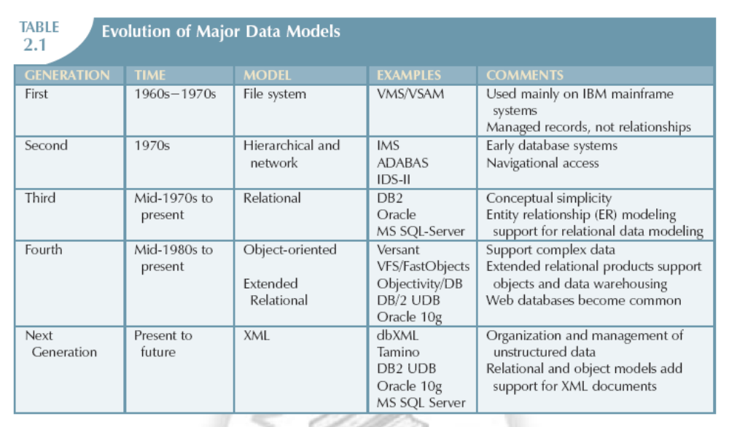
EVOLUTION OF MAJOR DATA MODELS
Database Systems 6e / Rob & Coronel
2- <number>

Slide 12
THE HIERARCHICAL MODEL—EVOLUTION
North American Rockwell was the prime contractor for the Apollo project which culminated in the moon landing.
This project required the management of millions of parts – a complex computer file system was used.
  An audit of the tapes revealed that 60% of the data was redundant
  This led Rockwell to develop an alternate strategy to manage their data
Database Systems 6e / Rob & Coronel
2- <number>

Slide 13
THE HIERARCHICAL MODEL—EVOLUTION
GUAM (Generalized Update Access Method)
  Based on the recognition that the many smaller parts would come together as components of still larger components
  In the mid 1960s. IBM joined Rockwell to expand the capabilities of GUAM, replacing computer tapes with disk storage
Information Management System (IMS)
  The result of the joint effort between Rockwell and IBM
  World’s leading mainframe hierarchical database system in the 1970s and early 1980s
Database Systems 6e / Rob & Coronel
2- <number>

Slide 14
THE HIERARCHICAL MODEL—CHARACTERISTICS
Basic concepts form the basis for subsequent database development
Limitations lead to a different way of looking at database design
Basic concepts show up in current data models
Best understood by examining manufacturing process
Database Systems 6e / Rob & Coronel
2- <number>

Slide 15
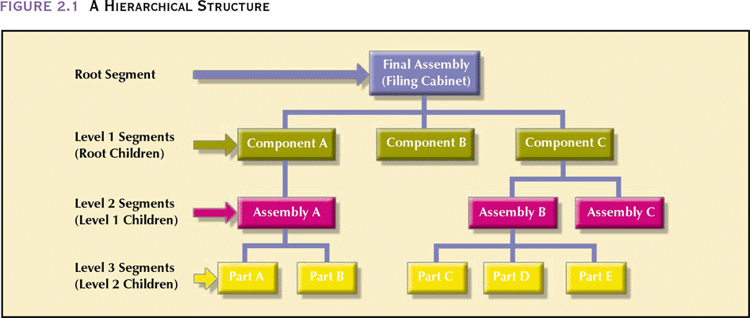
A HIERARCHICAL STRUCTURE
Database Systems 6e / Rob & Coronel
2- <number>

Slide 16
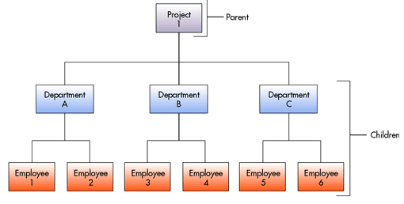
HIERARCHICAL EXAMPLE
2- <number>

Slide 17
HIERARCHICAL STRUCTURE—CHARACTERISTICS
Each parent can have many children
Each child has only one parent
Tree is defined by path that traces parent segments to child segments, beginning from the left
Hierarchical path
  Ordered sequencing of segments tracing hierarchical structure
Preorder traversal or hierarchic sequence
  “Left-list” path
  If Part D is most frequently accessed and updated, change the database structure to place Part D closer to the left side of the tree
  This will give a shorter traversal
Database Systems 6e / Rob & Coronel
2- <number>

Slide 18
THE HIERARCHICAL MODEL
Advantages over a file system
  Conceptual simplicity – easy to understand the model layout
  Database security
  Data independence (a change in a data type will be automatically cascaded throughout the database by the DBMS, thereby eliminating the need to make changes in the program segments that reference the changes data type)
  Database integrity – always a link between parent and child
  Efficiency – very efficient when it contains a large volume of data in 1:M relationships and whose relationships are fixed over time
Database Systems 6e / Rob & Coronel
2- <number>

Slide 19
THE HIERARCHICAL MODEL (CONTINUED)
Disadvantages over a file system
  Complex implementation – detailed knowledge of the physical data storage characteristics is required by the designers and programmers
  Difficult to manage – relocation of segments requires application changes
  Lacks structural independence
  Complex applications programming and use – programmers and end users must know precisely how the data are physically distributed within the database
  Implementation limitations – difficult to support M:N relationships
  Lack of standards – no standard DDL and no DML
Database Systems 6e / Rob & Coronel
2- <number>

Slide 20
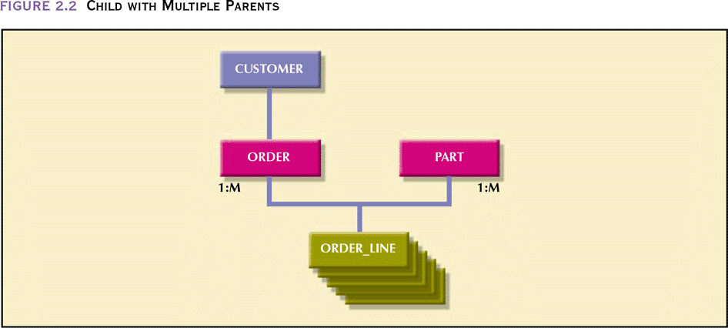
CHILD WITH MULTIPLE PARENTS
Database Systems 6e / Rob & Coronel
2- <number>

Slide 21
THE NETWORK MODEL
Created to
  Represent complex data relationships more effectively
  Improve database performance
  Impose a database standard
Conference on Data Systems Languages (CODASYL)
American National Standards Institute (ANSI)
Database Task Group (DBTG)
Database Systems 6e / Rob & Coronel
2- <number>

Slide 22
CRUCIAL DATABASE COMPONENTS
Schema
  Conceptual organization of entire database as viewed by the database administrator
Subschema
  Defines database portion “seen” by the application programs that actually produce the desired information from data contained within the database
Data Management Language (DML)
  Define data characteristics and data structure in order to manipulate the data
Database Systems 6e / Rob & Coronel
2- <number>

Slide 23
DATA MANAGEMENT
LANGUAGE COMPONENTS
Schema Data Definition Language (DDL)
  Enables database administrator to define schema components
Subschema DDL
  Allows application programs to define database components that will be used
DML
  Manipulates database contents
Database Systems 6e / Rob & Coronel
2- <number>

Slide 24
NETWORK MODEL—BASIC STRUCTURE
Resembles hierarchical model
Collection of records in 1:M relationships
  A relationship is called a Set
  Composed of at least two record types
    Owner
      Equivalent to the hierarchical model’s parent
    Member
      Equivalent to the hierarchical model’s child
      A record can appear as a member in more than one set i.e., a member may have multiple owners
Database Systems 6e / Rob & Coronel
2- <number>

Slide 25
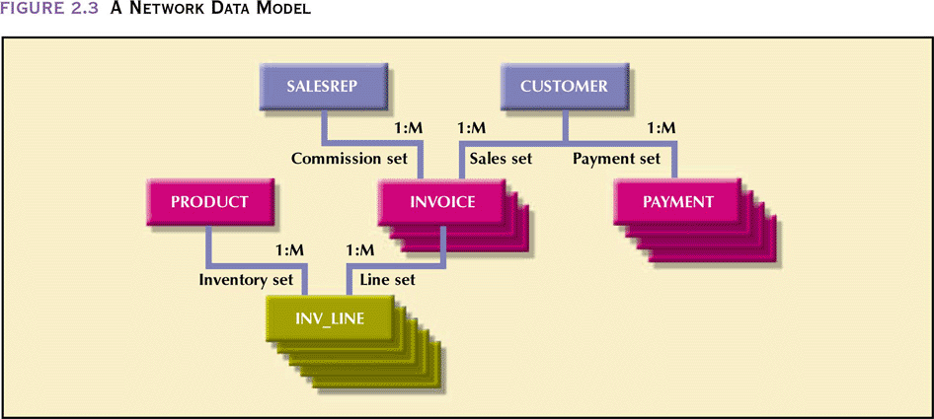
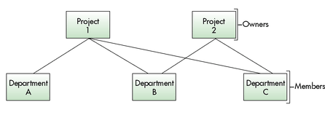
A NETWORK DATA MODEL
Database Systems 6e / Rob & Coronel
2- <number>

Slide 26
THE NETWORK DATA MODEL
Advantages
  Conceptual simplicity
  Handles more relationship types
  Data access flexibility – no need for a preorder traversal
  Promotes database integrity – must first define the owner and then the member record
  Data independence
  Conformance to standards
Database Systems 6e / Rob & Coronel
2- <number>

Slide 27
THE NETWORK DATA MODEL (CONTINUED)
Disadvantages
  System complexity
  Lack of structural independence
Database Systems 6e / Rob & Coronel
2- <number>

Slide 28
THE RELATIONAL MODEL
Developed by Codd (IBM) in 1970
Considered ingenious but impractical in 1970
Conceptually simple
Computers lacked power to implement the relational model
Today, microcomputers can run sophisticated relational database software
Database Systems 6e / Rob & Coronel
2- <number>

Slide 29
THE RELATIONAL MODEL: BASIC STRUCTURE
Relational Database Management System (RDBMS)
Performs same basic functions provided by hierarchical and network DBMS systems, plus other functions
  RDBMS handles all the complex physical detais
Most important advantage of the RDBMS is its ability to let the user/designer operate in a human logical environment
Database Systems 6e / Rob & Coronel
2- <number>

Slide 30
THE RELATIONAL MODEL:BASIC STRUCTURE
Table (relations)
  Matrix consisting of a series of row/column intersections
  Related to each other by sharing a common entity characteristic
Relational schema
  Visual representation of relational database’s entities, attributes within those entities, and relationships between those entities
Database Systems 6e / Rob & Coronel
2- <number>

Slide 31
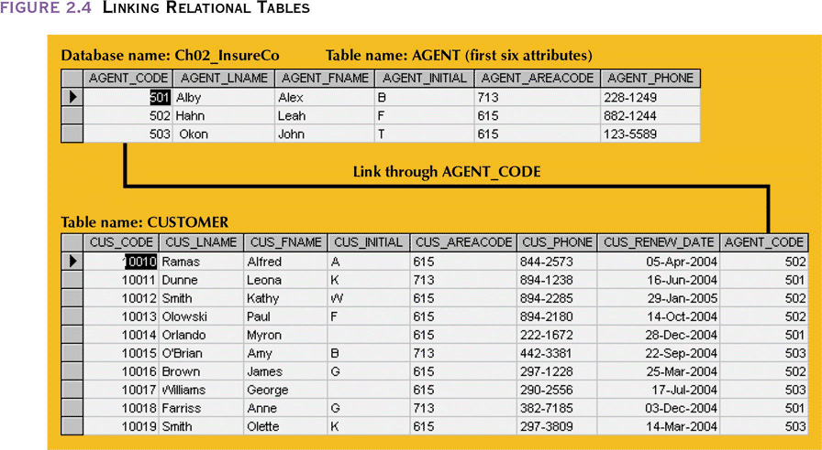
LINKING RELATIONAL TABLES
Database Systems 6e / Rob & Coronel
2- <number>

Slide 32
RELATIONAL TABLE
Stores a collection of related entities
  Resembles a file
Relational table is purely logical structure
  How data are physically stored in the database is of no concern to the user or the designer
  This property became the source of a real database revolution
Database Systems 6e / Rob & Coronel
2- <number>

Slide 33
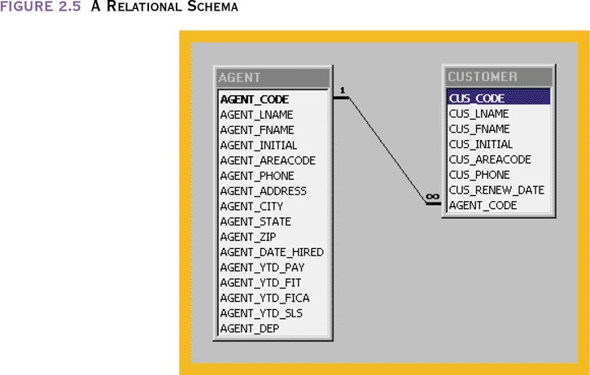
A RELATIONAL SCHEMA
Database Systems 6e / Rob & Coronel
2- <number>

Slide 34
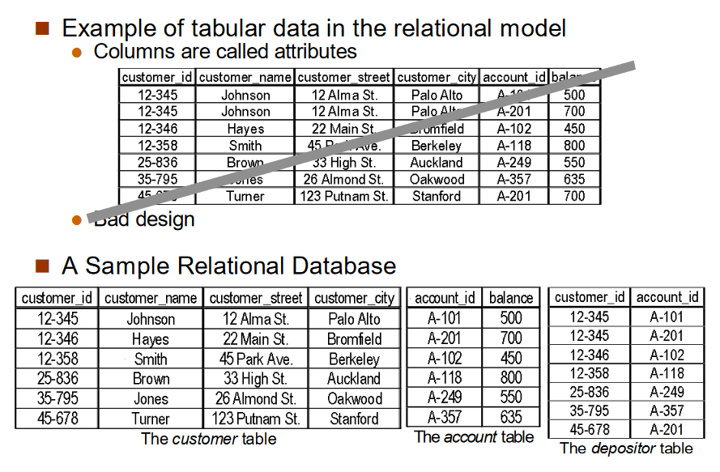
Database Systems 6e / Rob & Coronel
2- <number>

Slide 35
THE RELATIONAL MODEL
Advantages
  Structural independence – changes in the relational data structure do not affect the DBMS’s data access in any way
  Improved conceptual simplicity by concentrating on the logical view
  Easier database design, implementation, management, and use
  Ad hoc query capability - SQL
  Powerful database management system
Database Systems 6e / Rob & Coronel
2- <number>

Slide 36
THE RELATIONAL MODEL (CONTINUED)
Disadvantages
  Substantial hardware and system software overhead
  Can facilitate poor design and implementation
  May promote “islands of information” problems
Database Systems 6e / Rob & Coronel
2- <number>

Slide 37
THE ENTITY RELATIONSHIP MODEL
Widely accepted and adapted graphical tool for data modeling
Introduced by Peter Chen in 1976
Graphical representation of entities and their relationships in a database structure
Database Systems 6e / Rob & Coronel
2- <number>

Slide 38
THE ENTITY RELATIONSHIP MODEL—
BASIC STRUCTURE
Entity relationship diagram (ERD)
  Uses graphic representations to model database components
  Entity is mapped to a relational table
Entity instance (or occurrence) is row in table
Entity set is collection of like entities
Connectivity labels types of relationships
  Diamond connected to related entities through a relationship line
Database Systems 6e / Rob & Coronel
2- <number>

Slide 39
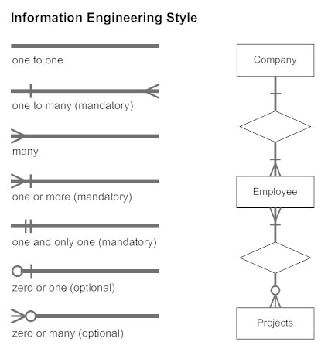
THE ENTITY RELATIONSHIP MODEL—
CROWFOOT COMPONENTS
Database Systems 6e / Rob & Coronel
2- <number>

Slide 40
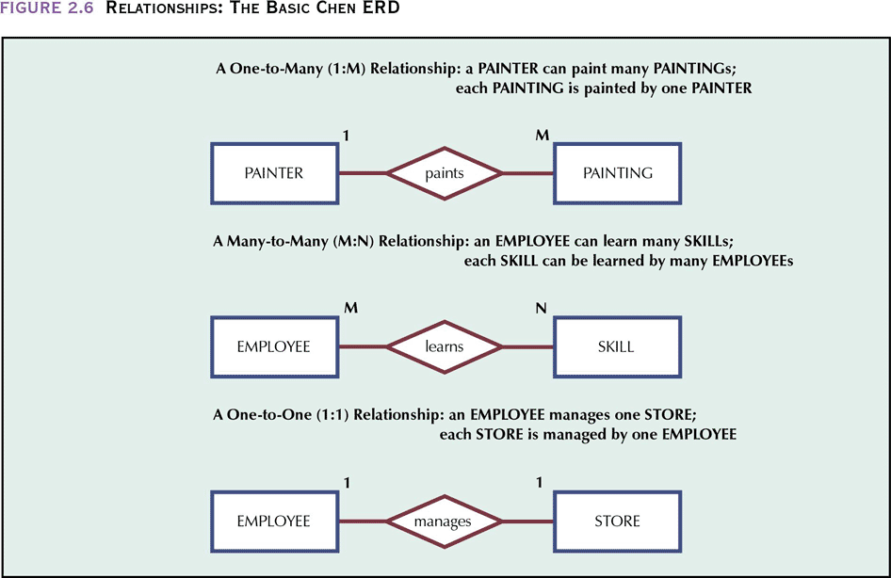
RELATIONSHIPS: THE BASIC CHEN ERD
Database Systems 6e / Rob & Coronel
2- <number>

Slide 41
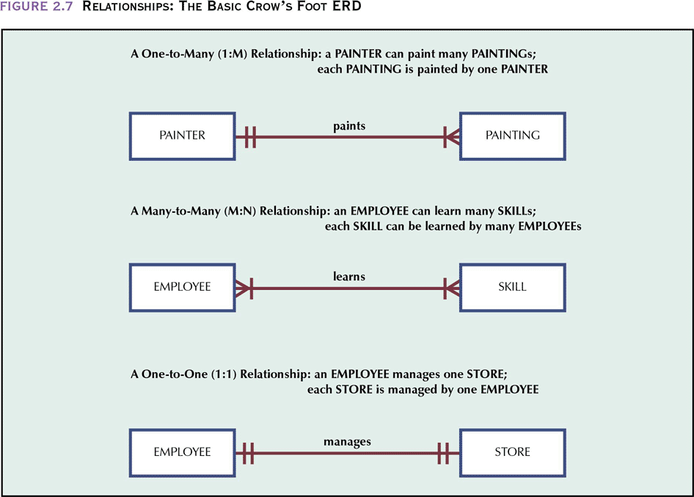
RELATIONSHIPS:
THE BASIC CROW’S FOOT ERD
Database Systems 6e / Rob & Coronel
2- <number>

Slide 42
THE ENTITY RELATIONSHIP MODEL
Advantages
  Exceptional conceptual simplicity
  Visual representation
  Effective communication tool
  Integrated with the relational data model
Database Systems 6e / Rob & Coronel
2- <number>

Slide 43
THE ENTITY RELATIONSHIP MODEL
Disadvantages
  Limited constraint representation
  Limited relationship representation
  No data manipulation language
  Loss of information content
Database Systems 6e / Rob & Coronel
2- <number>

Slide 44
THE OBJECT ORIENTED MODEL
Semantic data model (SDM) developed by Hammer and McLeod in 1981
Modeled both data and their relationships in a single structure known as an object
Basis of object oriented data model (OODM)
OODM becomes the basis for the object oriented database management system (OODBMS)
Database Systems 6e / Rob & Coronel
2- <number>

Slide 45
THE OBJECT ORIENTED MODEL
Object is described by its factual content
  Like relational model’s entity
Includes information about relationships between facts within object and relationships with other objects
  Unlike relational model’s entity
Subsequent OODM development allowed an object to also contain operations
Object becomes basic building block for autonomous structures
Database Systems 6e / Rob & Coronel
2- <number>

Slide 46
DEVELOPMENTS THAT
BOOSTED OODM’S POPULARITY
Growing costs put a premium on code reusability
Complex data types and system requirements became difficult to manage with a traditional RDBMS
Became possible to support increasingly sophisticated transaction & information requirements
Ever-increasing computing power made it possible to support the large computing overhead required
Database Systems 6e / Rob & Coronel
2- <number>

Slide 47
OBJECT ORIENTED DATA MODEL—
BASIC STRUCTURE
Object: abstraction of a real-world entity
Attributes describe the properties of an object
Objects that share similar characteristics are grouped in classes
Classes are organized in a class hierarchy
Inheritance is the ability of an object within the class hierarchy to inherit the attributes and methods of classes above it
Database Systems 6e / Rob & Coronel
2- <number>

Slide 48
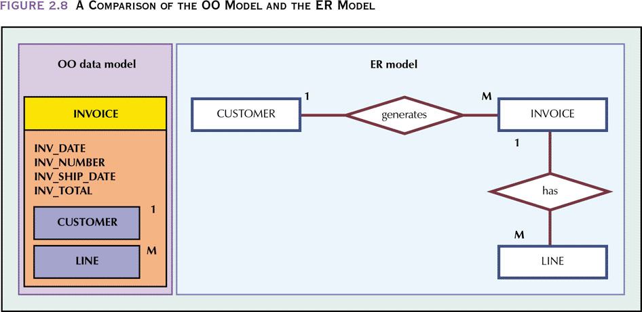
A COMPARISON OF THE OO MODEL
AND THE ER MODEL
Database Systems 6e / Rob & Coronel
2- <number>

Slide 49
THE OBJECT ORIENTED MODEL
Advantages
  Adds semantic content
  Visual presentation includes semantic content
  Database integrity
  Both structural and data independence
Database Systems 6e / Rob & Coronel
2- <number>

Slide 50
THE OBJECT ORIENTED MODEL (CONTINUED)
Disadvantages
  Slow pace of OODM standards development
  Complex navigational data access
  Steep learning curve
  High system overhead slows transactions
  Lack of market penetration
Database Systems 6e / Rob & Coronel
2- <number>

Slide 51
OTHER MODELS
Extended Relational Data Model (ERDM)
  Semantic data model developed in response to increasing complexity of applications
  DBMS based on the ERDM often described as an object/relational database management system (O/RDBMS)
  Primarily geared to business applications
Database Systems 6e / Rob & Coronel
2- <number>

Slide 52
OTHER MODELS (CONTINUED)
Date’s objections to ERDM label
  Given proper support for domains, relational data models are quite capable of handling complex data
    Therefore, capability that is supposedly being extended is already there
  O/RDM label is not accurate because the relational data model’s domain is not an object model structure
Database Systems 6e / Rob & Coronel
2- <number>

Slide 53
DATA MODELS: A SUMMARY
Each new data model capitalized on the shortcomings of previous models
Common characteristics:
  Conceptual simplicity without compromising the semantic completeness of the database
  Represent the real world as closely as possible
  Representation of real-world transformations (behavior) must be in compliance with consistency and integrity characteristics of any data model
Database Systems 6e / Rob & Coronel
2- <number>

Slide 54
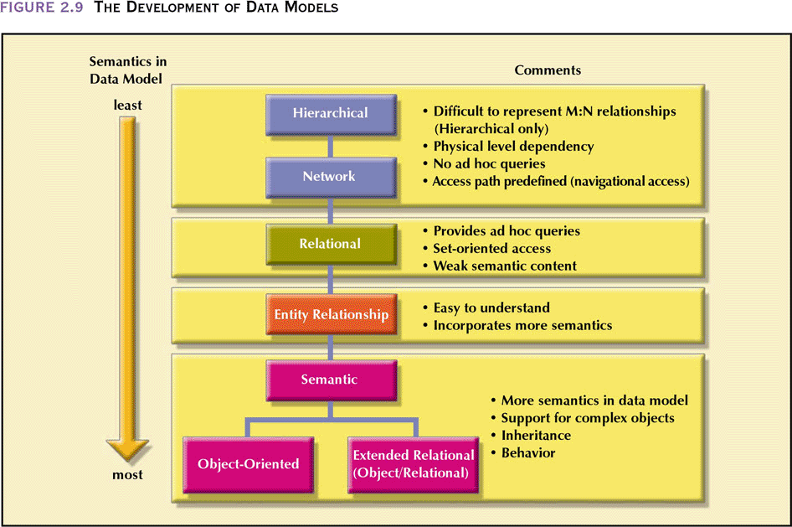
THE DEVELOPMENT OF DATA MODELS
Database Systems 6e / Rob & Coronel
2- <number>

Slide 55
DATABASE MODELS AND THE INTERNET
Characteristics of successful “Internet age” databases
  Flexible, efficient, and secure Internet access that is easily used, developed, and supported
  Support for complex data types and relationships
  Seamless interfacing with multiple data sources and structures
Database Systems 6e / Rob & Coronel
2- <number>

Slide 56
DATABASE MODELS AND THE INTERNET
  Relative conceptual simplicity to make database design and implementation less cumbersome
  An abundance of available database design, implementation, and application development tools
  A powerful DBMS graphical user interface (GUI) to help make the DBA’s job easier
Database Systems 6e / Rob & Coronel
2- <number>

Slide 57
DEGREES OF DATA ABSTRACTION
Way of classifying data models
Many processes begin at high level of abstraction and proceed to an ever-increasing level of detail
Designing a usable database follows the same basic process
Database Systems 6e / Rob & Coronel
2- <number>

Slide 58
DEGREES OF DATA ABSTRACTION (CONTINUED)
American National Standards Institute/Standards Planning and Requirements Committee (ANSI/SPARC)
  Classified data models according to their degree of abstraction (1970s):
    Conceptual
    External
    Internal
Database Systems 6e / Rob & Coronel
2- <number>

Slide 59
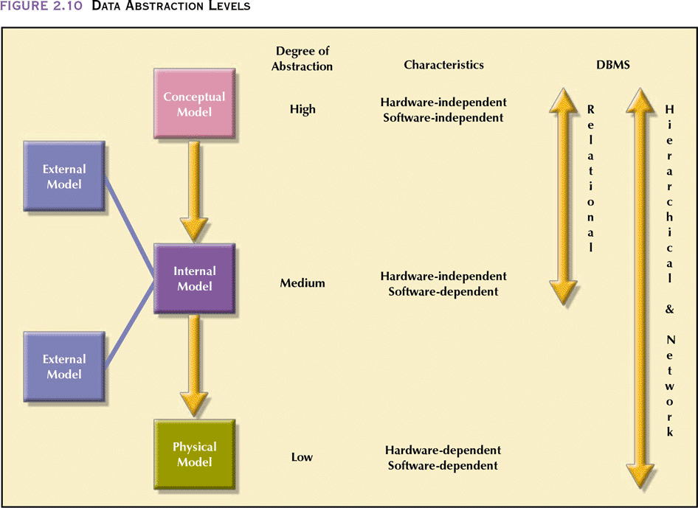
DATA ABSTRACTION LEVELS
Database Systems 6e / Rob & Coronel
2- <number>

Slide 60
THE CONCEPTUAL MODEL
Represents global view of the database
Enterprise-wide representation of data as viewed by high-level managers
Basis for identification and description of main data objects, avoiding details
Most widely used conceptual model is the entity relationship (ER) model
Database Systems 6e / Rob & Coronel
2- <number>

Slide 61
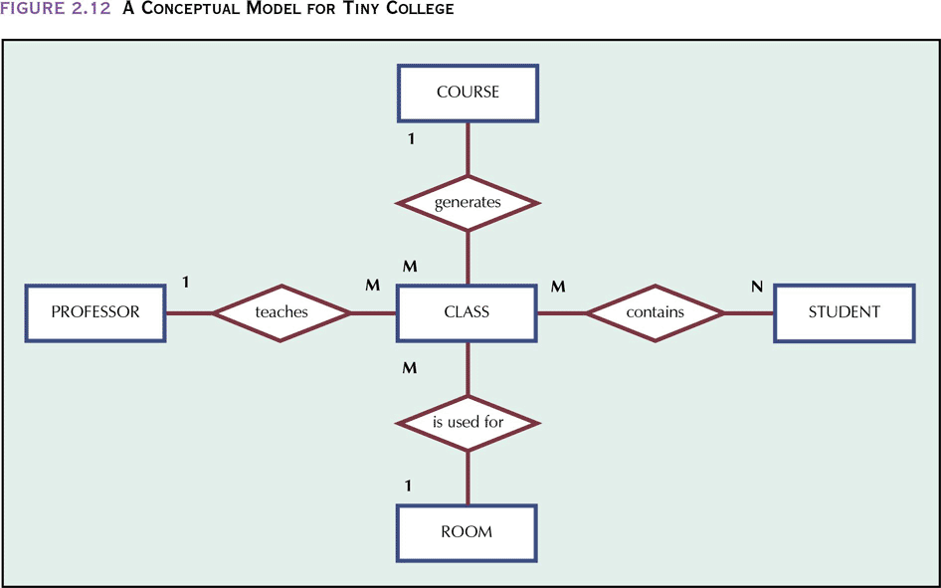
A CONCEPTUAL MODEL FOR TINY COLLEGE
Database Systems 6e / Rob & Coronel
2- <number>

Slide 62
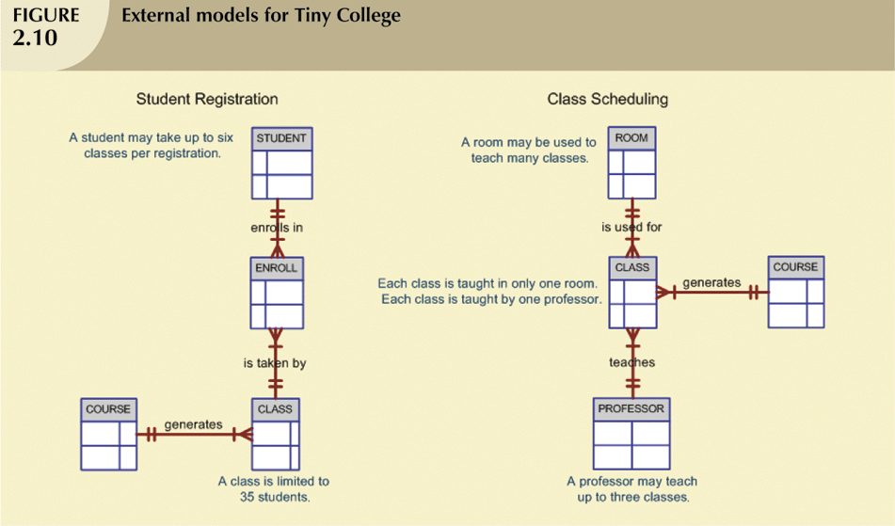
2- <number>

Slide 63
ADVANTAGES OF CONCEPTUAL MODEL
Provides a relatively easily understood macro level view of data environment
Independent of both software and hardware
  Does not depend on the DBMS software used to implement the model
  Does not depend on the hardware used in the implementation of the model
  Changes in either the hardware or the DBMS software have no effect on the database design at the conceptual level
Database Systems 6e / Rob & Coronel
2- <number>

Slide 64
THE INTERNAL MODEL
Representation of the database as “seen” by the DBMS
Adapts the conceptual model to the DBMS
Software dependent
Hardware independent
Database Systems 6e / Rob & Coronel
2- <number>

Slide 65
THE EXTERNAL MODEL
End users’ view of the data environment
Requires that the modeler subdivide set of requirements and constraints into functional modules that can be examined within the framework of their external models
Good design should:
  Consider such relationships between views
  Provide programmers with a set of restrictions that govern common entities
Database Systems 6e / Rob & Coronel
2- <number>

Slide 66
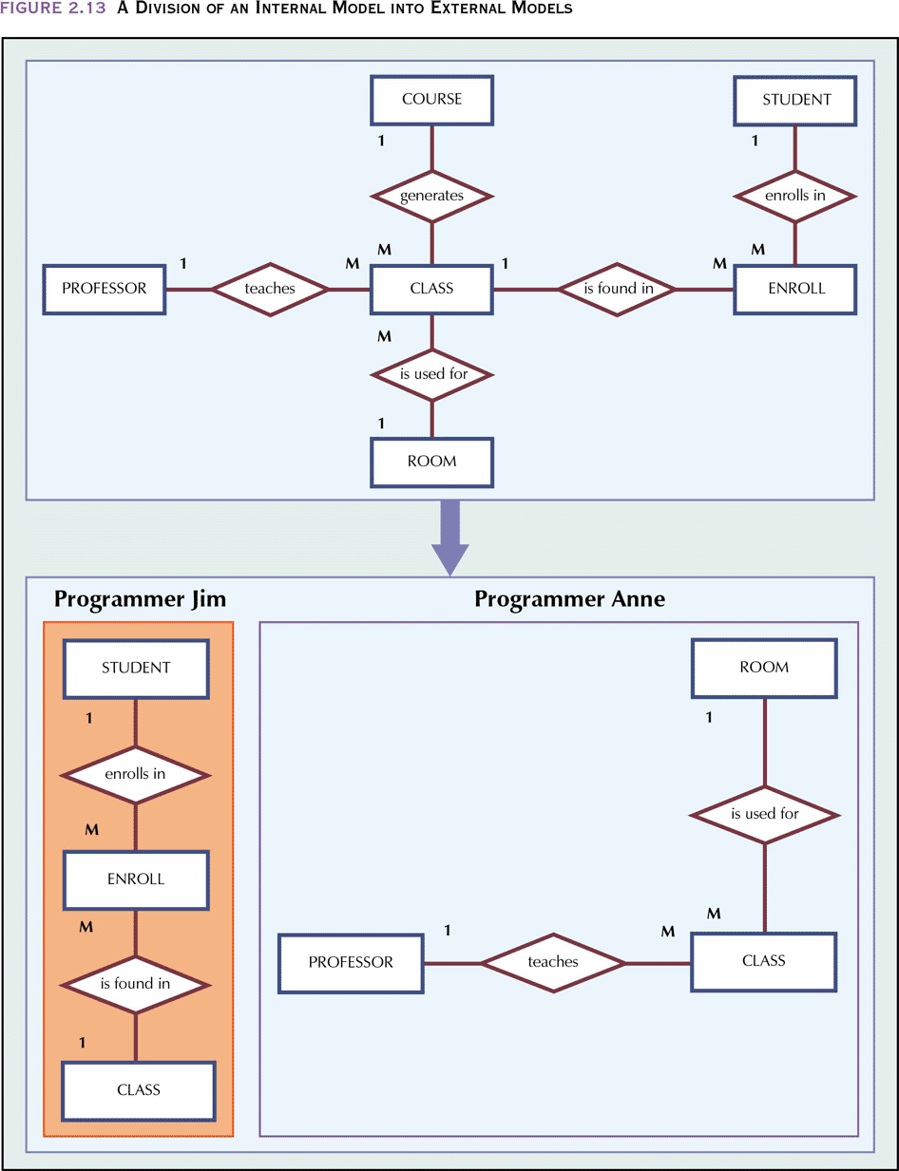
A DIVISION OF AN INTERNAL MODEL INTO EXTERNAL MODELS
Database Systems 6e / Rob & Coronel
2- <number>

Slide 67
ADVANTAGES OF EXTERNAL MODELS
Use of database subsets makes application program development much simpler
  Facilitates designer’s task by making it easier to identify specific data required to support each business unit’s operations
  Provides feedback about the conceptual model’s adequacy
Creation of external models helps to ensure security constraints in the database design
Database Systems 6e / Rob & Coronel
2- <number>

Slide 68
THE EXTERNAL MODEL
DBMS dependent
Hardware independent
Database Systems 6e / Rob & Coronel
2- <number>

Slide 69
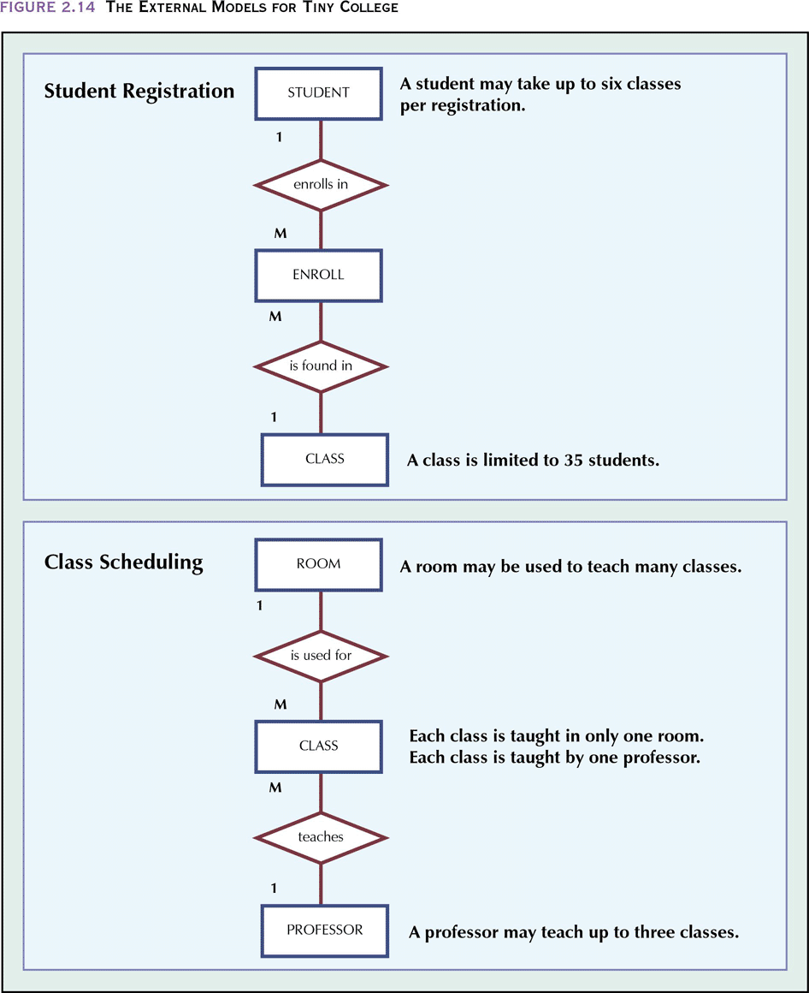
THE EXTERNAL MODELS FOR TINY COLLEGE
Database Systems 6e / Rob & Coronel
2- <number>

Slide 70
THE PHYSICAL MODEL
Operates at lowest level of abstraction, describing the way data are saved on storage media such as disks or tapes
Software and hardware dependent
Requires that database designers have a detailed knowledge of the hardware and software used to implement database design
Database Systems 6e / Rob & Coronel
2- <number>

Slide 71
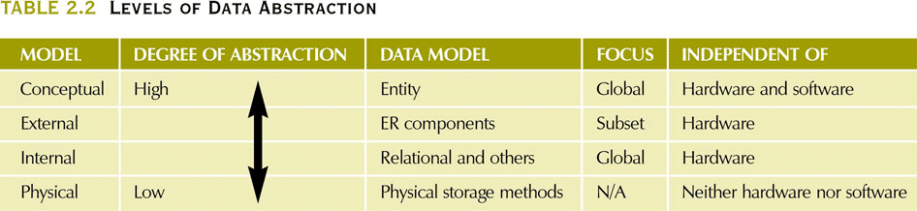
LEVELS OF DATA ABSTRACTION
Database Systems 6e / Rob & Coronel
2- <number>

Slide 72
SUMMARY
A good DBMS will perform poorly with a poorly designed database
A data model is a (relatively) simple abstraction of a complex real-world data-gathering environment
Basic data modeling components are:
  Entities
  Attributes
  Relationships
Database Systems 6e / Rob & Coronel
2- <number>

Slide 73
SUMMARY (CONTINUED)
Hierarchical model
  Based on a tree structure composed of a root segment, parent segments, and child segments
  Depicts a set of one-to-many (l:M) relationships between a parent and its children
  Does not include ad hoc querying capability
Database Systems 6e / Rob & Coronel
2- <number>

Slide 74
SUMMARY (CONTINUED)
Network model attempts to deal with many of the hierarchical model’s limitations
Relational model:
  Current database implementation standard
  Much simpler than hierarchical or network design
Object is basic modeling structure of object oriented model
Data modeling requirements are a function of different data views (global vs. local) and level of data abstraction
Database Systems 6e / Rob & Coronel
2- <number>

