Slide 1


Slide 2
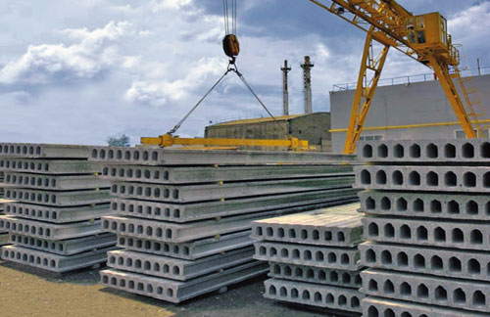
TOPIC DESCRIPTION:
Reinforced concrete (slabs) is a construction product made by pouring concrete into a reusable mold or “mold”, which is then aged in a controlled environment, transported to the construction site and lifted into place (“tilted up”). In contrast, standard concrete is poured into site-specific molds and cured in place.
Picture 1: Reinforced concrete products in the form of slabs

Slide 3
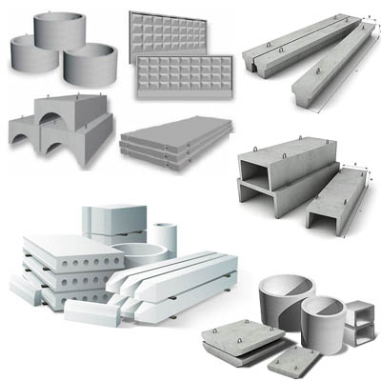
APPLICATION:
Reinforced concrete slab is used as a base for precast wall panels. It is lightweight and has better thermal insulation.
Picture 2: Possible applications of Reinforced concrete products: wells, walls, pillars, slabs

Slide 4
RELEVANCE:
A comparative analysis of existing building technologies has shown the most durable industry – the use of reinforced concrete structures. The results of the study confirmed the relevance of reinforced concrete construction, since modern technologies make it possible to significantly simplify, greatly accelerate and reduce the amount of work, while the durability of construction projects is extremely high. This technological process is relatively simple, but despite this, the products speed up the process of erecting walls and roofs.[4]

Slide 5
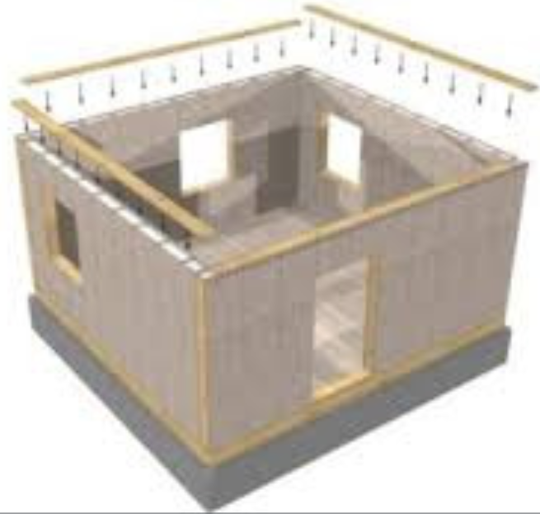
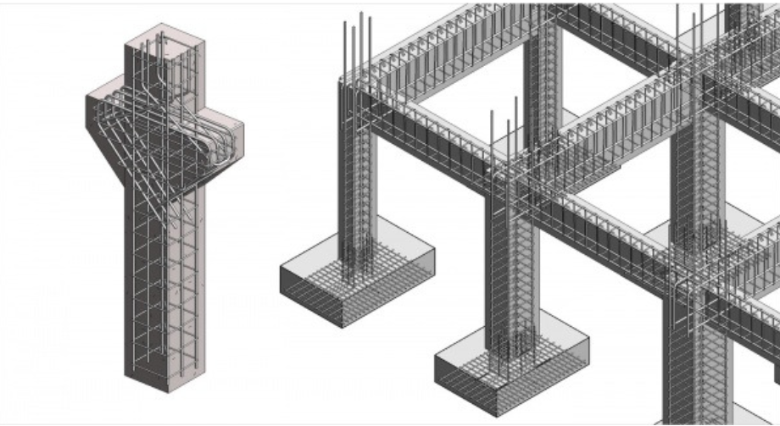
Usage in buildings:
Usage in the construction of walls, roofs, support structures, fences as well as wells.
Picture 3: The use of reinforced concrete products in the form of caracas structures, or rather pillars
Picture 4: walls of the building with the usage of reinforced concrete products (slabs)

Slide 6
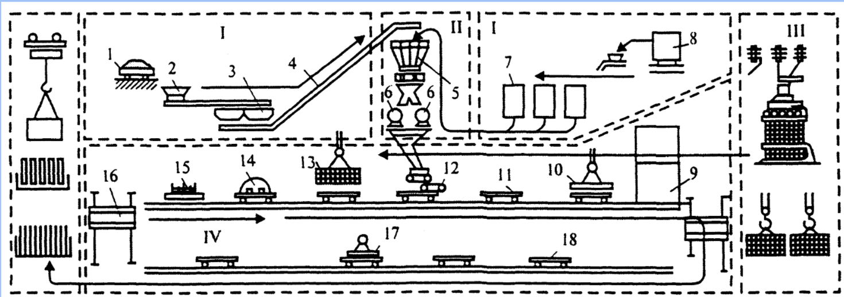
Technological process:
Picture 5: Process of reinforced concrete products’ production. Conveyor Method. {1,2,3,4} – Unloading raw materials (sand)
{7,8} – Unloading raw materials (cement)
{10,11,5,13,14,15} – Loading iron rebar, pouring concrete (cement + sand + stir)
{17,18,III} – quality control with ultrasound, loading to destination

Slide 7
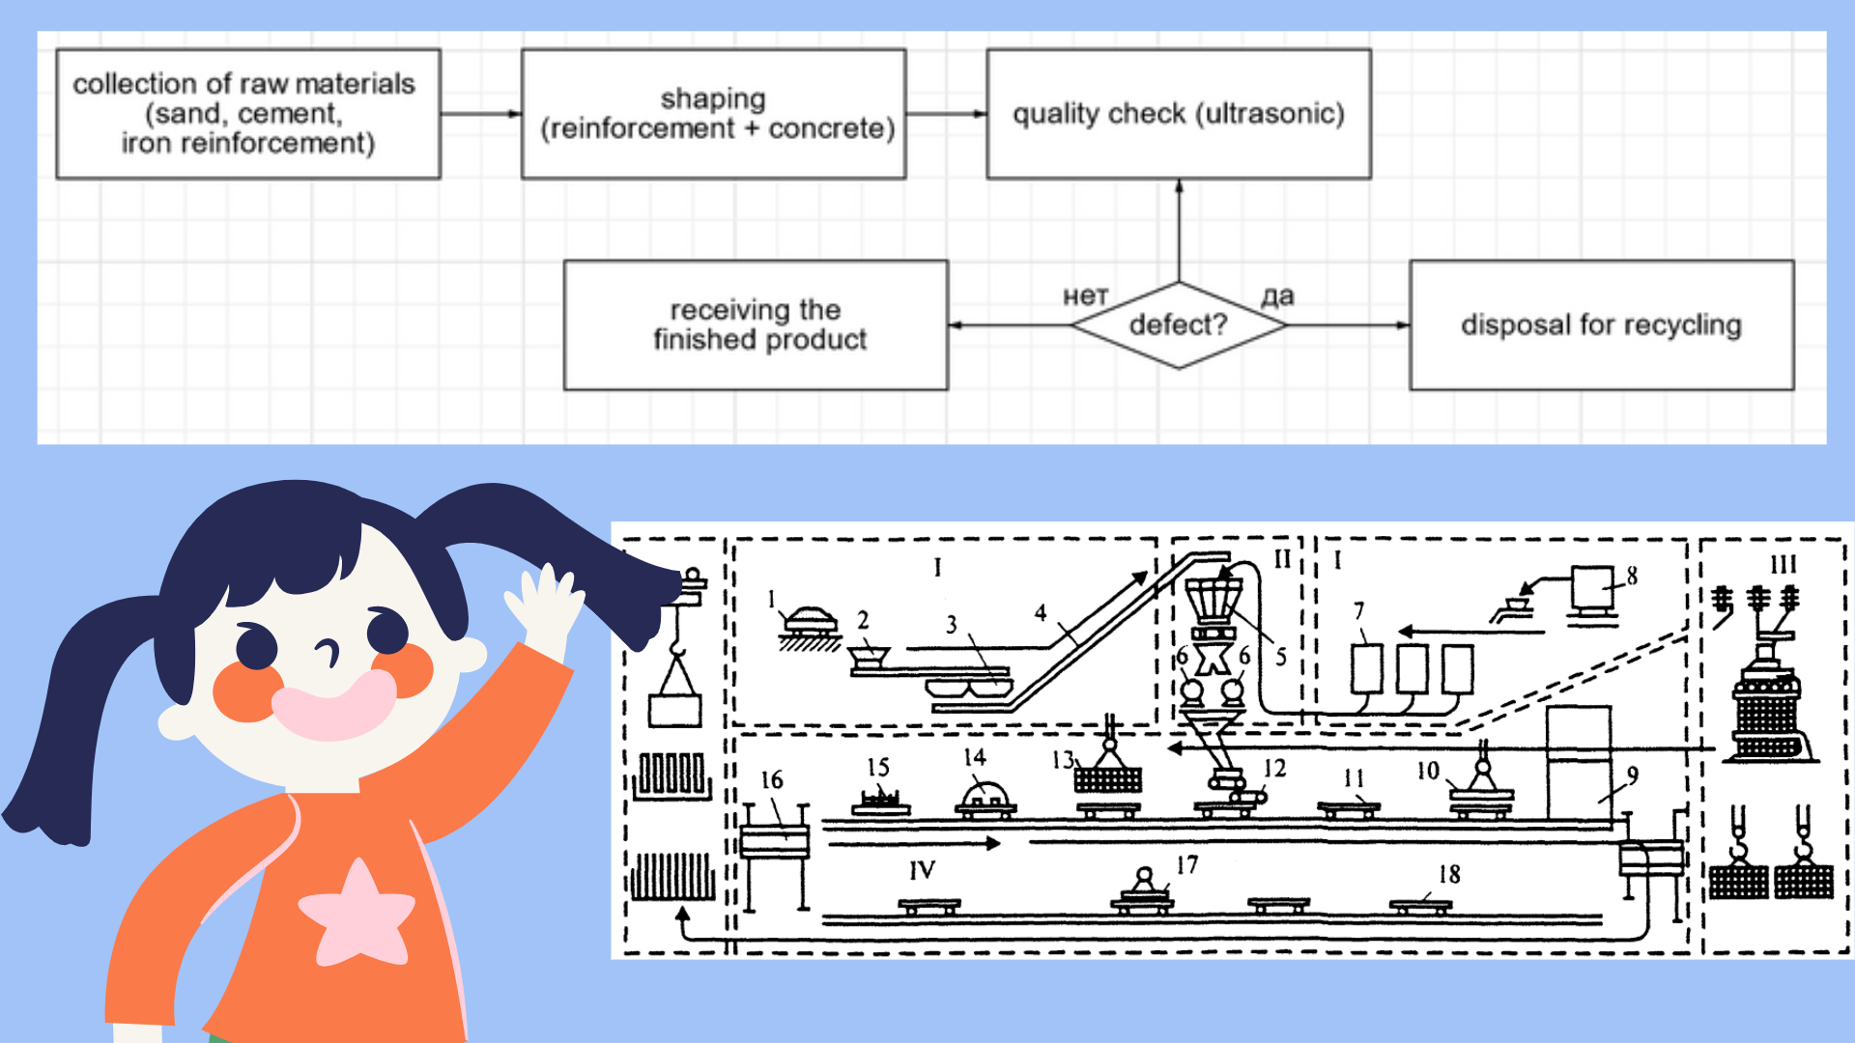
Picture 6: Conceptual view of the process in terms of blocks
Picture 5: Process of reinforced concrete products’ production. Conveyor Method

Slide 8
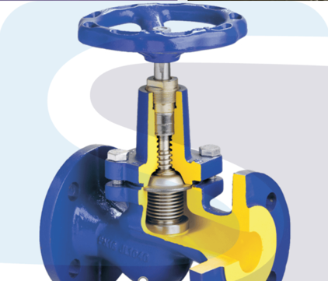
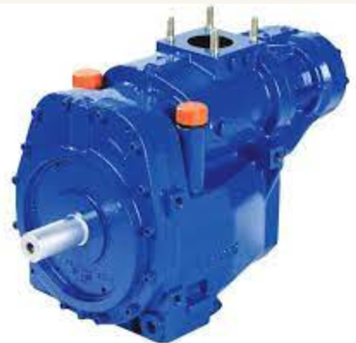
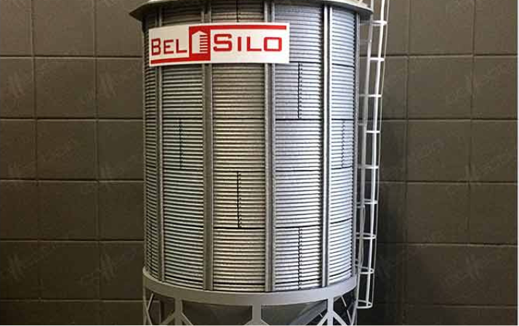
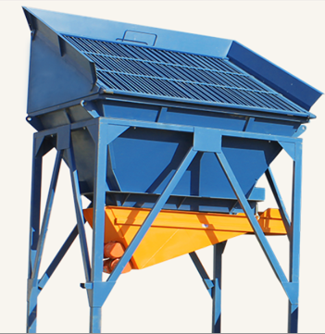
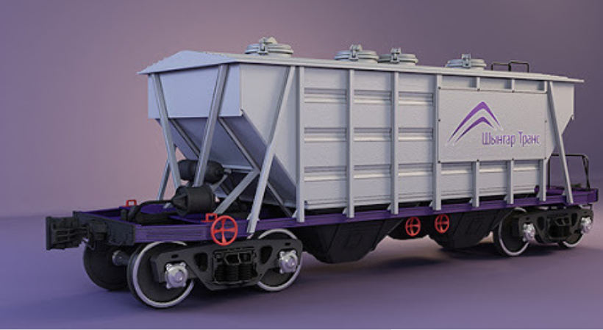
WHAT IS USED
Picture 7: Valve
Picture 8: Compressor
Picture 9: Silo storage
Picture 11: Activation storage
Picture 10: Cement truck

Slide 9
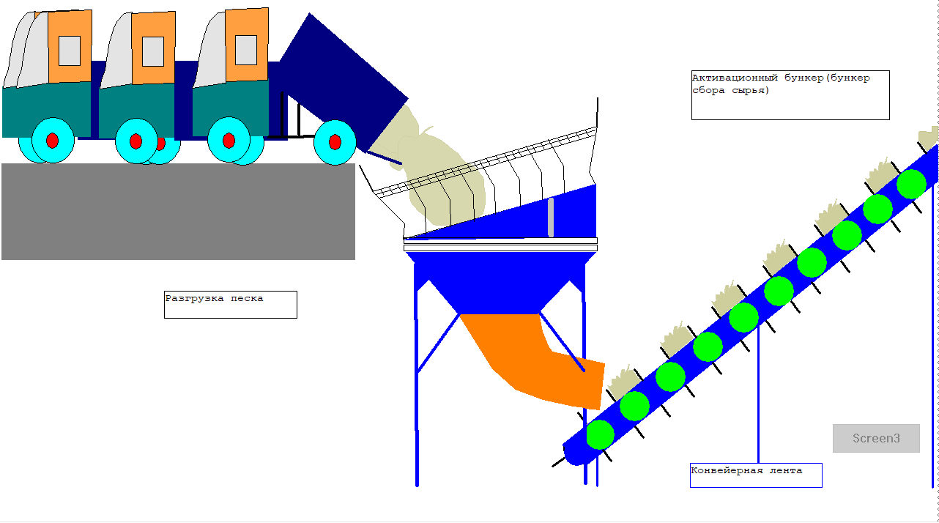
Picture 12: Unloading sand into a receiving hopper including unloading onto a conveyor gallery.

Slide 10
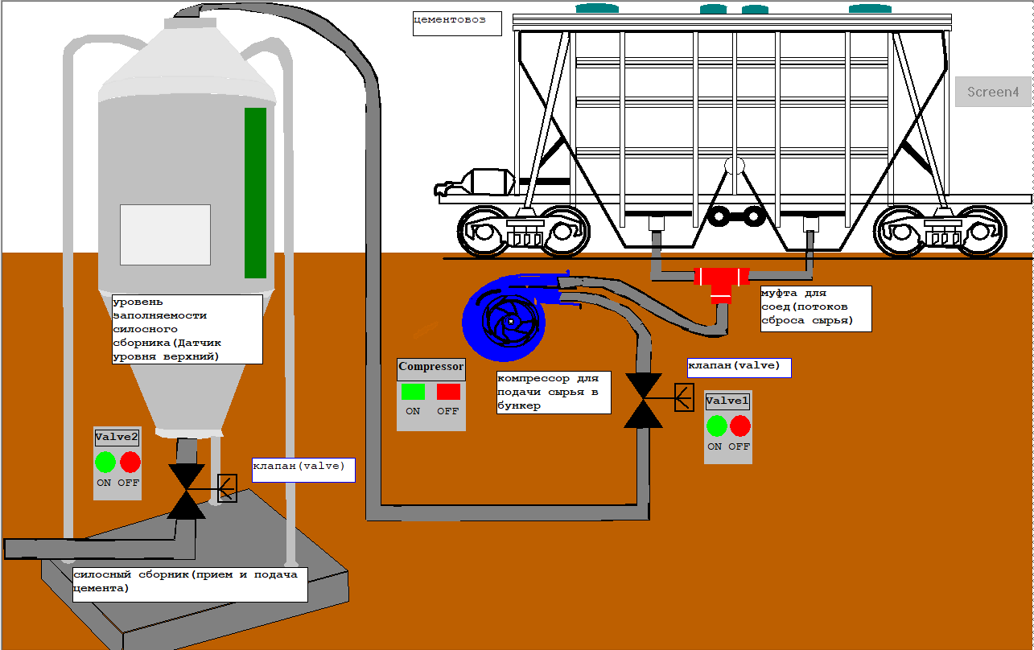
Picture 13: Unloading cement into a silo from cement track

Slide 11
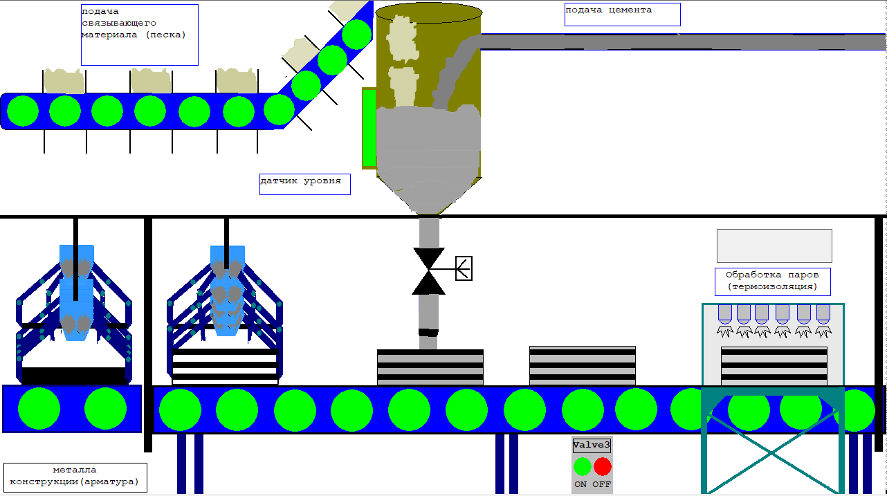
Picture 14: Feeding reinforcement into the mold and forming the product

Slide 12
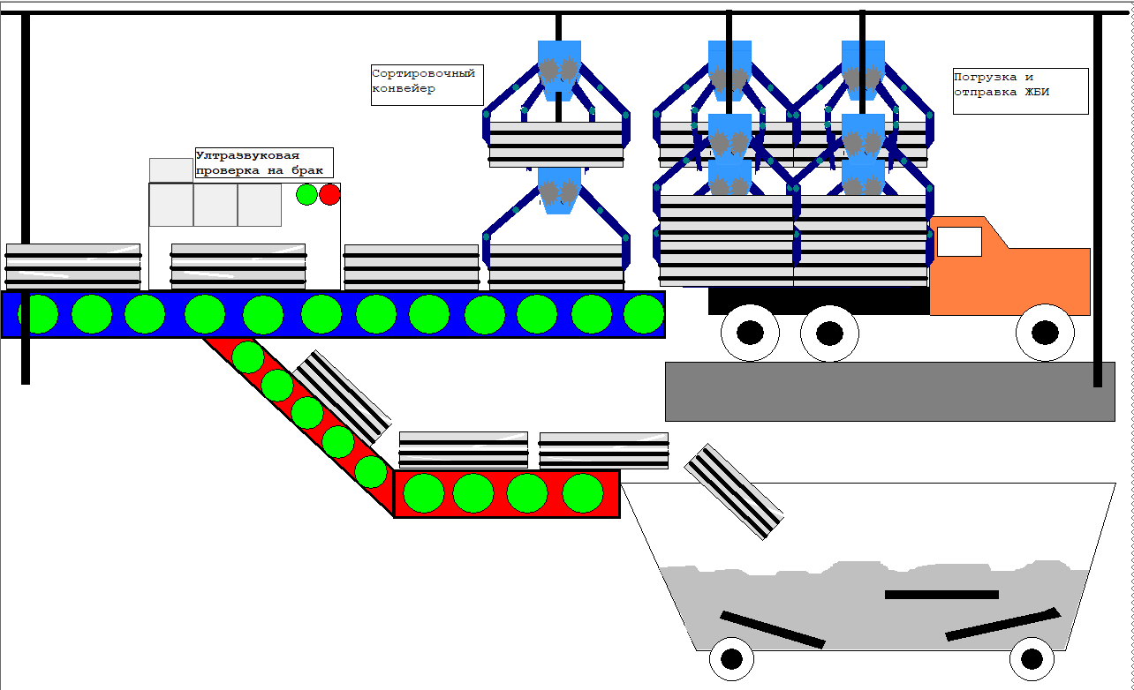
Picture 15: Quality control and loading of the finished product

Slide 13
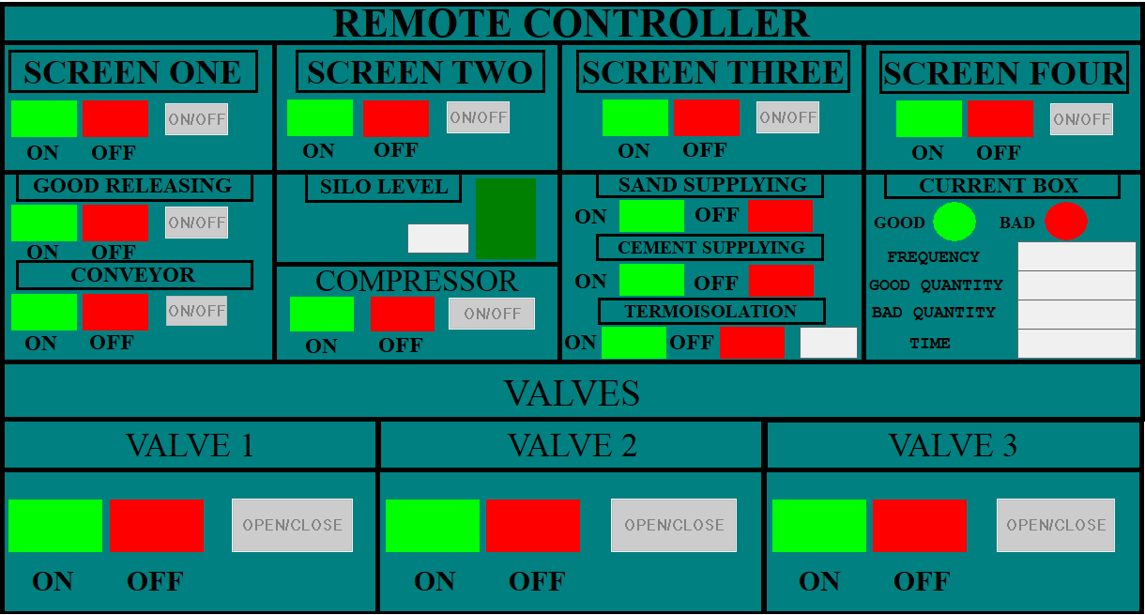
Picture 16: Remote controller for the whole processes

Slide 14
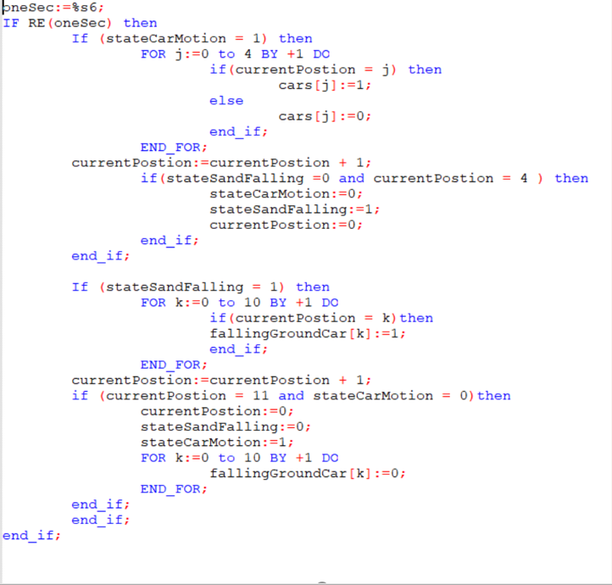
Code part for Unloading Part
Appendix A:

Slide 15
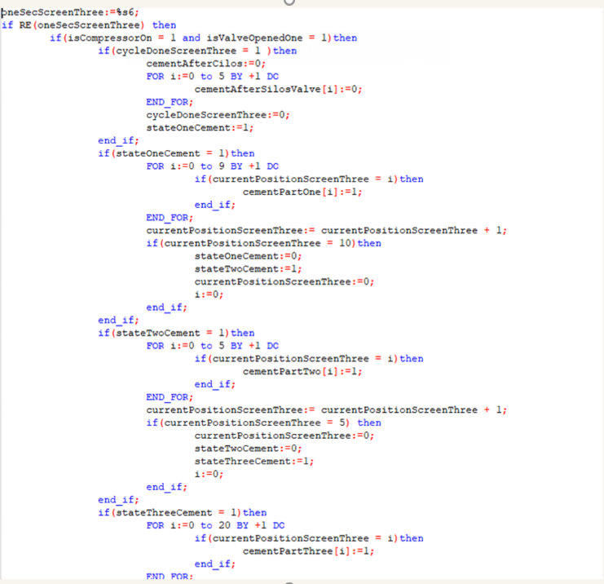
Appendix B: Code for Unloading cement into a silo from cement track

Slide 16
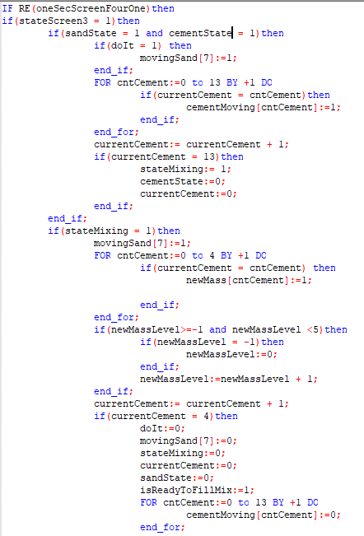
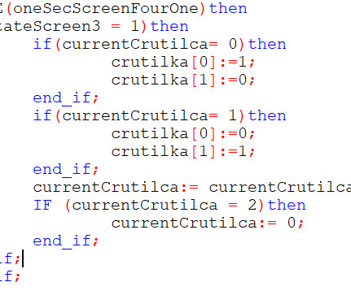
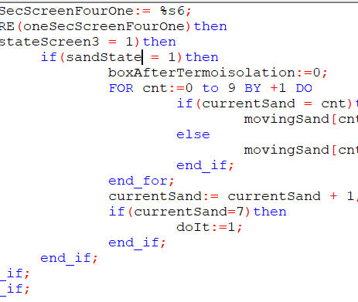
Appendix C: Code for Feeding reinforcement into the mold and forming the product

Slide 17
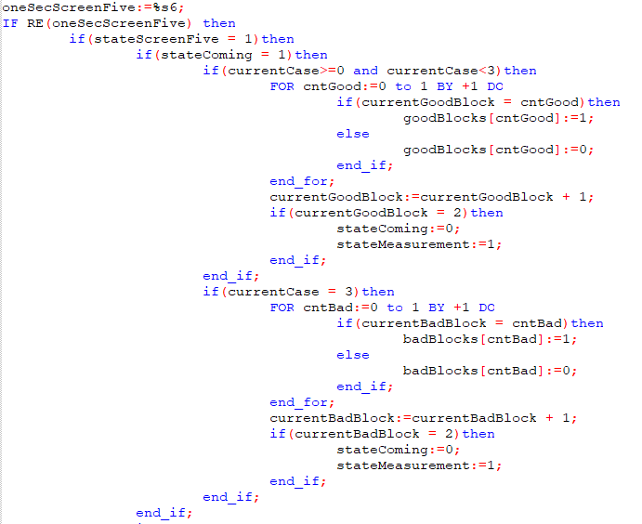
Appendix D: Code for Quality control and loading of the finished product

Slide 18
REFERENCES:
[Picture 1] Железобетонные конструкции- преимущества ЖБИ // https://tinyurl.com/2756nh6f
[Picture 2] ЖБИ в строительстве // https://tinyurl.com/3fhxk2xf
[Picture 5] Технология производства железобетонных изделий //https://betonzavod-info.com/tehnologiya-proizvodstva-zhelezobetonnyh-izdeliy/
[4] Преимущества ЖБИ изделий в строительстве // https://oz-gbi.ru/stati/preimushchestva-zhbi-izdeliy-v-stroitelstve/

