Slide 1
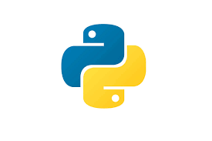
Programming on Python
Lecture 6
Functions. Defining a function. Calling a function.
Types of functions. Function Arguments
Complied by
Aizhan Altaibek

Slide 2
Python Functions

Slide 3
What is a function in Python?
In python, a function is a group of related statements that performs a specific task.
A function is a block of organized, reusable code that is used to perform a single, related action.
Functions help break our program into smaller and modular chunks. as our program grows larger and larger, functions make it more organized and manageable.
Furthermore, it avoids repetition and makes the code reusable.

Slide 4
Syntax of Function
def function_name(parameters):
"""docstring"""
statement(s)
Function definition consists of the following components:
Keyword def that marks the start of the function header.
A function name to uniquely identify the function.
Parameters (arguments) through which we pass values to a function. They are optional.
A colon (:) to mark the end of the function header.
Optional documentation string (docstring) to describe what the function does.
One or more valid python statements that make up the function body.
An optional return statement to return a value from the function.

Slide 5
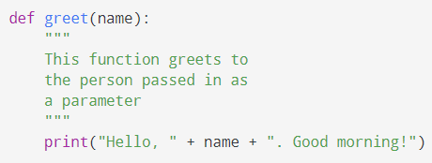
Example of a Function

Slide 6

How to call a function in python?
Once we have defined a function, we can call it from another function.
To call a function we simply type the function name with appropriate parameters.

Slide 7
Stored (and reused) Steps
Program:
def thing():
print 'Hello’
print 'Fun’
thing()
print 'Zip’
thing()
Output:
Hello
Fun
Zip
Hello
Fun
We call these reusable pieces of code “functions”.

Slide 8
docstrings
def function_name(parameters):
"""docstring"""
statement(s)
The first string after the function header is called the docstring and is short for documentation string.
It is briefly used to explain what a function does.
Although optional, documentation is a good programming practice, always document your code.
We generally use triple quotes so that docstring can extend up to multiple lines.
This string is available to us as the __doc__ attribute of the function.

Slide 9
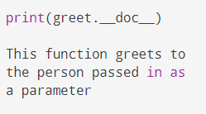
docstrings
This string is available to us as the __doc__ attribute of the function.

Slide 10
Parameters
def greet(lang):
if lang == 'es':
print ('Hola’)
elif lang == 'fr':
print ('Bonjour’)
else:
print ('Hello’)
greet('en') → Hello
greet('es') → Hola
greet('fr') → Bonjour
A parameter is a variable which we use in the function definition that is a “handle” that allows the code in the function to access the arguments for a particular function invocation.

Slide 11
Arguments
an argument is a value we pass into the function as its input when we call the function
we use arguments so we can direct the function to do different kinds of work when we call it at different times
we put the arguments in parenthesis after the name of the function
we can add as many arguments as we want, just separate them with a comma
arguments are often shortened to args in Python documentations
big = max('Hello world')
Argument

Slide 12
Parameters or Arguments?
The terms parameter and argument can be used for the same thing: information that are passed into a function.
From a function's perspective:
A parameter is the variable listed inside the parentheses in the function definition.
An argument is the value that is sent to the function when it is called.

Slide 13
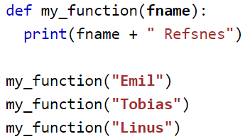
Parameters or Arguments?
The following example has a function with one parameter (fname). When the function is called, we pass along a first name, which is used inside the function to print the full name:

Slide 14
Types of Arguments
We can call a function by using the following types of formal arguments −
Required arguments
Keyword arguments
Default arguments
Variable-length arguments

Slide 15
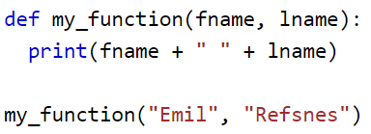
Required Arguments
Required arguments are the arguments passed to a function in correct positional order.
By default, a function must be called with the correct number of arguments.
Meaning that if your function expects 2 arguments, you have to call the function with 2 arguments, not more, and not less.
This function expects 2 arguments, and gets 2 arguments:

Slide 16
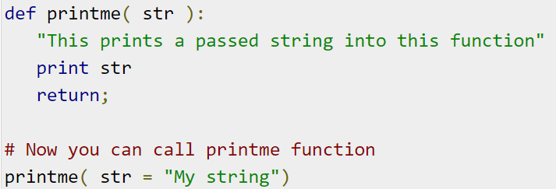
Keyword Arguments
Keyword arguments are related to the function calls.
When we use keyword arguments in a function call, the caller identifies the arguments by the parameter name.

Slide 17
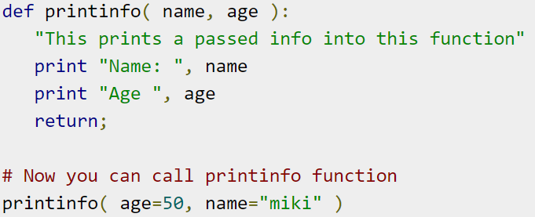

Keyword Arguments

Slide 18
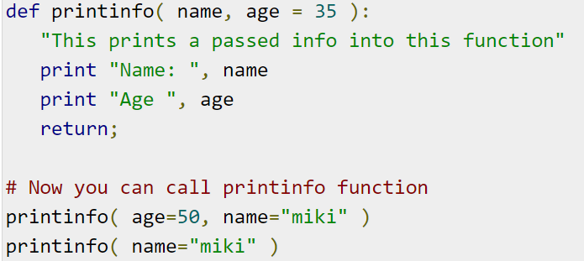
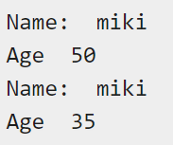
Default Arguments
A default argument is an argument that assumes a default value if a value is not provided in the function call for that argument.

Slide 19
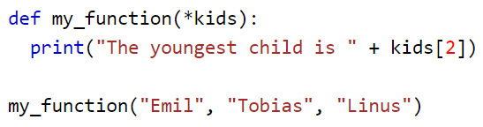
Variable-length arguments (Arbitrary Arguments, *args)
If you do not know how many arguments that will be passed into your function, add a * before the parameter name in the function definition.
These arguments are called variable-length arguments and are not named in the function definition, unlike required and default arguments.
This way the function will receive a tuple of arguments, and can access the items accordingly.
If the number of arguments is unknown, add a * before the parameter name:

Slide 20
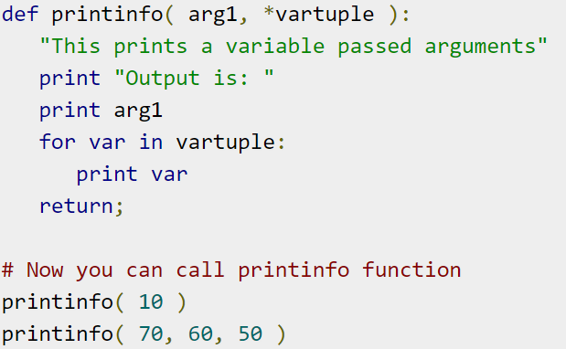
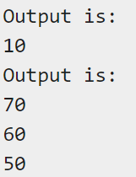
Variable-length arguments (Arbitrary Arguments, *args)

Slide 21
Return Values
Often a function will take its arguments, do some computation and return a value to be used as the value of the function call in the calling expression. The return keyword is used for this.
def greet():
return "Hello"
print (greet()+" Glenn")
print (greet()+" Sally")
Hello Glenn
Hello Sally

Slide 22
Return Value
def greet(lang):
if lang == 'es':
return'Hola’
elif lang == 'fr':
return'Bonjour’
else:
return'Hello’
print(greet('en')+'Glenn')
Hello Glenn
print(greet('es')+'Sally')
Hola Sally
print(greet('fr')+'Michael')
Bonjour Michael
a “fruitful” function is one that produces a result (or return value)
the return statement ends the function execution and “sends back” the result of the function

Slide 23
Arguments, Parameters, and Results
Parameter
s=greet(“John”)
print (s)
def greet(name):
return'Hello, '+name
greet('John')
“John”
‘Hello, John’
Argument
Result

Slide 24
Python Function Types
There are two kinds of functions in Python.
built-in functions - Functions that are built into Python: input(), type(), float(), int() ...
User-defined functions - Functions that we define ourselves and then use

Slide 25
User-defined function
We create a new function using the def keyword followed by optional parameters in parenthesis.
We indent the body of the function
This defines the function but does not execute the body of the function
Once we have defined a function, we can call (or invoke) it as many times as we like
This is the store and reuse pattern

Slide 26
Built-in functions

Slide 27
Max Function
A function is some stored code that we use. A function takes some input and produces an output.
>>> big = max('Hello world')
>>> print(big) → 'w'
max()
function
“Hello world”
(a string)
‘w’
(a string)

Slide 28
Max Function
big = max('Hello world')
print(big)
def max(inp):
…
for x in y:
…
“Hello world”
(a string)
‘w’
(a string)

Slide 29
Type Conversions
When you put an integer and floating point in an expression the integer is implicitly converted to a float
You can control this with the built in functions int() and float()
print float(99) / 100
0.99
i = 42
type(i)
<type 'int‘>
f = float(i)
print f
42.0
type(f)
<type 'float'>
print 1 + 2 * float(3) / 4 - 5
-2.5

Slide 30
String Conversions
sval = '123'
type(sval)
<type 'str'>
print sval + 1
Traceback (most recent call last):
File "<stdin>", line 1, in <module>
TypeError: cannot concatenate 'str' and 'int'
ival = int(sval)
type(ival)
<type 'int'>
print ival + 1
124
nsv = 'hello bob'
niv = int(nsv)
Traceback (most recent call last):
File "<stdin>", line 1, in <module>
ValueError: invalid literal for int()
You can also use int() and float() to convert between strings and integers
You will get an error if the string does not contain numeric characters

Slide 31
Void (non-fruitful) Functions
When a function does not return a value, we call it a "void" function
Functions that return values are "fruitful" functions
Void functions are "not fruitful"

Slide 32
To function or not to function...
Organize your code into “paragraphs” - capture a complete thought and “name it”
Don’t repeat yourself - make it work once and then reuse it
If something gets too long or complex, break up logical chunks and put those chunks in functions
Make a library of common stuff that you do over and over - perhaps share this with your friends...

Slide 33
Summary
Functions
Syntax of functions
docstring
Arguments/Parameters
The Return statement
User-defined/Built-In Functions
Void functions

Slide 34


