Slide 1

Programming on Python
Lecture 5
Input-Output. Printing on screen. Reading data from keyboard.
Opening and closing file. Reading and writing files Functions
Complied by
Aizhan Altaibek

Slide 2
Intro to Python for Data Science
Python input/output

Slide 3
Input/output
The input() and the print() built-in-functions are one of the most commonly used functions for performing standard input and output operations.
There is no output() function in python, rather print() is used to perform the standard output operations.

Slide 4
Reading Input From the Keyboard
Programs often need to obtain data from the user, usually by way of input from the keyboard.
The simplest way to accomplish this in Python is with input().
input([<prompt>])
Reads a line of input from the keyboard.

Slide 5
Reading Input From the Keyboard
input() pauses program execution to allow the user to type in a line of input from the keyboard.
Once the user presses the Enter key, all characters typed are read and returned as a string.

Slide 6
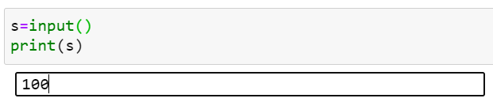
Reading Input From the Keyboard

Slide 7
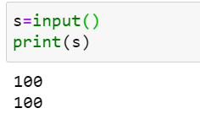
Reading Input From the Keyboard

Slide 8
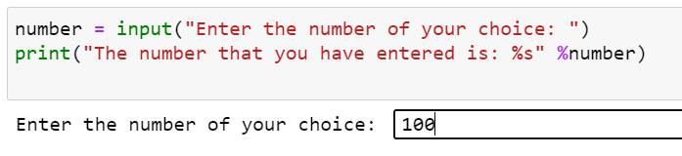

Reading Input From the Keyboard
Here the prompt is the one that would be displayed on the screen.

Slide 9
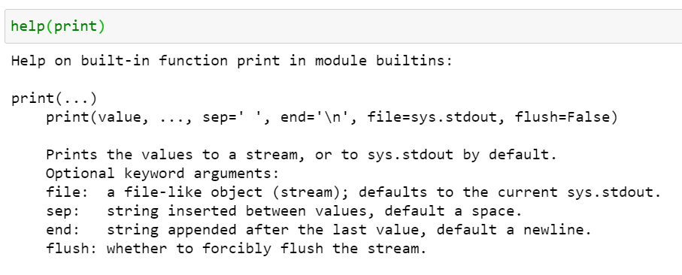
The output operation using the print function
The print function in python is normally used to print the output on the screen.
All you have to do is just call the function by passing the parameters.

Slide 10
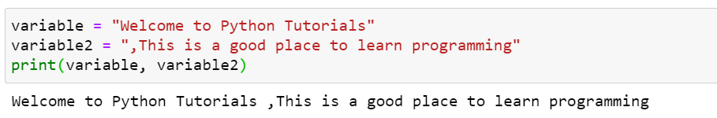
The output operation using the print function
You can pass as many parameters inside the print function but make sure that you separate the variable from one another.

Slide 11
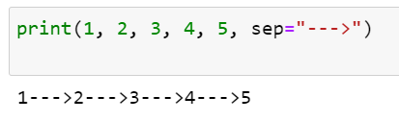
The output operation using the print function
The sep= Keyword Argument
Adding the keyword argument sep=<str> causes objects to be separated by the string <str> instead of the default single space:

Slide 12
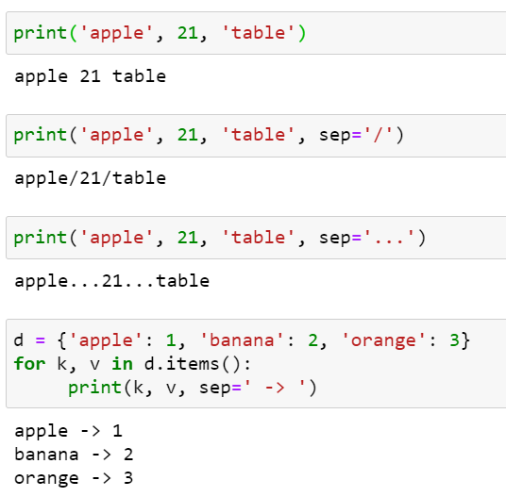
The output operation using the print function
The sep= Keyword Argument

Slide 13
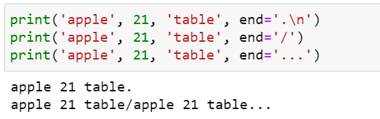
The output operation using the print function
The end= Keyword Argument
The keyword argument end=<str> causes output to be terminated by <str> instead of the default newline:

Slide 14
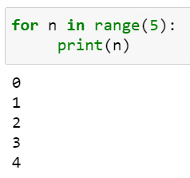
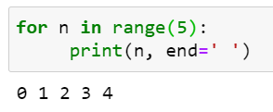
The output operation using the print function
The end= Keyword Argument
For example, if you are displaying values in a loop, you might use end= to cause the values to be displayed on one line, rather than on individual lines:

Slide 15
Intro to Python for Data Science
Python Files

Slide 16
Files.
File handling is an important part of any web application.
Python has several functions for creating, reading, updating, and deleting files.

Slide 17
Files as types.
Python has a type used to deal with files.
There are four main things we want to do with files:
Figure out how to open them. Figure out how to read them. Figure out how to write to them. Figure out how to close them.

Slide 18
File handling
The key function for working with files in Python is the open() function.
The open() function takes two parameters; filename, and mode.

Slide 19
File handling
There are four different methods (modes) for opening a file:
"r" - Read - Default value. Opens a file for reading, error if the file does not exist
"a" - Append - Opens a file for appending, creates the file if it does not exist
"w" - Write - Opens a file for writing, creates the file if it does not exist
"x" - Create - Creates the specified file, returns an error if the file exists

Slide 20
File handling
In addition you can specify if the file should be handled as binary
or text mode
"t" - Text - Default value. Text mode
"b" - Binary - Binary mode (e.g. images)

Slide 21
syntax
To open a file for reading it is enough to specify the name of the file:
f = open("demofile.txt")
The code above is the same as:
f = open("demofile.txt", "rt")
Because "r" for read, and "t" for text are the default values,
you do not need to specify them.

Slide 22
Intro to Python for Data Science
Python File Open

Slide 23
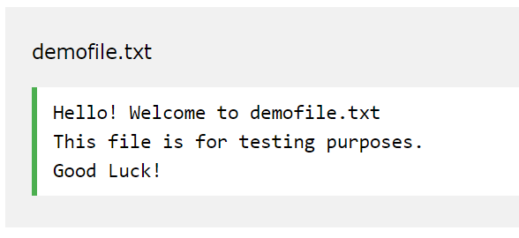
Open a File on the Server
We have the following file, located in the same folder as Python:
To open the file, use the built-in open() function.

Slide 24
Open a File on the Server
The open() function returns a file object, which has a read() method
for reading the content of the file:
f = open("demofile.txt", "r") print(f.read())

Slide 25
Open a File on the Server
If the file is located in a different location,
you will have to specify the file path, like this:
Open a file on a different location:
f = open("D:\\myfiles\welcome.txt", "r") print(f.read())
Or
f = open("D:/myfiles/welcome.txt", "r") print(f.read())

Slide 26
Intro to Python for Data Science
Python File Read

Slide 27
Read Only Parts of the File
By default the read() method returns the whole text,
but you can also specify how many characters you want to return:
Return the 5 first characters of the file:
f = open("demofile.txt", "r") print(f.read(5))

Slide 28
Read Lines
You can return one line by using the readline() method:
Read one line of the file:
f = open("demofile.txt", "r") print(f.readline())

Slide 29
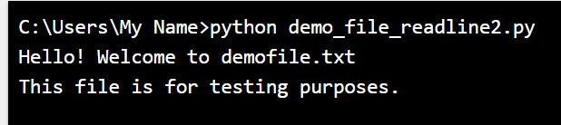
Read Lines
By calling readline() two times, you can read the two first lines:
Read two lines of the file:
f = open("demofile.txt", "r") print(f.readline()) print(f.readline())

Slide 30
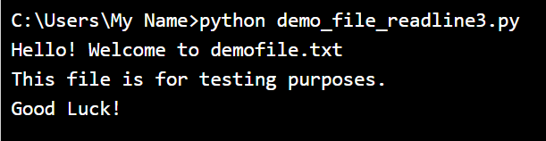
Read Lines
By looping through the lines of the file, you can read the whole file, line by line:
Loop through the file line by line:
f = open("demofile.txt", "r") for x in f: print(x)

Slide 31
Close Files
It is a good practice to always close the file when you are done with it.
Close the file when you are finish with it:
f = open("demofile.txt", "r") print(f.readline()) f.close()

Slide 32
Intro to Python for Data Science
Python File Write

Slide 33
Write to an Existing File
To write to an existing file, you must add a parameter to the
open() function:
"a" - Append - will append to the end of the file
"w" - Write - will overwrite any existing content

Slide 34
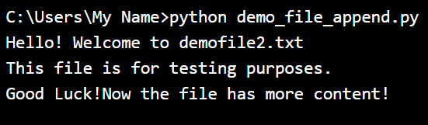
Write to an Existing File
Open the file "demofile2.txt" and append content to the file:
f = open("demofile2.txt", "a") f.write("Now the file has more content!") f.close() #open and read the file after the appending: f = open("demofile2.txt", "r") print(f.read())

Slide 35
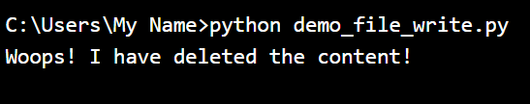
Write to an Existing File
Open the file "demofile3.txt" and overwrite the content:
f = open("demofile3.txt", "w") f.write("Woops! I have deleted the content!") f.close() #open and read the file after the appending: f = open("demofile3.txt", "r") print(f.read())
Note: the "w" method will overwrite the entire file.

Slide 36
Intro to Python for Data Science
Python File Creation

Slide 37
Create a New File
To create a new file in Python, use the open() method,
with one of the following parameters:
"x" - Create - will create a file, returns an error if the file exist
"a" - Append - will create a file if the specified file does not exist
"w" - Write - will create a file if the specified file does not exist

Slide 38
Create a New File
Create a file called "myfile.txt":
f = open("myfile.txt", "x")
Result: a new empty file is created!
Create a new file if it does not exist:
f = open("myfile.txt", "w")

Slide 39
Intro to Python for Data Science
Python Delete File

Slide 40
Delete a File
To delete a file, you must import the OS module,
and run its os.remove() function:
Remove the file "demofile.txt":
import os os.remove("demofile.txt")

Slide 41
Check if File exist:
To avoid getting an error, you might want to check if the file exists before you try to delete it:
Check if file exists, then delete it:
import os if os.path.exists("demofile.txt"): os.remove("demofile.txt") else: print("The file does not exist")

Slide 42
Delete Folder
To delete an entire folder, use the os.rmdir() method:
Remove the folder "myfolder":
import os os.rmdir("myfolder")
Note: You can only remove empty folders.

Slide 43


