Slide 1

Programming on Python
Lecture 4
Collections. Dictionaries.
Sets. Tuple.
Complied by
Aizhan Altaibek

Slide 2
Intro to Python for Data Science
Python Collections

Slide 3
Python collections
Intro to Python for Data Science
There are four collection data types in the Python programming language:
List is a collection which is ordered and changeable. Allows duplicate members.
Tuple is a collection which is ordered and unchangeable. Allows duplicate members.
Set is a collection which is unordered and unindexed. No duplicate members.
Dictionary is a collection which is unordered, changeable and indexed. No duplicate members.
When choosing a collection type, it is useful to understand the properties of that type. Choosing the right type for a particular data set could mean retention of meaning, and, it could mean an increase in efficiency or security.

Slide 4
Intro to Python for Data Science
Tuples

Slide 5
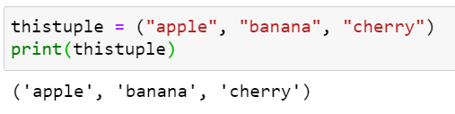
tuple
A tuple is a collection which is ordered and unchangeable. In Python tuples are written with round brackets

Slide 6
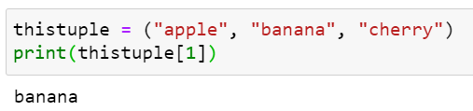
Access Tuple Items
You can access tuple items by referring to the index number, inside square brackets:

Slide 7

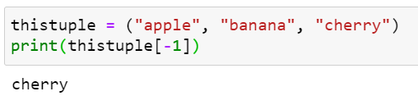
Negative Indexing
Negative indexing means beginning from the end, -1 refers to the last item, -2 refers to the second last item etc.

Slide 8

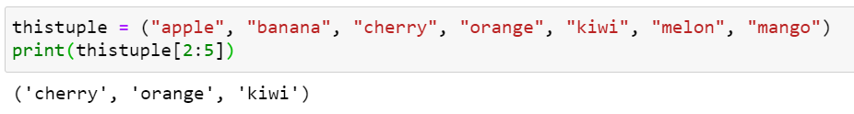
Range of Indexes
Specifying a range of indexes by specifying where to start and where to end the range.
When specifying a range, the return value will be a new tuple with the specified items.

Slide 9
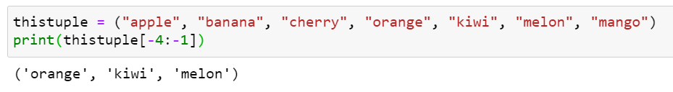
Range of Negative Indexing
Specify negative indexes if you want to start the search from the end of the tuple:

Slide 10
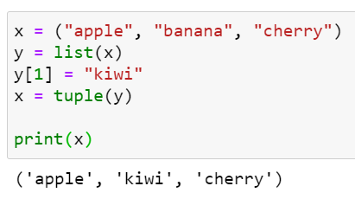
Change Tuple Values
Once a tuple is created, you cannot change its values. Tuples are unchangeable, or immutable as it also is called.
But there is a workaround. You can convert the tuple into a list, change the list, and convert the list back into a tuple.
Convert the tuple into a list to be able to change it:

Slide 11
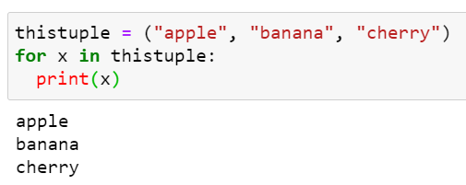
Loop Through a Tuple
You can loop through the tuple items by using a for loop.

Slide 12
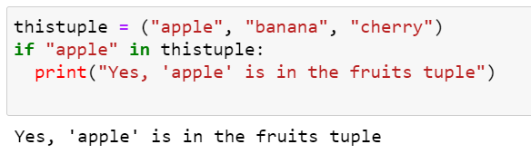
check if Item Exists
To determine if a specified item is present in a tuple use the in keyword:

Slide 13
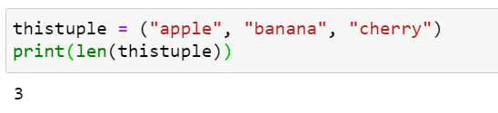
Tuple Length
To determine how many items a tuple has, use the len() method:

Slide 14
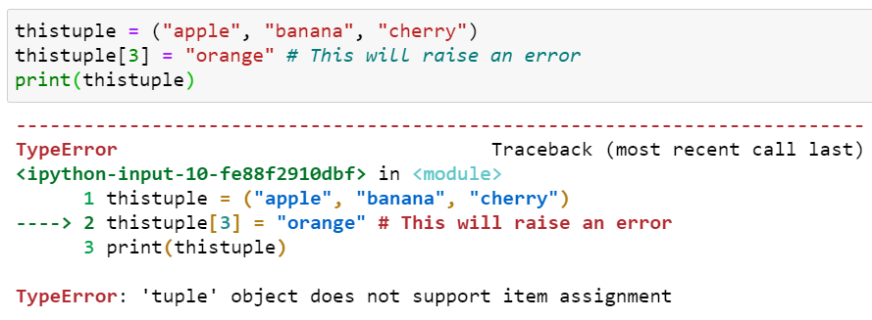
Add Items in the tuple?
Once a tuple is created, you cannot add items to it. Tuples are unchangeable.

Slide 15
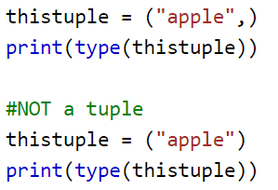
Create Tuple With One Item
To create a tuple with only one item, you have to add a comma after the item, otherwise Python will not recognize it as a tuple.

Slide 16
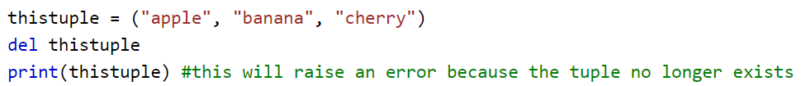
Remove Items
Tuples are unchangeable, so you cannot remove items from it, but you can delete the tuple completely:

Slide 17
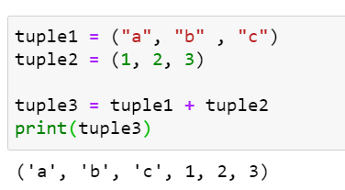
Join Two Tuples
To join two or more tuples you can use the + operator:

Slide 18
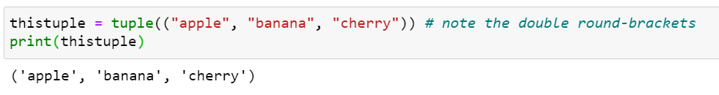
The tuple() Constructor
It is also possible to use the tuple() constructor to make a tuple.

Slide 19
Tuple Methods
Python has two built-in methods that you can use on tuples.
Method | Description
count() | Returns the number of times a specified value occurs in a tuple
index() | Searches the tuple for a specified value and returns the position of where it was found

Slide 20
Intro to Python for Data Science
Python Sets

Slide 21
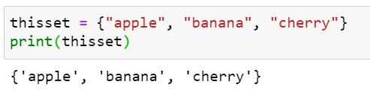
set
A set is a collection which is unordered and unindexed.
In Python, sets are written with curly brackets.
Note: Sets are unordered, so you cannot be sure in which order the items will appear.

Slide 22
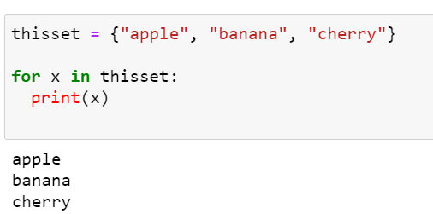
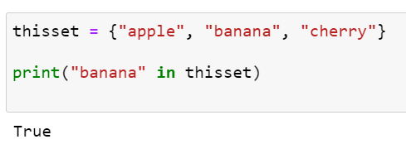
Access Items
You cannot access items in a set by referring to an index or a key.
But you can loop through the set items using a for loop,
or ask if a specified value is present in a set, by using the in keyword.

Slide 23
Change Items
Once a set is created, you cannot change its items, but you can add new items.

Slide 24
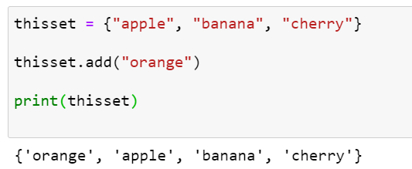
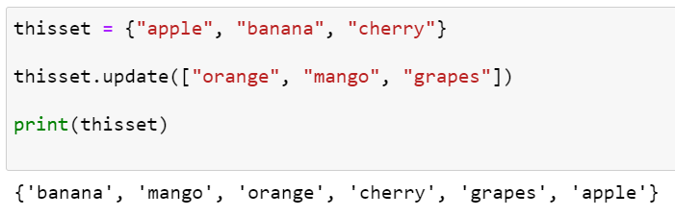
add items
To add one item to a set use the add() method.
To add more than one item to a set use the update() method.

Slide 25
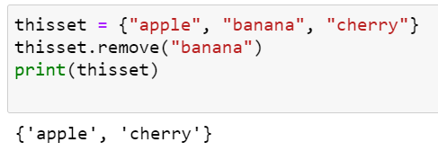
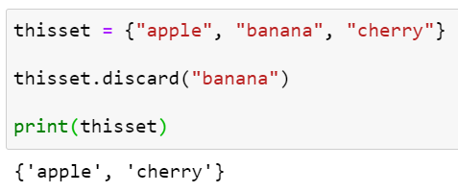
Remove item
To remove an item in a set, use the remove(),
or the discard() method.

Slide 26
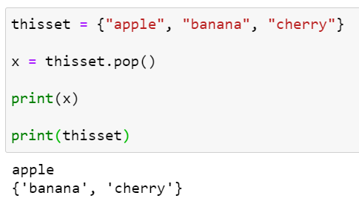
Remove item
You can also use the pop(), method to remove an item,
but this method will remove the last item.
Remember that sets are unordered, so you will not know what item
that gets removed.
The return value of the pop() method is the removed item.

Slide 27
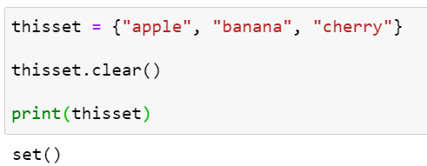
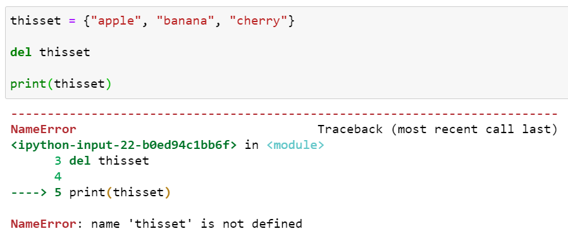
Remove item
The clear() method empties the set:
The del keyword will delete the set completely:

Slide 28
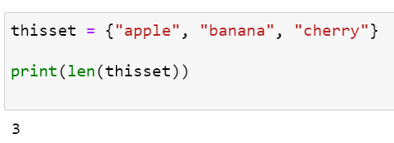
Get the Length of a Set
To determine how many items a set has, use the len() method.

Slide 29
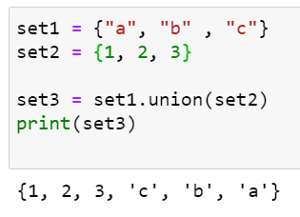
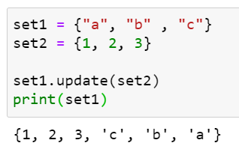
Join Two Sets
There are several ways to join two or more sets in Python.
You can use the union() method that returns a new set containing
all items from both sets, or the update() method that inserts
all the items from one set into another:
Note: Both union() and update()
will exclude any duplicate items.

Slide 30
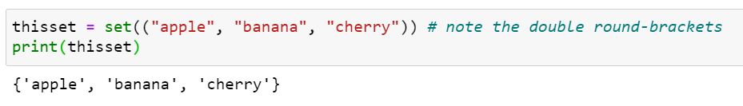
The set() Constructor
It is also possible to use the set() constructor to make a set.

Slide 31
Set Methods
Method | Description
add() | Adds an element to the set
clear() | Removes all the elements from the set
copy() | Returns a copy of the set
difference() | Returns a set containing the difference between two or more sets
difference_update() | Removes the items in this set that are also included in another, specified set
discard() | Remove the specified item
intersection() | Returns a set, that is the intersection of two other sets
intersection_update() | Removes the items in this set that are not present in other, specified set(s)
isdisjoint() | Returns whether two sets have a intersection or not
issubset() | Returns whether another set contains this set or not
issuperset() | Returns whether this set contains another set or not
pop() | Removes an element from the set
remove() | Removes the specified element
symmetric_difference() | Returns a set with the symmetric differences of two sets
symmetric_difference_update() | inserts the symmetric differences from this set and another
union() | Return a set containing the union of sets
update() | Update the set with the union of this set and others

Slide 32
Intro to Python for Data Science
Python Dictionaries

Slide 33
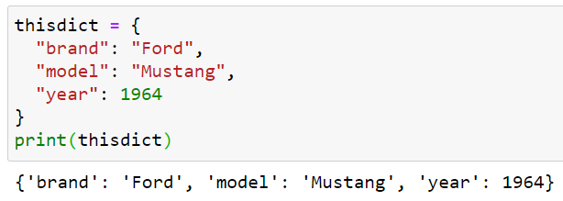
Dictionary
A dictionary is a collection which is unordered, changeable and indexed. In Python dictionaries are written with curly brackets, and they have keys and values.

Slide 34
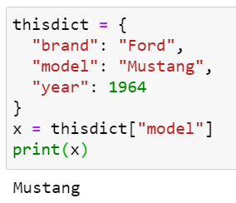
Accessing Items
You can access the items of a dictionary by referring to its key name, inside square brackets:
There is also a method called get() that will give you the same result:
x = thisdict.get("model")

Slide 35
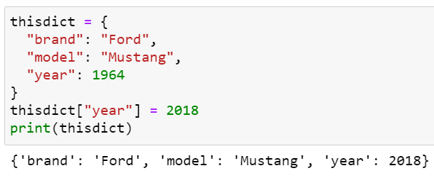
Change Values
You can change the value of a specific item by referring to its key name:

Slide 36
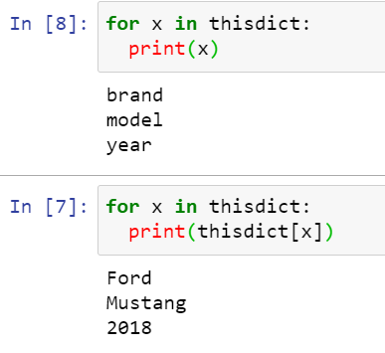
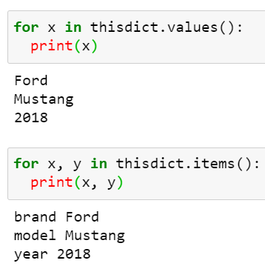
Loop Through a Dictionary
You can loop through a dictionary by using a for loop.
When looping through a dictionary, the return value are the keys of the dictionary,
but there are methods to return the values as well.
The values() method to return
values of a dictionary
Loop through both keys and values,
by using the items() method:

Slide 37
Removing items
There are several methods to remove items from a dictionary
Methods | Description | Example
pop() | removes the item with the specified key name | thisdict.pop("model")
popitem() | removes the last inserted item | thisdict.popitem()
del | keyword removes the item with the specified key name | del thisdict["model"]
 | can also delete the dictionary completely | del thisdict
clear() | empties the dictionary | thisdict.clear()

Slide 38
Other operations
Methods | Description | Example
In | Check if Key Exists | if "model" in thisdict:
len() | Dictionary Length | print(len(thisdict))
 | Adding Items | thisdict["color"] = "red"
copy() | Copy a Dictionary | mydict = thisdict.copy()
dict() | Another way to make a copy | mydict = dict(thisdict)

Slide 39
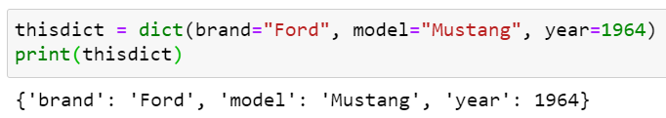
The dict() Constructor
It is also possible to use the dict() constructor to make a new dictionary:

Slide 40
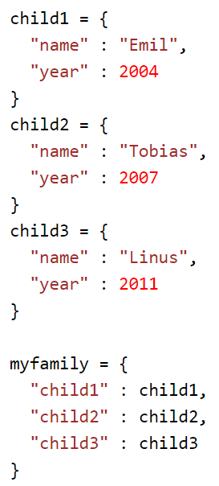
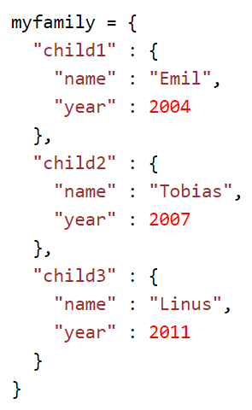
Nested Dictionaries
A dictionary can also contain many dictionaries, this is called nested dictionaries.

Slide 41
Dictionary Methods
Method | Description
clear() | Removes all the elements from the dictionary
copy() | Returns a copy of the dictionary
fromkeys() | Returns a dictionary with the specified keys and value
get() | Returns the value of the specified key
items() | Returns a list containing a tuple for each key value pair
keys() | Returns a list containing the dictionary's keys
pop() | Removes the element with the specified key
popitem() | Removes the last inserted key-value pair
setdefault() | Returns the value of the specified key. If the key does not exist: insert the key, with the specified value
update() | Updates the dictionary with the specified key-value pairs
values() | Returns a list of all the values in the dictionary

Slide 42


