Slide 1

Programming on Python
Lecture 10
List Comprehensions. NumPy
Complied by
Aizhan Altaibek

Slide 2
Content
List Comprehensions
NumPy
2D NumPy array
NumPy functions

Slide 3
List Comprehensions

Slide 4
List Comprehensions
List comprehensions are one of Python's most beloved and unique features.
List comprehension offers a shorter syntax when you want to create a new list based on the values of an existing list.

Slide 5
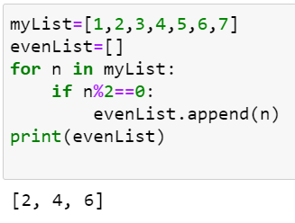
List Comprehensions
Examples
Getting even numbers from the list.
Without list comprehension

Slide 6
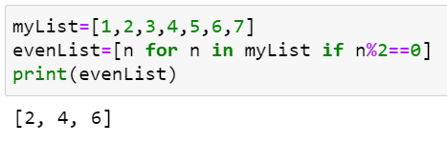
List Comprehensions
Examples
Getting even numbers from the list.
With list comprehension

Slide 7
List Comprehensions
Without list comprehension
With list comprehension

Slide 8
List Comprehensions
The Syntax
newlist = [expression for item in iterable if condition == True]
Example
evenList = [n for n in myList if n%2==0]

Slide 9
List Comprehensions
Conditions
newlist = [expression for item in iterable if condition == True]
The condition is like a filter that only accepts the items that valuate to True. The condition is optional and can be omitted.
Example
oddList = [n for n in myList if n%2!=0]
newList = [n for n in myList]

Slide 10
List Comprehensions
Iterable
newlist = [expression for item in iterable if condition == True]
The iterable can be any iterable object, like a list, tuple, set etc.
Example
1)
newlist = [x for x in range(10)]
2)
mySet={1,2,3,4}
print({x for x in mySet})

Slide 11
List Comprehensions
Expression
newlist = [expression for item in iterable if condition == True]
The expression is the current item in the iteration, but it is also the outcome, which you can manipulate before it ends up like a list item in the new list:
Example
newlist = [x for x in range(10)]
Output: [0, 1, 2, 3, 4, 5, 6, 7, 8, 9]
newlist = [x**2 for x in range(10)]
Output:[0, 1, 4, 9, 16, 25, 36, 49, 64, 81]

Slide 12
List Comprehensions
Expression
newlist = [expression for item in iterable if condition == True]
The expression can also contain conditions, not like a filter, but as a way to manipulate the outcome:
Example
newlist = [x if x%2==0 else 0 for x in range(10)]
Output:[0, 0, 2, 0, 4, 0, 6, 0, 8, 0]

Slide 13
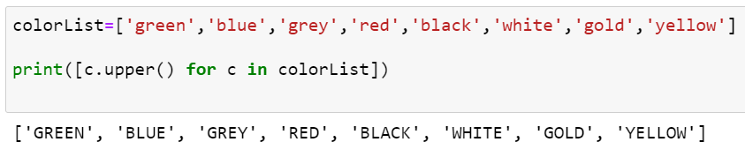
List Comprehensions
Examples

Slide 14
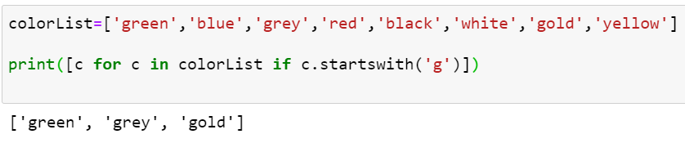
List Comprehensions
Examples

Slide 15
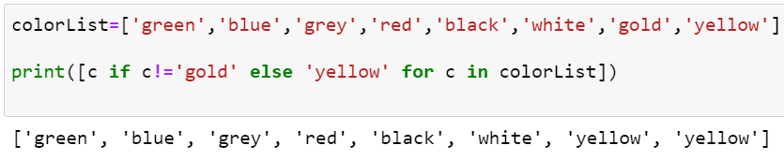
List Comprehensions
Examples

Slide 16
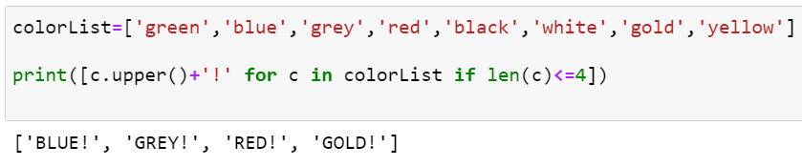
List Comprehensions
Using len(), sum() functions.

Slide 17
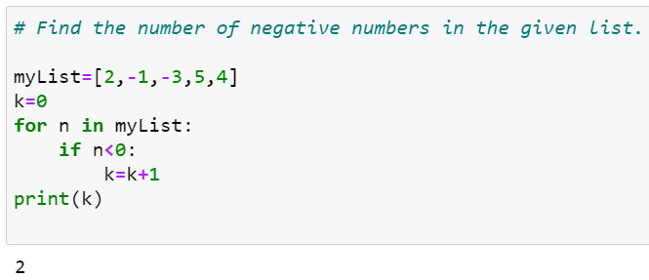
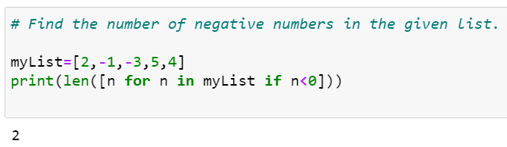
List Comprehensions
Using len() functions.

Slide 18
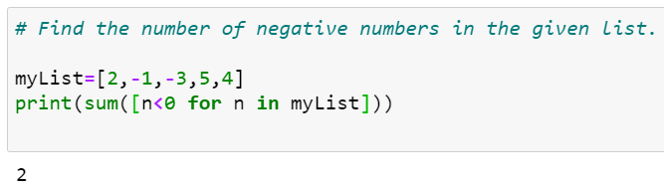
List Comprehensions
Using len() and sum() functions to count negative numbers.

Slide 19
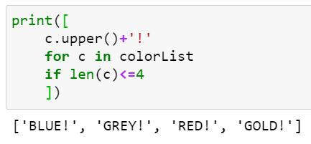
List Comprehensions
Like SQL
SELECT
FROM
WHERE

Slide 20
NumPy

Slide 21
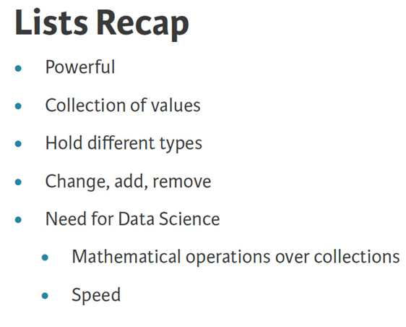

Slide 22
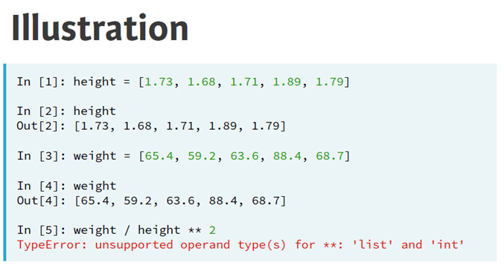

Slide 23
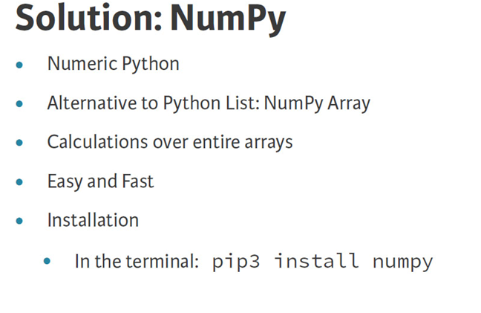

Slide 24
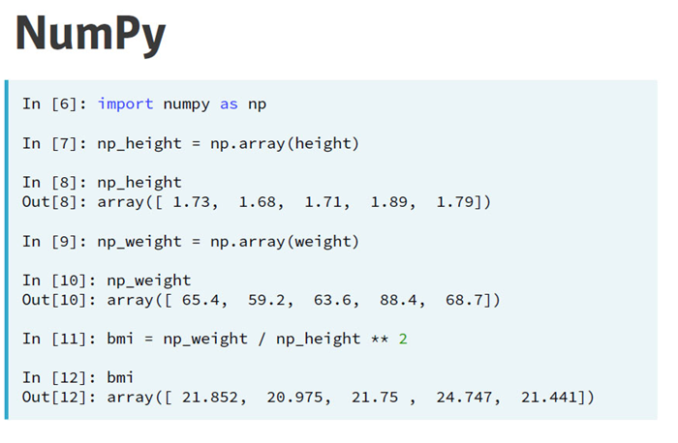

Slide 25
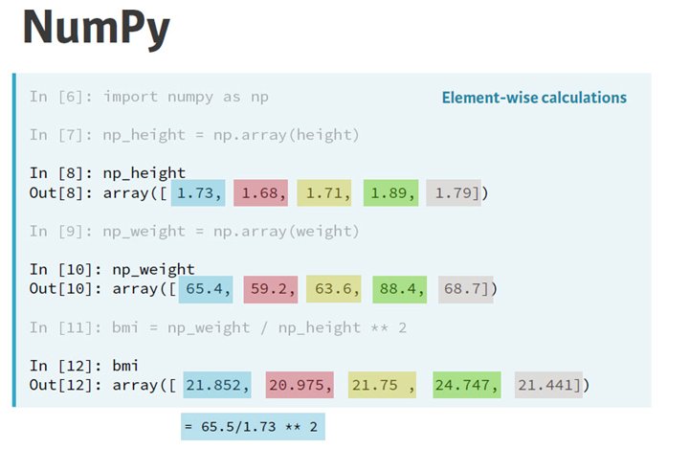

Slide 26
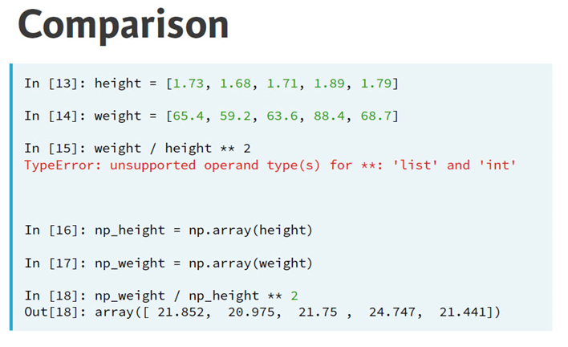

Slide 27
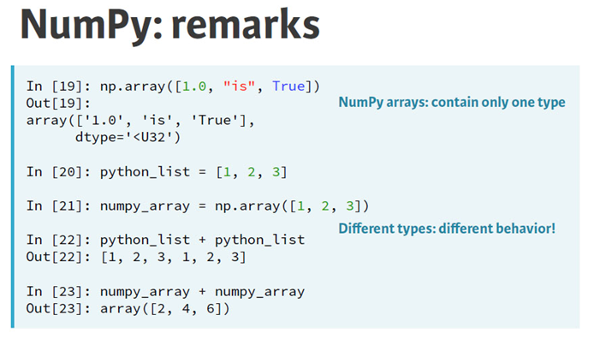

Slide 28
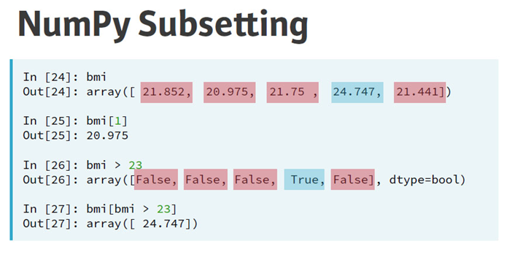

Slide 29
2D Numpy Array

Slide 30
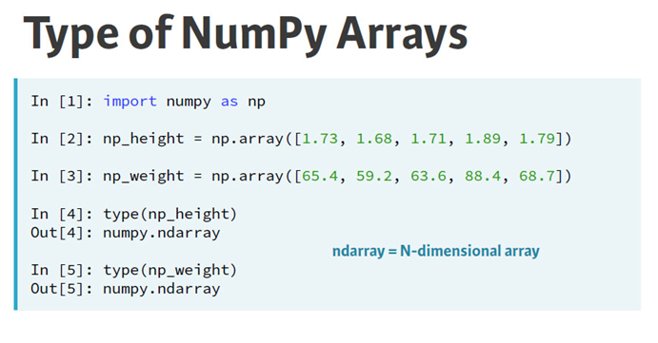

Slide 31
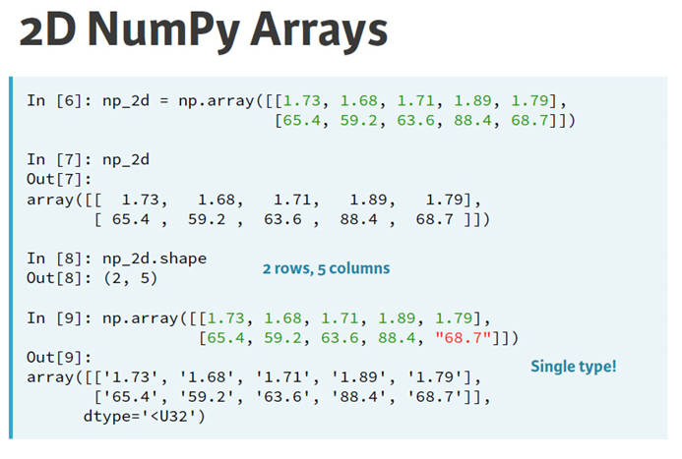

Slide 32
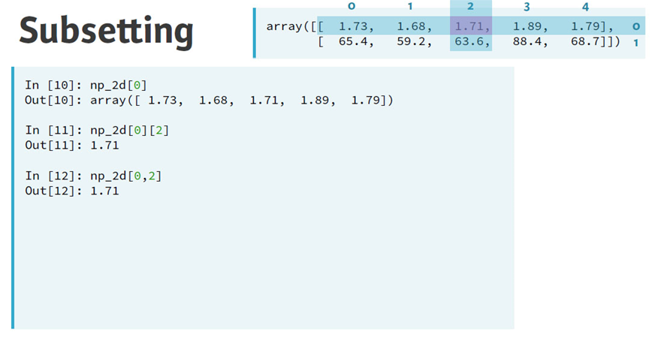

Slide 33
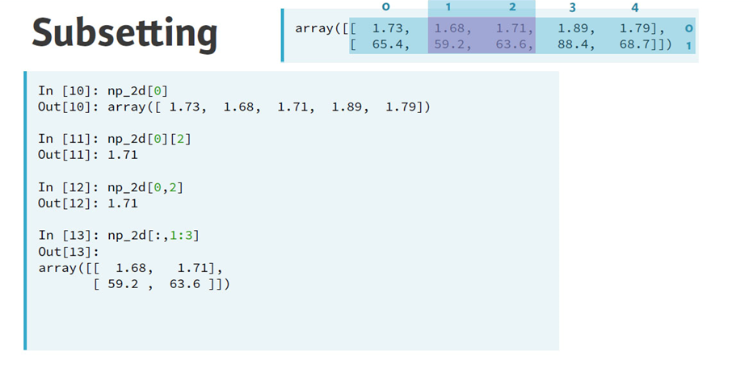

Slide 34
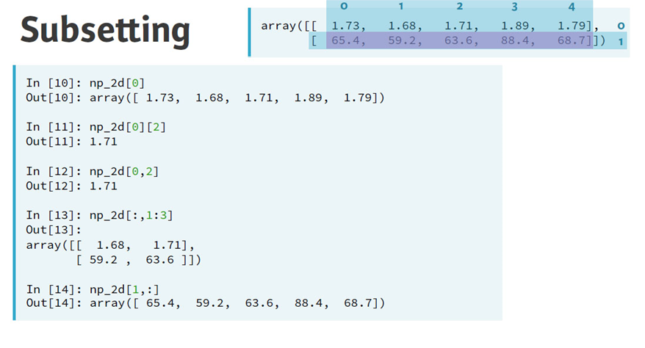

Slide 35
What is NumPy?
NumPy is a python library used for working with arrays.
It also has functions for working in domain of linear algebra, fourier transform, and matrices.
NumPy was created in 2005 by Travis Oliphant. It is an open source project and you can use it freely.
NumPy stands for Numerical Python.

Slide 36
Why Use NumPy ?
In Python we have lists that serve the purpose of arrays, but they are slow to process.
NumPy aims to provide an array object that is up to 50x faster that traditional Python lists.
The array object in NumPy is called ndarray, it provides a lot of supporting functions that make working with ndarray very easy.
Arrays are very frequently used in data science, where speed and resources are very important.

Slide 37
Why is NumPy Faster Than Lists?
NumPy arrays are stored at one continuous place in memory unlike lists, so processes can access and manipulate them very efficiently.
This behavior is called locality of reference in computer science.
This is the main reason why NumPy is faster than lists.

Slide 38
Which Language is NumPy written in?
NumPy is a Python library and is written partially in Python, but most of the parts that require fast computation are written in C or C++.

Slide 39
Splitting NumPy Arrays
Splitting is reverse operation of Joining.
Joining merges multiple arrays into one and Splitting breaks one array into multiple.
We use array_split() for splitting arrays, we pass it the array we want to split and the number of splits.

Slide 40
Splitting NumPy Arrays
Split the array in 3 parts:
import numpy as np arr = np.array([1, 2, 3, 4, 5, 6]) newarr = np.array_split(arr, 3) print(newarr)
[array([1, 2]), array([3, 4]), array([5, 6])]
The return value is an array containing three arrays.

Slide 41
Split Into Arrays
If you split an array into 3 arrays, you can access them from the result just like any array element:
import numpy as np arr = np.array([1, 2, 3, 4, 5, 6]) newarr = np.array_split(arr, 3) print(newarr[0]) print(newarr[1]) print(newarr[2])
[1 2] [3 4] [5 6]

Slide 42
Splitting 2-D Arrays
Use the array_split() method, pass in the array you want to split and the number of splits you want to do.
Split the 2-D array into three 2-D arrays.
import numpy as np arr = np.array([[1, 2], [3, 4], [5, 6], [7, 8], [9, 10], [11, 12]]) newarr = np.array_split(arr, 3) print(newarr)
[array([[1, 2], [3, 4]]), array([[5, 6], [7, 8]]), array([[ 9, 10], [11, 12]])]

Slide 43
NumPy Searching Arrays
You can search an array for a certain value, and return the indexes that get a match.
To search an array, use the where() method.
Find the indexes where the value is 4:
import numpy as np arr = np.array([1, 2, 3, 4, 5, 4, 4]) x = np.where(arr == 4) print(x)
(array([3, 5, 6]),)

Slide 44
NumPy Filter Array
Getting some elements out of an existing array and creating a new array out of them is called filtering.
In NumPy, you filter an array using a boolean index list.
A boolean index list is a list of booleans corresponding to indexes in the array.
If the value at an index is True that element is contained in the filtered array, if the value at that index is False that element is excluded from the filtered array.
Create an array from the elements on index 0 and 2:
import numpy as np arr = np.array([41, 42, 43, 44]) x = [True, False, True, False] newarr = arr[x] print(newarr)
[41 43]

Slide 45
Creating Filter Directly From Array
We can directly substitute the array instead of the iterable variable in our condition and it will work just as we expect it to.
Create a filter array that will return only values higher than 42:
import numpy as np arr = np.array([41, 42, 43, 44]) filter_arr = arr > 42 newarr = arr[filter_arr] print(filter_arr) print(newarr)
[False False True True]
[43 44]

Slide 46


