Slide 1

Programming on Python
Lecture 11
Multithreading and Client/Server Programming; introduction to HTML, interacting with remote HTML server, running html-based queries, downloading pages.
Complied by
Aizhan Altaibek

Slide 2

Content
Multithreading
Client/Server programming
Web technologies
What is HTML?
History of HTML
Anatomy of an HTML Tag
HTML Document Structure
Create HTML using Python

Slide 3
Multithreading

Slide 4
Multithreading in Python
Multithreading is just a way of achieving multitasking. In multithreading, the concept of threads is used.
Let us first understand the concept of thread in computer architecture.

Slide 5
Thread
In computing, a process is an instance of a computer program that is being executed. Any process has 3 basic components:
An executable program.
The associated data needed by the program (variables, work space, buffers, etc.)
The execution context of the program (State of process)
A thread is an entity within a process that can be scheduled for execution. Also, it is the smallest unit of processing that can be performed in an OS (Operating System).
In simple words, a thread is a sequence of such instructions within a program that can be executed independently of other code. For simplicity, you can assume that a thread is simply a subset of a process!

Slide 6
Thread
A thread contains all this information in a Thread Control Block (TCB):
Thread Identifier: Unique id (TID) is assigned to every new thread
Stack pointer: Points to thread’s stack in the process. Stack contains the local variables under thread’s scope.
Program counter: a register which stores the address of the instruction currently being executed by thread.
Thread state: can be running, ready, waiting, start or done.
Thread’s register set: registers assigned to thread for computations.
Parent process Pointer: A pointer to the Process control block (PCB) of the process that the thread lives on.

Slide 7
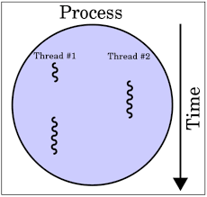
Thread
Consider the diagram to understand the relation between process and its thread:

Slide 8
Multithreading
Multiple threads can exist within one process where:
Each thread contains its own register set and local variables (stored in stack).
All thread of a process share global variables (stored in heap) and the program code.

Slide 9
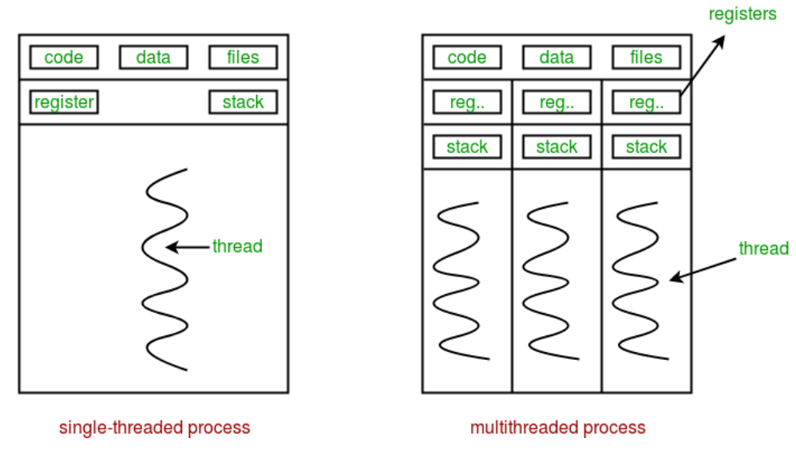
Multithreading
Consider the diagram below to understand how multiple threads exist in memory:

Slide 10
Multithreading in Python
import threading
def print_cube(num):
# function to print cube of given num
print("Cube: {}".format(num * num * num))
def print_square(num):
# function to print square of given num
print("Square: {}".format(num * num))
if __name__ == "__main__":
# creating thread
t1 = threading.Thread(target=print_square, args=(10,))
t2 = threading.Thread(target=print_cube, args=(10,))
# starting thread 1
t1.start()
# starting thread 2
t2.start()
# wait until thread 1 is completely executed
t1.join()
# wait until thread 2 is completely executed
t2.join()
# both threads completely executed
print("Done!")
In Python, the threading module provides a very simple and intuitive API for spawning multiple threads in a program.
Let us consider a simple example using threading module:

Slide 11
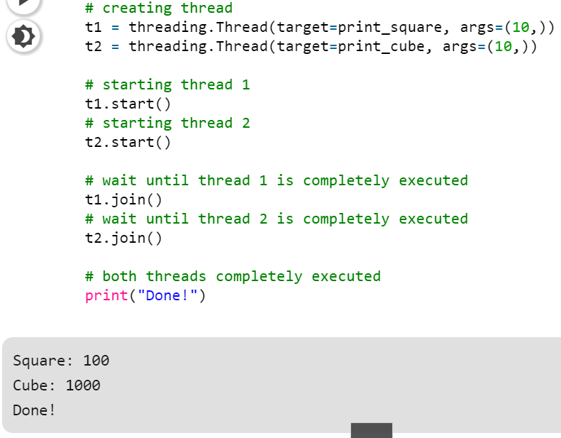
Multithreading in Python
To import the threading module, we do:import threading
To create a new thread, we create an object of Thread class. It takes following arguments:
target: the function to be executed by thread
args: the arguments to be passed to the target function
In this example, we created 2 threads with different target functions:
t1 = threading.Thread(target=print_square, args=(10,))
t2 = threading.Thread(target=print_cube, args=(10,))
To start a thread, we use start method of Thread class.t1.start() t2.start()
Once the threads start, the current program (you can think of it like a main thread) also keeps on executing. In order to stop execution of current program until a thread is complete, we use join method.t1.join() t2.join()
As a result, the current program will first wait for the completion of t1 and then t2. Once, they are finished, the remaining statements of current program are executed.

Slide 12
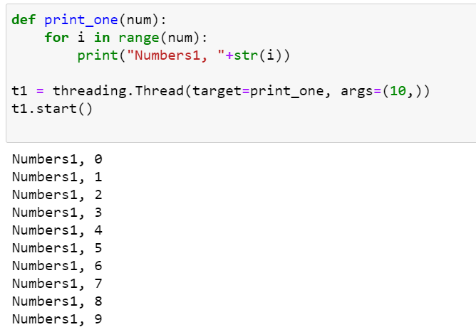
Multithreading in Python

Slide 13
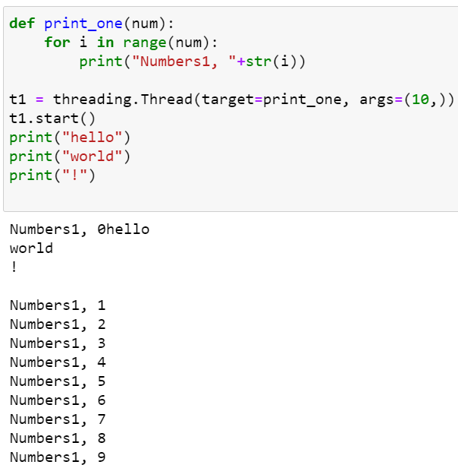
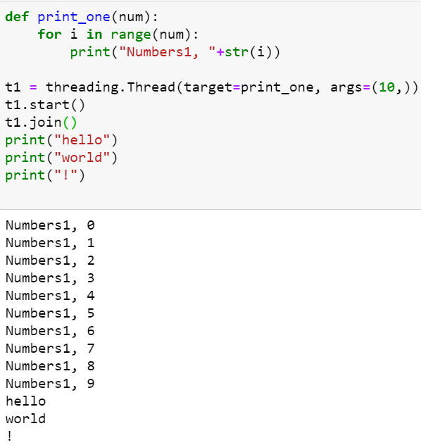
Multithreading in Python

Slide 14
Client/Server Programming

Slide 15
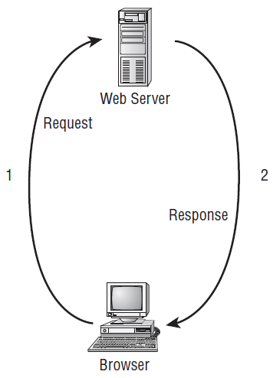
Client-Server Programming
When we type some web address like www.facebook.com in your web browser and press Enter, the browser sends a request to the web server at that address. This is done through HTTP, the Hyper Text Transfer Protocol.
HTTP is the protocol by which web browsers and web servers communicate. When you send the address, you send a request to the server. When the server is active and the request is valid, the server accepts the request, processes it, and then sends the response back to the client browser. The relationship between the request and response is shown in the Figure.

Slide 16
Client-Server Programming
-Client-Side Programming
-Server-Side Programming

Slide 17
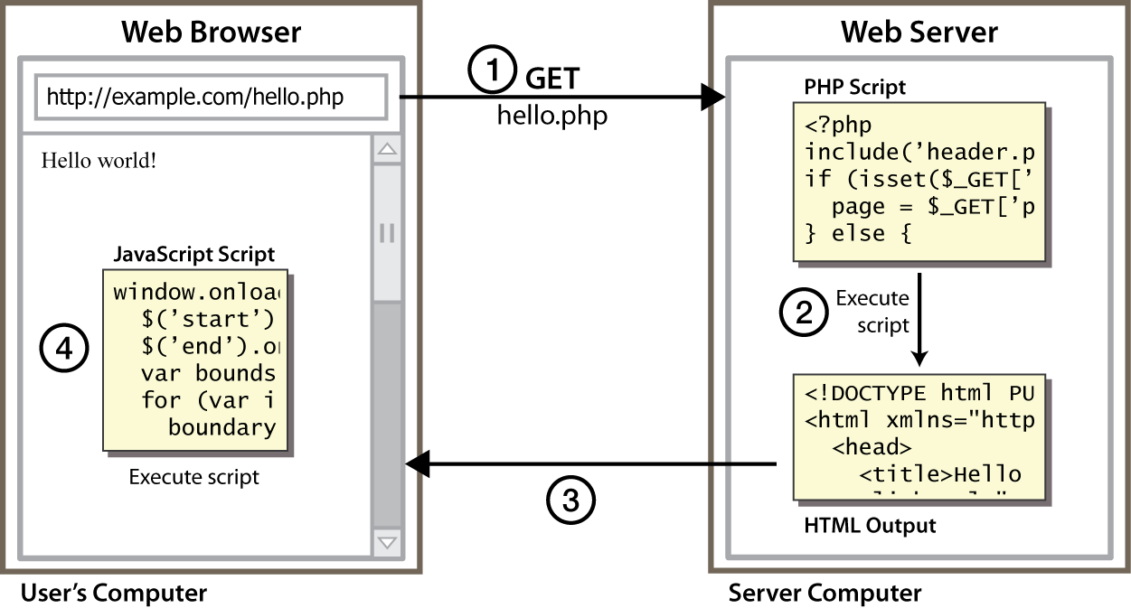
Client-side programming (scripting)
client-side script: code runs in browser after page is sent back from server often this code manipulates the page or responds to user actions

Slide 18




Server-Side web programming
server-side pages are programs written using one of many web programming languages/frameworks
examples: PHP, Java/JSP, Ruby on Rails, ASP.NET, Python, Perl
the web server contains software that allows it to run those programs and send back their output
each language/framework has its pros and cons

Slide 19
Client-Side and Server-Side programming benefits
client-side scripting benefits:
usability: can modify a page without having to post back to the server (faster UI)
efficiency: can make small, quick changes to page without waiting for server
event-driven: can respond to user actions like clicks and key presses
server-side programming benefits:
security: has access to server's private data; client can't see source code
compatibility: not subject to browser compatibility issues
power: can write files, open connections to servers, connect to databases, ...

Slide 20
HTML

Slide 21
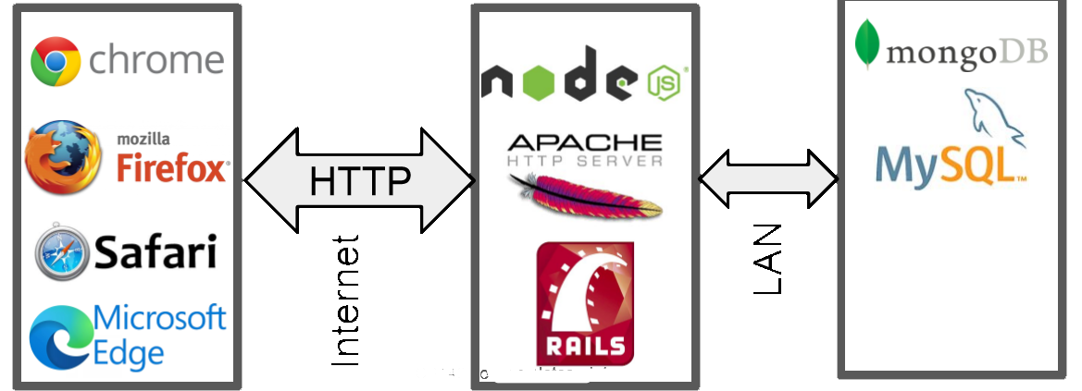
Web application architecture
Web server/ Application server
Web browser
Storage system

Slide 22
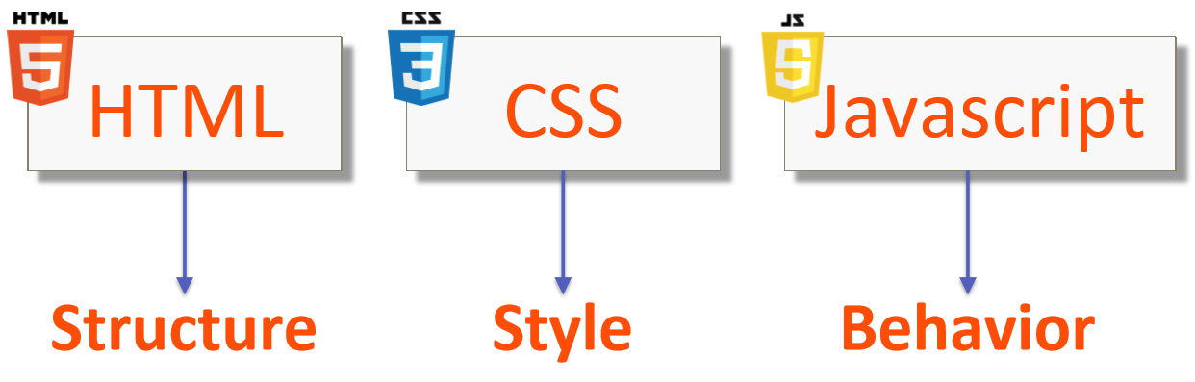
Web technologies
Technologies That Drive The Web

Slide 23


What is HTML?
HTML is the standard markup language for Web pages.
What does HTML stand for?

Slide 24
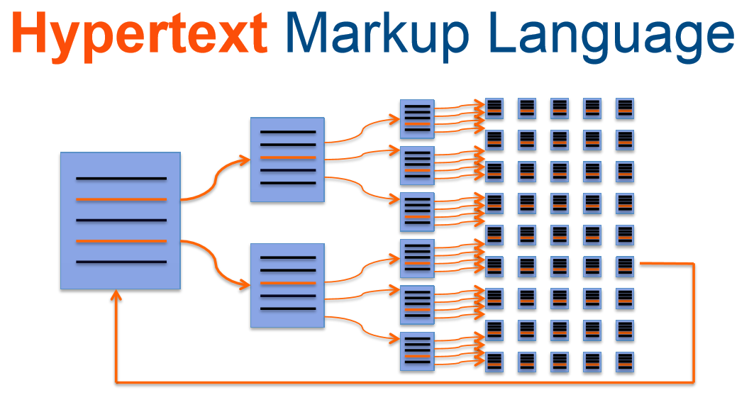
What is HTML?

Slide 25
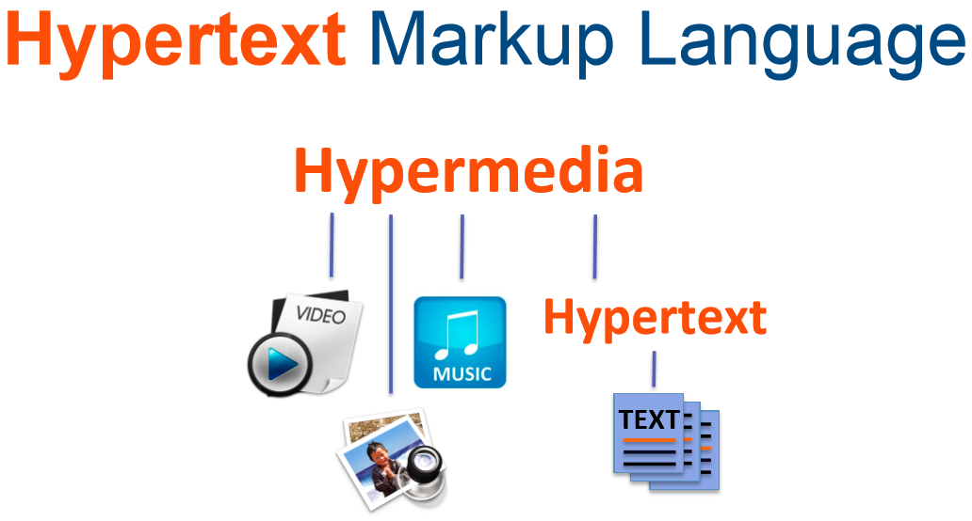
What is HTML?

Slide 26
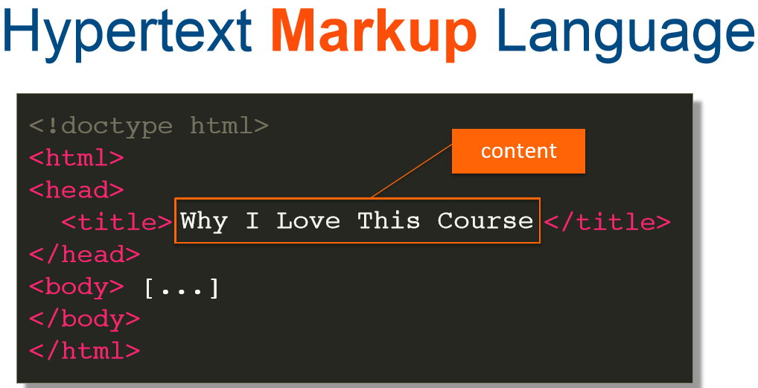
What is HTML?

Slide 27
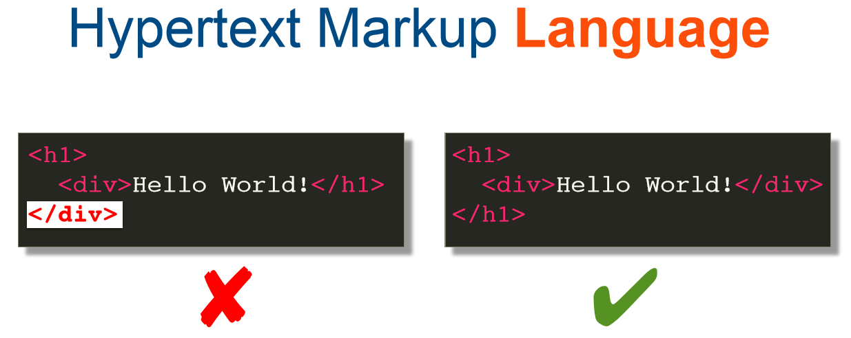
What is HTML?

Slide 28
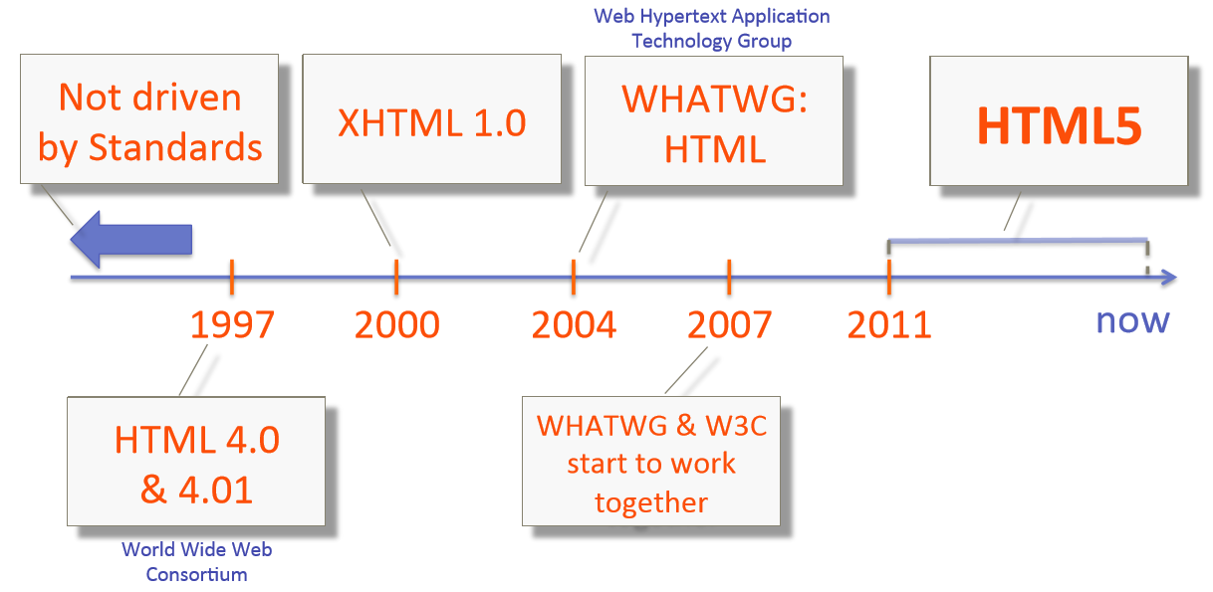
How we got to HTML5

Slide 29
History of HTML
Type of content | HTML 1.2 | HTML 4.01 | HTML5 | Purpose
Heading | Yes | Yes | Yes | Organize page content by adding headings and subheadings to the top of each section of the page
Paragraph | Yes | Yes | Yes | Identify paragraphs of text
Address | Yes | Yes | Yes | Identify a block of text that contains contact information
Anchor | Yes | Yes | Yes | Link to other web content
List | Yes | Yes | Yes | Organize items into a list
Image | Yes | Yes | Yes | Embed a photograph or drawing into a web page
Table | No | Yes | Yes | Organize data into rows and columns
Style | No | Yes | Yes | Add CSS to control how objects on a web page are presented
Script | No | Yes | Yes | Add Javascript to make pages respond to user behaviors (more interactive)
Audio | No | No | Yes | Add audio to a web page with a single tag
Video | No | No | Yes | Add video to a web page with a single tag
Canvas | No | No | Yes | Add an invisible drawing pad to a web page, on which you can add drawings (animations, games, and other interactive features) using Javascript

Slide 30
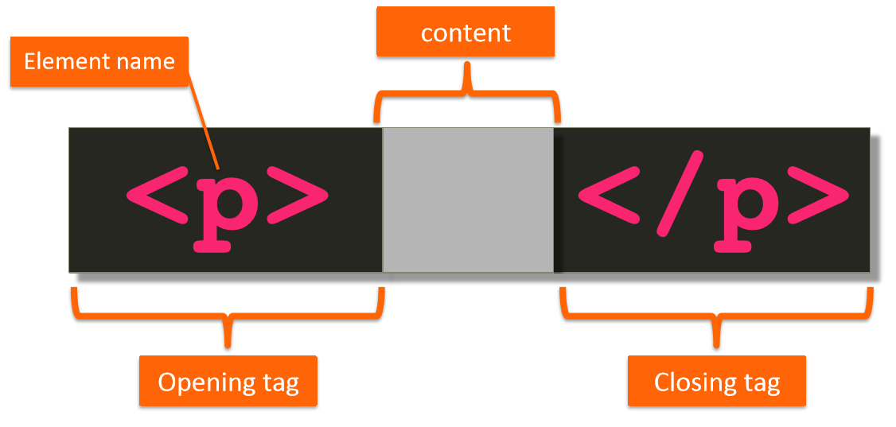
Anatomy of an HTML tag

Slide 31
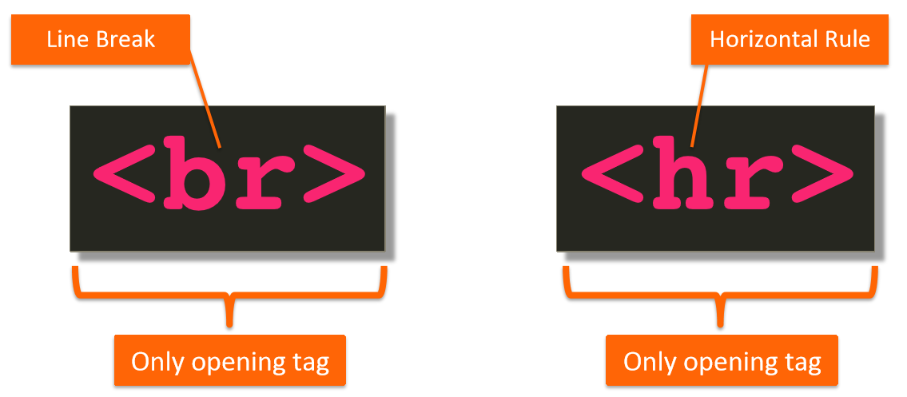
Anatomy of an HTML tag

Slide 32
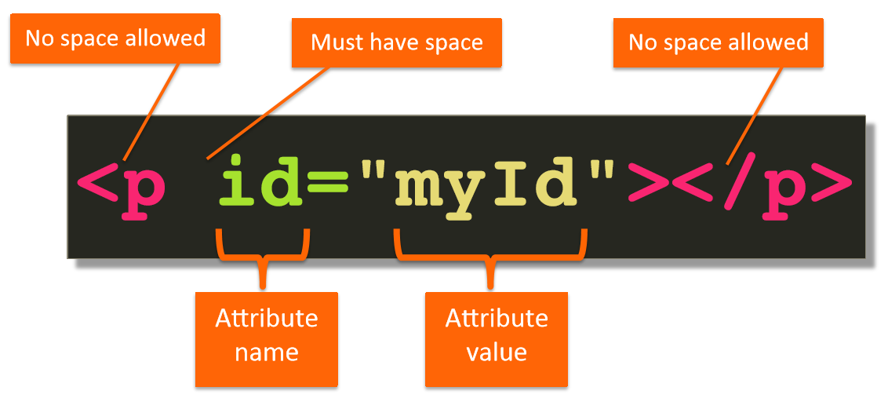
Anatomy of an HTML tag

Slide 33
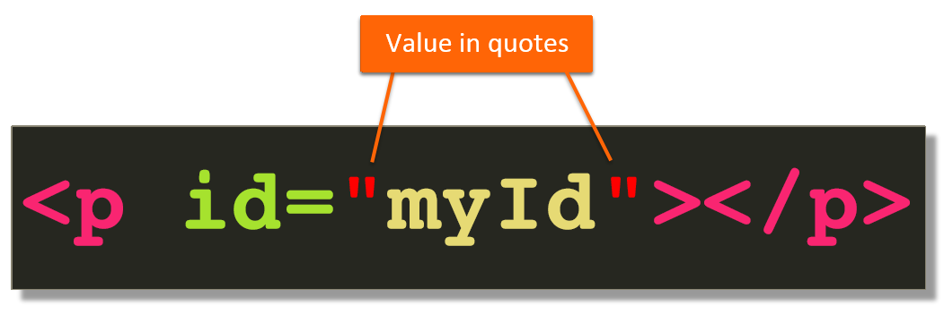
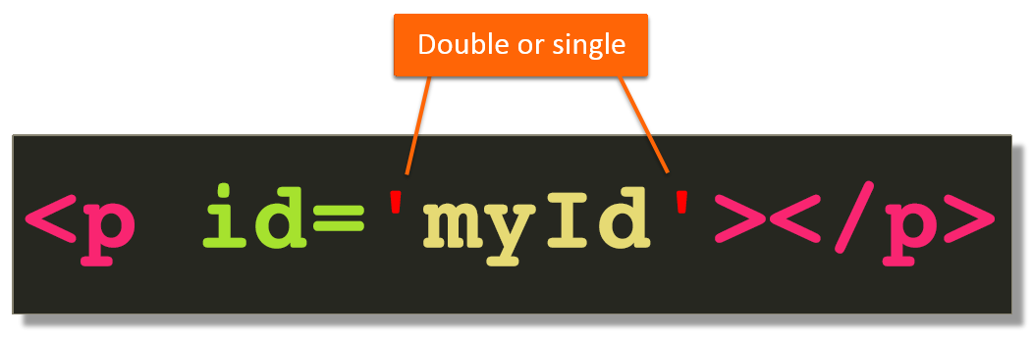
Anatomy of an HTML tag

Slide 34
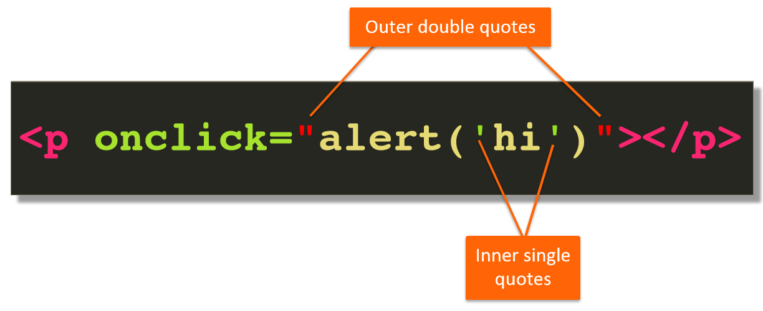
Anatomy of an HTML tag

Slide 35
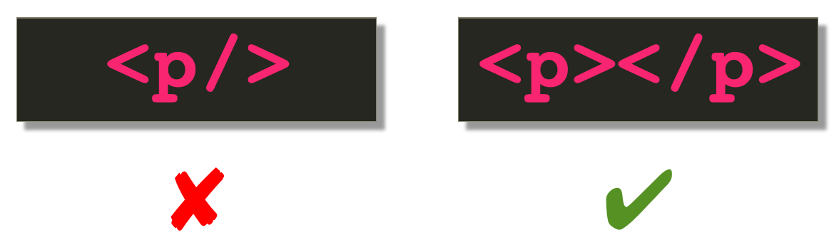
Anatomy of an HTML tag

Slide 36
Structure of an HTML page
<!DOCTYPE html>
<html>
<head>
information about the page
</head>
<body>
page contents
</body>
</html>

Slide 37
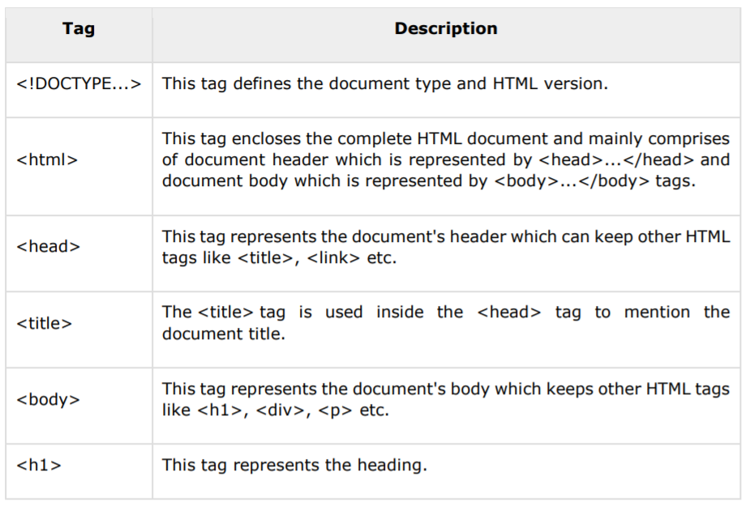
Page Structure Elements

Slide 38
Commonly used tags in <head> section:
<title> Specify a title for the page, which will appear in the title bar for the browser window.
<link> Include CSS stylesheets
<script> Used to add Javascript to a page (can be used in body as well)

Slide 39
Key Structural Elements
Element | Name | Description
<h1> </h1> | Heading 1 | Reserved fo strongest emphasis
<h2> </h2> | Heading 2 | Secondary level heading. Headings go down to level 6, but <h1> through <h3> are most common
<p> </p> | Paragraph | Most of the body of a page should be enclosed in paragraphs
<div> </div> | Division | Similar to a paragraph, but normally marks a section of a page. Divs usually contain paragraphs

Slide 40
Headings: <h1>, <h2>, ..., <h6>
headings to separate major areas of the page (block)
<h1>University of KZ</h1>
<h2>Department of Computer Science</h2>
<h3>Sponsored by Microsoft</h3>
OUTPUT:
University of KZ
Department of Computer Science
Sponsored by Microsoft

Slide 41
Need to handle markup characters in content
To display a literal < or > in a document, use entities:
&lt; Displays <
&gt; Displays >
&amp; Displays &
&quot; Displays "
&nbsp; Nonbreaking space (won’t insert a line break at this space)
Many other entities are defined for special characters. Whitespace is not significant except in a few cases (e.g. textarea, pre tags)

Slide 42
HTML Links
HTML links are hyperlinks.
Syntax:
<a href="url">link text</a>
Example:
<a href = "https://www.coursera.org">Visit Coursera.org</a>
By default, links will appear as follows in all browsers:
An unvisited link is underlined and blue
A visited link is underlined and purple
An active link is underlined and red

Slide 43
HTML Links- The target Attribute
By default, the linked page will be displayed in the current browser window.
The target attribute specifies where to open the linked document.
The target attribute can have one of the following values:
_self - Default. Opens the document in the same window/tab as it was clicked
_blank - Opens the document in a new window or tab
_parent - Opens the document in the parent frame
_top - Opens the document in the full body of the window
Example:
<a href = "https://www.coursera.org" target= "_blank" >Visit Coursera.org</a>

Slide 44
Absolute and Relative references
Both examples above are using an absolute URL (a full web address) in the href attribute.
A local link (a link to a page within the same website) is specified with a relative URL (without the "https://www" part):
<h2>Absolute URLs</h2> <p><a href="https://www.coursera.org/">Coursera.org</a></p> <p><a href="https://www.google.com/">Google</a></p> <h2>Relative URLs</h2> <p><a href="html_images.asp">HTML Images</a></p> <p><a href="/css/default.asp">CSS Tutorial</a></p>

Slide 45
An Image as Link and Link to Email Address
Using an Image as Link
To use an image as a link, just put the <img> tag inside the <a> tag:
Example
<a href="https://google.com" ><img src=“some.gif" /></a>
Link to Email Address
Use mailto: inside the href attribute to create a link that opens the user's email program (to let them send a new email):
Example
<a href="mailto:someone@example.com">Send email</a>

Slide 46
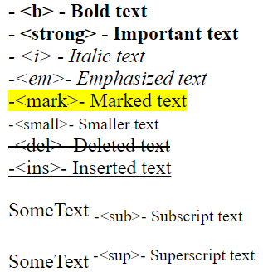
Text Formatting
<b> - Bold text
<strong> - Important text
<i> - Italic text
<em> - Emphasized text
<mark> - Marked text
<small> - Smaller text
<del> - Deleted text
<ins> - Inserted text
<sub> - Subscript text
<sup> - Superscript text
Result

Slide 47
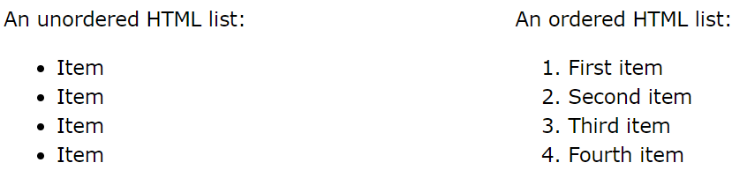
HTML Lists
HTML lists allow web developers to group a set of related items in lists.

Slide 48
Unordered HTML List
An unordered list starts with the <ul> tag.
Each list item starts with the <li> tag.
The list items will be marked with bullets (small black circles) by default:
Example
<ul> <li>Coffee</li> <li>Tea</li> <li>Milk</li> </ul>

Slide 49
More Unordered Lists...
The TYPE=shape attribute allows you to change the type of bullet that appears
circle corresponds to an empty round bullet
square corresponds to a square bullet
disc corresponds to a solid round bullet; this is the default value

Slide 50
Ordered HTML List
An ordered list starts with the <ol> tag.
Each list item starts with the <li> tag.
The list items will be marked with numbers by default:
Example
<ol> <li>Coffee</li> <li>Tea</li> <li>Milk</li> </ol>

Slide 51
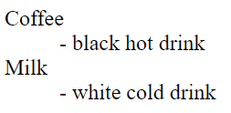
HTML Description Lists
HTML also supports description lists.
A description list is a list of terms, with a description of each term.
The <dl> tag defines the description list, the <dt> tag defines the term (name), and the <dd> tag describes each term:
Example
<dl> <dt>Coffee</dt> <dd>- black hot drink</dd> <dt>Milk</dt> <dd>- white cold drink</dd> </dl>
Result

Slide 52
HTML Tables
HTML tables allow web developers to arrange data into rows and columns.
The <table> tag defines an HTML table.
Each table row is defined with a <tr> tag.
Each table header is defined with a <th> tag.
Each table data/cell is defined with a <td> tag.
By default, the text in <th> elements are bold and centered.
By default, the text in <td> elements are regular and left-aligned.

Slide 53
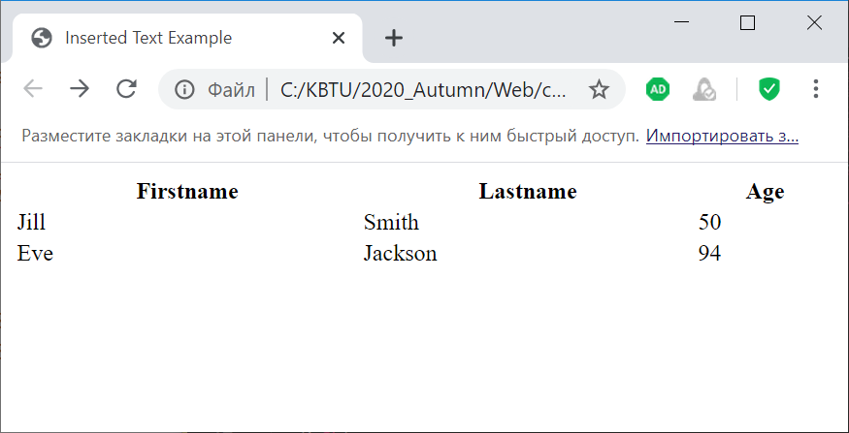
HTML Tables - Example
<table width=100%> <tr> <th>Firstname</th> <th>Lastname</th> <th>Age</th> </tr> <tr> <td>Jill</td> <td>Smith</td> <td>50</td> </tr> <tr> <td>Eve</td> <td>Jackson</td> <td>94</td> </tr> </table>

Slide 54
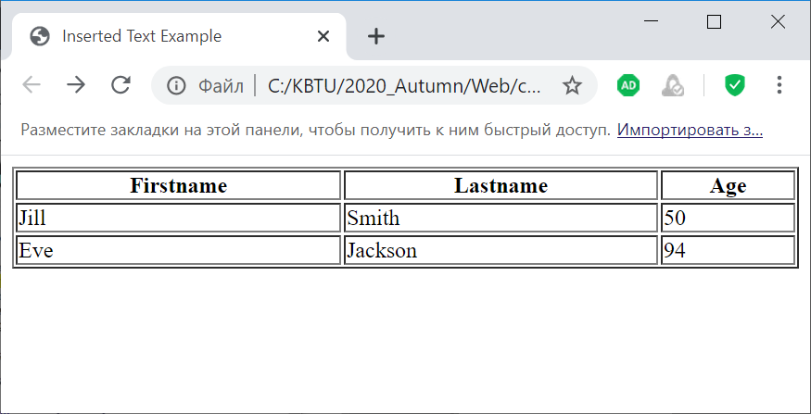
HTML Tables – Adding borders
<table width=100% border=1> <tr> <th>Firstname</th> <th>Lastname</th> <th>Age</th> </tr> <tr> <td>Jill</td> <td>Smith</td> <td>50</td> </tr> <tr> <td>Eve</td> <td>Jackson</td> <td>94</td> </tr> </table>

Slide 55
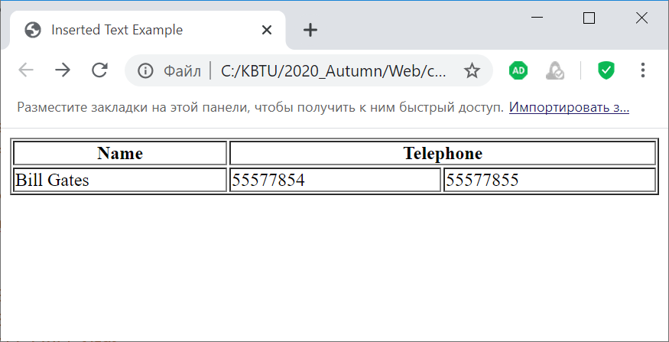
HTML Tables – Cell that Span Many Columns
<table style="width:100%" border=1>
<tr>
<th>Name</th>
<th colspan="2">Telephone</th>
</tr>
<tr>
<td>Bill Gates</td>
<td>55577854</td>
<td>55577855</td>
</tr>
</table>

Slide 56
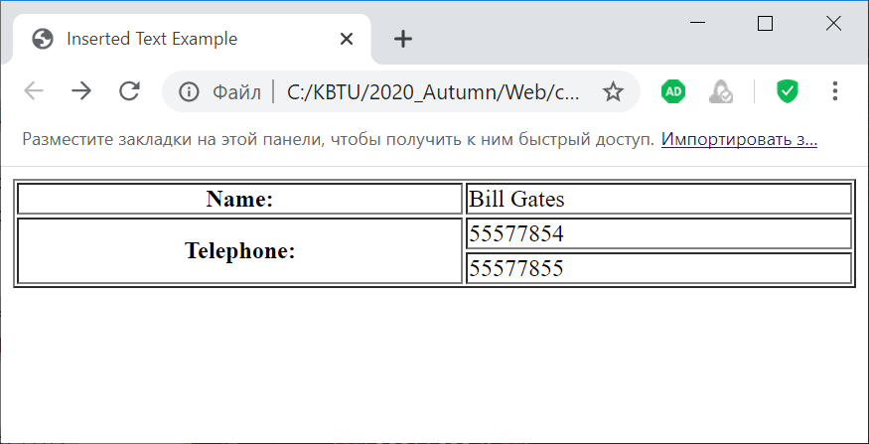
HTML Tables – Cell that Span Many Rows
<table style="width:100%" border=1>
<tr>
<th>Name:</th>
<td>Bill Gates</td>
</tr>
<tr>
<th rowspan="2">Telephone:</th>
<td>55577854</td>
</tr>
<tr>
<td>55577855</td>
</tr>

Slide 57
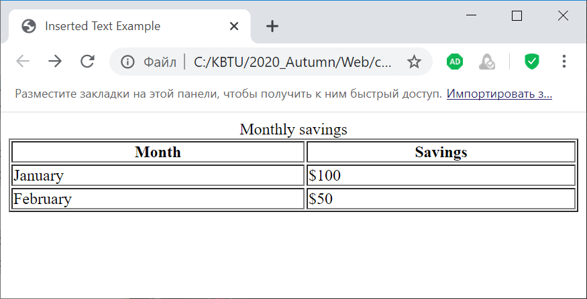
HTML Tables – Add a caption
<table style="width:100%" border=1>
<caption>Monthly savings</caption>
<tr>
<th>Month</th>
<th>Savings</th>
</tr>
<tr>
<td>January</td>
<td>$100</td>
</tr>
<tr>
<td>February</td>
<td>$50</td>
</tr>
</table>

Slide 58
HTML Forms
What are forms?
An HTML form is an area of the document that allows users to enter information into fields.
A form may be used to collect personal information, opinions in polls, user preferences and other kinds of information.

Slide 59
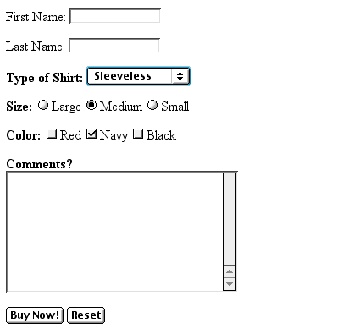
Example: Form
Text Box
Drop-down Menu
Radio Buttons
Checkboxes
Text Area
Reset Button
Submit Button

Slide 60
HTML Forms
The <form> Element
The HTML <form> element is used to create an HTML form for user input:
<form> … form elements … </form>

Slide 61
HTML Forms – Input Type Element
The <input> Element
The HTML <input> element is the most used form element.
An <input> element can be displayed in many ways, depending on the type attribute.
Type | Description
<input type="text"> | Displays a single-line text input field
<input type="radio"> | Displays a radio button (for selecting one of many choices)
<input type="checkbox"> | Displays a checkbox (for selecting zero or more of many choices)
<input type="submit"> | Displays a submit button (for submitting the form)
<input type="button"> | Displays a clickable button

Slide 62
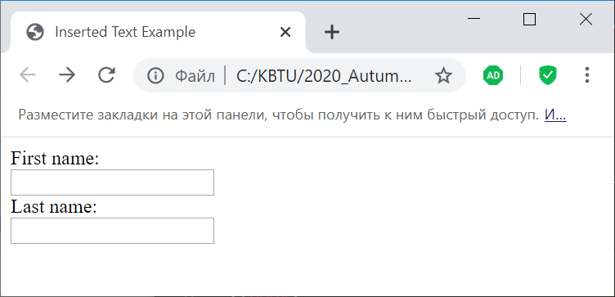
HTML Forms - Input Type Element
Text Fields
The <input type="text"> defines a single-line input field for text input.
<form> <label for="fname">First name:</label><br> <input type="text" id="fname" name="fname"><br> <label for="lname">Last name:</label><br> <input type="text" id="lname" name="lname"> </form>

Slide 63
Creating HTML with Python

Slide 64
Creating HTML page using Python
One of the more powerful ideas in computer science is that a file that seems to contain code from one perspective can be seen as data from another. In other words, to write programs that manipulate other programs.
To create an HTML file that says “Hello World!” using Python, it need to store HTML tags in a multiline Python string and saving the contents to a new file. This file will be saved with an .html extension.

Slide 65
Creating HTML page using Python
f = open('helloworld.html','w')
message = """<html>
<head></head>
<body><p>Hello World!</p></body>
</html>"""
f.write(message)
f.close()

Slide 66
Using Python to Control Browser
We automatically created an HTML file, but then we had to leave our editor and go to Browser to open the file in a new tab. Wouldn’t it be better to have our Python program include that final step?
When we execute code below, it should create HTML file and then automatically open it in a new tab in Browser.
import webbrowser
f = open('helloworld.html','w’)
message = """<!DOCTYPE><html>
<head></head>
<body><p>Hello World!bb</p>
</body>
</html>""«
f.write(message)
f.close()
#Change path to reflect file location
filename = 'http://localhost:8888/view/helloworld.html'
webbrowser.open_new_tab(filename)

Slide 67
Thank you!

