Slide 1

Programming on Python
Lecture 12
CSS for styling. Basic CSS. CSS properties. More CSS syntax.
Complied by
Aizhan Altaibek

Slide 2

Content
What is CSS?
Power of CSS
Advantages of CSS
Syntax of CSS
Adding CSS to Web Page

Slide 3
What is CSS?
To spruce up your pages, you need a way to change their presentation in the browser. The most common way to do this is by using the Cascading Style Sheets (CSS) language.
CSS is the language for formatting and designing information on the Web, including HTML, PHP, ASP.NET and other web pages.
Cascading Style Sheets, fondly referred to as CSS, is a simple design language intended to simplify the process of making web pages presentable.

Slide 4
Power of CSS
In the early days of the Internet, web pages consisted mostly of text and images.
The text was formatted using plain HTML, using tags like
<b> to make the text bold, and
<font> tag to influence the font family, size, and color.
Web developers soon realized that they needed more power to format their pages, so CSS was created to address some of HTML’s styling shortcomings.

Slide 5
Problems of HTML Formatting
One of the problems with using HTML for formatting is that it only offers a limited set of options to style your pages.
You can use tags like <i>, <b>, and <font> to change the appearance of text and use attributes like bgcolor to change the background color of HTML elements.
You also have a number of attributes at your disposal for changing the way links appear in your page.
Another problem of HTML with a lot more impact on how you build your web pages is the way the styling information is applied to the page. By design, HTML forces you to embed your formatting in your HTML document, making it harder to reuse or change the design later.

Slide 6
Consider the following example:
<p>
<font face=”Arial” color=”red” size=”1”>
This is red text, in an Arial type face and slightly larger than the default text
</font>
</p>
The problem with this code snippet is that the actual
data (the text in the <p> element) is mixed with the
presentation (the formatting of the text with the
<font> tag in this example). Ideally, the two should be
separated, so each of them is easier to change without
affecting the other.

Slide 7
Another problem with HTML formatting is the fact that you can’t easily change the formatting at runtime, in the user’s browser.
The final problem with HTML formatting is that all the additional markup in your page adds considerably to the size of the page. This makes it slower to download and display as the information needs to be downloaded with each page in your web site.

Slide 8
To summarize, formatting with HTML suffers from the following problems:
❑ Its feature set severely limits the formatting possibilities that your pages require.
❑ Data and presentation are mixed within the same file.
❑ HTML doesn’t allow you to easily switch formatting at runtime in the browser.
❑ The required formatting tags and attributes make your pages larger and thus slower to load and display.
Fortunately, CSS allows you to overcome all of these problems.

Slide 9
How CSS Fixes Formatting Problems
CSS is designed to format your web pages in almost every possible way. It offers a rich set of options to change every little aspect of your web page, including fonts (size, color, family, and so on), colors and background colors, borders around HTML elements, positioning of elements in your page, and much more.
CSS is widely understood by all major browsers today, so it’s the language for visual presentation of web pages and very popular among web developers.

Slide 10
CSS overcomes the problem of mixed data and presentation by allowing you to define all formatting information in external files.
Your HTML pages can then reference these files and the browser will apply the correct styles for you.
With this separation,
the HTML document contains what you want to display,
while the CSS file defines how you want to display it,
enabling you to change or switch one of the two documents, leaving the other unmodified.

Slide 11
Advantages of CSS
CSS saves time - You can write CSS once and then reuse the same sheet in multiple HTML pages. You can define a style for each HTML element and apply it to as many web pages as you want.
Pages load faster - If you are using CSS, you do not need to write HTML tag attributes every time. Just write one CSS rule of a tag and apply it to all the occurrences of that tag. So, less code means faster download times.
Easy maintenance - To make a global change, simply change the style, and all the elements in all the web pages will be updated automatically.
Superior styles to HTML - CSS has a much wider array of attributes than HTML, so you can give a far better look to your HTML page in comparison to HTML attributes.
Multiple Device Compatibility - Style sheets allow content to be optimized for more than one type of device. By using the same HTML document, different versions of a website can be presented for handheld devices such as PDAs and cellphones or for printing.
Global web standards – Today HTML attributes are being deprecated and it is being recommended to use CSS. So it’s a good idea to start using CSS in all the HTML pages to make them compatible with future browsers.

Slide 12
CSS - Syntax
A CSS comprises of style rules. A style rule is made of three parts −
Selector − A selector is an HTML tag at which a style will be applied.
Property − A property is a type of attribute of HTML tag.
Value − Values are assigned to properties.
selector { property: value }

Slide 13
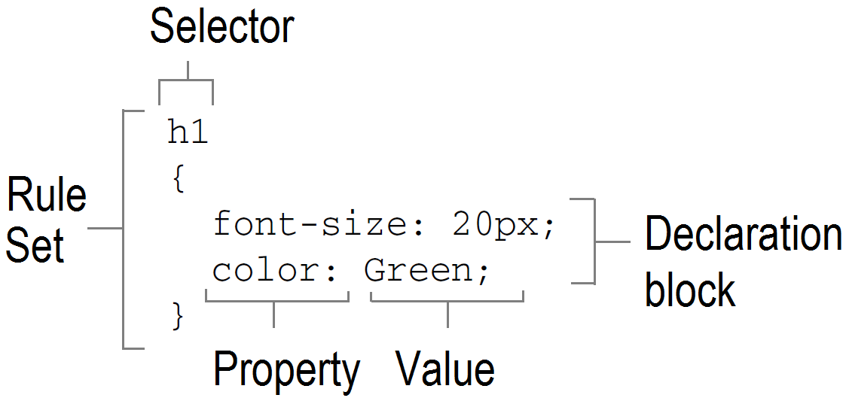
CSS - Syntax

Slide 14
Example
<style type=”text/css”>
h1
{
font-size: 20px;
color: Green;
}
...
</style>

Slide 15
The <style> tag is used to wrap a style sheet that is embedded in the page with its type attribute set to text/css.
The code block from h1 until the closing curly brace (}) between the <style> tags is called a rule set or simply a rule. The rule in this code snippet defines the appearance for all <h1> elements in your page.
The h1 at the top of the code block is called a selector and is used to indicate to what element the formatting should be applied.
Between the curly braces you see the style information that should be applied to the heading.
Each line between the curly braces is called a declaration. A declaration consists of a property, followed by a colon and then followed by a value.

Slide 16
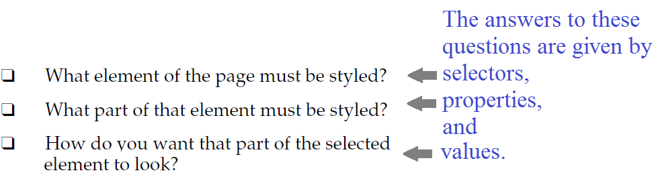
To be able to style an element on a page, a browser has to know three things:

Slide 17
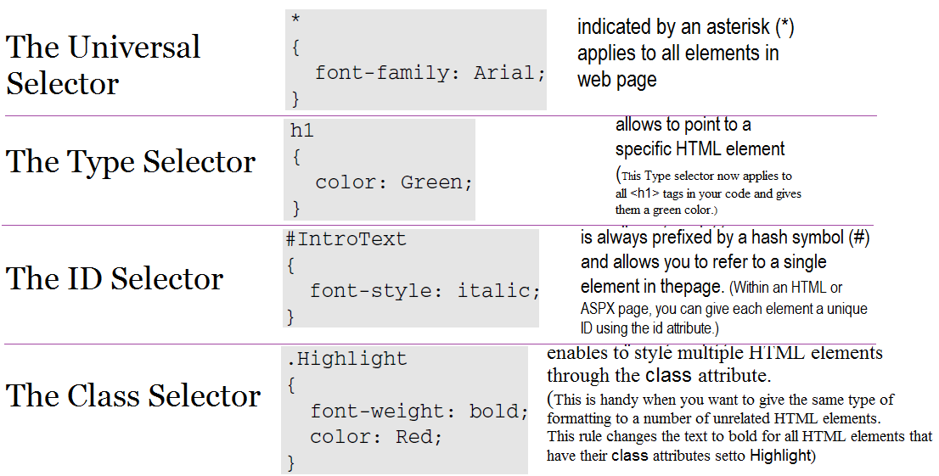
The four most important types of selectors

Slide 18
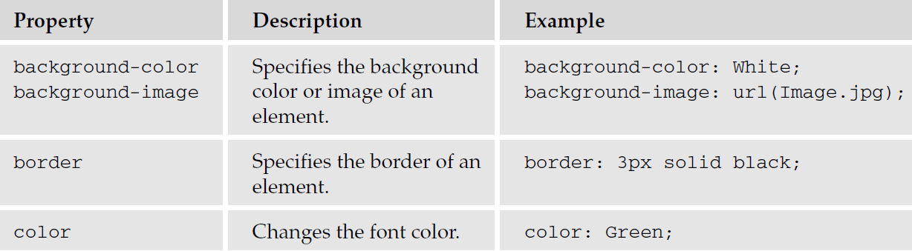
Properties The following table lists some of the most common CSS properties and describes where they are used.

Slide 19
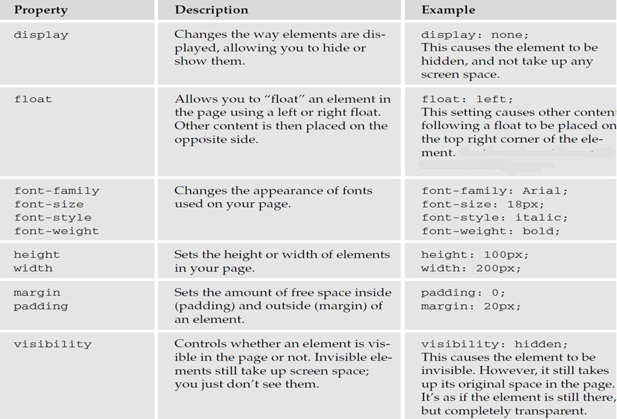

Slide 20
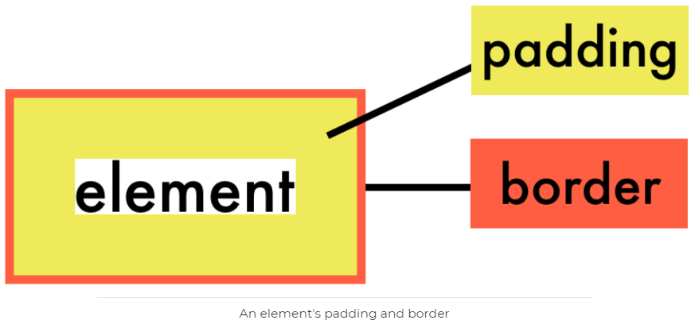
Padding
Padding is the space between an element's contents and border. It is still within the element itself, not around it.
Unlike many other CSS properties, padding is not inherited from parent elements. You must explicitly set it on the elements where you want it.

Slide 21
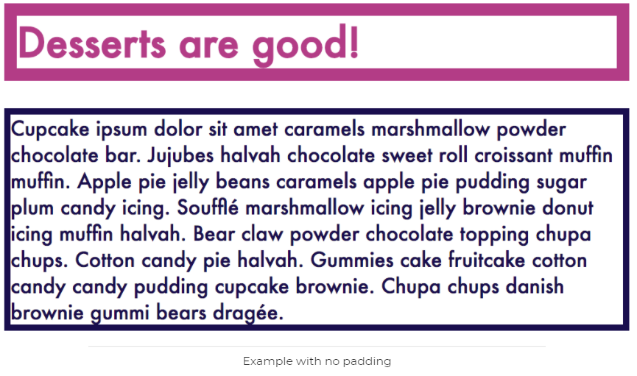
Setting padding

Slide 22
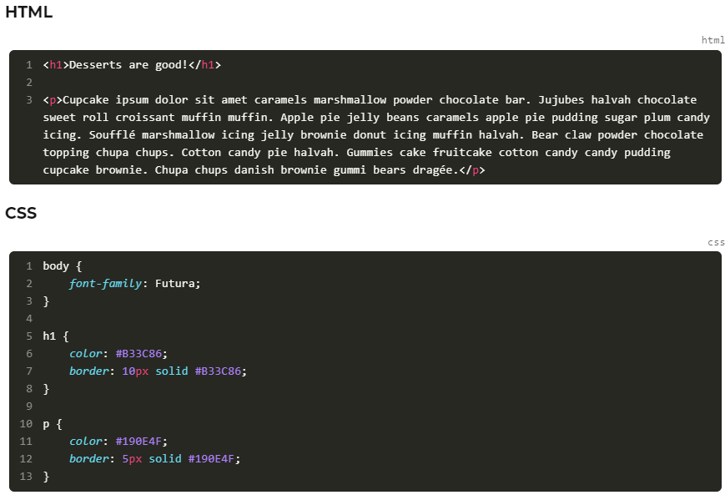

Slide 23
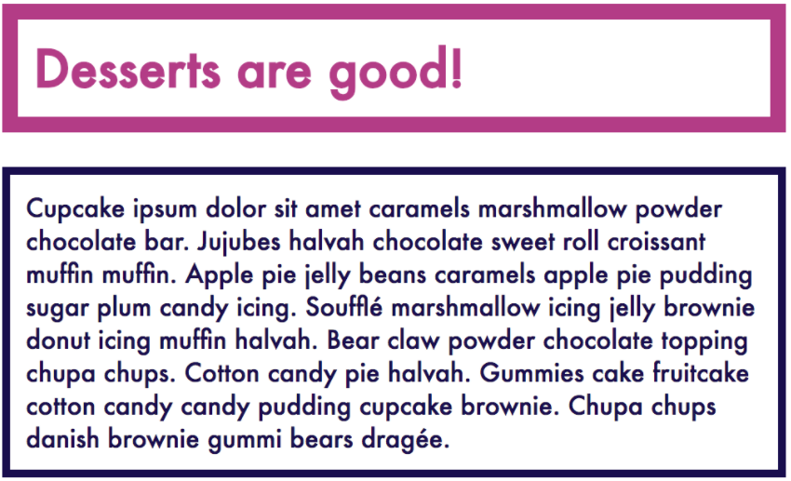
Setting padding: compare

Slide 24
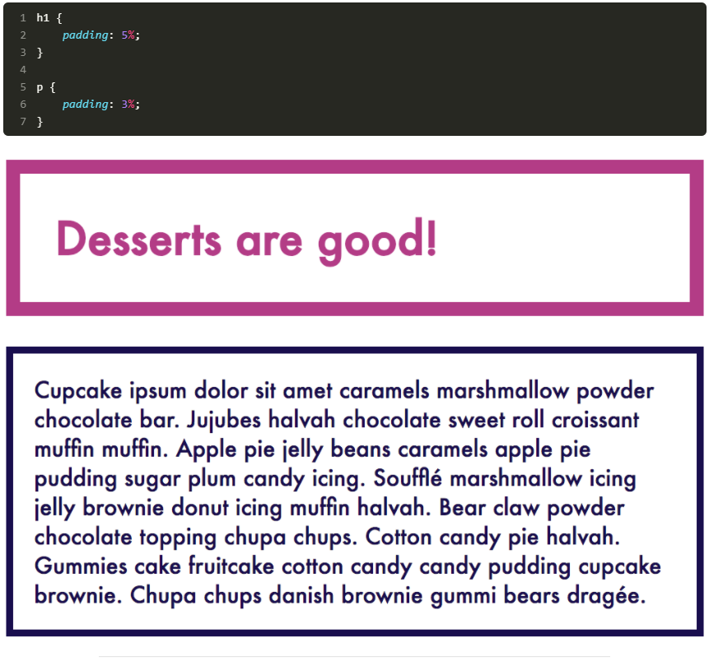

Slide 25
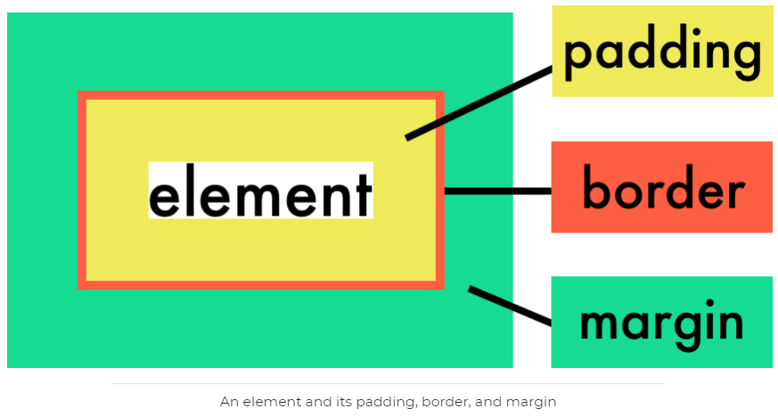
Margin
Margin is the CSS property that controls spacing between elements. In this picture, see how it relates to the other layout elements you've seen so far:

Slide 26

Setting margin

Slide 27
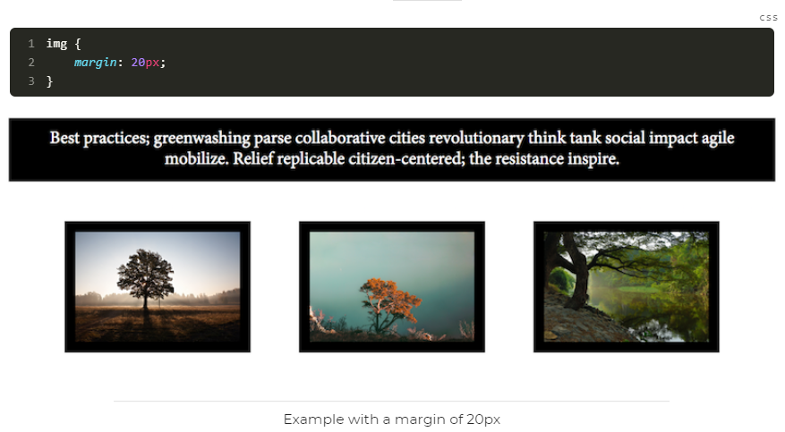
Setting margin

Slide 28
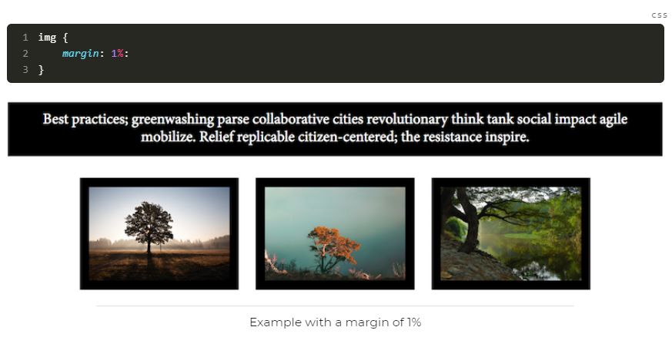
Setting margin

Slide 29
Adding CSS to Web Pages
There are three methods of using CSS in HTML file:
In-line – using by style attribute in Web page;
Internal – using by HTML tag;
External – separated file.

Slide 30
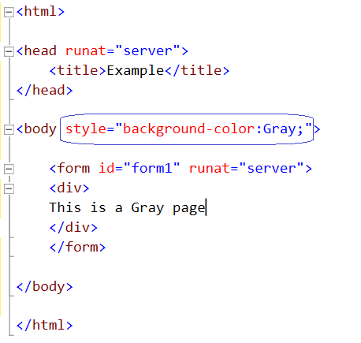
In-line (style attribute)

Slide 31
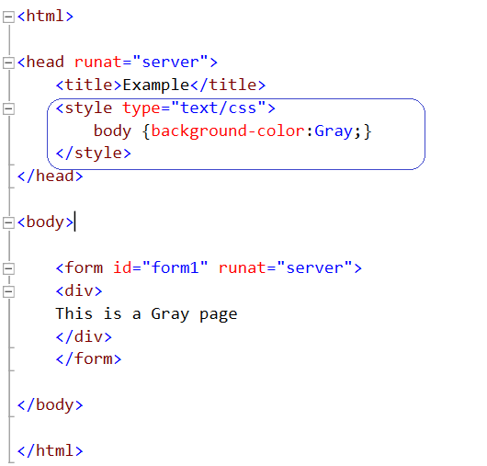
Internal (style tag)

Slide 32
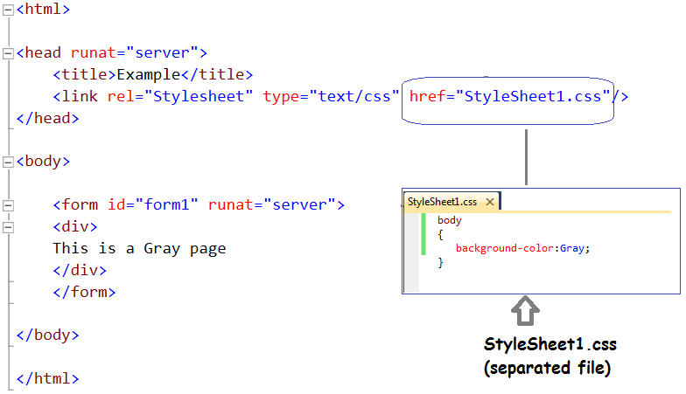
External (separated file)

Slide 33
Thank you!

