Slide 1
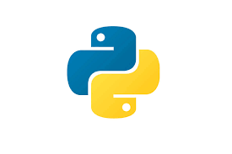
Programming on Python
Lecture 13
Exceptions
Complied by
Aizhan Altaibek

Slide 2
Content
Defensive programming
Black Box testing
Glass Box testing
Debugging
Errors and exceptions
Dealing exceptions
6.0001 LECTURE 7
2

Slide 3
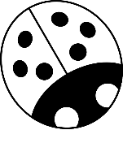
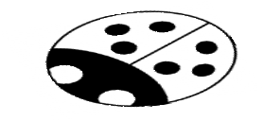



WE AIM FOR HIGH QUALITY –
AN ANALOGY WITH SOUP
You are making soup but bugs keep falling in from the
ceiling. What do you do?
check soup for bugs
testing
keep lid closed
defensive programming
clean kitchen
eliminate source of bugs
6.0001 LECTURE 7
3

Slide 4
DEFENSIVE PROGRAMMING
Write specifications for functions
Modularize programs
Check conditions on inputs/outputs (assertions)
TESTING/VALIDATION
Compare input/output pairs to specification
“It’s not working!”
“How can I break my program?”
DEBUGGING
Study events leading up to an error
“Why is it not working?”
“How can I fix my program?”
4

Slide 5
SET YOURSELF UP FOR EASY
TESTING AND DEBUGGING
from the start, design code to ease this part
break program up into modules that can be tested and debugged individually
document constraints on modules
what do you expect the input to be?
what do you expect the output to be?
document assumptions behind code design
6.0001 LECTURE 7
5

Slide 6
WHEN ARE YOU READY TO TEST?
ensure code runs
remove syntax errors
remove static semantic errors
Python interpreter can usually find these for you
have a set of expected results
an input set
for each input, the expected output
6

Slide 7
CLASSES OF TESTS
Unit testing
validate each piece of program
testing each function separately
Regression testing
add test for bugs as you find them
catch reintroduced errors that were previously fixed
Integration testing
does overall program work?
tend to rush to do this
7

Slide 8
TESTING APPROACHES
intuition about natural boundaries to the problem
def is_bigger(x, y):
""" Assumes x and y are ints
Returns True if y is less than x, else False """
can you come up with some natural partitions?
if no natural partitions, might do random testing
probability that code is correct increases with more tests
better options below
black box testing
explore paths through specification
glass box testing
explore paths through code
8

Slide 9
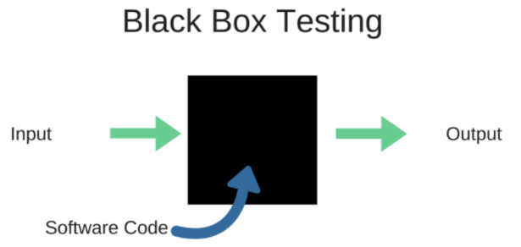
BLACK BOX TESTING
Black-box testing is a method of software testing that
examines the functionality of an application
without peering into its internal structures or workings.

Slide 10
BLACK BOX TESTING
def sqrt(x, eps):
""" Assumes x, eps floats, x >= 0, eps > 0
Returns res such that x-eps <= res*res <= x+eps """
designed without looking at the code
can be done by someone other than the implementer to avoid some implementer biases
testing can be reused if implementation changes
paths through specification
build test cases in different natural space partitions
also consider boundary conditions (empty lists, singleton list, large numbers, small numbers)

Slide 11

GLASS BOX TESTING
Glass box testing is a testing technique that examines the program structure and derives test data from the program logic/code.
The other names of glass box testing are clear box testing, open box testing, logic driven testing or path driven testing or structural testing.
10

Slide 12
GLASS BOX TESTING
use code directly to guide design of test cases
called path-complete if every potential path through code is tested at least once
what are some drawbacks of this type of testing?
can go through loops arbitrarily many times
missing paths
10

Slide 13
GLASS BOX TESTING
def abs(x):
""" Assumes x is an int
Returns x if x>=0 and –x otherwise """ if x < -1:
return –x else:
return x
a path-complete test suite could miss a bug
path-complete test suite: 2 and -2
but abs(-1) incorrectly returns -1
should still test boundary cases

Slide 14
DEBUGGING STEPS
study program code
don’t ask what is wrong
ask how did I get the unexpected result
scientific method
study available data
form hypothesis
repeatable experiments
pick simplest input to test with

Slide 15
Errors and exceptions
There are (at least) two distinguishable kinds of errors:
Syntax errors
Exceptions
6.0001 LECTURE 7
15

Slide 16
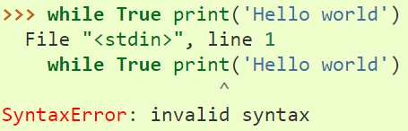
Syntax errors
Syntax errors, also known as parsing errors, are perhaps the most common kind of complaint you get while you are still learning Python:
The parser repeats the offending line and displays a little ‘arrow’ pointing at the earliest point in the line where the error was detected. The error is caused by (or at least detected at) the token preceding the arrow: in the example, the error is detected at the function print(), since a colon (':') is missing before it. File name and line number are printed so you know where to look in case the input came from a script.
6.0001 LECTURE 7
16

Slide 17
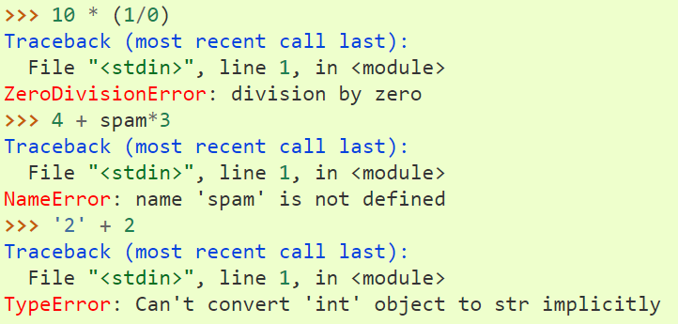
Exceptions
Even if a statement or expression is syntactically correct, it may cause an error when an attempt is made to execute it. Errors detected during execution are called exceptions and are not unconditionally fatal: you can learn how to handle them in Python programs. However, most exceptions are not handled by programs, and result in error messages as shown here:
6.0001 LECTURE 7
17

Slide 18
ERROR MESSAGES – EASY
trying to access beyond the limits of a list
test =
[1,2,3] then →
test[4]
IndexError
trying to convert an inappropriate type
int(test)
referencing a non-existent variable
a
→ TypeError
→ NameError
mixing data types without appropriate conversion
'3'/4 →
TypeError
forgetting to close parenthesis, quotation, etc.
a = len([1,2,3]
print(a) →
SyntaxError

Slide 19
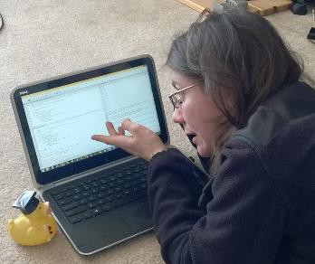
LOGIC ERRORS - HARD
think before writing new code
draw pictures, take a break
explain the code to
someone else
a rubber ducky

Slide 20


DON’T
DO
Write entire program
Test entire program
Debug entire program
Write a function
Test the function, debug the function
Write a function
Test the function, debug the function
*** Do integration testing ***
Change code
Remember where bug was
Test code
Forget where bug was or what change you made
Panic
Backup code
Change code
Write down potential bug in a comment
Test code
Compare new version with old version

Slide 21
EXCEPTIONS AND ASSERTIONS
what happens when procedure execution hits an
unexpected condition?
get an exception… to what was expected
trying to access beyond list limits
test = [1,7,4]
test[4]
trying to convert an inappropriate type
int(test)
referencing a non-existing variable
a
mixing data types without coercion
'a'/4
→ IndexError
→ TypeError
→ NameError
→ TypeError

Slide 22
some TYPES OF EXCEPTIONS/errors
already seen common error types:
SyntaxError: Python can’t parse program
NameError: local or global name not found
AttributeError: attribute reference fails
TypeError: operand doesn’t have correct type
ValueError: operand type okay, but value is illegal
IOError: IO system reports malfunction (e.g. file not
found)

Slide 23
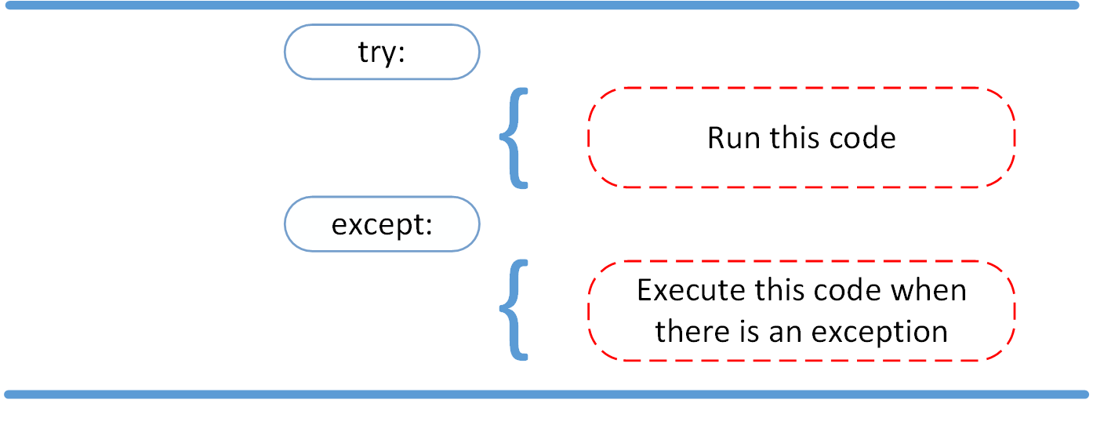
The try and except Block: Handling Exceptions
20

Slide 24
DEALING WITH EXCEPTIONS
Python code can provide handlers for exceptions
try:
a = int(input("Tell b = int(input("Tell
me
me another
one number:"))
number:"))
print(a/b) except:
print("Bug
in user
input.")
exceptions raised by any statement in body of try are handled by the except statement and execution continues with the body of the except statement
20

Slide 25
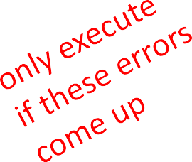
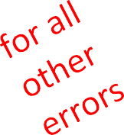
HANDLING SPECIFIC EXCEPTIONS
Have separate except clauses to deal with a particular
type of exception
try:
a | = | int(input("Tell | me one number: "))
b | = | int(input("Tell | me another number: | "))
print("a/b = print("a+b =
", a/b)
", a+b)
except
ValueError:
print("Could
not convert to a number.")
except
ZeroDivisionError:
print("Can't divide by zero") except:
print("Something went very wrong.")

Slide 26
OTHER EXCEPTIONS
else:
body of this is executed when execution of associated
try body completes with no exceptions
finally:
body of this is always executed after try, else and except clauses, even if they raised another error or executed a break, continue or return
useful for clean-up code that should be run no matter
what else happened (e.g. close a file)

Slide 27
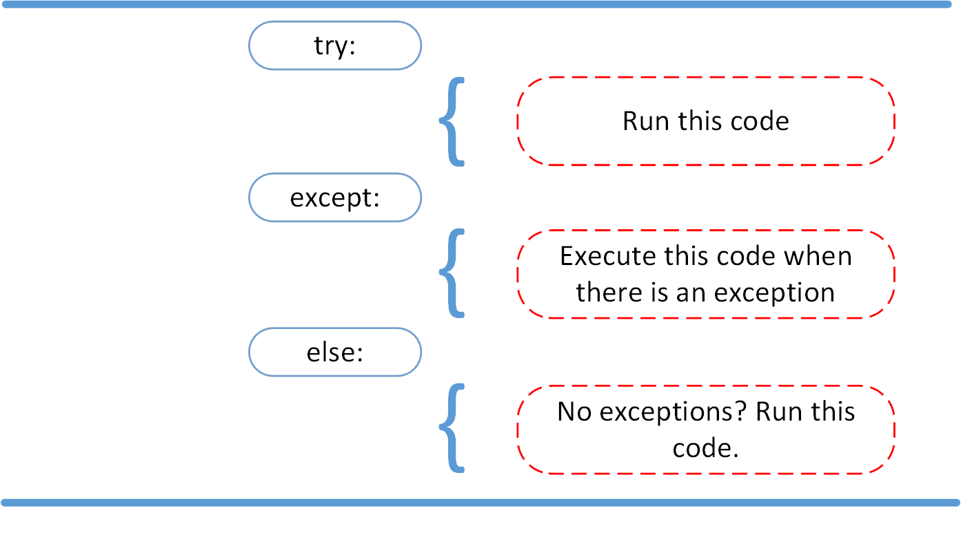
The else Clause

Slide 28
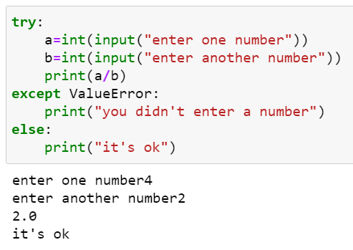
The else Clause

Slide 29
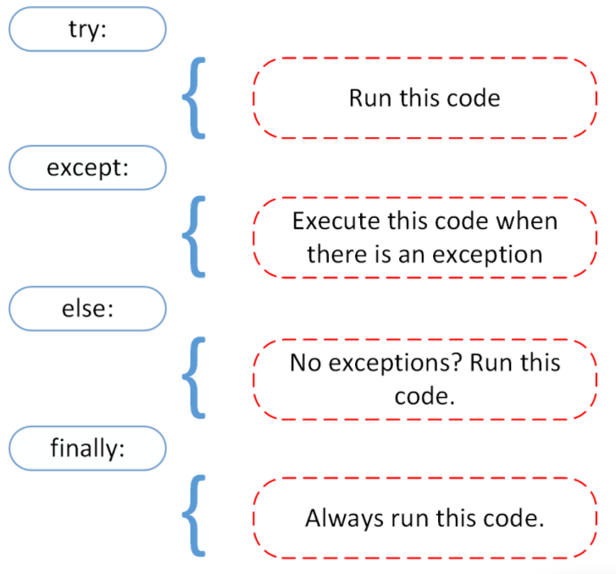
The finally Clause

Slide 30
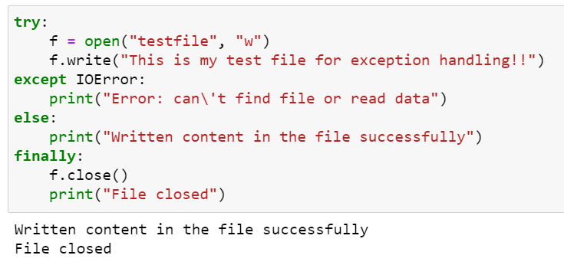
The finally Clause

Slide 31


