Slide 1

Programming on Python
Lecture 8
OOPs concept. Class and object.
Inheritance, Overloading, Overriding. Data hiding
Complied by
Aizhan Altaibek

Slide 2
Object oriented programming
Object-oriented programming is a programming paradigm that provides a means of structuring programs so that properties and behaviors are bundled into individual objects.
For instance, an object could represent a person with properties like a name, age, and address and behaviors such as walking, talking, breathing, and running. Or it could represent an email with properties like a recipient list, subject, and body and behaviors like adding attachments and sending.
Put another way, object-oriented programming is an approach for modeling concrete, real-world things, like cars, as well as relations between things, like companies and employees, students and teachers, and so on. OOP models real-world entities as software objects that have some data associated with them and can perform certain functions.
6.0001 LECTURE 8
2

Slide 3
Object oriented programming
Another common programming paradigm is procedural programming, which structures a program like a recipe in that it provides a set of steps, in the form of functions and code blocks, that flow sequentially in order to complete a task.
The key takeaway is that objects are at the center of object-oriented programming in Python, not only representing the data, as in procedural programming, but in the overall structure of the program as well.
6.0001 LECTURE 8
3

Slide 4
Object oriented programming
One of the popular approaches to solve a programming problem is by creating objects. This is known as Object-Oriented Programming (OOP).
An object has two characteristics:
Attributes (properties)
Behavior (methods)
Let's take an example:
A cat is can be an object, as it has the following properties:
name, age, color as attributes
walking, sleeping, hunting, eating, etc. as behavior
6.0001 LECTURE 8
4

Slide 5
Principles of oop
Object-oriented programming is based on the following principles:
Encapsulation
Abstraction
Inheritance
Polymorphism
6.0001 LECTURE 8
5

Slide 6
Principles of oop
Encapsulation. The implementation and state of each object are privately held inside a defined boundary, or class. Other objects do not have access to this class or the authority to make changes but are only able to call a list of public functions, or methods. This characteristic of data hiding provides greater program security and avoids unintended data corruption.
Abstraction. Objects only reveal internal mechanisms that are relevant for the use of other objects, hiding any unnecessary implementation code. This concept helps developers more easily make changes and additions over time.
Inheritance. Relationships and subclasses between objects can be assigned, allowing developers to reuse a common logic while still maintaining a unique hierarchy. This property of OOP forces a more thorough data analysis, reduces development time and ensures a higher level of accuracy.
Polymorphism. Objects can take on more than one form depending on the context. The program will determine which meaning or usage is necessary for each execution of that object, cutting down the need to duplicate code.
6.0001 LECTURE 8
6

Slide 7
oop languages
While Simula is credited as the first object-oriented programming language, the most popular OOP languages are:
Java
JavaScript
Python
C++, C#
Visual Basic .NET
Ruby
Scala
PHP
6.0001 LECTURE 8
7

Slide 8
Python oop languages
Python is a great programming language that supports OOP. You will use it to define a class with attributes and methods, which you will then call. Python offers a number of benefits compared to other programming languages like Java, C++ or R. It's a dynamic language, with high-level data types. This means that development happens much faster than with Java or C++. It does not require the programmer to declare types of variables and arguments. This also makes Python easier to understand and learn for beginners, its code being more readable and intuitive.
6.0001 LECTURE 8
8

Slide 9
OBJECT ORIENTED
PROGRAMMING (OOP)
EVERYTHING IN PYTHON IS AN OBJECT (and has a type)
can create new objects of some type
can manipulate objects
can destroy objects
explicitly using del or just “forget” about them
python system will reclaim destroyed or inaccessible
objects – called “garbage collection”
6.0001 LECTURE 8
9

Slide 10
Python classes
Classes are used to create user-defined data structures. Classes define properties (like name, age etc.) and functions called methods, which identify the behaviors and actions that an object created from the class can perform with its data.
All class definitions start with the class keyword, which is followed by the name of the class and a colon.
Any code that is indented below the class definition is considered part of the class’s body.
class name:
statements
10

Slide 11
Python object
An object (instance) is an instantiation of a class. When class is defined, only the description for the object is defined. Therefore, no memory or storage is allocated.
Now we can use the class named MyClass to create objects:
Example
Create an object named p1, and print the value of x:
p1 = MyClass() print(p1.x)
6.0001 LECTURE 8
11

Slide 12
Object methods
def name(self, parameter, ..., parameter):
statements
-self must be the first parameter to any object method
represents the "implicit parameter" (this in Java)
-must access the object's fields through the self reference
class Point:
def translate(self, dx, dy):
self.x += dx
self.y += dy
...

Slide 13
"Implicit" Parameter (self)
Java: this, implicit
public void translate(int dx, int dy) {
x += dx; // this.x += dx;
y += dy; // this.y += dy;
}
Python: self, explicit
def translate(self, dx, dy):
self.x += dx
self.y += dy
Exercise: Write distance, set_location, and distance_from_origin methods.
6.0001 LECTURE 8
13

Slide 14
point.py
1 2 3 4 5 6 7 8 9 10 11 12 13 14 15 16 17 | from math import * class Point: x = 0 y = 0 def set_location(self, x, y): self.x = x self.y = y def distance_from_origin(self): return sqrt(self.x * self.x + self.y * self.y) def distance(self, other): dx = self.x - other.x dy = self.y - other.y return sqrt(dx * dx + dy * dy)
6.0001 LECTURE 8
14

Slide 15
calling methods
A client can call the methods of an object in two ways:
(the value of self can be an implicit or explicit parameter)
1) object.method(parameters)
or
2) Class.method(object, parameters)
Example:
p = Point(3, -4)
p.translate(1, 5)
Point.translate(p, 1, 5)

Slide 16
Conctructor
def __init__(self, parameter, ..., parameter):
statements
a constructor is a special method with the name __init__
Example:
class Point:
def __init__(self, x, y):
self.x = x
self.y = y
...
How would we make it possible to construct a Point() with no parameters to get (0, 0)?
6.0001 LECTURE 8
16

Slide 17
Example
Create a class named Person, use the __init__() function to assign values for name and age:
class Person: def __init__(self, name, age): self.name = name self.age = age p1 = Person("John", 36) print(p1.name) print(p1.age)
Note: The __init__() function is called automatically every time the class is being used to create a new object.

Slide 18
Example
Insert a function that prints a greeting, and execute it on the p1 object:
class Person: def __init__(self, name, age): self.name = name self.age = age def myfunc(self): print("Hello my name is " + self.name) p1 = Person("John", 36) p1.myfunc()
Note: The self parameter is a reference to the current instance of the class, and is used to access variables that belong to the class.

Slide 19
The self Parameter
The self parameter is a reference to the current instance of the class, and is used to access variables that belongs to the class.
It does not have to be named self , you can call it whatever you like, but it has to be the first parameter of any function in the class:
Example
Use the words mysillyobject and abc instead of self:
class Person: def __init__(mysillyobject, name, age): mysillyobject.name = name mysillyobject.age = age def myfunc(abc): print("Hello my name is " + abc.name) p1 = Person("John", 36) p1.myfunc()

Slide 20
Modify Object Properties
You can modify properties on objects like this:
Example
Set the age of p1 to 40:
p1.age = 40

Slide 21
Delete Object Properties
You can delete properties on objects by using the del keyword:
Example
Delete the age property from the p1 object:
del p1.age

Slide 22
Delete Objects
You can delete objects by using the del keyword:
Example
Delete the p1 object:
del p1

Slide 23
The pass Statement
class definitions cannot be empty, but if you for some reason have a class definition with no content, put in the pass statement to avoid getting an error.
Example
class Person: pass

Slide 24
Python Inheritance
Inheritance allows us to define a class that inherits all the methods and properties from another class.
Parent class is the class being inherited from, also called base class.
Child class is the class that inherits from another class, also called derived class.

Slide 25
Create a parent class
Any class can be a parent class, so the syntax is the same as creating any other class:
Example
Create a class named Person, with firstname and lastname properties, and a printname method:
class Person: def __init__(self, fname, lname): self.firstname = fname self.lastname = lname def printname(self): print(self.firstname, self.lastname) #Use the Person class to create an object, and then execute the printname method: x = Person("John", "Doe") x.printname()
20

Slide 26
Create a child class
To create a class that inherits the functionality from another class, send the parent class as a parameter when creating the child class:
Example
Create a class named Student, which will inherit the properties and methods from the Person class:
class Student(Person): pass
Note: Use the pass keyword when you do not want to add any other properties or methods to the class.
Now the Student class has the same properties and methods as the Person class.
20

Slide 27
Create a child class
Example
Use the Student class to create an object, and then execute the printname method:
x = Student("Mike", "Olsen") x.printname()
20

Slide 28
Use the super() Function
Python also has a super() function that will make the child class inherit all the methods and properties from its parent:
Example
class Student(Person): def __init__(self, fname, lname): super().__init__(fname, lname)
By using the super() function, you do not have to use the name of the parent element, it will automatically inherit the methods and properties from its parent.
20

Slide 29
Add Properties
Example
Add a property called graduationyear to the Student class:
class Student(Person): def __init__(self, fname, lname): super().__init__(fname, lname) self.graduationyear = 2019
20

Slide 30
Use of Inheritance in Python
# parent class
class Bird:
def __init__(self):
print("Bird is ready")
def whoisThis(self):
print("Bird")
def swim(self):
print("Swim faster")
# child class
class Penguin(Bird):
def __init__(self):
# call super() function
super().__init__()
print("Penguin is ready")
def whoisThis(self):
print("Penguin")
def run(self):
print("Run faster")
peggy = Penguin()
peggy.whoisThis()
peggy.swim()
peggy.run()
Output
Bird is ready
Penguin is ready
Penguin
Swim faster
Run faster
20

Slide 31
Encapsulation
Using OOP in Python, we can restrict access to methods and variables. This prevents data from direct modification which is called encapsulation. In Python, we denote private attributes using underscore as the prefix i.e single _ or double __.
20

Slide 32
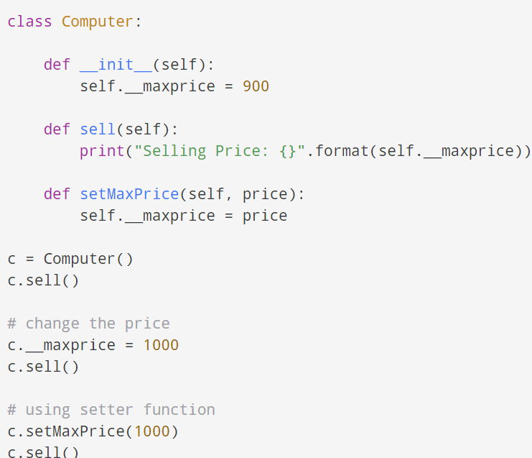
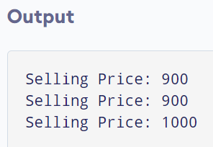
20

Slide 33
Polymorphism
Polymorphism is an ability (in OOP) to use a common interface for multiple forms (data types).
Suppose, we need to color a shape, there are multiple shape options (rectangle, square, circle). However we could use the same method to color any shape. This concept is called Polymorphism.
20

Slide 34
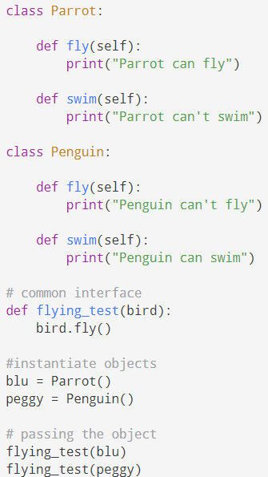
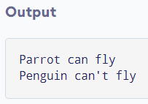
20

Slide 35


