Slide 1

Programming on Python
Lecture 9
Databases
Complied by
Aizhan Altaibek

Slide 2
Content
What id Database?
Data modelling
Types of models
Operations and relations
SQL

Slide 3
Database
Information is not useful if not organized
In database, data are organized in a way that people find meaningful and useful.
Database Management System (DBMS) is used to input, sort, organize and store data.

Slide 4
Data modelling
Data modeling (data modelling) is the process of creating a data model for the data to be stored in a database. This data model is a conceptual representation of Data objects, the associations between different data objects, and the rules.

Slide 5
History of Database Systems
First generation
Hierarchical model
Information Management System (IMS)
Network model
Conference on Data System Languages (CODASYL)
Data Base Task Group (DBTG)
Limitation
Complex program for simple query
Minimum data independence
No theoretical foundation
Second generation
Relational model
E. R. Codd
DB2, Oracle
Limitation
Limited data modeling
Third generation
Object-relational DBMS
Object-oriented DBMS

Slide 6
Types of models
Types of Data Models: There are mainly three different types of data models:
conceptual data models
logical data models
physical data models
Each one has a specific purpose.

Slide 7
Types of models
Conceptual Data Model: This Data Model defines WHAT the system contains. This model is typically created by Business stakeholders and Data Architects. The purpose is to organize, scope and define business concepts and rules.
Logical Data Model: Defines HOW the system should be implemented regardless of the DBMS. This model is typically created by Data Architects and Business Analysts. The purpose is to developed technical map of rules and data structures.
Physical Data Model: This Data Model describes HOW the system will be implemented using a specific DBMS system. This model is typically created by DBA and developers. The purpose is actual implementation of the database.

Slide 8
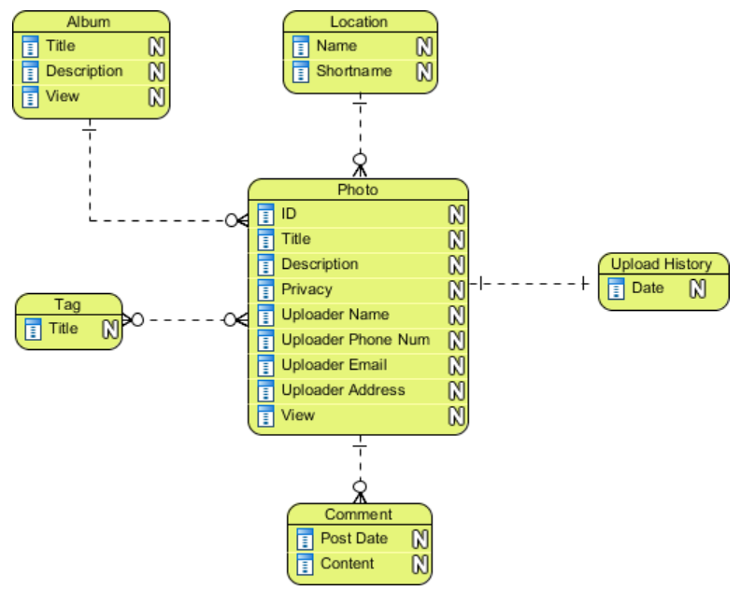
Conceptual Data Model
ER model, UML model

Slide 9
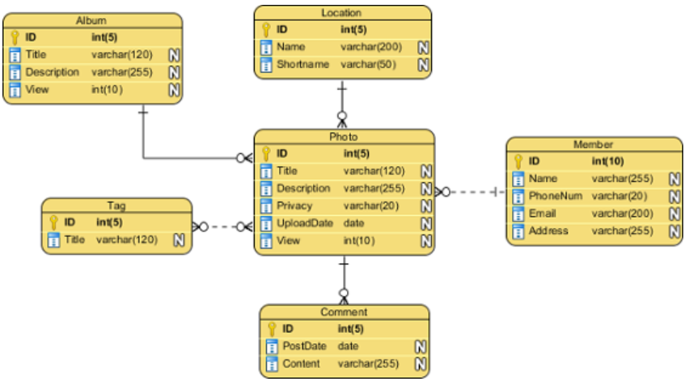
Logical Data Model
Relational model, object-oriented model, semi-structured data models, network model and hierarchical model

Slide 10
Database Model
Database model defines the logical design of data.
Database model describes the relation between different parts of data.
There are main three database models:
Hierarchical Model
Network Model
Relational Model

Slide 11
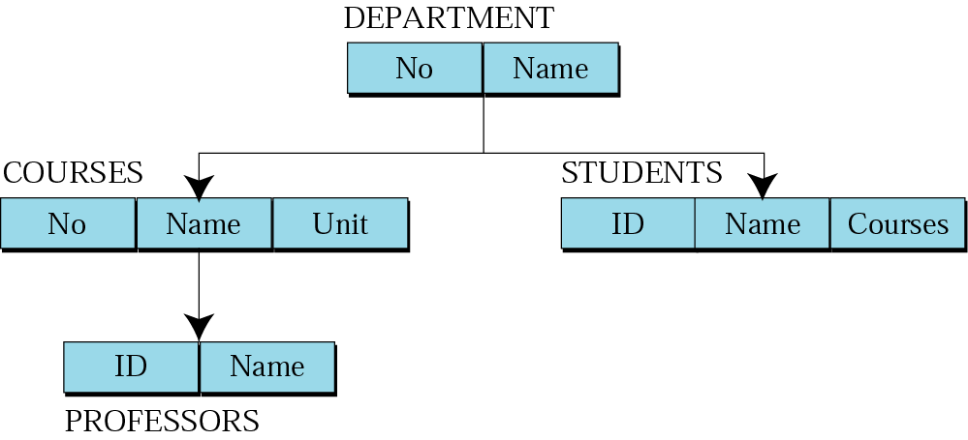
Hierarchical model
Data are organized in an upside down tree
Each entity has one parent and many children
Old and not used now

Slide 12
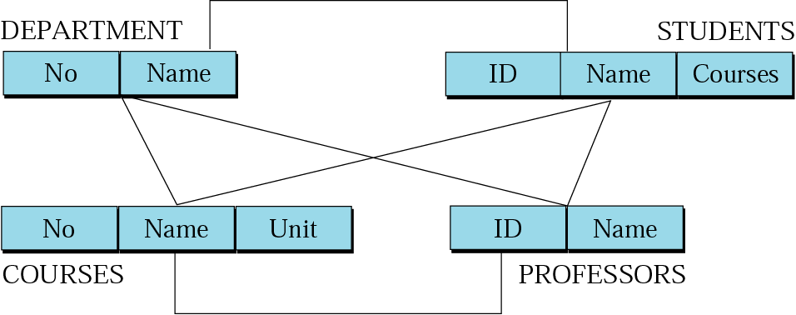
Network model
Entities are organized in a graph
Entities can be accessed through several paths
Old and not used

Slide 13
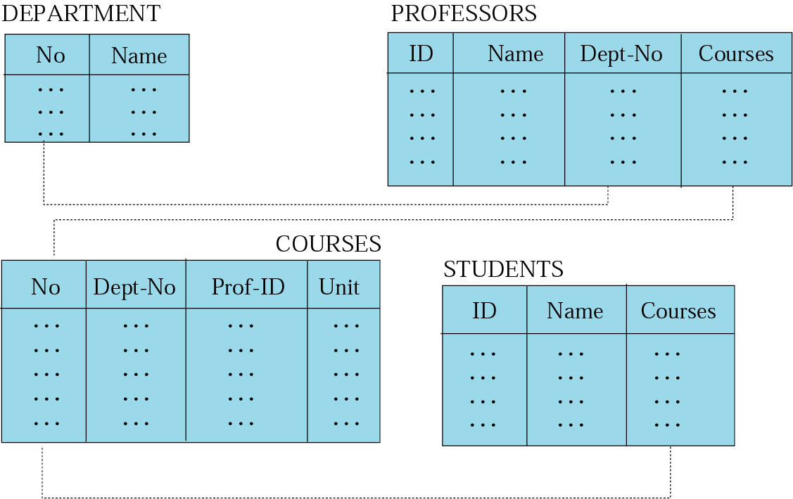
Relational model
Data are organized in two dimensional tables (relations)
Tables are related to each other
Relational Database Management System (RDBMS) are more common model used today

Slide 14
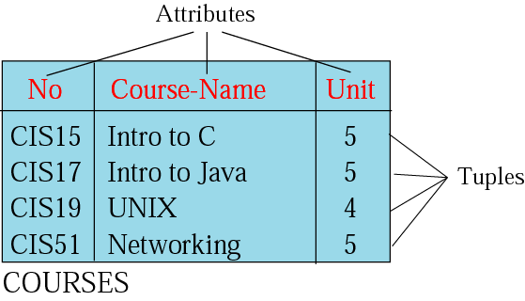
Relation (Name, Attributes, Tuples)
Attributes are the column heading
Each column must have a unique heading
Number of columns is called the degree of the relation
Tuple is a collection of attribute value
Total number of rows is called Cardinality of the relation
Each relation must have a unique name
Name
Relation appears in 2 dimensional table
That doesn’t mean data stored as table; the physical storage of data is independent of the logical organization of data

Slide 15
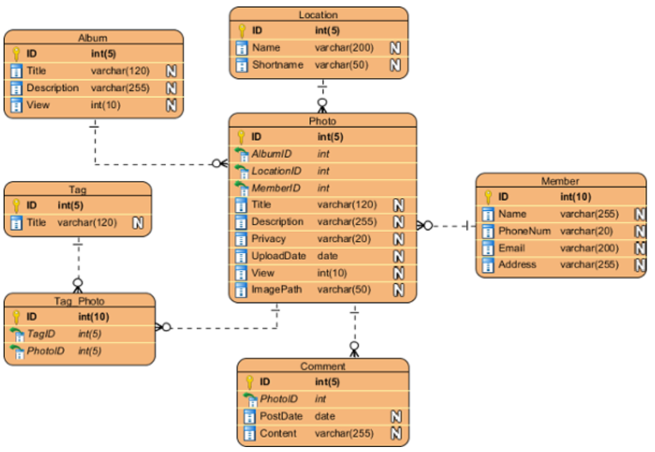
Physical Data Model
DBMS:
SQL Server, Oracle, SQL Lite,
MongoDB, Microsoft Access, etc.

Slide 16
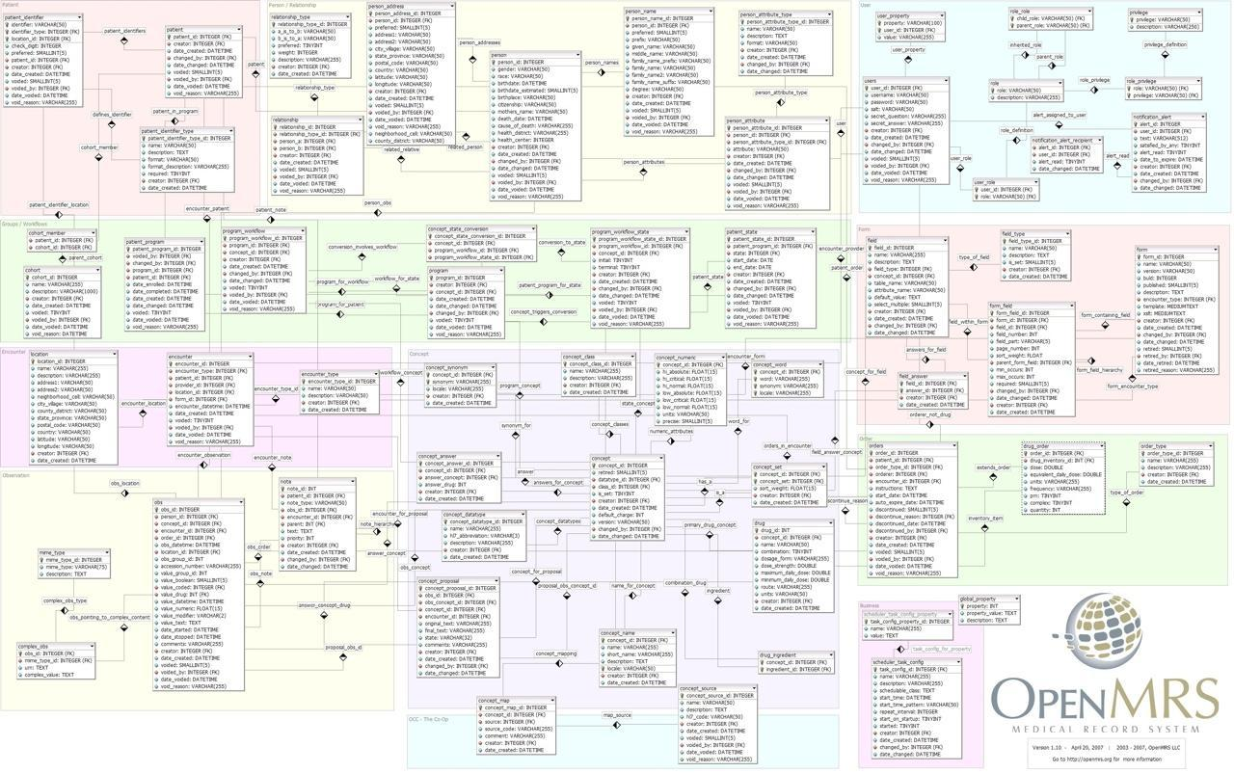
Physical Data Model

Slide 17
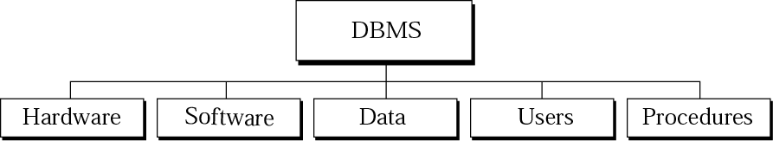
Figure 14-1
DBMS Components
Hardware: the physical computer system
Software: the program that allows users to access, maintain update the data
Data: Data are stored on the computer. In database data are separate entity from the software that access them
Users: could be either (1) end users: people who has access to the database or (2) application program: applications that access and process data
Procedures: rules that are defined and followed by the users

Slide 18
DBMS Environment
Hardware
Client-server architecture
Software
dbms, os, network, application
Data
Schema, subschema, table, attribute
People
Data administrator & database administrator
Database designer: logical & physical
Application programmer
End-user: naive & sophisticated
Procedure
Start, stop, log on, log off, back up, recovery

Slide 19
Database Management System Facility
Data definition language (DDL)
Data manipulation language (DML)
Structured query language (SQL)
Security system
Integrity system
Concurrency control system
Backup & recovery system
View mechanism

Slide 20
Advantages of DBMS
Control redundancy
Consistency
Integrity
Security
Concurrency control
Backup & recovery
Data standard
More information
Data sharing & conflict control
Productivity & accessibility
Economy of scale
Maintenance

Slide 21
Limitations of DBMS
Complexity
Size
Cost
Software
Hardware
Conversion
Performance
Vulnerability

Slide 22
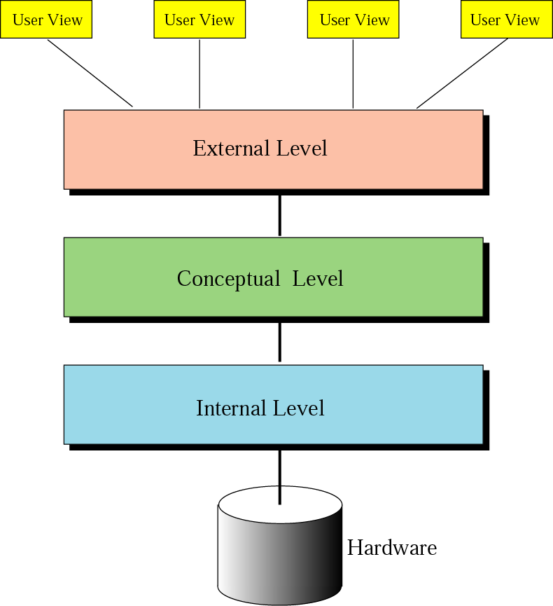
Database architecture
Internal Level: Interact directly with the hardware
Conceptual Level: (1) Define the logical view of the data. (2) Define the data model. (3) Contain the main functions of the DBMS (4) Intermediary level that free users from dealing with internal level
External Level: (1) Interact directly with users (2) Display data in familiar format

Slide 23
OPERATIONS
ON
RELATIONS

Slide 24
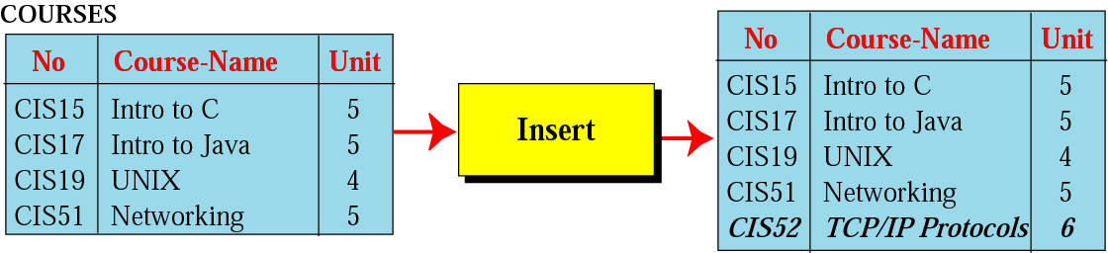
Insert operation
Unary operation
Insert Operation: Inserts new tuple into the relation

Slide 25
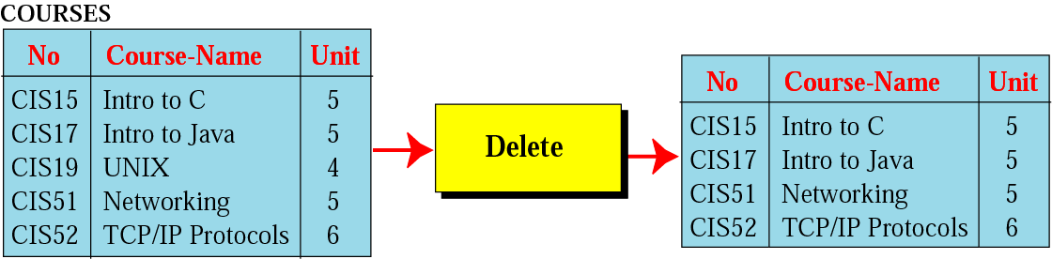
Delete operation
Unary operation
Delete Operation: Deletes tuple from the relation

Slide 26
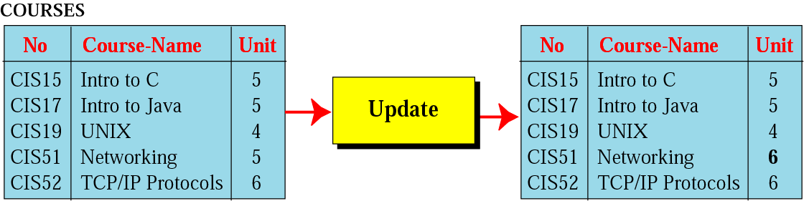
Update operation
Unary operation
Update Operation: Changes the values of some attributes of a tulpe

Slide 27
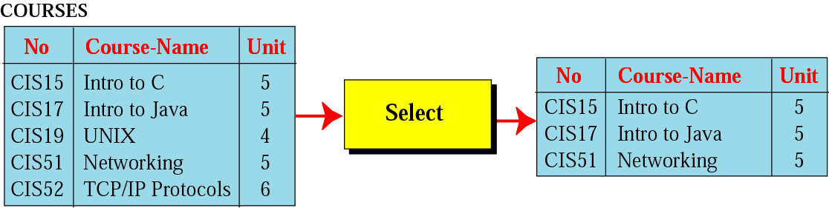
Select operation
Unary operation
Select Operation: Uses some criteria to select some tuples from the original relation

Slide 28
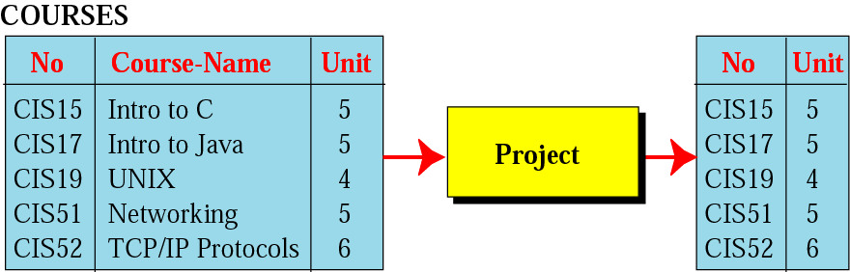
Project operation
Unary operation
Project Operation: Creates relation in which each tulpe has fewer attributes

Slide 29
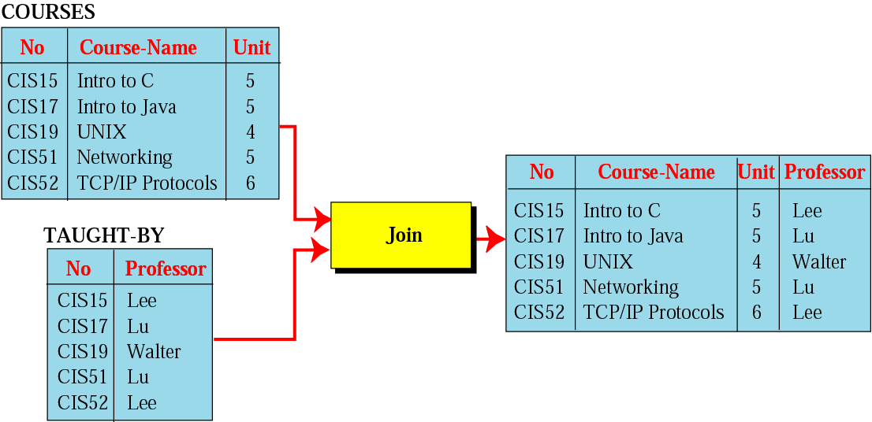
Join operation
Binary operation
Join Operation: Takes two relation and combine them based on common attribute

Slide 30
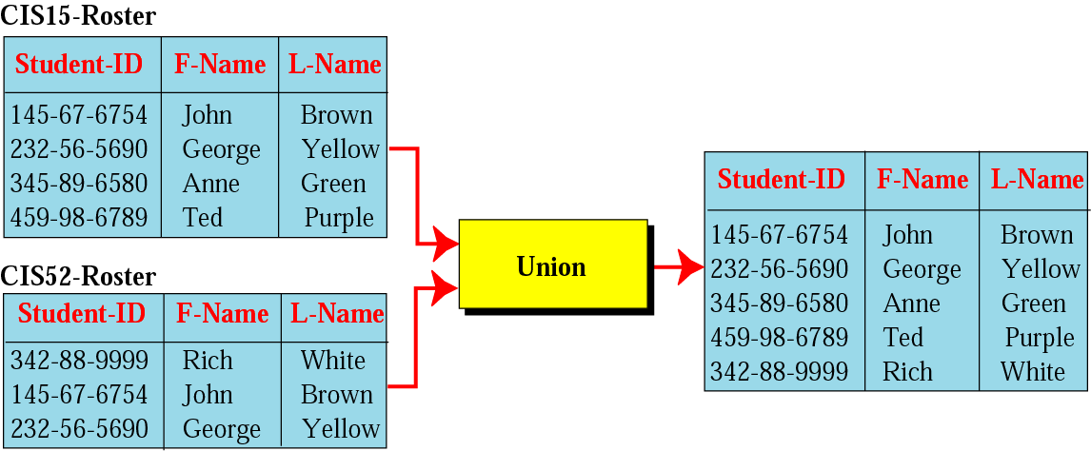
Union operation
Binary operation
Union Operation: Creates new relation in which each tuple is either in the first relation, the second relation or in both

Slide 31
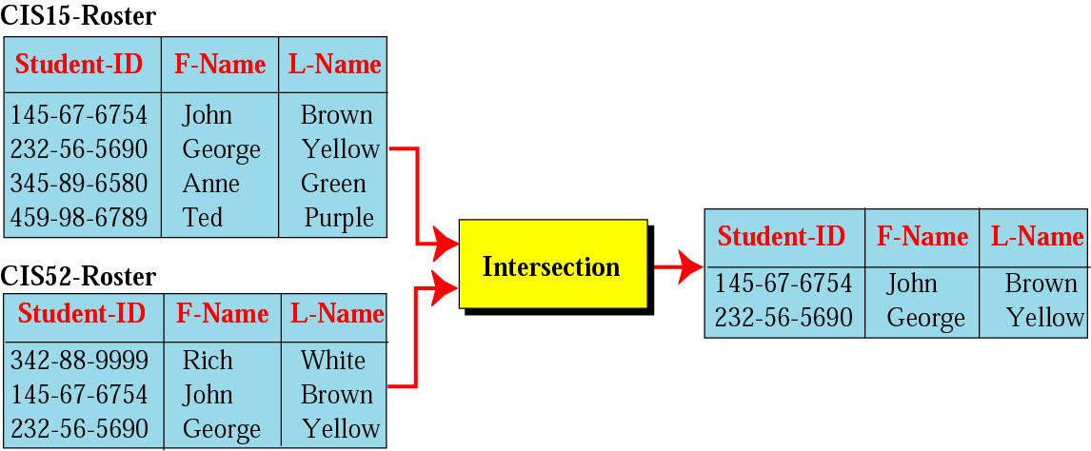
Intersection operation
Binary operation
Intersection Operation: Creates new relation in which each tuple is either in both relations.

Slide 32
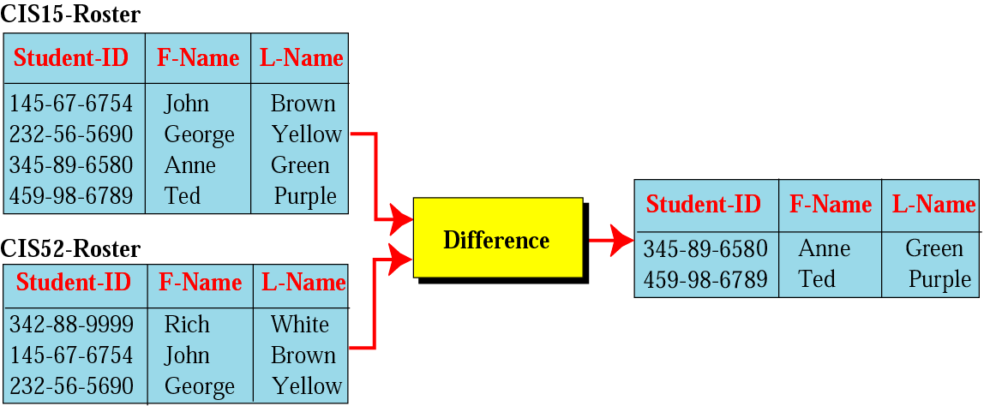
Difference operation
Binary Operation
Difference Operation: Creates new relation where the new tuples are in the first relation but not in the second.

Slide 33
STRUCTURED
QUERY
LANGUAGE

Slide 34
SQL
SQL is the standard language used for relational databases.
It is declarative language where users declare what they want without having to write a step by stem procedure.
It was first implemented by Oracle Corporation

Slide 35
1. Insert
SQL Insert Operation format
insert into RELATION-NAME
values (…, …, …)

Slide 36
Insert (Example)
insert into COURSES
values (“CIS52”, “TCP/IP Protocols”, 6)

Slide 37
2. Delete
SQL Delete Operation format
delete from RELATION-NAME
where criteria

Slide 38
Delete (Example)
Delete from COURSES
where No = “CIS19”

Slide 39
3. Update
SQL Update Operation format
update RELATION-NAME
set attribute1 = value1 attribute 2 = value2 …
where criteria

Slide 40
Update (Example)
update COURSES
set unit = 6
where No = “CIS51”

Slide 41
4. Select
SQL Select Operation format
select *
from RELATION-NAME
where criteria

Slide 42
Select (Example)
select *
from COURSES
where Unit = 5

Slide 43
5. Project
SQL Project Operation format
select attribute-list
from RELATION-NAME

Slide 44
Project (Example)
select No, Unit
from COURSES

Slide 45
6. Join
SQL Join Operation format
select attribute-list
from RELATION NO1, RELATION NO2
where criteria

Slide 46
Join (Example)
select No, Course-Name, Unit, Professor
from COURSES, TAUGHT-BY
where COURSES.No = TAUGHT-BY.No;

Slide 47
7. Union
SQL Union Operation format
select *
from RELATION NO1
union
select *
from RELATION NO2

Slide 48
Union (Example)
select *
from CIS15-Roster
union
select *
from CIS52-Roster;

Slide 49
8. Intersection
SQL Intersection Operation format
select *
from RELATION NO1
intersection
select *
from RELATION NO2

Slide 50
Intersection (Example)
select *
from CIS15-Roster
intersection
select *
from CIS52-Roster;

Slide 51
9. Difference
SQL Difference Operation format
select *
from RELATION NO1
minus
select *
from RELATION NO2

Slide 52
Intersection (Example)
select *
from CIS15-Roster
minus
select *
from CIS52-Roster;

Slide 53


