Slide 1
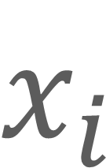



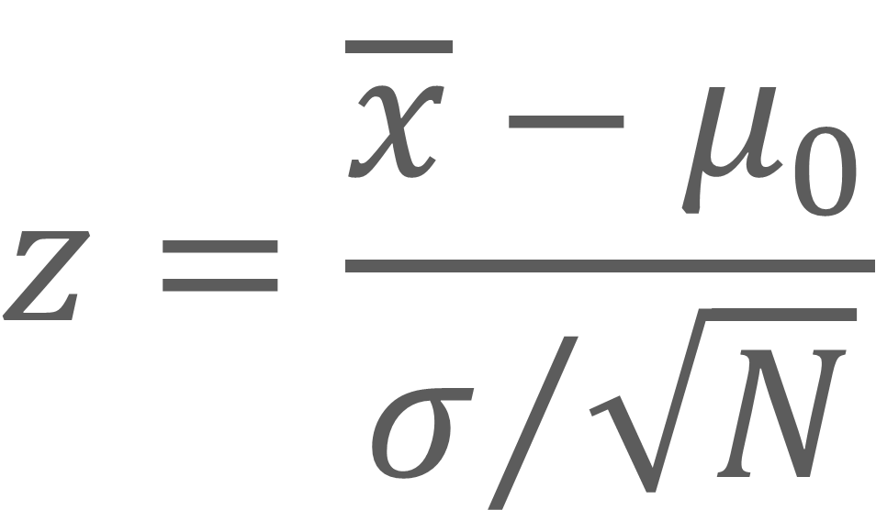
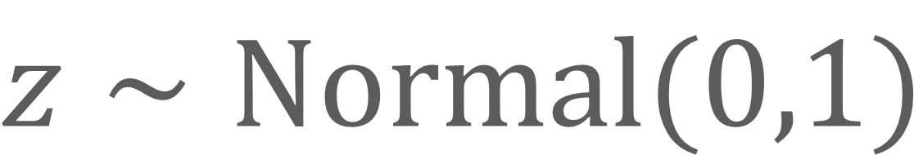
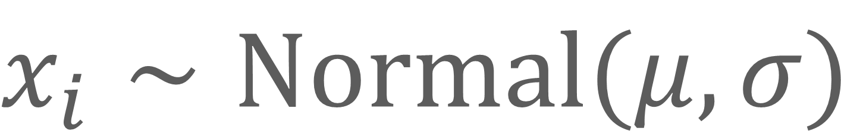

$$σ$$
$$μ$$
$$x_{i}∼Normal(μ,σ)$$
$$z=\frac{\overline{x}−μ_{0}}{σ/{\sqrt{N}}}$$
$$N$$
$$x_{i}$$
Sampling distribution:
$$z∼Normal(0,1)$$
$$z$$
Notes:
This model appears in chapter 10.3.2.

Slide 2
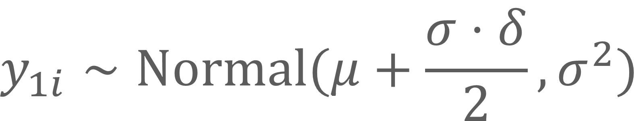

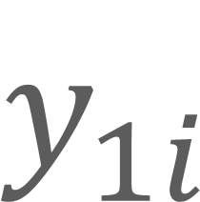
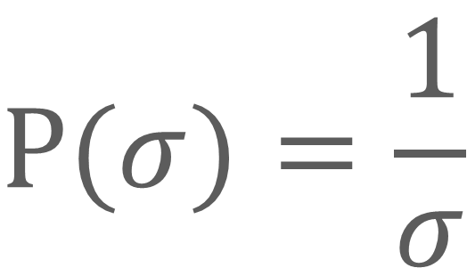

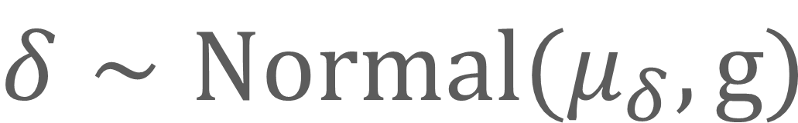

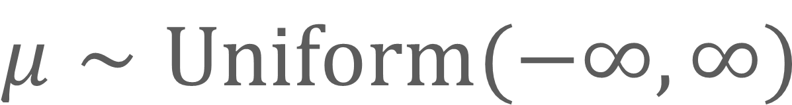
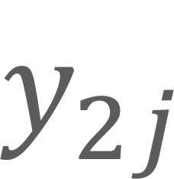
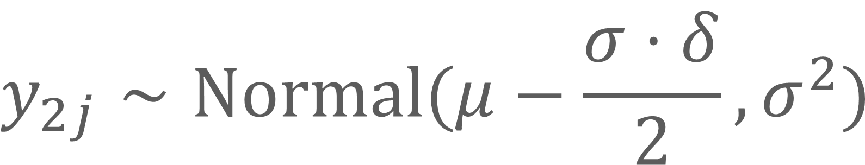
PRIORS
$$μ∼Uniform(−∞,∞)$$
$$μ$$
$$δ$$
$$δ∼Normal(μ_{δ},g)$$
$$σ$$
$$P(σ)=\frac{1}{σ}$$
LIKELIHOOD
$$y_{1i}∼Normal(μ+\frac{σ⋅δ}{2},σ^{2})$$
$$y_{1i}$$
$$y_{2j}$$
$$y_{2j}∼Normal(μ−\frac{σ⋅δ}{2},σ^{2})$$
$$for i=1,...,n_{1} and j=1,...,n_{2}$$
Notes:
This model appears in chapter 12.1.2.

